Slide 1
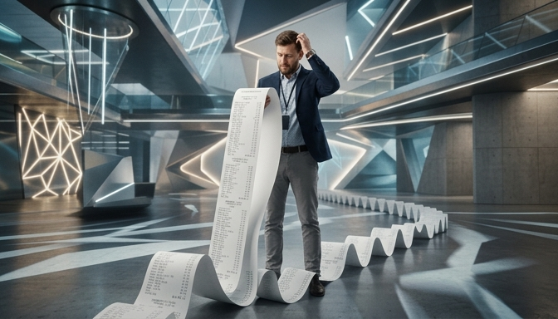
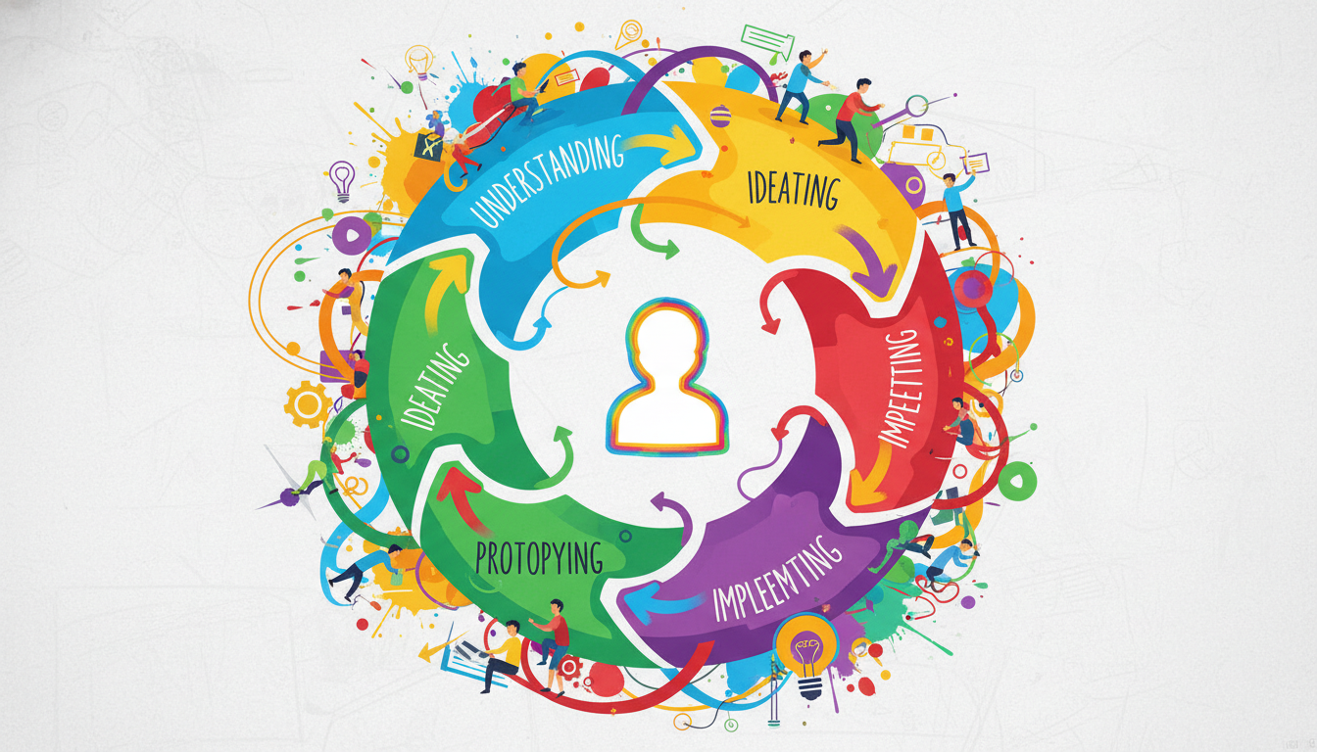
Demystifying Consumer Behavior
Focuses on the core question: 'Why did they do that?'
Moves beyond demographics to understand underlying motivations
Traces the complete path to purchase
Marketers must act like detectives to uncover the hidden 'why' behind every purchase on the receipt.
Notes:
Welcome to Consumer Behavior. Today, we start with the most important question in marketing: 'Why did the consumer do that?' It is not enough to simply know who our customer is; we need to deeply understand the psychological and behavioral drivers behind their actions. This course will turn you into a behavioral detective, tracing the exact steps a consumer takes before they ever open their wallet.

Slide 2
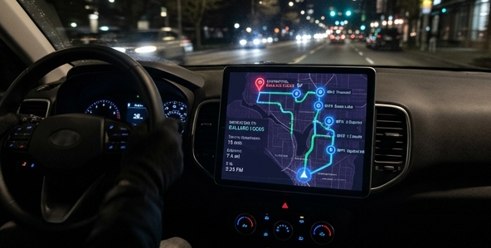
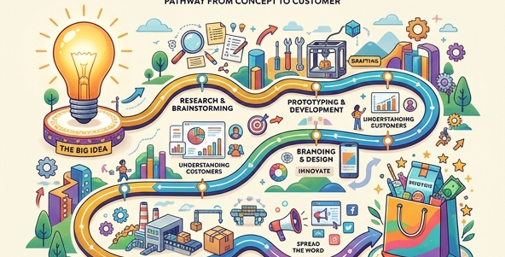
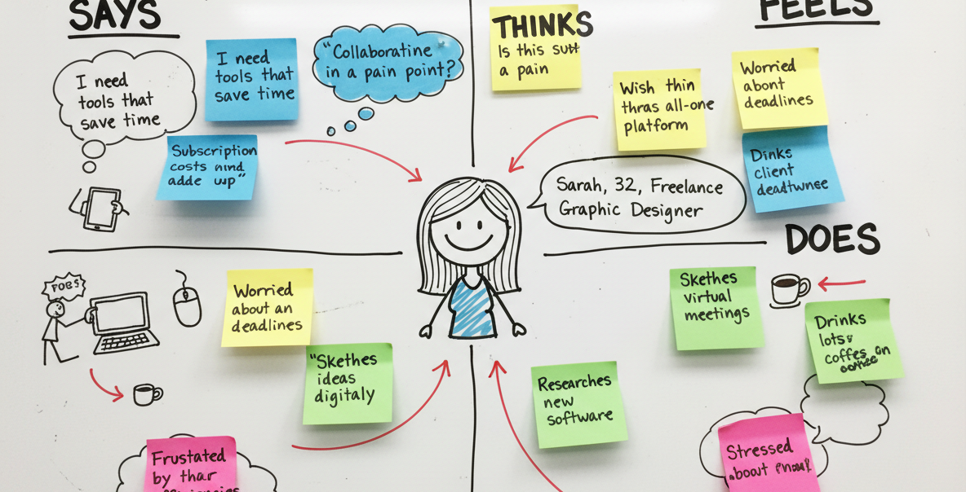

Mapping the Consumer Journey
The purchase is just the final destination
The journey maps out every thought, turn, and stop
Non-example: Buying is rarely a random, instant reflex
A GPS maps out every turn and stop long before you reach the destination.
Similarly, the buyer decision process maps every thought leading up to the final transaction.
Notes:
Think of the buying process like a GPS for a road trip. The final purchase is simply your destination, but it doesn't happen by teleporting there. The GPS maps out every single thought, turn, and stop you make from the moment you decide to travel until you unpack your bags at home. By understanding this journey, we realize that purchasing is almost never a random, immediate reflex.

Slide 3
The 5-Stage Decision Framework
1. Need Recognition (Identifying a problem)
2. Information Search (Gathering data)
3. Evaluation of Alternatives (Comparing options)
4. Purchase & 5. Post-Purchase Behavior
Notes:
Here is our anchor framework for the entire course: the 5-Stage Buyer Decision Process. It starts with Need Recognition, where an internal or external trigger highlights a problem. Next is the Information Search, followed closely by the Evaluation of Alternatives where consumers actively weigh their options. Then comes the actual Purchase Decision, and finally, Post-Purchase Behavior, where the consumer evaluates if they made the right choice. We will use this exact model to diagnose consumer actions in every future lesson.

Slide 4

The Framework in Action: Oishi
Need Recognition: Feeling thirsty in the heat
Search & Evaluation: Scanning convenience store shelves
Purchase & Post-Purchase: Buying and feeling refreshed
Evaluating alternatives in real-time: choosing between different green tea brands based on flavor, price, and brand perception.
Notes:
Let's apply this to a real scenario using a Thai beverage brand like Oishi. The journey doesn't start at the cash register; it starts with feeling incredibly thirsty in the Bangkok heat, which represents Need Recognition. Walking into a convenience store and scanning the shelves covers the search and evaluation phases. Finally, buying the Oishi and feeling instantly refreshed represents the purchase and post-purchase stages. This simple example proves that the 5-stage model is operating constantly in our everyday lives.

Slide 5

The 5-Stage Journey in Action
Theoretical frameworks require practical application.
Everyday habits follow structured psychological paths.
Case scenario: The journey of purchasing a cold beverage.
A common, everyday product like green tea serves as the perfect case study to visualize the entire buyer decision process.
Notes:
To truly understand the 5-stage buyer decision process, we must see it in action. Let's step away from the abstract theory and look at an incredibly common scenario: buying a cold beverage on a hot day. Even something as simple and low-involvement as purchasing an Oishi Green Tea follows this exact psychological sequence. By mapping this everyday habit to our framework, you'll see how consumer behavior happens constantly around us.

Slide 6

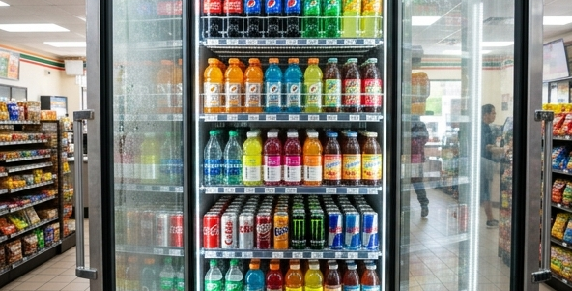
Stages 1 & 2: Need and Search
Stage 1 (Need): Initiated by internal physiological stimuli.
Stage 2 (Search): Active seeking of solutions in the environment.
Shifts from feeling a physical sensation to visual scanning.
Stage 1: Internal physiological triggers, such as heat and thirst, spark immediate need recognition.
Stage 2: Information search begins immediately by scanning available physical inventory rather than deep research.
Notes:
The journey begins with Need Recognition. Imagine walking down a street; you feel hot and thirsty—this is a powerful internal stimulus triggering a physiological need. Almost immediately, you transition into Stage 2, Information Search. For a low-involvement purchase, this doesn't mean Googling extensive reviews; it simply means walking into a nearby convenience store and visually scanning the drinks fridge. The recognized need has immediately initiated the active search for a solution.

Slide 7


Stages 3 & 4: Evaluation and Purchase
Stage 3 (Evaluate): Weighing specific criteria like flavor vs. price.
Narrowing the 'evoked set' to a final choice (e.g., Tea vs. Cola).
Stage 4 (Purchase): The physical transaction bridging intent to action.
Stage 3: The consumer evaluates alternatives in their evoked set based on specific criteria like health benefits and immediate refreshment.
Stage 4: The purchase decision is finalized through the actual transaction, committing to the evaluated choice.
Notes:
Next, we hit Stage 3: Evaluation of Alternatives. As you stare at the fridge, you mentally compare a green tea against a cola. You are unconsciously weighing evaluation criteria: the cola might be cheaper, but the green tea feels healthier and more refreshing for this specific moment. Once the green tea wins this mental calculation, you proceed to Stage 4: The Purchase Decision. You bring the bottle to the counter and pay, overcoming any remaining friction to finally acquire the product.

Slide 8

Stage 5: Post-Purchase Behavior
Assessing satisfaction immediately after consumption.
Positive experiences prevent buyer's remorse or cognitive dissonance.
Satisfaction reinforces future habitual purchase loops.
Stage 5: Post-purchase satisfaction ensures the consumer will repeat this specific behavioral loop in the future.
Notes:
The final stage occurs after the money has changed hands. In Stage 5, Post-Purchase Behavior, you drink the tea and assess whether it actually met your expectations. Since it successfully quenches your thirst and tastes great, you feel highly satisfied, completely avoiding buyer's remorse. This positive post-purchase evaluation is crucial for marketers because it reinforces a habit loop: the next time you are hot and thirsty, you will likely bypass the evaluation stage entirely and reach straight for that brand.

Slide 9
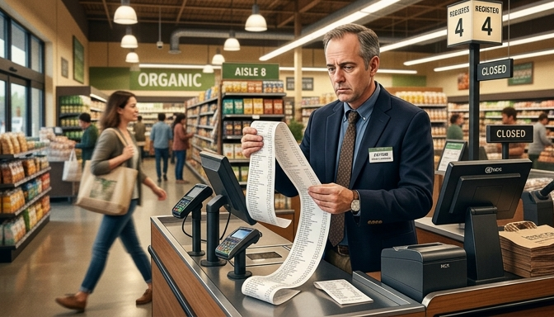
The Great Misconception
Focusing only on the final transaction
Treating the purchase as the entire story
Missing the "Why" behind the action
A receipt shows what was bought, not why the customer bought it.
Notes:
Welcome to a crucial concept in consumer behavior: understanding what it is NOT. Often, businesses make the mistake of looking only at the final transaction. They think that analyzing a cash register receipt is enough to understand their customer. However, this is a dangerous misconception because it completely misses the underlying psychological and social reasons behind the purchase.

Slide 10
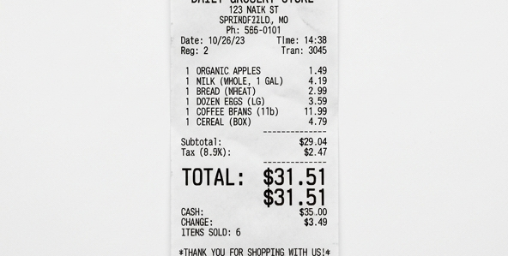
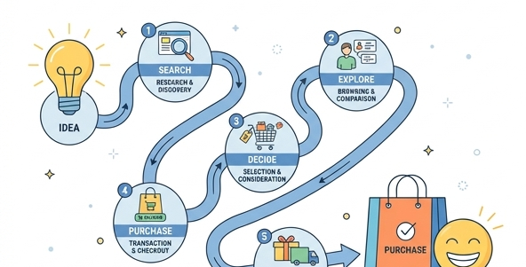
Transaction vs. The Full Journey
Receipts capture only Stage 4 (Purchase)
True behavior spans 5 full stages
Pre-purchase journey is ignored
A receipt only represents Stage 4: The Purchase.
True consumer behavior encompasses the entire five-stage journey.
Notes:
Let's compare the receipt to the actual consumer journey to see why this non-example is so limiting. A receipt is merely a snapshot of Stage 4, which is the purchase decision itself. It tells us the price paid and the specific item chosen at that exact moment. But consumer behavior is the entire five-stage journey, encompassing everything that happened before they reached the checkout counter.

Slide 11
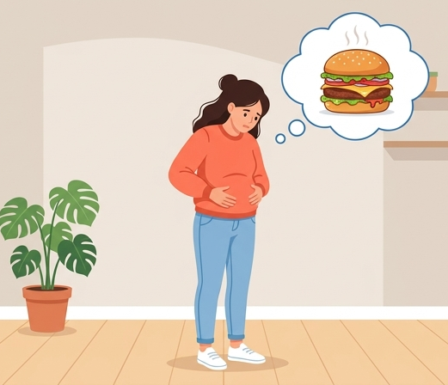
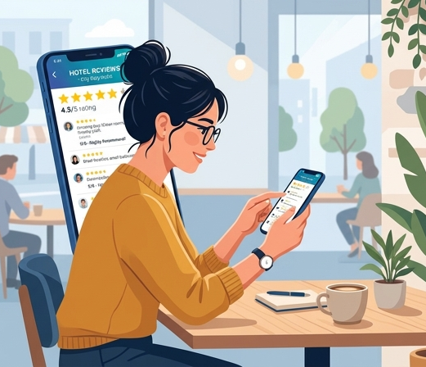

What the Transaction Misses
Why did they enter the store? (Need)
What information was sought? (Search)
Which alternatives were rejected? (Evaluation)
Stage 1: The initial trigger or need recognition.
Stage 2: Searching for information and options.
Stage 3: Evaluating different alternatives.
Notes:
When we only look at the final transaction, we miss a massive amount of critical data. We don't see why the customer walked into the store in the first place, which is the initial need recognition. We miss what information they searched for online beforehand. Most importantly, we have no idea which competing alternatives they considered and ultimately rejected before choosing our product.

Slide 12
Redefining Consumer Behavior
Behavior is an end-to-end process
Starts long before the store visit
Continues after product usage
Answers the crucial question: "Why?"
Notes:
To summarize, consumer behavior is not a single action; it is a continuous, dynamic process. It begins long before the customer interacts with your business and continues long after they consume your product. By studying all five stages, we shift our focus from simply knowing 'what' was bought to deeply understanding 'why' the consumer did that.

Slide 13
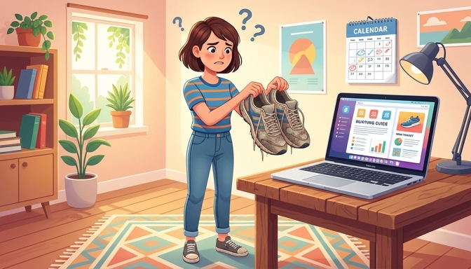
Knowledge Check: The Sneaker Scenario
Review the 5-stage buyer decision process.
Analyze a real-world shopping scenario.
Trace the consumer's exact steps.
Identify the missing stage in the sequence.
A consumer beginning their journey to replace worn-out shoes, initiating the decision process.
Notes:
Let's test your understanding of the buyer decision process with a quick scenario. Imagine a customer realizes their current running shoes are completely worn out. They decide they need a new pair to keep up with their workouts. We will trace their steps and see if you can identify which crucial stage they skipped in the standard consumer journey.

Slide 14


Mapping the Actions: Need & Search
Stage 1: Realizing shoes are worn out.
Trigger: Internal recognition of a problem.
Stage 2: Asking friends for recommendations.
Source: Relying on a personal network.
Stage 1: Need Recognition triggered by a broken, unusable product.
Stage 2: Information Search leveraging personal sources like friends for recommendations.
Notes:
The journey begins logically. First, the consumer experiences Need Recognition when they see their torn shoe. This is an internal trigger driving them to act. Immediately after, they move into Information Search by texting friends for brand recommendations, leveraging their trusted personal network to gather data.

Slide 15
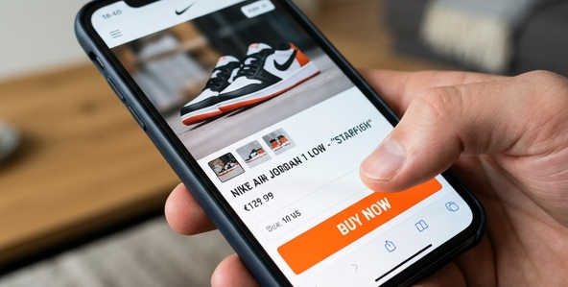
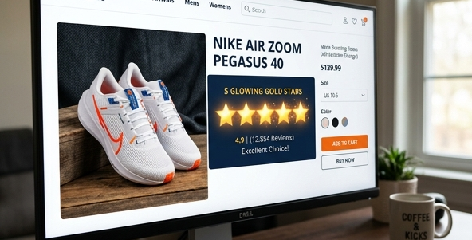
The Jump: Purchase & Review
Action jumps to an immediate online payment.
Stage 4: Executing the transaction.
Customer leaves a glowing 5-star review.
Stage 5: Displaying post-purchase satisfaction.
Stage 4: The Purchase Decision is executed immediately online.
Stage 5: Post-Purchase Behavior expressed via a highly positive review.
Notes:
The story then jumps forward abruptly. The customer immediately pays for a pair of sneakers online, which represents Stage 4, the Purchase Decision. Later, they wear the shoes, love them, and leave a 5-star review, clearly demonstrating Stage 5, Post-Purchase Behavior. Look closely at this entire sequence—did you catch what behavior was skipped?

Slide 16
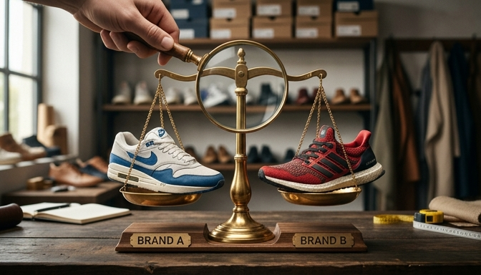
Spotting the Gap: The Missing Stage
Missing link: Stage 3 (Evaluation of Alternatives).
Skipped weighing the pros and cons.
No comparison of price, style, or features.
Customer did not analyze their 'evoked set'.
Stage 3: Evaluation of Alternatives involves weighing different options before committing to a purchase.
Notes:
The missing critical step is Stage 3: Evaluation of Alternatives. In our scenario, the customer went straight from asking for recommendations to instantly buying a pair. They completely skipped weighing the pros and cons, comparing prices, or evaluating different brands against one another. Recognizing these gaps helps marketers understand if a consumer is making an impulse buy or if they bypassed normal logical steps.

