Slide 1




The "Medical Chart" of a Business
Doctors use charts to check physical health.
Investors use statements to check business health.
Standardizes complex information for easy reading.
Doctors rely on medical charts to evaluate a patient's physical health.
Decision-makers rely on financial statements to evaluate a company's financial health.
Notes:
Welcome, everyone. Imagine going to a doctor; they don't just guess how you feel, they look at your medical chart to see your vitals. In the business world, financial statements serve the exact same purpose. They are the essential health check for any company, allowing managers, investors, and lenders to clearly see how the business is truly performing.

Slide 2
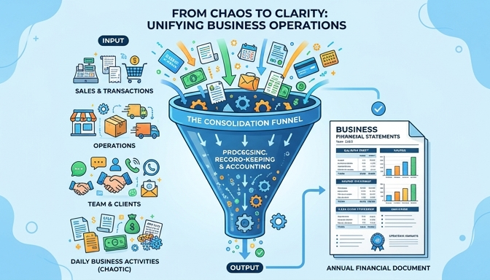

Translating Business Activities
Daily operations are chaotic and diverse.
Statements convert actions into a universal language.
Enables objective, data-driven decisions.
Not just a random pile of daily receipts.
Financial statements act as a translator, turning everyday business chaos into structured, readable data.
Notes:
Every day, a business engages in hundreds of activities like selling goods, paying staff, and buying equipment. If you just looked at a giant pile of receipts, it would be impossible to understand what's happening. Financial statements translate all of that chaotic daily activity into a standardized, universal language of numbers. This translation is what empowers leaders to make smart, data-driven decisions rather than guessing.

Slide 3



The Three Core Financial Statements
Income Statement: Measures profitability.
Balance Sheet: Snapshots financial position.
Cash Flow Statement: Tracks real money movement.
Income Statement: Tracks performance over a period of time.
Balance Sheet: A snapshot of current financial standing.
Cash Flow Statement: Tracks actual cash movement.
Notes:
To get a complete picture of a company's health, we rely on three core statements working together. The Income Statement shows us if the company is actually making a profit over a specific period. The Balance Sheet acts as a snapshot, showing what the company owns and owes at a single exact moment. Finally, the Cash Flow Statement strips away the accounting rules to show us exactly how real cash is moving in and out of the business.

Slide 4

Evaluating Business Health
Businesses require standard health checks.
Financial statements act as a medical chart.
Daily activities are translated into standardized numbers.
Financial statements act as a comprehensive medical chart for a business.
Notes:
Welcome to our first look at the core financial statements. Just like a doctor uses a medical chart to evaluate a patient's health, investors and managers use financial statements to check a company's vitality. They are standardized reports that translate complex, everyday business activities into a universal language of numbers. Without them, we would just be guessing at how well a company is truly performing.

Slide 5



The Three Core Statements
Income Statement: Tracks profitability over a period.
Balance Sheet: Snapshot of what is owned and owed.
Cash Flow Statement: Monitors actual cash movement.
Income Statement: Tracks profitability over time.
Balance Sheet: A snapshot of current financial position.
Cash Flow Statement: Monitors real cash moving in and out.
Notes:
There are three primary tools in our financial toolkit. First is the Income Statement, which measures how profitable a company is over a specific period, like a quarter or a year. Second is the Balance Sheet, which gives us a snapshot of exactly what the business owns and owes at a single moment in time. Finally, the Cash Flow Statement strips away the accounting rules to show us the actual cash flowing in and out of the business, because accounting profit does not always equal cash on hand.

Slide 6


Understanding the Timeframe
Balance Sheet = A static point in time (Snapshot).
Income & Cash Flow = A period of time (Video recording).
A snapshot alone cannot show the full operational story.
Balance Sheet: A static snapshot frozen at a specific date.
Income & Cash Flow: A video capturing motion over a period.
Notes:
It is critical to understand the timeframes these statements cover to interpret them correctly. The Balance Sheet is exactly like taking a photograph; it freezes the company at one specific date, showing its exact financial position on that singular day. Conversely, the Income Statement and Cash Flow Statement act like video recordings. They capture what happened continuously over a whole month, quarter, or year, showing the motion and flow of business activities.

Slide 7

What Financial Statements Are NOT
Not all business information is financial data.
Separate subjective claims from financial reality.
Focus strictly on standardized monetary metrics.
Distinguishing between marketing hype and standardized financial data.
Notes:
Welcome to this section. Before we dive into what financial statements are, it's crucial to understand what they are not. In the business world, there is a lot of noise, from marketing campaigns to brand popularity metrics. Financial statements cut through this noise to provide a standardized, objective view of financial reality.

Slide 8



Common Non-Examples
Subjective marketing materials.
Daily diaries of employee tasks.
Brand popularity and social media metrics.
Marketing materials focus on persuasion, not financial health.
Daily task logs do not show company-wide financial performance.
Social media popularity does not equal financial profitability.
Notes:
Let's look at three clear non-examples to build our mental model. First, a CEO's motivational newsletter or marketing brochure is highly subjective and designed to persuade. Second, a daily diary of what employees are doing is operational, not financial. Finally, having millions of social media followers might be great for the brand, but it doesn't automatically translate to standardized financial health.

Slide 9


Subjective Hype vs. Standardized Reality
Subjective: Opinions, predictions, and PR campaigns.
Objective: Hard numbers and verifiable reporting.
Financial statements rely on strict accounting rules.
Subjective claims and PR campaigns.
Objective, standardized financial reporting.
Notes:
The core distinction here is between subjective business information and objective financial reality. Marketing materials and PR campaigns can paint a rosy picture based on opinions or future hopes. In contrast, financial statements are grounded in strict, standardized accounting rules that require verifiable numbers. This is why investors rely on statements, not just newsletters.

Slide 10
The Bottom Line on Financial Statements
They are not a measure of overall brand sentiment.
They do not track day-to-day employee operations.
They strictly document standardized financial events.
Purpose: Objective evaluation, not marketing.
Notes:
To summarize, when we read an income statement or a balance sheet, we must remember its exact purpose. It is not there to tell us if customers love the brand, or if employees are happy. It strictly documents standardized financial events. Keeping this boundary in mind ensures you don't look to financial statements for answers they were never designed to provide.

Slide 11

Business Translation: Real-World Scenario
Action 1: Buy a new delivery truck
Action 2: Sell 1,000 units of product
Action 3: Secure a bank loan
Challenge: Translate actions to financial data
Everyday business activities ready to be translated into a standardized financial language.
Notes:
Let's put the concept of business translation to the test with a real-world scenario. Imagine your company just had a very busy day: you bought a brand new delivery truck, sold one thousand units of your main product, and secured a new bank loan. In the real world, these are physical actions and interactions. But in finance, we must translate these exact events into our standardized financial language to see how they impact the business.

Slide 12



Translating Actions to Statements
Income Statement: Records units sold
Cash Flow: Tracks money moving in and out
Balance Sheet: Captures new truck and debt
Income Statement tracks the sales performance.
Cash Flow Statement tracks the money movement.
Balance Sheet tracks what the business owns and owes.
Notes:
To evaluate our business health, we must sort these three activities into our three core statements. The sale of the one thousand units is a performance metric, so it translates into revenue on the Income Statement. The actual cash coming in from the bank and leaving to pay for the truck is tracked on the Cash Flow Statement. Finally, the new truck we now own and the bank debt we now owe must be recorded as well.

Slide 13
Knowledge Check: The "Snapshot"
Recall the 'medical chart' analogy
Which statement acts as a snapshot of today?
Where do the new truck and loan belong?
Focus on what is owned vs. what is owed
Notes:
Now, let's focus specifically on the new delivery truck and the bank loan. Think back to the 'medical chart' analogy we used earlier to describe financial statements. If a doctor wants a snapshot of your current physical condition at this exact moment, they look at your current vitals. In our business scenario, which of the three financial statements provides this exact 'snapshot' of the truck we just bought and the loan we just secured today?

Slide 14
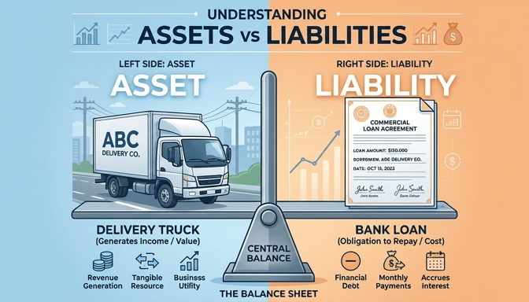
Answer: The Balance Sheet
The Balance Sheet is the financial snapshot
Truck = New Asset (What we own)
Bank Loan = New Liability (What we owe)
Shows exact position at a specific time
The Balance Sheet translates the truck into an asset and the loan into a liability.
Notes:
The correct answer is the Balance Sheet. Just like a medical chart shows your weight and blood pressure at a specific moment, the balance sheet takes a snapshot of the company's financial position today. It translates the delivery truck into an 'Asset' because it is something of value the business now owns. Simultaneously, it translates the bank loan into a 'Liability' because it is an obligation the business now owes.

