Slide 1
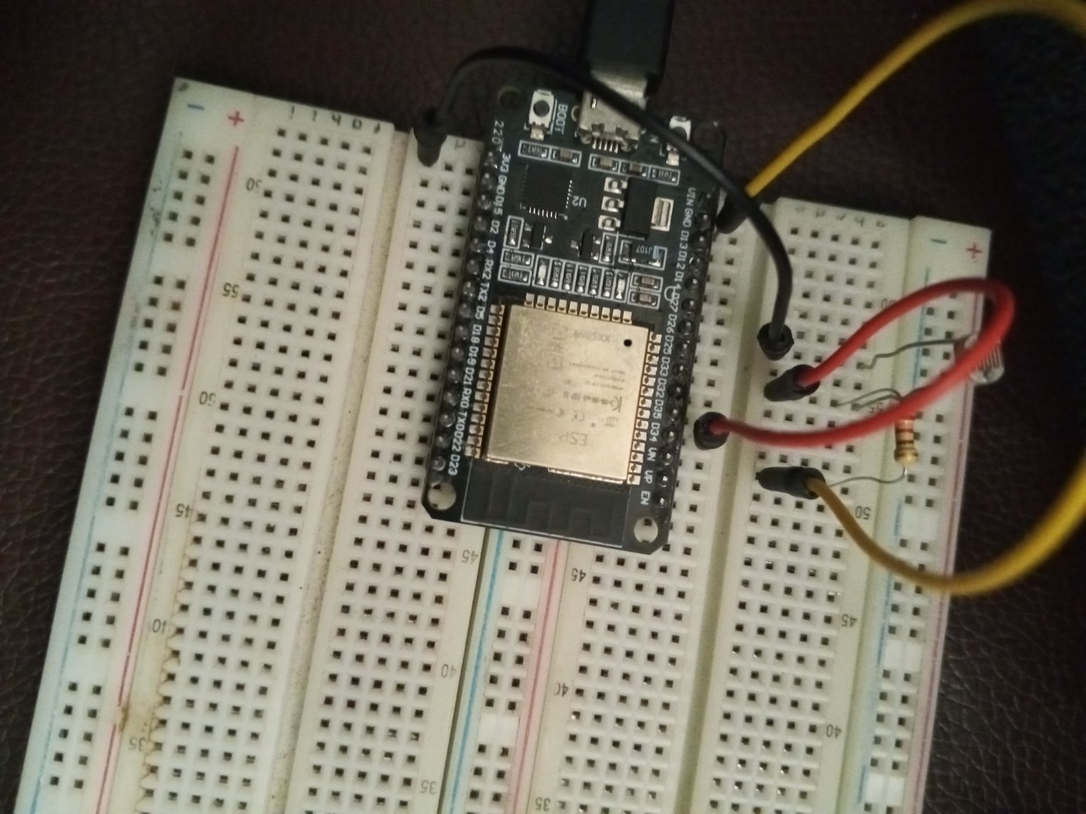
HACKATHON PROTOTYPE
Smart Library
Availability Tracker
An ESP32-powered system that shows whether the library is open, which seats are free, and staff access activity in real time.
Built with ESP32 sensors, RFID, Python API, MySQL, and Flutter.
Notes:
Open with the real problem: students walk to the library without knowing if it is open or which seats are available. This prototype turns sensor readings into live information for students and staff.

Slide 2
The campus problem
Students waste time because room availability is not visible before they arrive.
What happens today
1
• Students walk across campus only to find the library closed or full.
• Staff do not have a simple live view of seat usage.
• Manual checking is slow and cannot scale during busy periods.
open / closed state from light sensor
2
seats checked with ultrasonic sensors
RFID
staff scan logs for access control
Goal: make room status visible before anyone wastes time walking there.
ESP32 • IoT • RFID • Flutter • Python API
02
Notes:
Frame the challenge as a campus communication problem, not just a sensor project. The value is saving time and making shared spaces easier to manage.

Slide 3
Our idea in one sentence
A smart library node reads the environment and sends live availability to a mobile app.
Sensors
ESP32
API + DB
Flutter App
LDR, PIR, ultrasonic, button, RFID
Reads pins, decides open/closed and seat status
Python endpoints store the latest state
Students see open seats before moving
What makes it hackathon-ready
It is small, demoable, useful on campus, and easy to extend from the library to labs or classrooms.
ESP32 • IoT • RFID • Flutter • Python API
03
Notes:
Walk the judges across the flow: sensor event, ESP32 decision, HTTP request, database update, and app screen update.

Slide 4
Hardware prototype
The ESP32 is the brain. Each sensor has one job in the availability story.
ESP32-WROOM-32
WiFi microcontroller that sends HTTP data
LDR on GPIO 34
Detects light level to infer library open/closed
PIR on GPIO 14
Detects movement in the area
Ultrasonic A1/A2
Checks if each seat is occupied by distance
MFRC522 RFID
Scans staff card UID for access logging
LED + Button
Simple physical demo input and output
ESP32 • IoT • RFID • Flutter • Python API
04
Notes:
Use the physical photo to prove the idea is not only slides. Mention that the prototype can be simplified or expanded depending on time.

Slide 5
What the ESP32 code does
The firmware turns raw sensor readings into meaningful library events.
1. Connect WiFi
2. Read inputs
3. Decide status
4. Send changes
5. Scan staff
Uses station mode and connects to the configured SSID
Button, LDR, PIR, ultrasonic distance, RFID
Light > 1800 = open; distance ≤ 45cm = occupied
PATCH library state; POST IoT readings
POST card UID to staff endpoint
Key timing rule
IoT data is sent immediately when something changes, or every 5 seconds as a heartbeat so the backend stays updated.
ESP32 • IoT • RFID • Flutter • Python API
05
Notes:
Explain firstRun, change detection, and five-second interval in simple language: the ESP32 does not spam the server every loop unless needed.

Slide 6
Backend communication
The firmware already separates data into three clear API actions.
Library state
IoT readings
Staff scan
PATCH /api/v1/library/state
POST /api/v1/iot/readings
POST /api/v1/staff/scan
Payload: { is_open: true/false }
Purpose: show if the library is opened or closed.
Payload: device id, motion state, A1/A2 occupancy and distance.
Payload: RFID UID
Purpose: identify staff access events and trigger permission logic.
Current URL uses a local IP. For final remote access, we deploy the API online and replace the IP with an HTTPS domain.
ESP32 • IoT • RFID • Flutter • Python API
06
Notes:
Make it clear that the code has a good backend structure: separate endpoint for state, sensor readings, and RFID staff scans.

Slide 7
What students see
The app turns sensor data into a simple answer: go now, or try somewhere else.
Behind the screen
Library
• Latest library open/closed state
• Latest seat readings from A1 and A2
• Motion confidence from PIR + LDR
• Staff access event history for administrators
OPEN NOW
Seat availability
A1
A2
FREE
USED
Get directions
The system is useful even with only two seats: it proves the full pipeline from physical space to mobile view.
ESP32 • IoT • RFID • Flutter • Python API
07
Notes:
The phone mockup is not meant to be a full final UI. It shows exactly what the sensor data would become in Flutter.

Slide 8
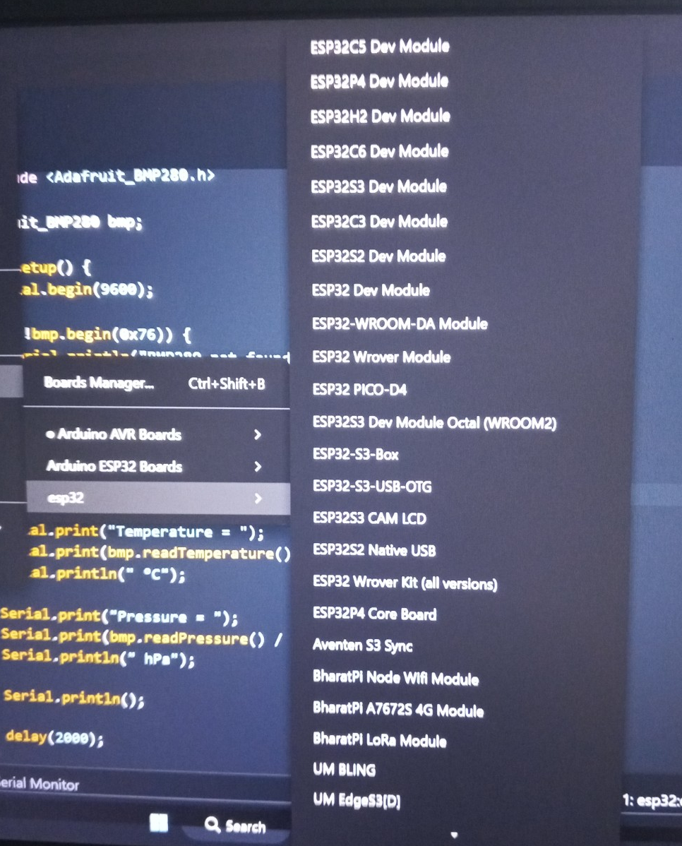
Demo plan for judges
A short physical demo can prove the idea in under two minutes.
1
Cover / uncover LDR
Serial monitor shows light value and library state changes.
2
Place hand near A1/A2
Ultrasonic distance falls below 45cm and seat becomes occupied.
3
Move in front of PIR
Motion state changes and IoT reading is posted.
4
Scan RFID card
UID is printed and sent to staff scan endpoint.
Judge takeaway: this is not a mockup only — the serial monitor and API status codes show live hardware-to-server behavior.
ESP32 • IoT • RFID • Flutter • Python API
08
Notes:
Run the demo slowly. First show serial output. Then show server responses. Finally show the app state if the frontend is ready.

Slide 9
Impact and value
The same design can support more rooms after the library prototype works.
For students
For staff
For campus
Know before walking. Save time. Find a free seat faster during busy hours.
View occupancy trends, opening state, and staff scan activity without manual checks.
Extend from library to labs, classrooms, study halls, and workstation zones.
One small sensor node can become a campus-wide resource availability network.
ESP32 • IoT • RFID • Flutter • Python API
09
Notes:
Connect the technical build to real campus value. This is the slide where the idea becomes bigger than the demo table.

Slide 10
Downsides we identified
We know the prototype has weaknesses, so the plan includes fixes.
Local server IP
The ESP32 URL points to 10.72.127.242, so it only works on that network.
WiFi + power issues
ESP32 WiFi can draw more current and cause resets with weak USB power.
Light sensor errors
Sunlight or shadows can make the LDR think the library is open or closed.
Ultrasonic noise
Seats can be misread if people move, bags block the sensor, or echo voltage is wrong.
Privacy concern
Occupancy tracking must avoid collecting personal student identity.
ESP32 • IoT • RFID • Flutter • Python API
10
Notes:
Do not hide the weaknesses. Judges often like teams that understand limitations and have practical fixes.

Slide 11
How we plan to solve them
Each downside has a practical engineering fix.
Local IP
Deploy backend online with HTTPS or use a tunnel during demo. Store the URL as a config value.
Power reset
Use stable 5V 2A power, short USB cable, common ground, and test current under WiFi load.
LDR false state
Calibrate threshold per room, combine with staff RFID and opening schedule, and shield sensor.
Sensor noise
Average distance readings, add timeout handling, use 3.3V-safe echo divider, and confirm with PIR.
Privacy
Do not use cameras. Store seat state and staff UID events only; no student identity needed.
ESP32 • IoT • RFID • Flutter • Python API
11
Notes:
For the remote connection issue, explain that the endpoint structure stays the same. Only the base URL changes from local IP to cloud HTTPS.

Slide 12
Build roadmap
What we can finish for the hackathon, and what comes next.
1
2
3
4
Now
Hackathon demo
Next version
Campus scale
Upload firmware, prove serial readings, confirm HTTP status codes.
Show open/closed state, A1/A2 occupancy, RFID scan, and Flutter screen.
Cloud backend, database dashboard, better sensor calibration, more seats.
Multiple ESP32 nodes for library, labs, classrooms, and workstations.
The prototype already contains the correct foundation: sensors → decision logic → API → app.
ESP32 • IoT • RFID • Flutter • Python API
12
Notes:
Close with an action plan. Make the judges feel the team can execute this within the hackathon timeline.

Slide 13
Smart spaces start with simple signals.
Our ESP32 node gives the campus a live view of library availability — open status, seat status, movement, and staff scan events.
READY TO DEMO
Thank you
Notes:
End confidently and invite questions.

