Slide 1
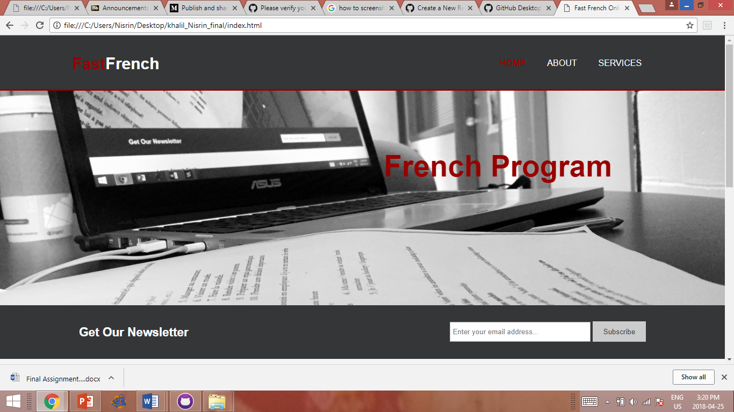

Slide 2
Creative Direction
Simple, basic layout
Easy to navigate
Simple colour palette

Slide 3
Homepage
Basic info about the program
Subscribe to newsletter

Slide 4
