Slide 1
Restaurant Booking System

Slide 2
Contents
Report: 3-8
Use case diagram: 9
Class diagram: 10
sequence diagram: for make reservation: 11
sequence diagram: for cancellation:12
sequence diagram for: Arrival :13
sequence diagram: for change table: 14
Context diagram:15
End of project: 16

Slide 3
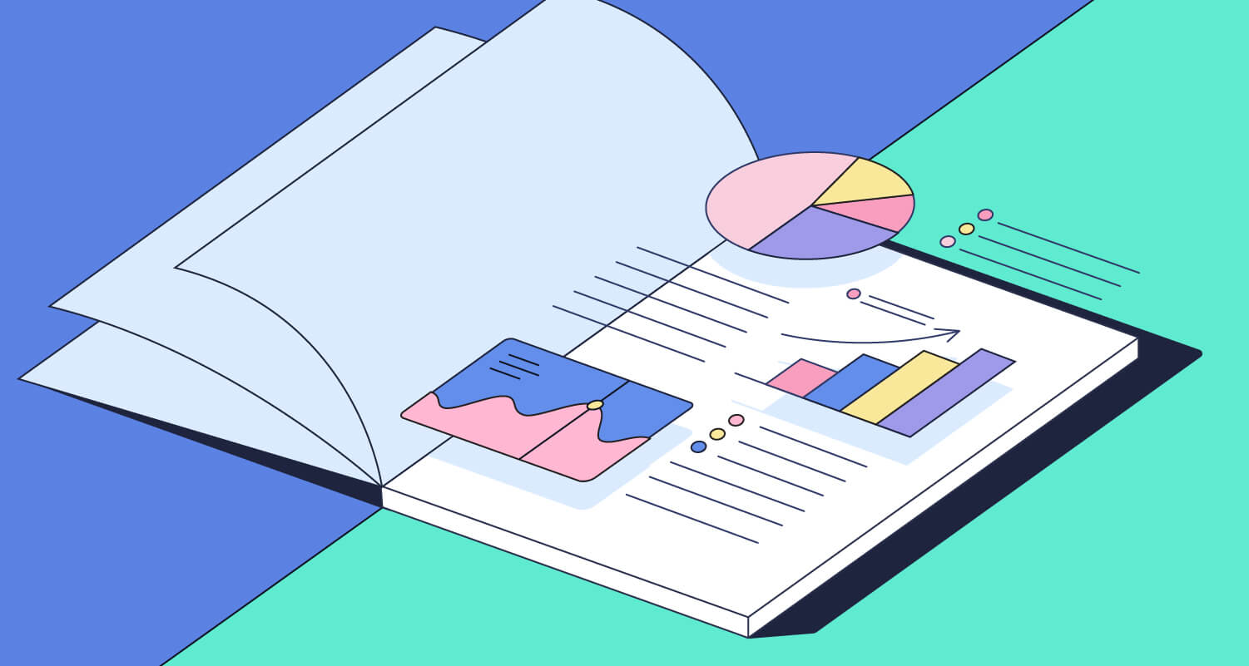
Report

Slide 4
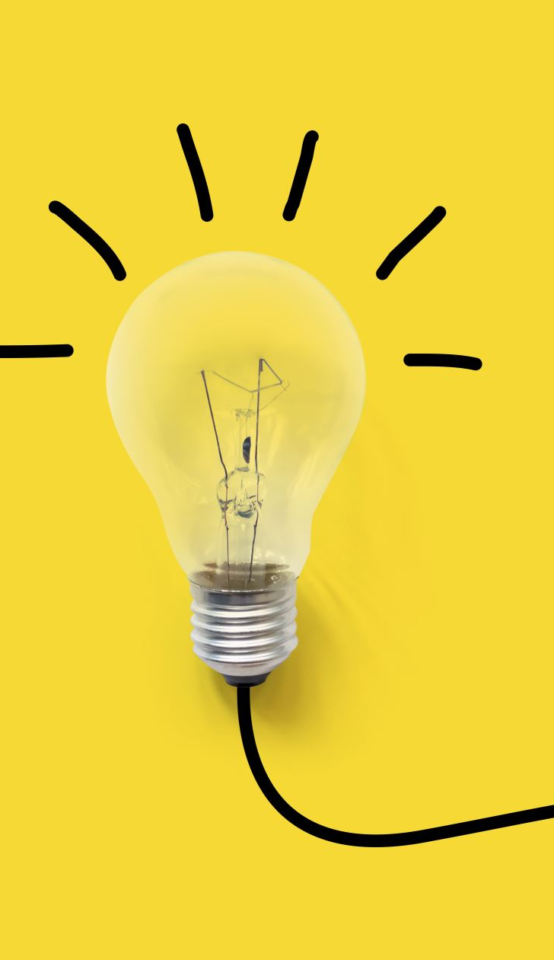
Project idea:
Restaurant reservation system
It is a program that is being worked on to ensure the highest possible quality to serve customers in the best possible way and in the fastest time.
To improve the restaurant’s services for customers.

Slide 5
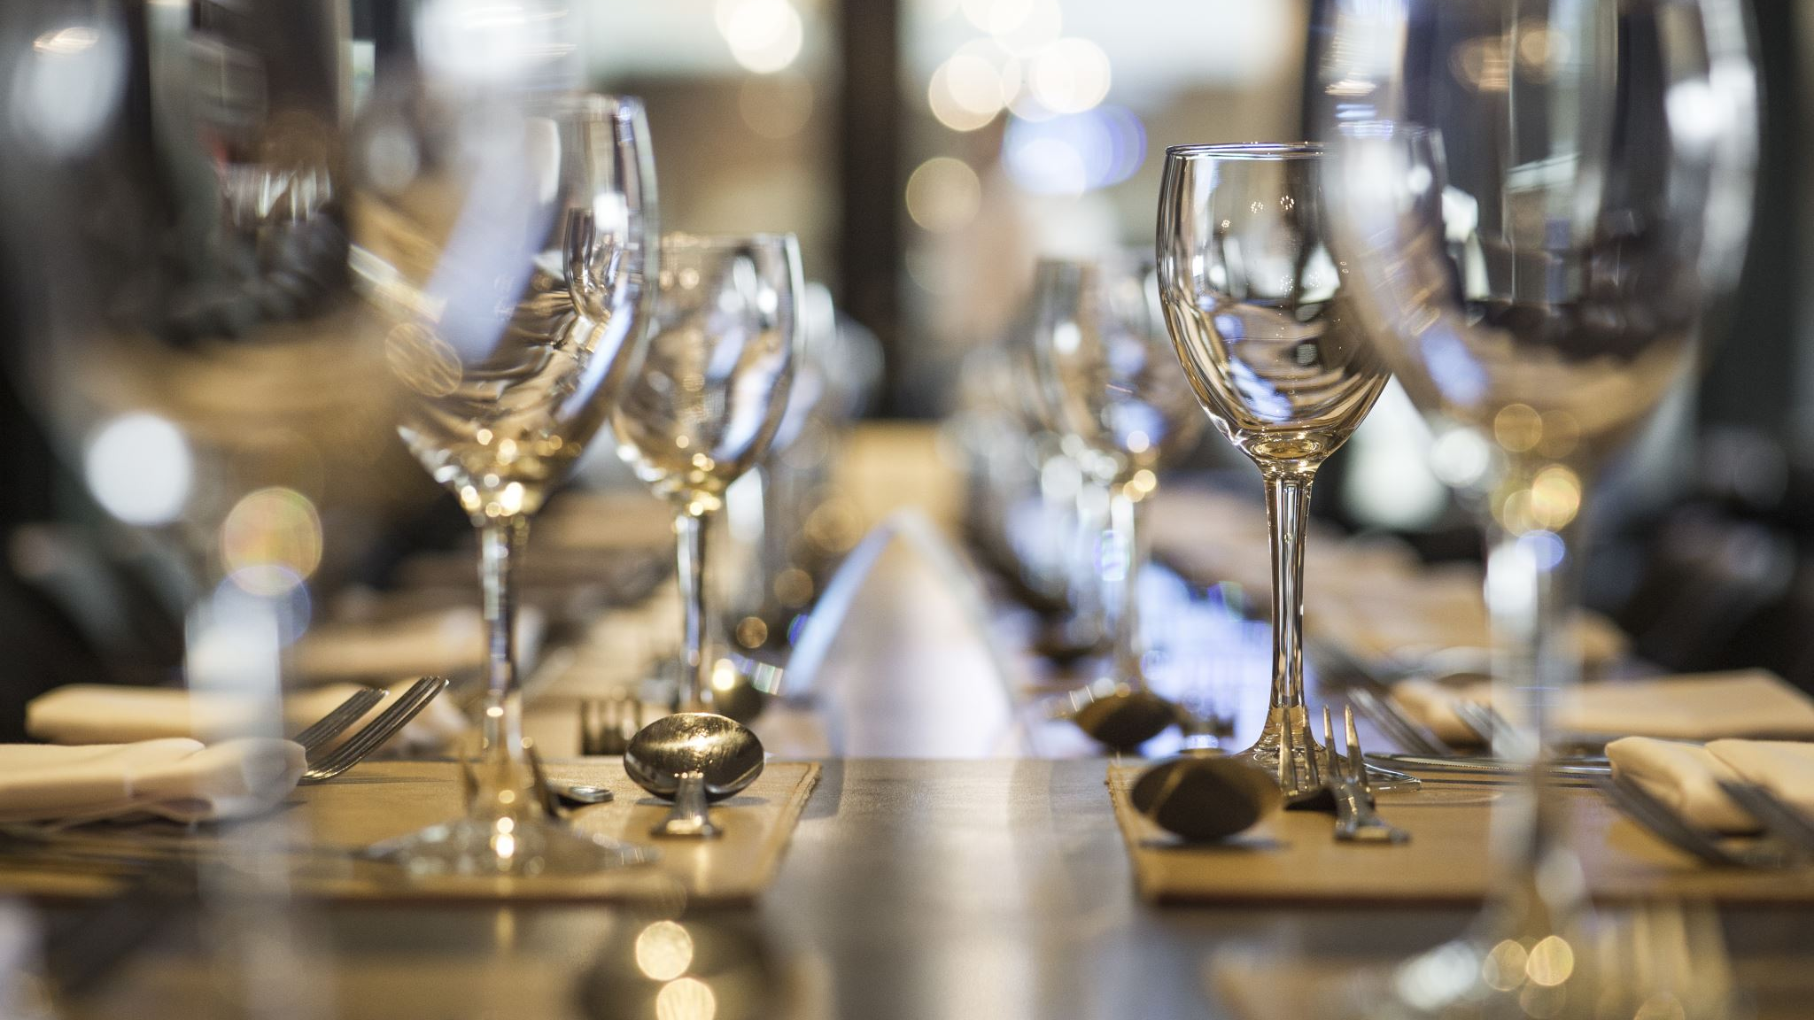
The problem:
One of the most common problems when reserving a table in a restaurant is the lack of clarity about the waiting mechanism at the time of ordering and how long the customer will wait to receive the table.

Slide 6

The solution
The solution was for the customer to enter his data every time he requested a new order, which made the system separate each order from the other in a separate way and form a new order without overlapping the data.

Slide 7

Inputs\Outputs
Inputs:
Data
the name
Password
Mobile number
Emil
time of booking
Outputs:
Number of seats
Requests
Customer data
Bill
order number.

Slide 8
Constraints:
If the receptionist by mistake tried to allocate a booking to a table that was too small to seat requested number of diners, the system also displays error message.
I cannot reserve the same table twice in one row.

Slide 9
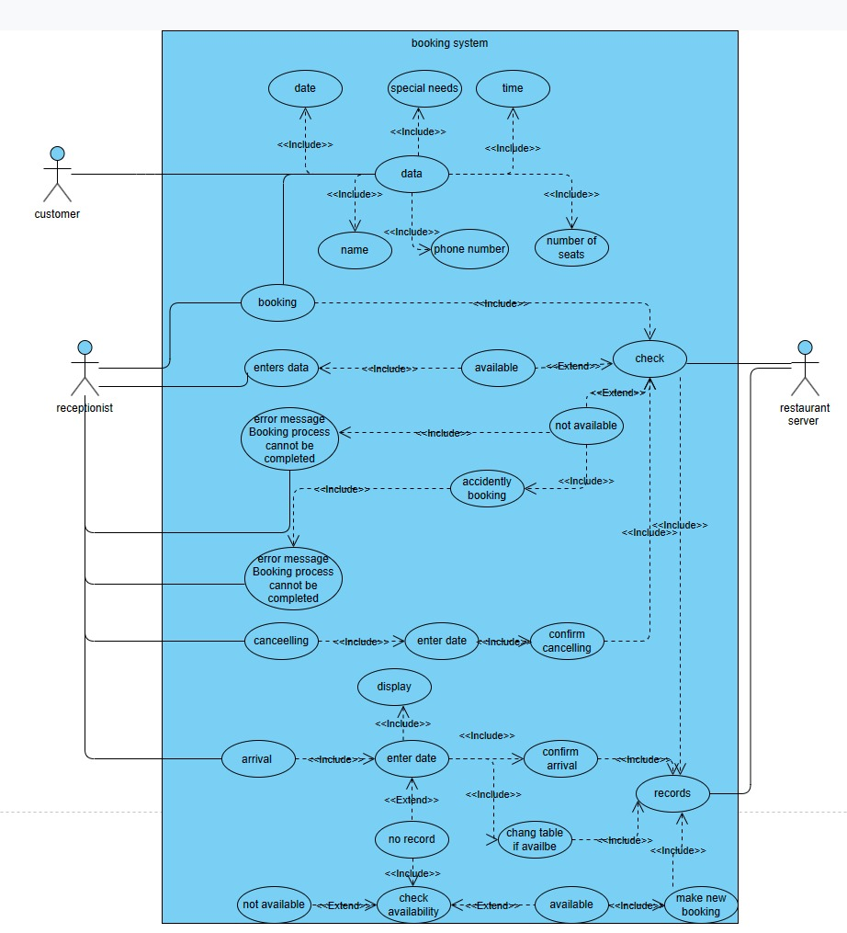
Use case diagram

Slide 10
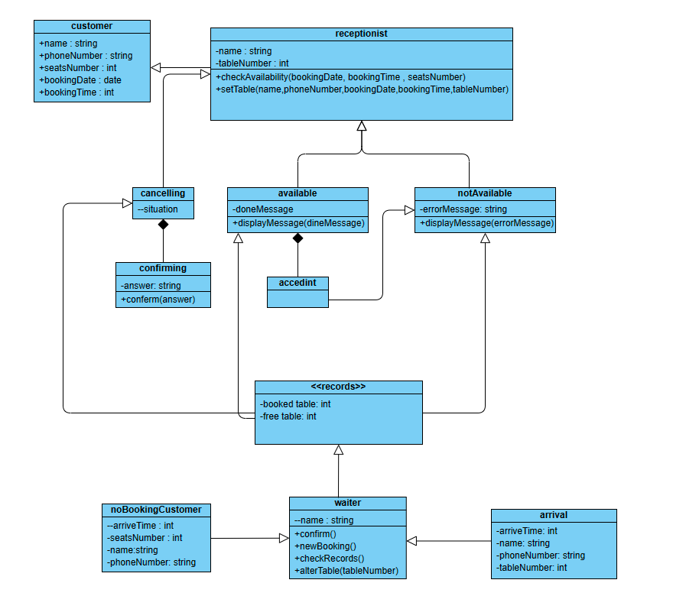
Class diagram

Slide 11
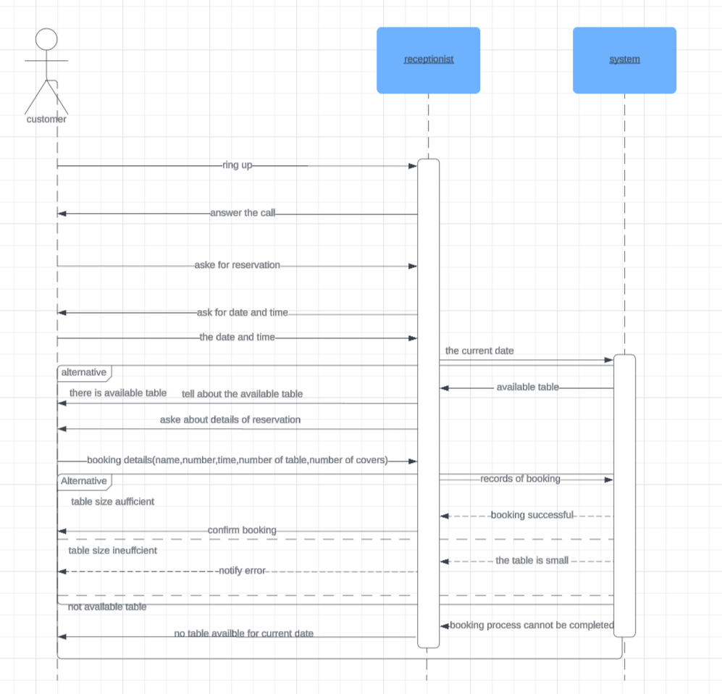
sequence diagram: for make reservation

Slide 12
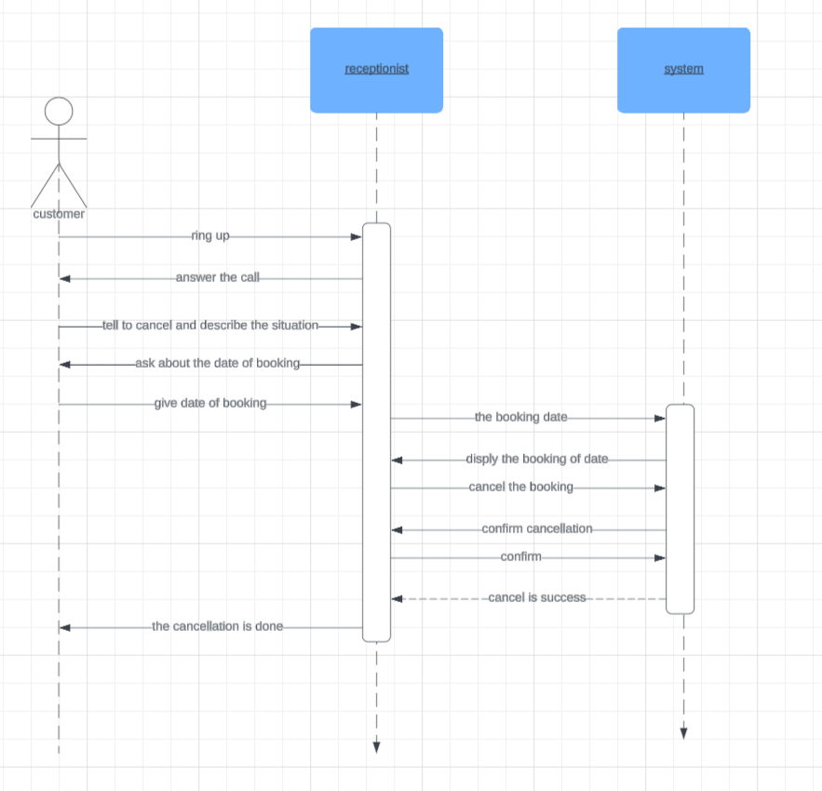
sequence diagram: for cancellation

Slide 13
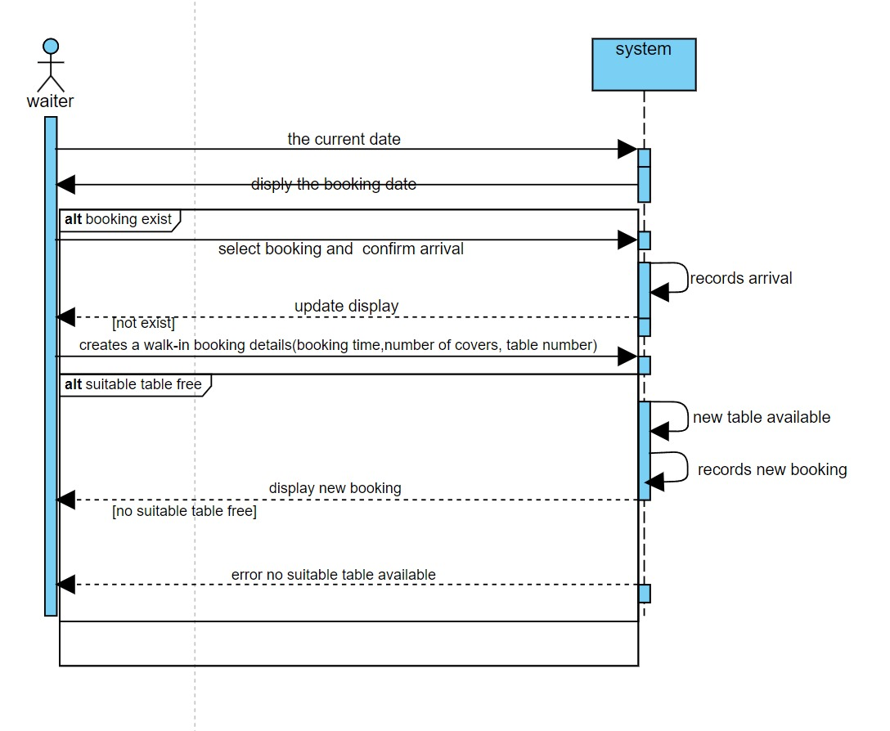
sequence diagram for: Arrival

Slide 14
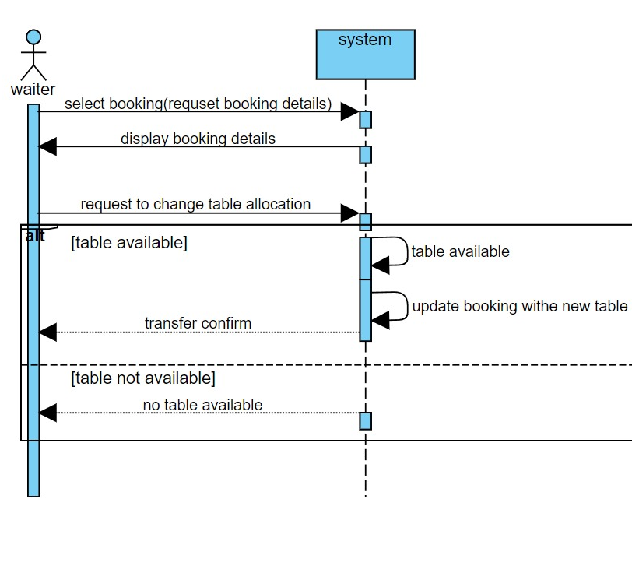
sequence diagram: for change table

Slide 15
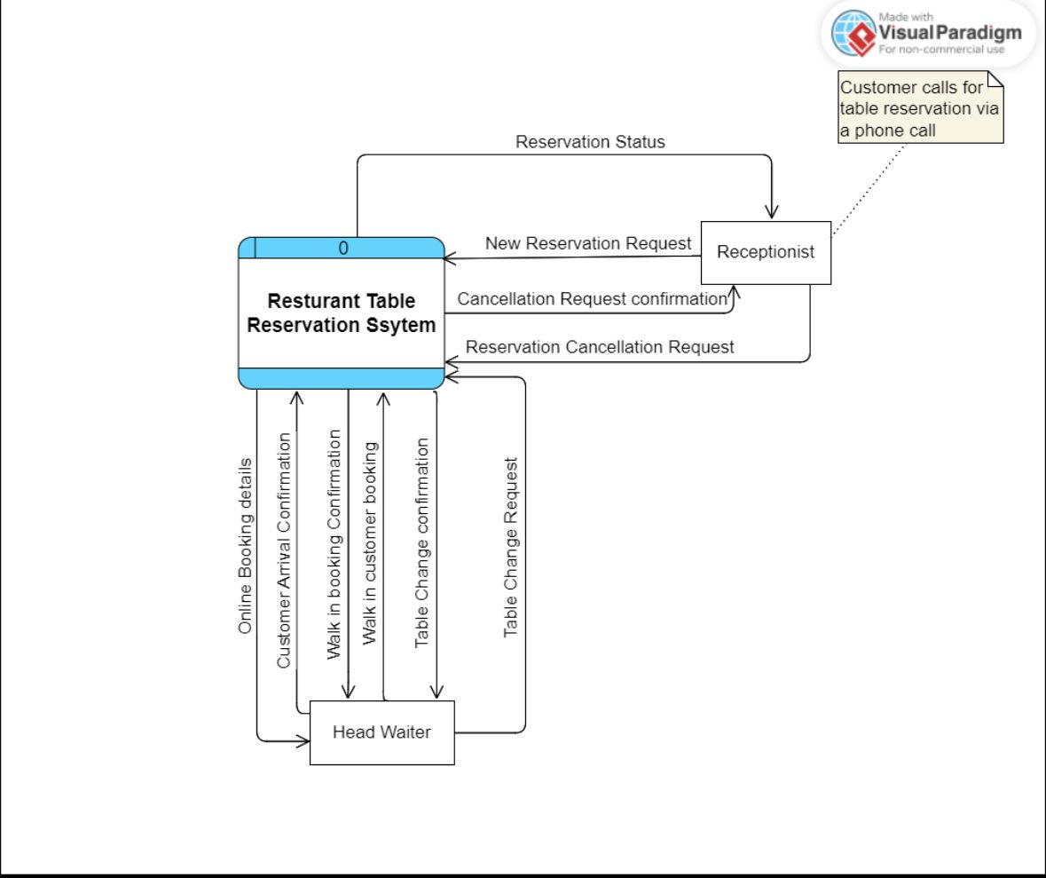
Context diagram

Slide 16
End of project
Project Title
Restaurant Booking System
Student Information
No. | Student ID | Student Name
1 | 2240107 | basm alahmadi | Leader
2 | 2141395 | Abdulrhman almarwani | Member
3 | 2040414 | Naser mansour alslimani | Member
4 | 2243643 | Ahmed Mohammed Babader | Member
5 | 2243121 | Khalaf Alshammri | Member

