Slide 1
What are the most popular categories for movies?
The most popular movie categories are Documentary, Family, Foreign, and Sports.
Sports is the most popular by 1 movie.

Slide 2
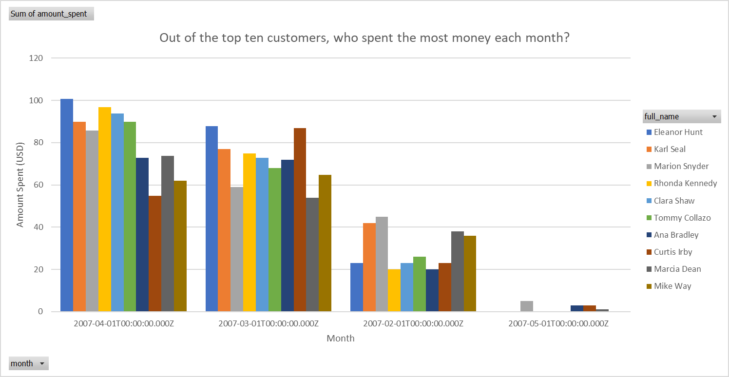
Out of the top ten customers, who spent the most money each month?
In February 2007, Marion Snyder spent the most money.
In March 2007, Eleanor Hunt spent the most money.
In April 2007, Eleanor Hunt spent the most money.
In May 2007, Marion Snyder spent the most money.

Slide 3
Which employee had the best total sales each month?
Jon Stephens had the best sales every month.

Slide 4
How many times have movies from each category been rented out?
Sports movies are rented the most.
Animation movies are a close second.
Action movies are third.

