Slide 1


Movies Gener Prediction
Created by:
Khaled SeifAldin
Confidential

Slide 2
AGENDA
Welcome to our informative presentation.
Problem Statement:
03
Data Sources: Data Collection
04
EDA & Preprocessing
05 - 07
Pipeline , Modeling & Evaluation
08-09
Non-Spoiler Summaries for Movie Plots
10
Vector DB & RAG
11
Deployment
12
Conclusion
13

Slide 3
Problem Statement:
Provide non‑spoiler plot summaries
2
Enable semantic search & RAG Q&A
3
Predict movie genres (multi‑label)
1

Slide 4
Data Sources: Data Collection
• Wikipedia plot summaries (~34k movies)
• TMDB auxiliary metadata & credits(5K movies)

Slide 5
EDA (Exploratory Data Analysis) & Preprocessing
1-Data Cleaning and preparation:
Removed or imputed rows with missing data
Coerced non-numeric year ‘Release Year’
2-Data Visualization:
Explore the top 15 genres in a bar chart
Display top 10 movies by origin/ethnicity using pie chart
3-Feature Engineering:
Extracted a new `'Decade'` column from `'Release Year'
Extracted new ‘Plot_Length’ from ‘Plot’

Slide 6
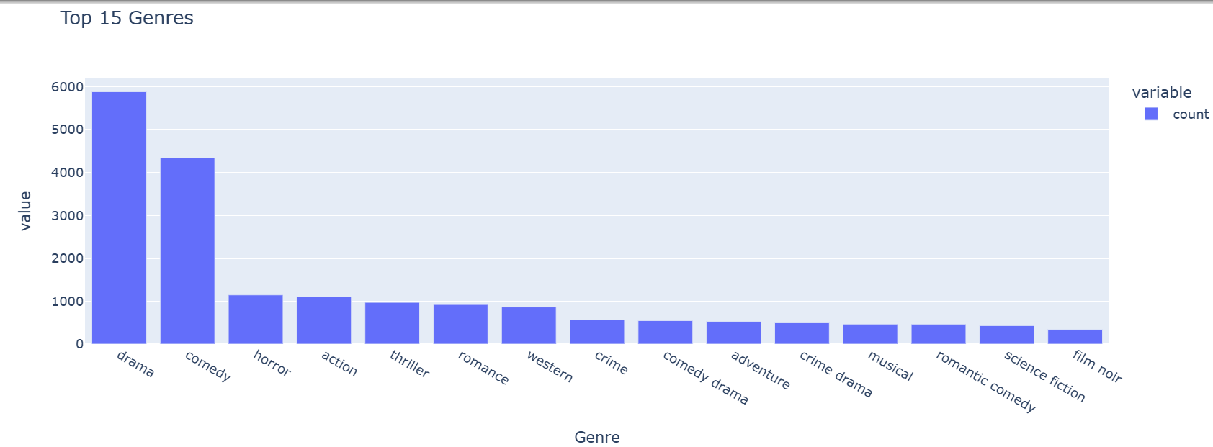
EDA (Exploratory Data Analysis) & Preprocessing
Most frequent 15 genres in a bar chart

Slide 7
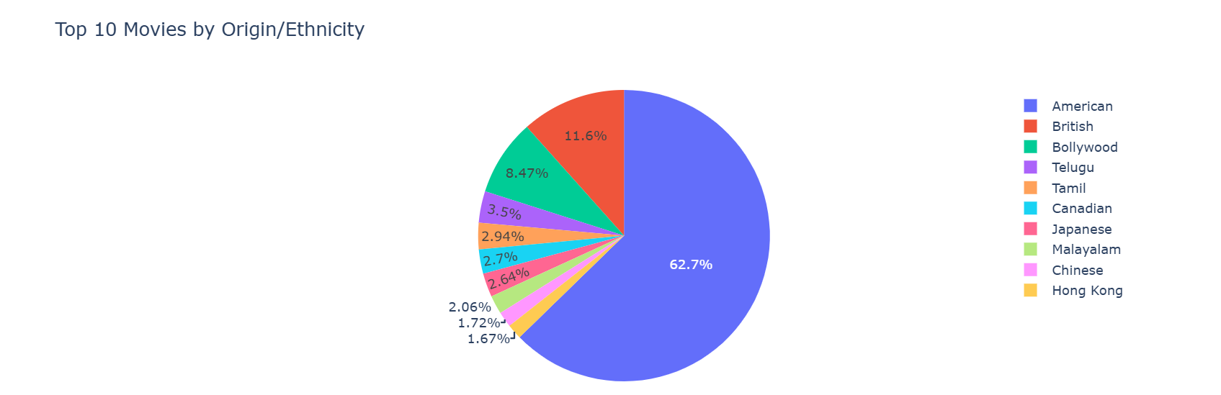
EDA (Exploratory Data Analysis) & Preprocessing
Top 10 countries has film production

Slide 8
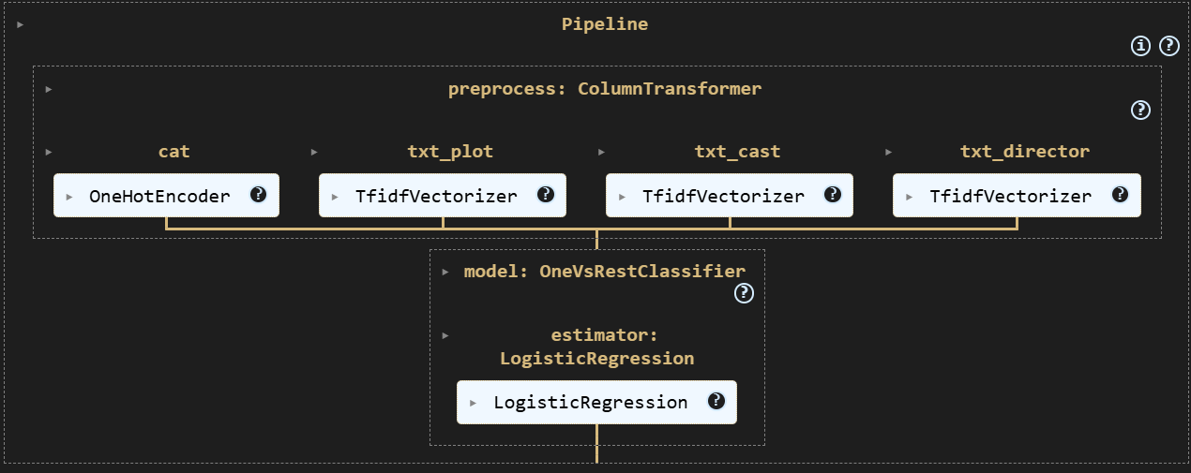
Pipeline , Modeling & Evaluation
Pipeline:
Encoders:
-TF-IDF: to vectorize text columns.
-OnHotEncoder: To convert categorical to numerical
-Robust Scaler: to scale data and, also robust to outlier’s
Modeling :
-Test model : Logistic Regression
-Train Accuracy: 86%
-Test Accuracy: 68%

Slide 9
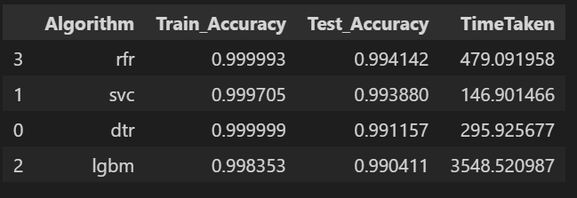
Pipeline , Modeling & Evaluation
List of models used:
DecisionTreeClassifier
RandomForestClassifier
LinearSVC
LGBMClassifier
List of models used:
Hamming Loss_score
f1_micro_socre

Slide 10
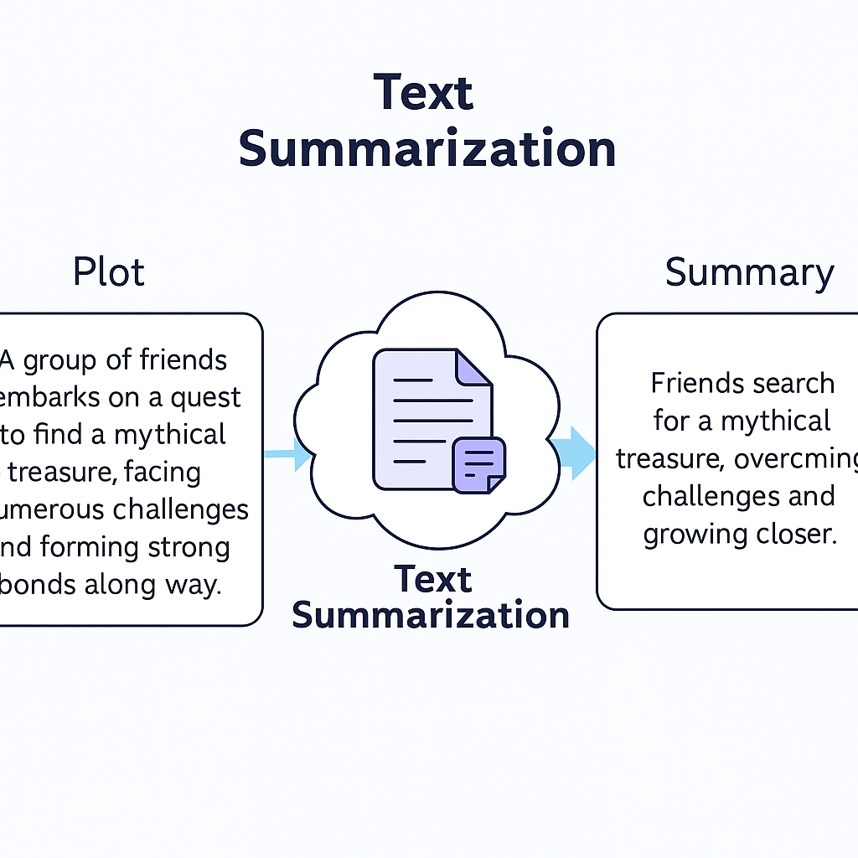
Non-Spoiler Summaries for Movie Plots
Used Model:
- google/flan-t5-xl
-transformer model via Hugging Face's `pipeline("summarization")` to produce high-quality summaries.
Custom Prompting:
Each movie plot was summarized using a tailored prompt to instruct the model *not* to reveal spoilers:
*"Summarize the following movie plot without revealing major twists or the ending:"*

Slide 11
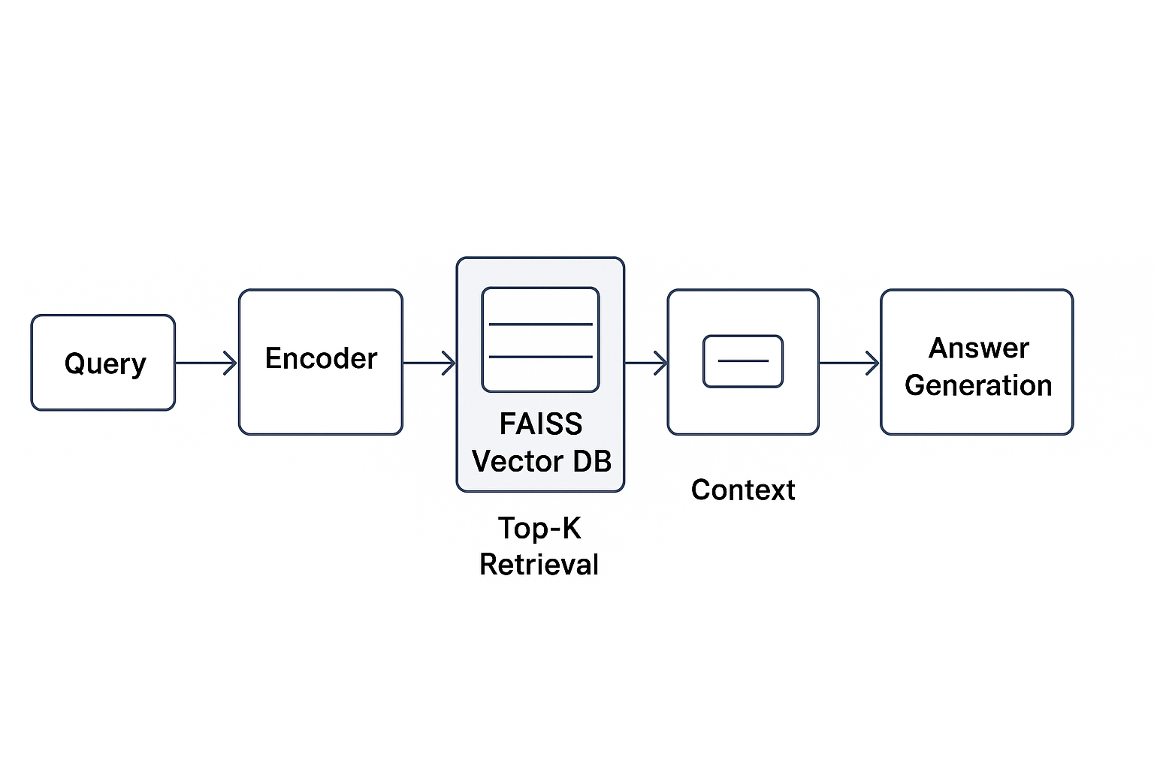
Vector DB & RAG
Used Models:
Sentence Embedding Model: "sentence-transformers/all-MiniLM-L6-v2"
Retrieval-Augmented Generation (RAG): "google/flan-t5-base"

Slide 12
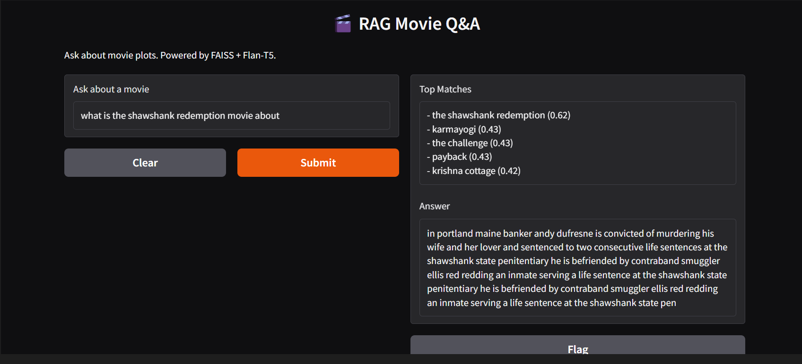
Deployment

Slide 13
Conclusion
In this project, I performed data cleaning, feature extraction, and exploratory data analysis on movie metadata, focusing on columns like Cast_Size, Director, and Genres. I applied custom functions to handle missing values, normalize text, and extract relevant fields from JSON-like structures. I visualized distributions and identified features with low variance or missing data. These steps prepared the dataset for further modeling and ensured its quality and consistency.

Slide 14
Confidential

