Slide 1
GK-MOVeMENT
Khaled khamassi

Slide 2
SUMMARY
Introduction​
HTML
CSS​
DOM

Slide 3
Introduction
It is a web page for sealing online courses and in person courses . So I use my skills in HTML , CSS and JS to create a platform to navigate and see the courses and order it , you can also send a direct message to get help

Slide 4
html

Slide 5
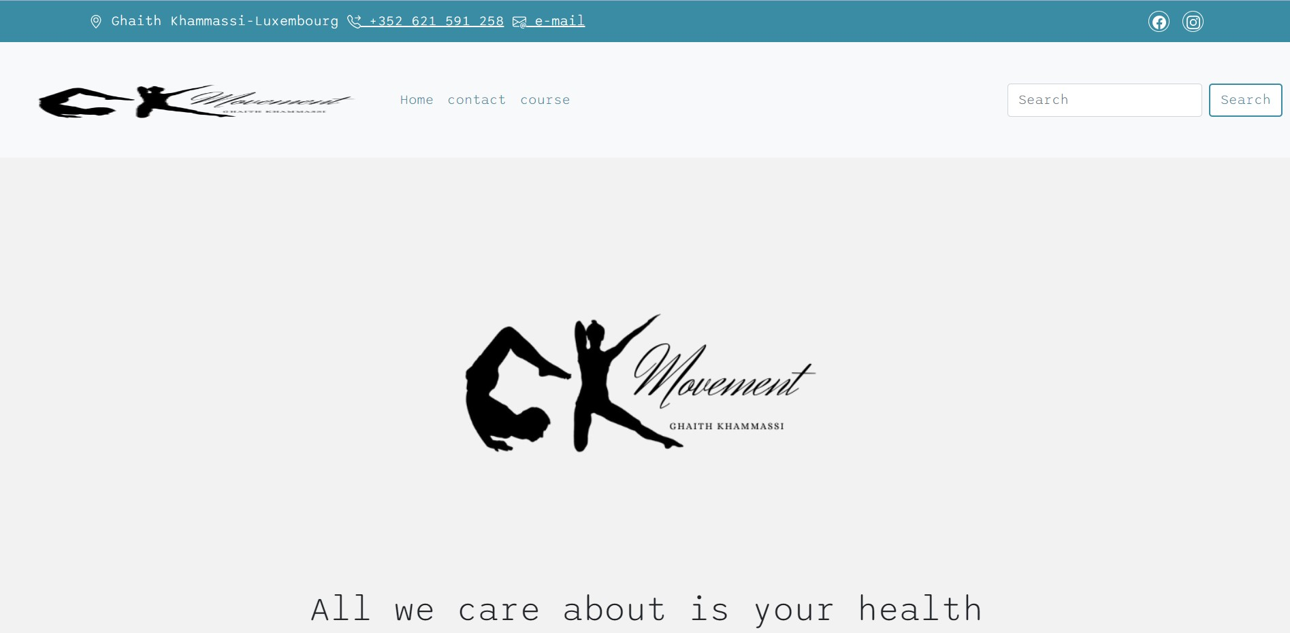
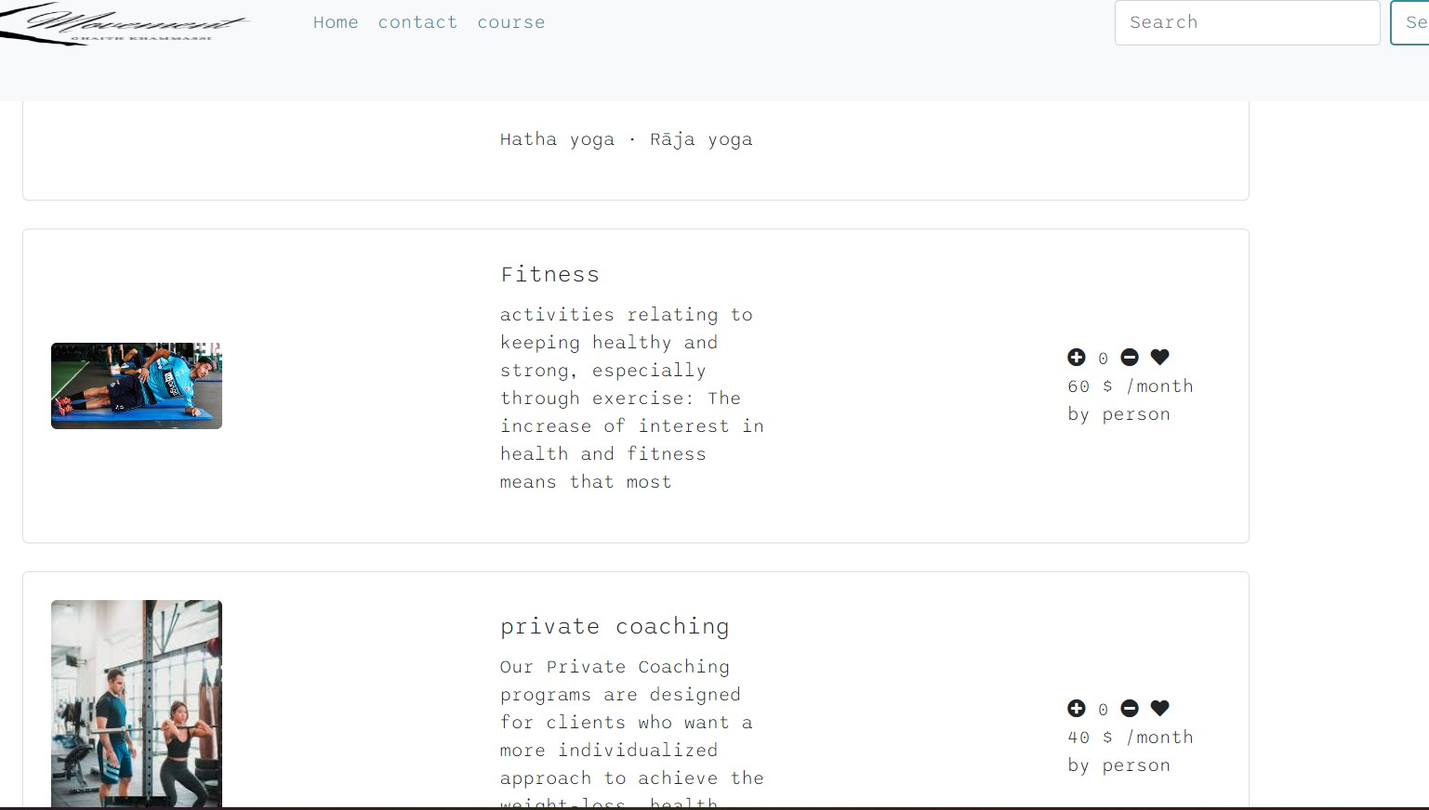
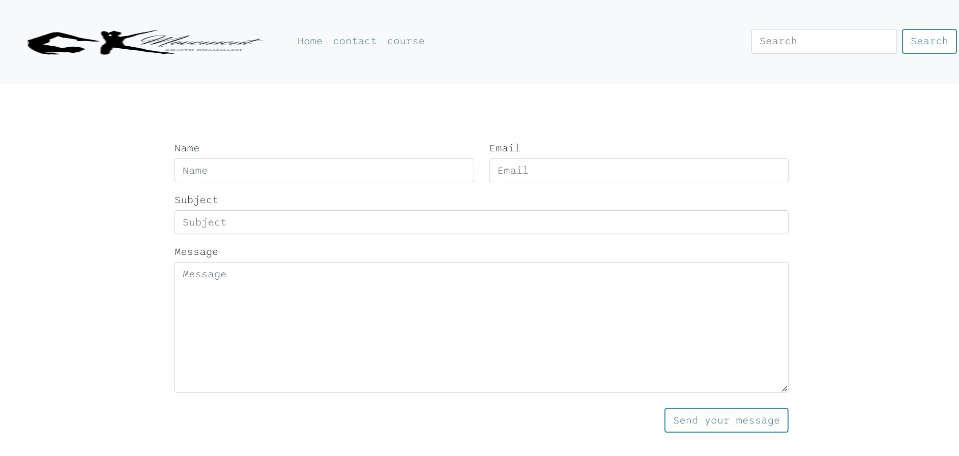

Slide 6
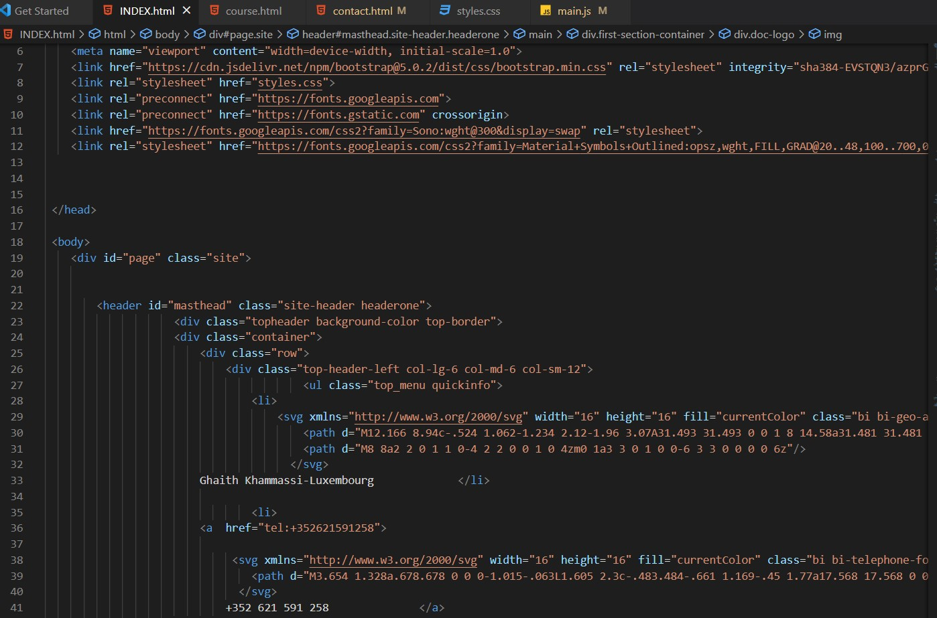
I use some of HTML tags to separate and organize my pages and elements in my page web , also to make it responsive

Slide 7
CSS

Slide 8
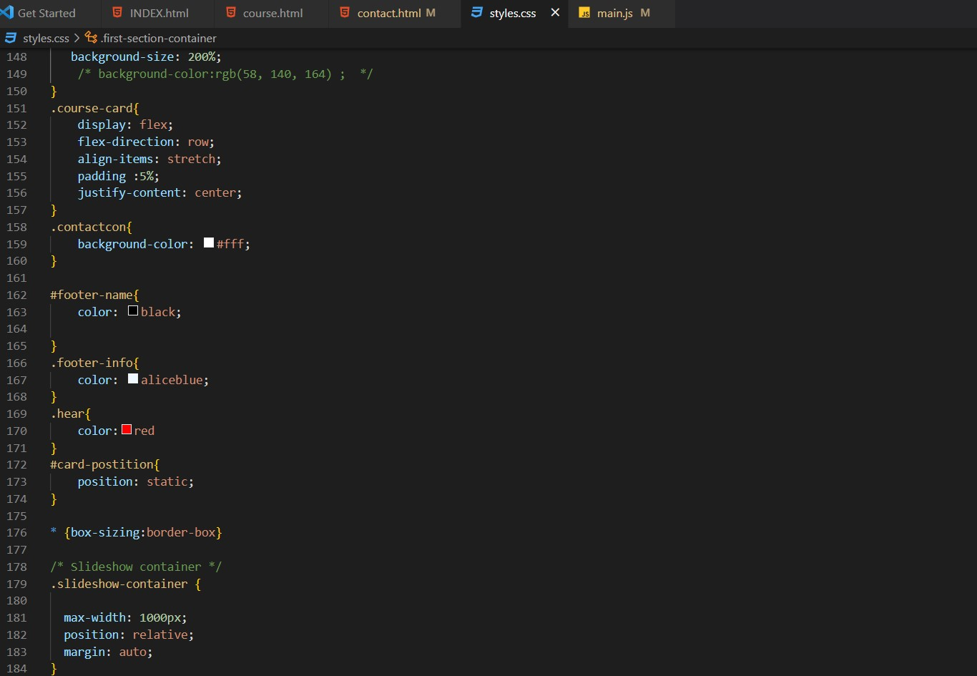
Then I uses some CSS styles to make it looks good

Slide 9
DOM

Slide 10
Finally, I uses dom to make it dynamics

Slide 11
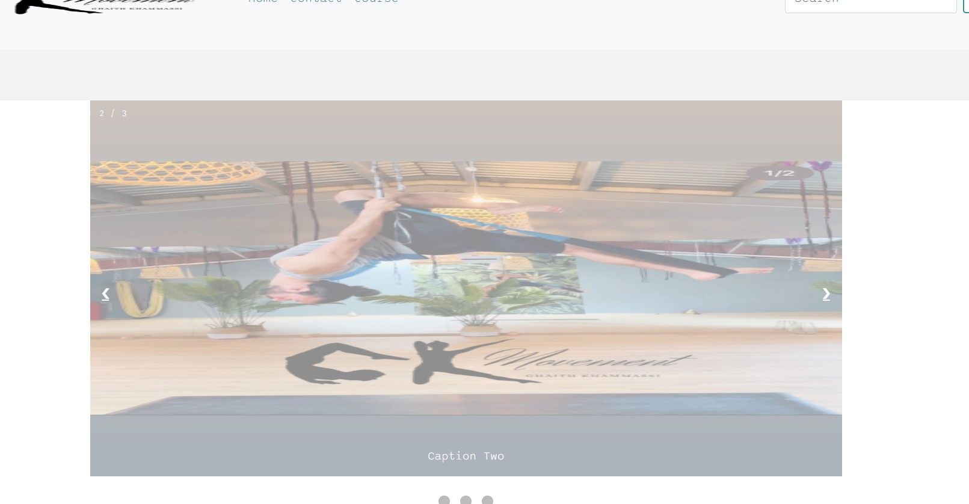
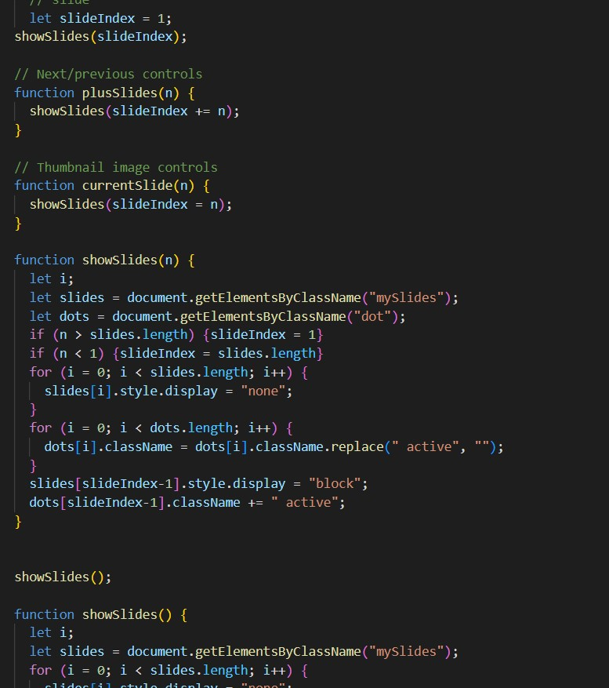
This function to make the show slides move

Slide 12
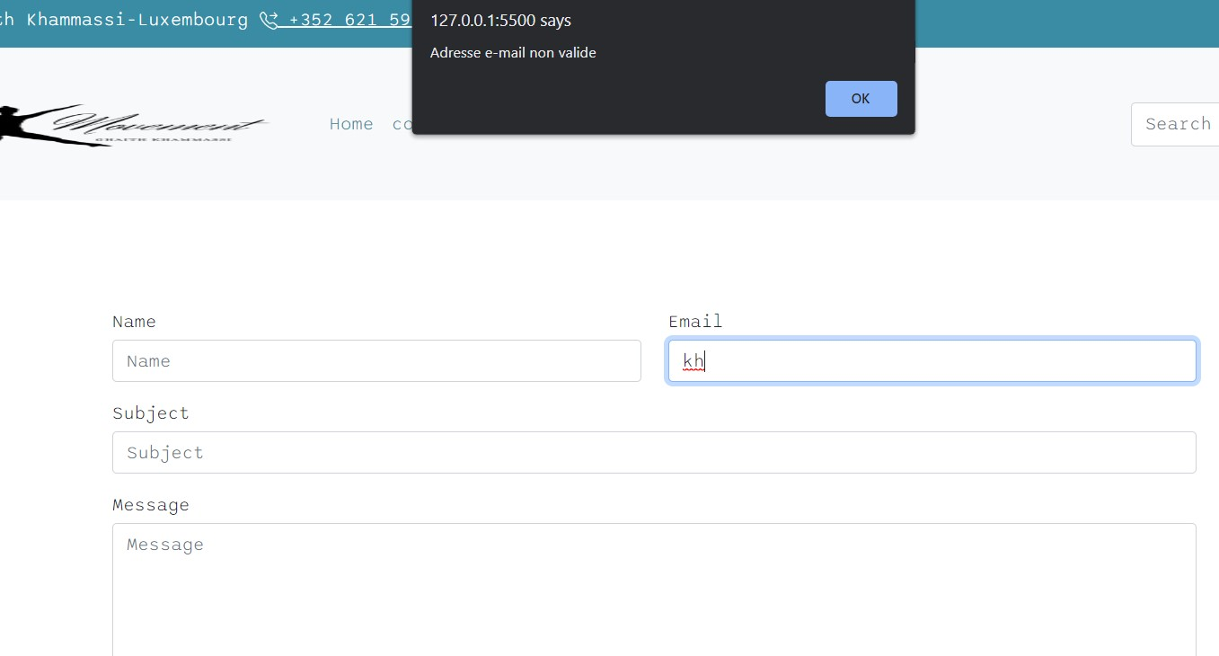
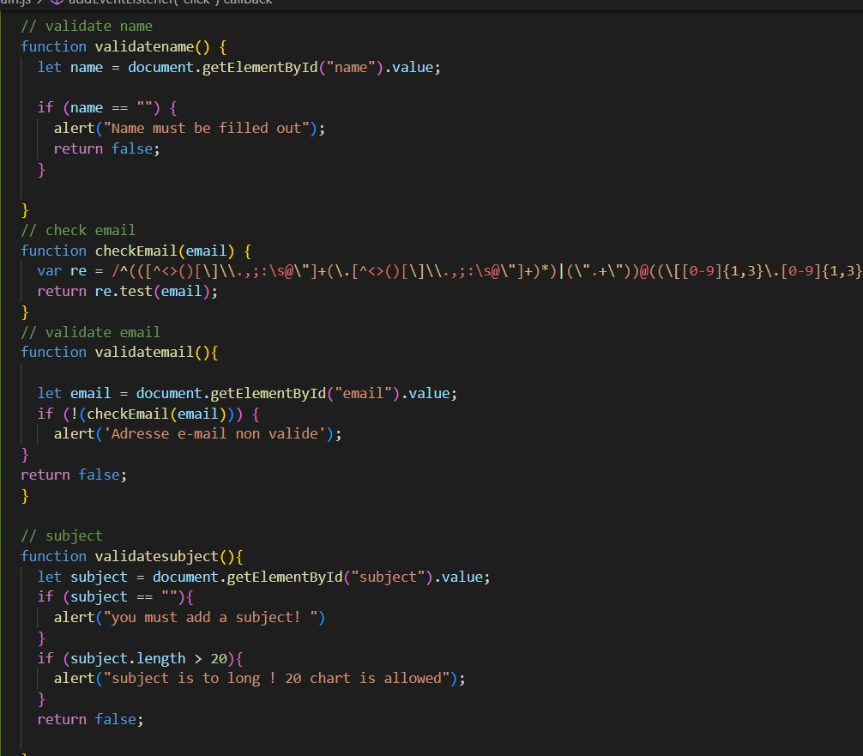
This function to alert the client about the formulary mistakes

Slide 13
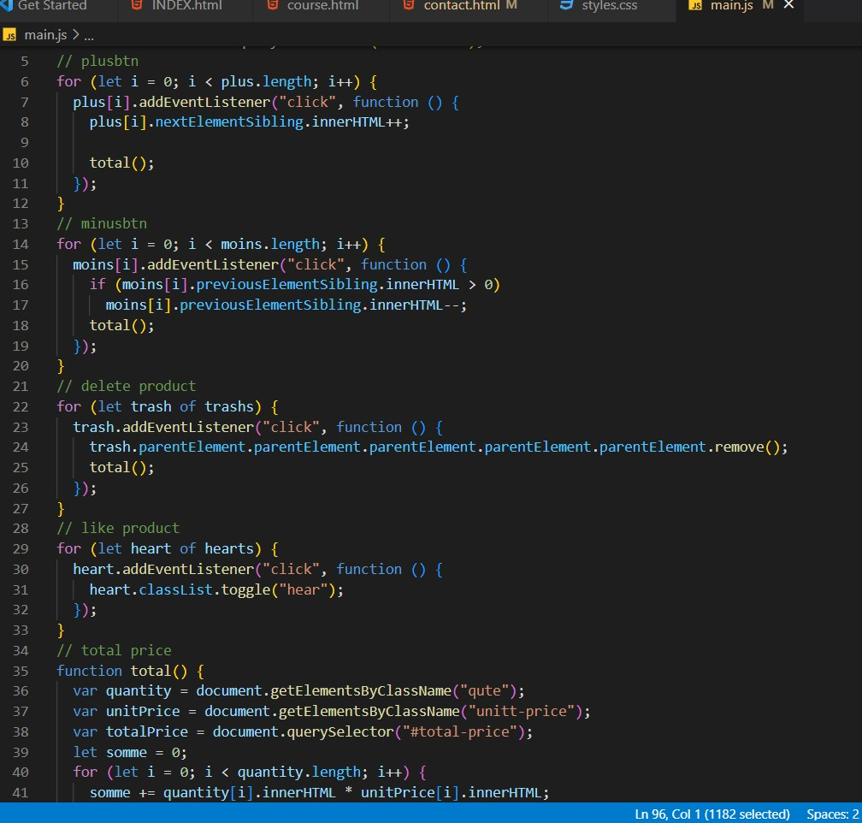
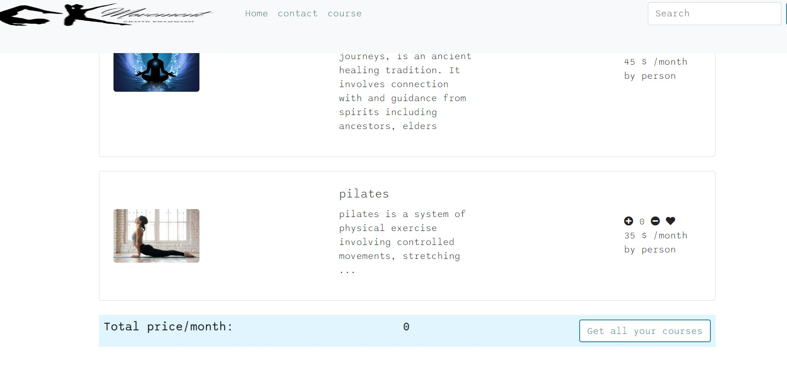
This function to make the total prices of your courses you want to buy

Slide 14
THANK YOU
Khaled khamassi
khammassi59@gmail.com

