Slide 1
Internet of Things
Lec.2

Slide 2
IoT Architecture
These layers are:
1. The perception layer hosting smart things
2. The connectivity or transport layer transferring data from the physical layer to the cloud and vice versa via networks and gateways;
3. The processing layer employs IoT platforms to accumulate and manage all data streams.
4. The application layer delivers solutions like analytics, reporting, and device control to end users.
5.Business layer

Slide 3
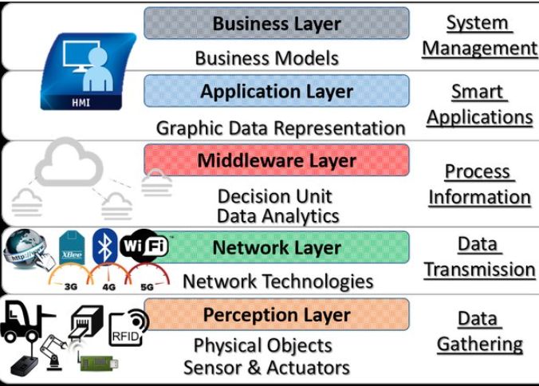

Slide 4
Perception layer (physical layer)
It converts analog signals into digital data and vice versa.
The initial stage of any IoT system embraces a wide range of “things” or endpoint devices that act as a bridge between the real and digital worlds.
It was including the various endpoint devices and sensors that send and receive information.
Their primary function is generating data and being capable of being queried and/or controlled over a network.

Slide 5
perception layer (physical layer)
Function: Collect information from the physical environment or perform an action.
It contains:
  Sensors
  Actuators
  RFID tags
  Cameras
  Smart devices

Slide 6
Perception layer (physical layer)
Sensors They collect physical parameters like temperature or humidity, turn them into electrical signals, and send them to the IoT system.
Example: A temperature sensor measures 25°C.
Actuators, translating electrical signals from the IoT system into physical actions.
Example: An actuator turns an air conditioner ON/OFF.
Machines and devices connected to sensors and actuators or having them as integral parts.
Example: Device as a smartwatch can measure heart rate and send the data to a smartphone.

Slide 7
Connectivity layer (Network Layer)
It enables data transmission
The function: communications across devices, networks, and cloud services that make up the IoT infrastructure.
The connectivity between the physical layer and the cloud is achieved in two ways:
  TCP or UDP/IP stack
  A gateway is a hardware or software component that connects IoT devices using different communication protocols.

Slide 8
Connectivity layer
The communications between devices and cloud services or gateways involve different networking technologies.
Depending on the device, distance, power requirements, and application, different networking technologies can be used to communicate between devices, gateways, and cloud services.

Slide 9
Connectivity layer
For example:
Bluetooth / BLE (Bluetooth Low-Energy): short-distance communication, such as smart watches.
Wi-Fi :connects devices to a local network and the Internet.
NFC (Near Field Communication) enables simple and safe data sharing between two devices over a distance of 4 inches (10 cm)
Zigbee : is a low-power wireless network for carrying small data packages over short distances -low-power communication for smart-home devices

Slide 10
Connectivity layer
For example:
LoRaWAN(Low-power Wide-area Network) : long-distance communication with very low power consumption.
5G / Cellular: communication over large geographical areas. Two important cellular technologies were developed especially for IoT:
  LTE-M ( Long-Term Evolution for Machines)LTE-M is designed for IoT devices that need to transmit larger amounts of data and exchange high volumes of data
  NB-IoT ( Narrowband Internet of Things) NB-IoT is designed for IoT devices that send small amounts of data.
Ethernet :connects stationary or fixed IoT devices - wired, reliable network connection.

Slide 11
Processing layer
This layer receives, stores, and processes the data.
Functions
  collects data from many IoT devices.
  keeps the data in databases or cloud storage.
  Processes data
  prepares information that can be used by applications or for decision-making.
Two Major Stages: Data accumulation stage - Data abstraction stage

Slide 12
Data accumulation stage
Data accumulation means collecting and storing the data received from the Network Layer
The data accumulation component stage works as a transit hub between event-based data generation and query-based data consumption.
For example:
A temperature sensor sends 25°C, 26°C, 27°C, 28°C. Then The system captures these readings and stores them in a database.

Slide 13
Data abstraction stage
After data has been accumulated and stored, it must be prepared so that applications can understand and use it.
It combines data from different sources and reconciling multiple data formats; and aggregating data in one place or making it accessible regardless of location through data virtualization.

Slide 14
Application layer:
Function: Analyze information and provide useful services to users and organizations.
It addresses business requirements
Examples of IoT Applications
Device monitoring and control: Monitor sensors and control devices remotely.
Mobile applications: Allow users to interact with IoT devices using smartphones.
Business Intelligence: Convert data into reports, dashboards, and useful information.
Machine Learning and Analytics : Analyze data and predict future events.

Slide 15
Business layer:
The information produced by previous layers has value only when it helps an organization:
  Solve problems
  Make decisions
  Improve productivity
  Reduce costs
  Achieve business goals
  Create new processes

Slide 16
Edge computing layer
Edge means the edge of the network, close to the IoT devices that produce the data
Function: to process data close to where it is generated, instead of sending all the data to a distant cloud server to reducing system latency

Slide 17
Security layer
Function preventing data breaches
IoT security protects IoT devices, communication networks, cloud services, and the data they handle. It can be divided into three main areas:
Device Security
Connection Security
Cloud Security

Slide 18
Security layer
Device security protects the physical IoT device and the software running on it.
It include:
TPM (Trusted Platform Module chips with cryptographic keys for authentication and protection of endpoint devices
Secure Boot: process that prevents unauthorized code from running on a powered-up device
Security Updates: Regularly installing security patches helps fix vulnerabilities.
Physical Protection: Physical barriers or metal shields can help prevent unauthorized access to the device's internal components.

Slide 19
Connection Security
Connection security protects data while it is being transmitted between IoT devices, networks, applications, and cloud services.
IoT-centric messaging protocols like MQTT, AMQP, and DDS may use standard Transport Layer Security (TSL) cryptographic protocol to ensure end-to-end data protection.

Slide 20
Cloud Security
Cloud security protects data and IoT services hosted in the cloud.
Data stored in the cloud should be encrypted.

Slide 21
Quiz
A smart home contains temperature sensors, an air conditioner, a Wi-Fi gateway, a cloud server, and a mobile application.
a) Identify the sensor.
b) Identify the actuator.
c) Which layer collects the temperature?
d) Which layer transmits the data?
e) Which layer processes the data?
f) Which layer provides the mobile application?
g) Give one example of security protection for this system

Slide 22
Quiz
Explain the five main layers of IoT architecture.
Explain the Data Accumulation and Data Abstraction stage
What is the main function of the Perception Layer
What is the main function of the Processing Layer
What is the role of Edge Computing
Compare Sensors and Actuators and give example of each
Explain the role of zigbee and LoRawan and blurtooth
List and explain 3 types of sensors and their use case

