Slide 1

Regional Sales Analysis
Presented By
Khaled Iskandarani
Submitted to
Director Information Technology Infrastructure
Mohammed Ali Hosho
Date:11/21/2023

Slide 2
Outline
Introduction
Data Sources
Data Cleaning and preparation
Key findings and Recommendations
Data Visualization
Implementation Plan
Impacts and Benefits
Conclusion
Q&A
Thank you
References

Slide 3
Introduction
Regional sales is a bike sales company that sells for both internet and reseller customers.
Provide insights and recommendations to address these challenges:
Low Accessories and clothing sales.
Decrease in sales in the last year (2013).
New customers not repeating their orders.
Retaining and Nurturing Old Customers.
Optimizing Reseller Sales.
Promotions conflicts and how to take advantages from it.
Understanding Customer Segmentation to target them.

Slide 4
Data Sources
"AdventureWorks2012" database is a fictional database created by Microsoft to simulate real world database
It contains tables and relations( Customers, Products, FactInternetSales , FactResellerSales …)
The data is about international business that sells bikes across the globe.

Slide 5
Data Cleaning and Preparation
Data Source: AdventureWorks2012.
Data Extraction: data-extraction.docx
Data Transformation :data-transformation.docx
Data Validation :data-validation.docx
Data Cleaning Tools : Sql Server Management Studio.

Slide 6
Key findings and Recommendations
Internet Sales
Recommendation
New customers are not repeating their orders as frequently as expected.
Old customers are ordering more frequently.
There's a need to understand the preferences and behaviors of new customers and offer personalized recommendations and on boarding emails to encourage repeat orders.
Implementing loyalty programs, community building ,points system , staying up-to-date, timely follow-ups ,send gifts and surprises to old customers can further nurture their loyalty and engagement.

Slide 7
Key findings and Recommendation
Reseller Sales
Recommendations
Some resellers are not taking full advantage of promotions.
Most mountain resellers are running the same "Half-Price Pedal Sale" promotion, which limits market share.
Valuable resellers Store who ordered a significant amount but received fewer discounts, might impact their loyalty.
Tailoring promotions to the specific needs and preferences of resellers is recommended.
Offering diverse promotions, including clearance sales for older models, can attract a broader customer base.
Implementing discount bands for valuable clients can encourage larger ordering and reduce shipping costs.

Slide 8
Key findings and Recommendation
Customer Analysis
Recommendations
The majority of customers fall into the moderate and low-income category.
High balance customers are often looking for premium bikes with advanced features.
Understanding their unique needs, such as the need for budget-friendly, short-distance bikes, and recommending appropriate accessories can drive sales.
Offering high-quality bikes and accessories like helmets, carbon fiber components, and bike cameras can enhance their experience.

Slide 9
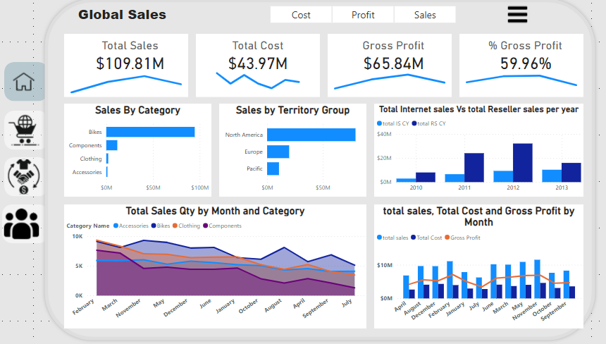
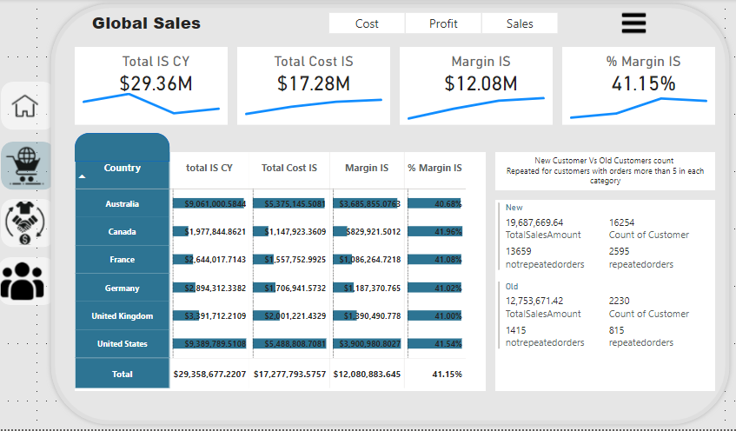
Data Visualization
Home Page
Internet Sales

Slide 10
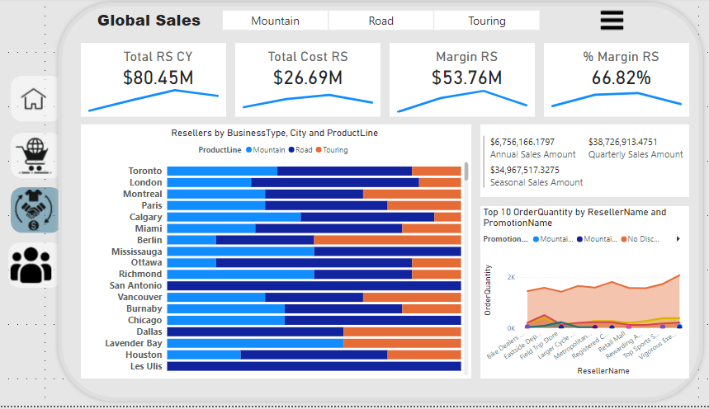
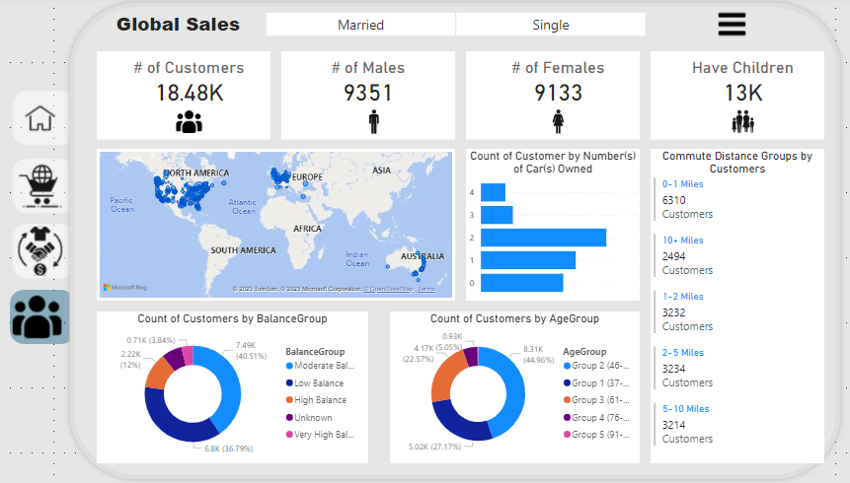
Data Visualization
Reseller Sales
Customer Analysis

Slide 11
Implementation Plan
Personalized Recommendation:
Collect data on customers (Web Analytics Tools: Google Analytics [2] )
Personalized Email Marketing(mailchimp [1]:send emails to target customers)
Website and App Integration(Homepage Banner, Product Pages, search result) [3]
On Boarding Email:
email marketing automation tool
Email Series(welcome email , product introduction, …..) [4]
Adjustment based on (customer behavior, product life cycle, A/B testing)
loyalty programs [5]
Reward your customers (exclusive promotion)
Community building ( Making events like extreme sports) [11]
Points System (theskimm ambassador program)[13]
Staying up-to-date
Timely Follow-Ups
Send gifts and surprises [10]

Slide 12
Implementation Plan
Recommend the right bikes and accessories for customers
Clear Categorization(mountain bikes , hybrid bikes…)
High quality images(show the product from various angles , provide enlargement to image size) [8]
Detailed product description [6]
Video Demonstrations [7]

Slide 13
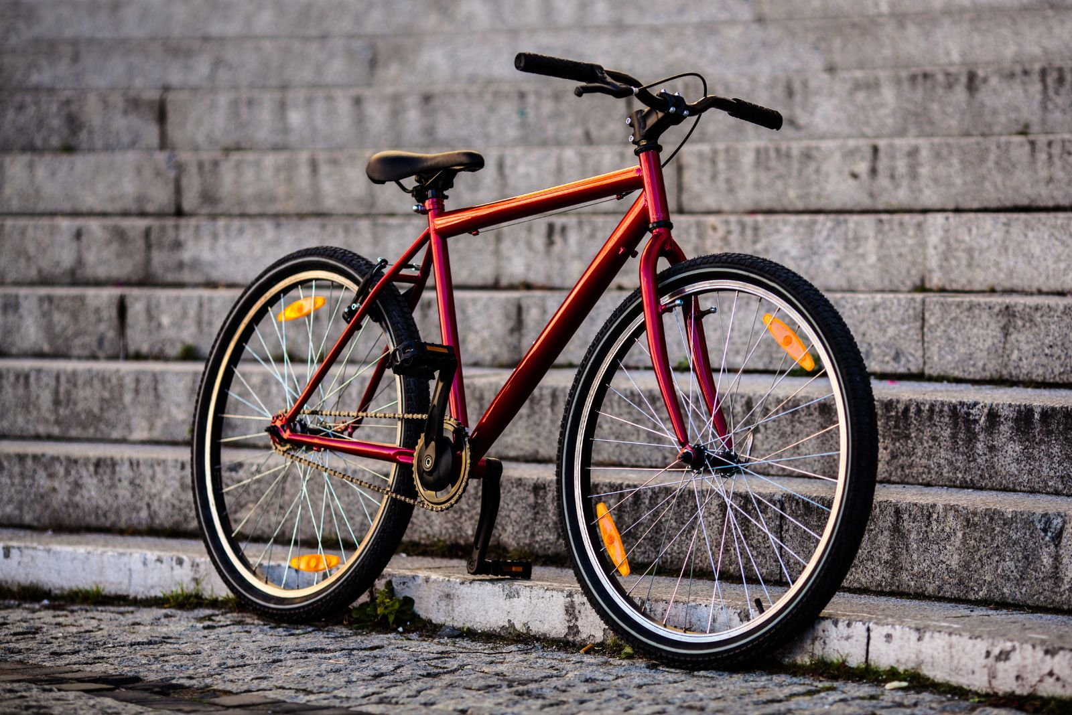
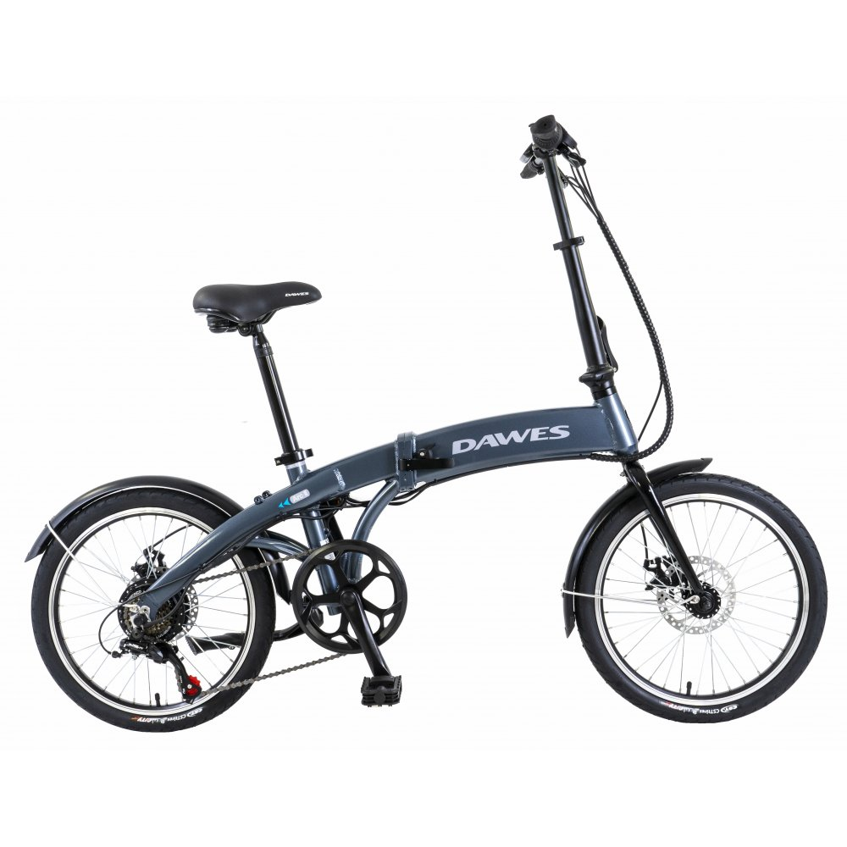
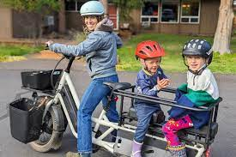
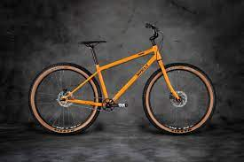
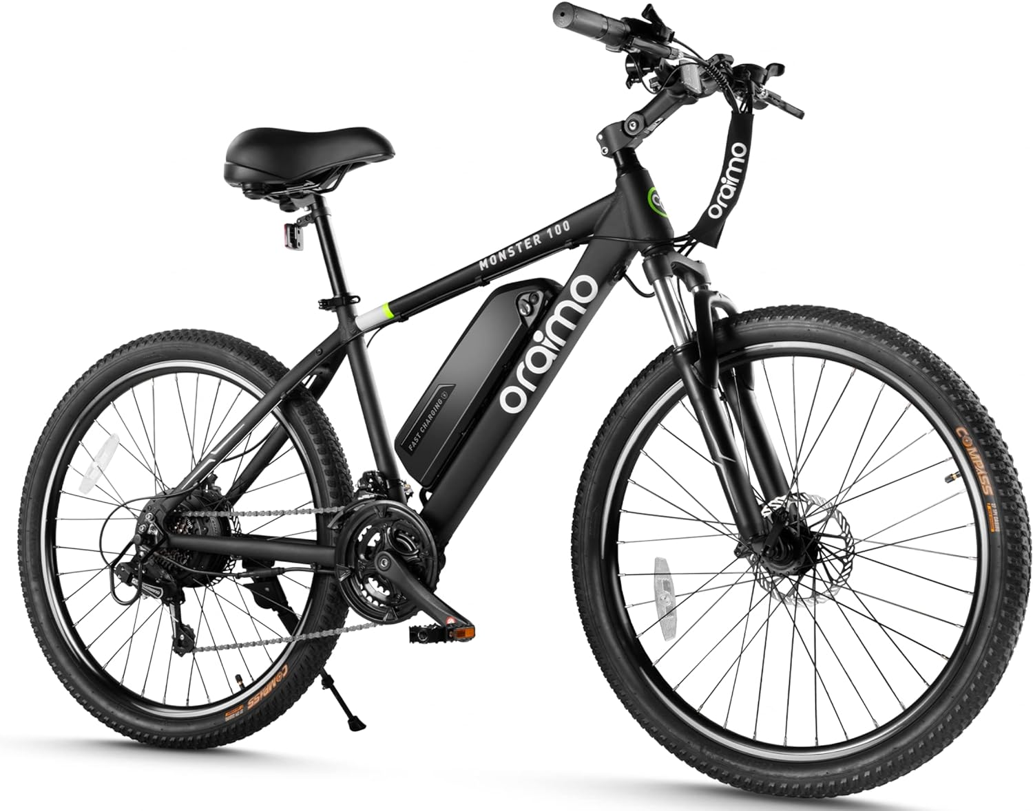
Implementation Plan
Recommended bikes for Moderate and low income customers
Hybrid bike
Folded bike
Cargo bike
Single-speed bike
electric bike

Slide 14
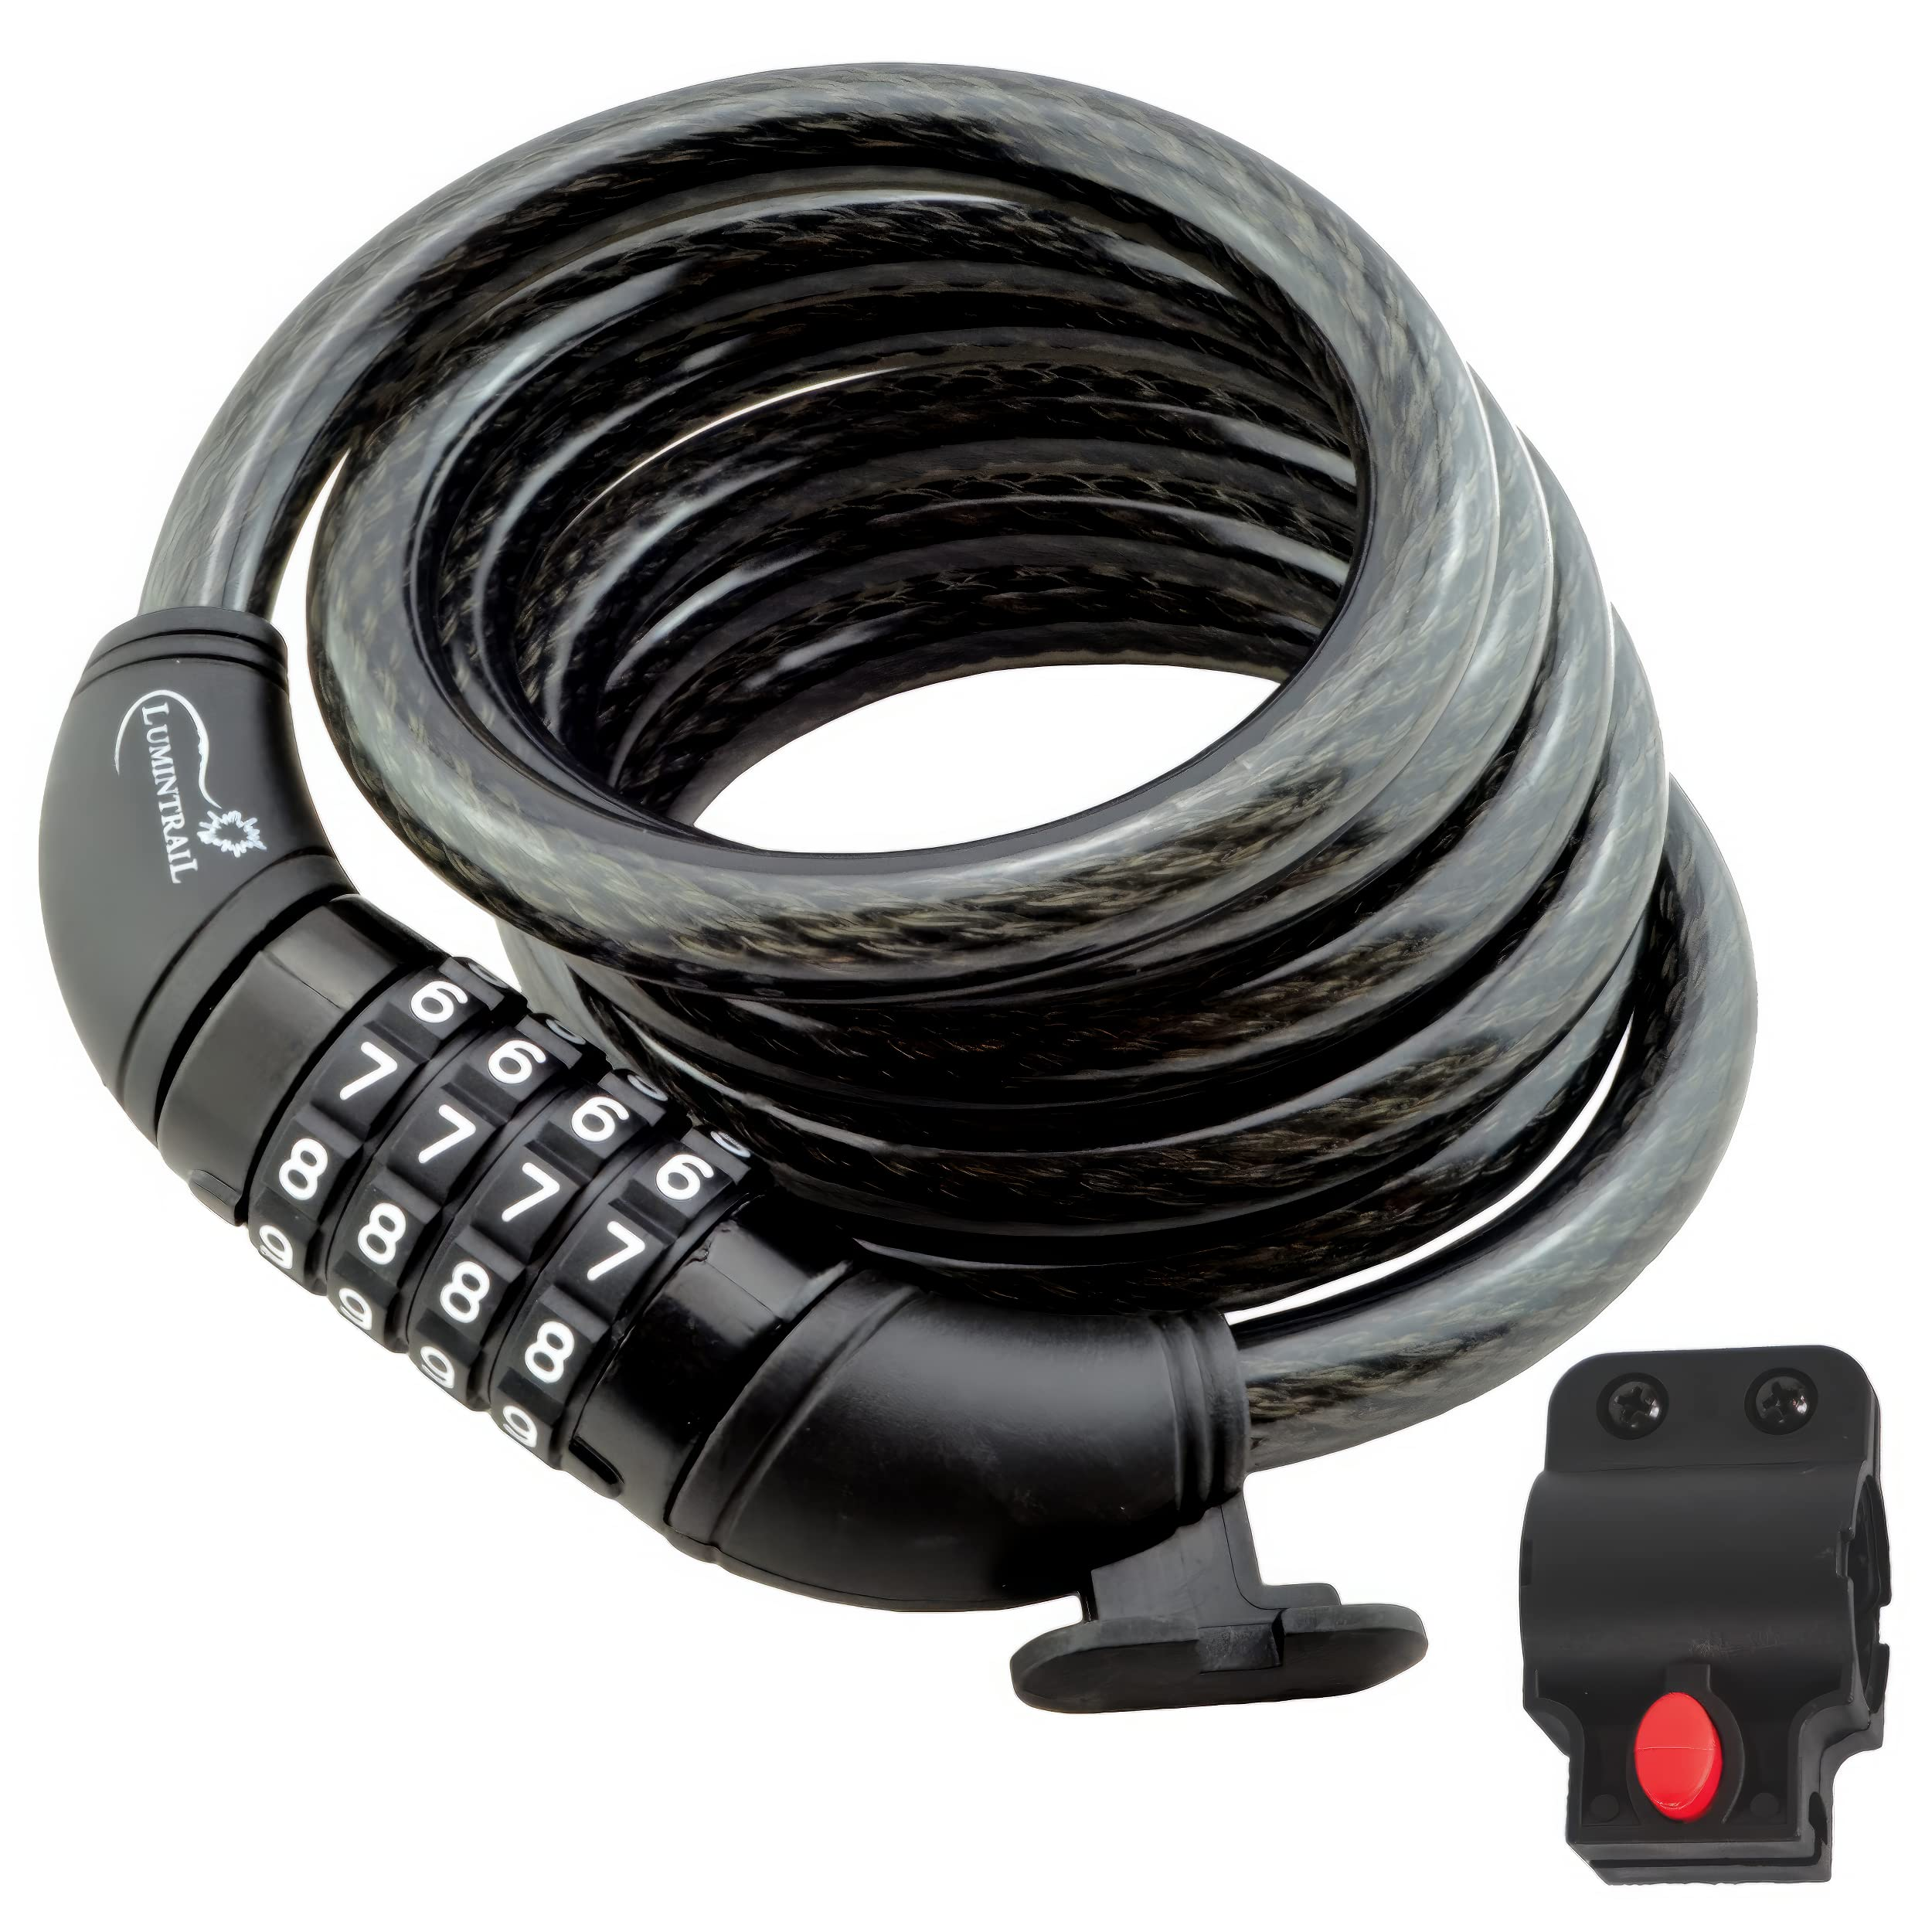
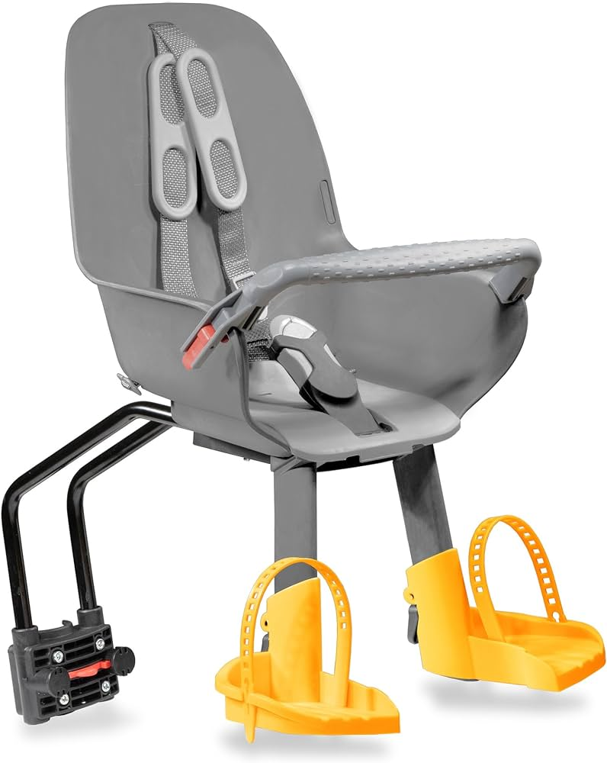
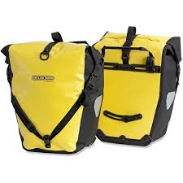
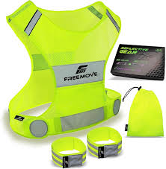
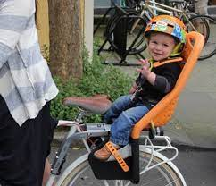
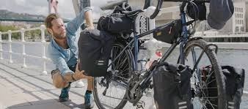
Implementation Plan
Recommended accessories for Moderate & low income customers
Bike lock
Child seat
Bike panniers
Reflective gear

Slide 15
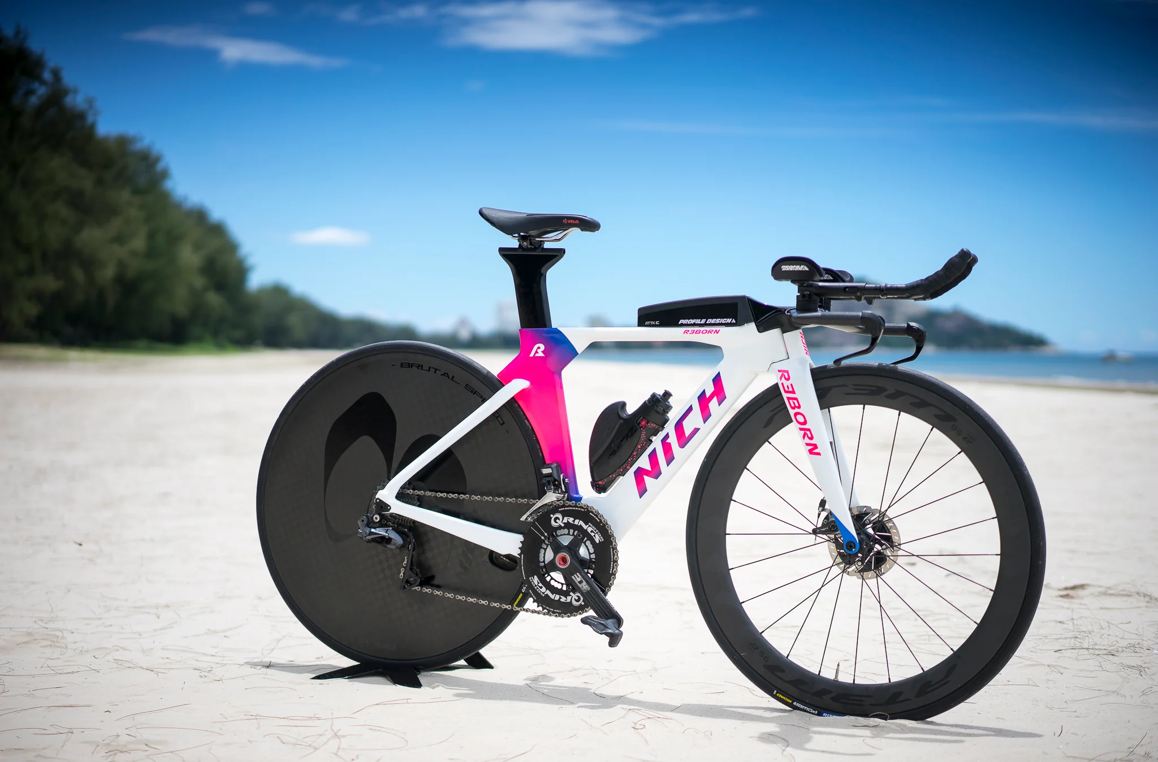
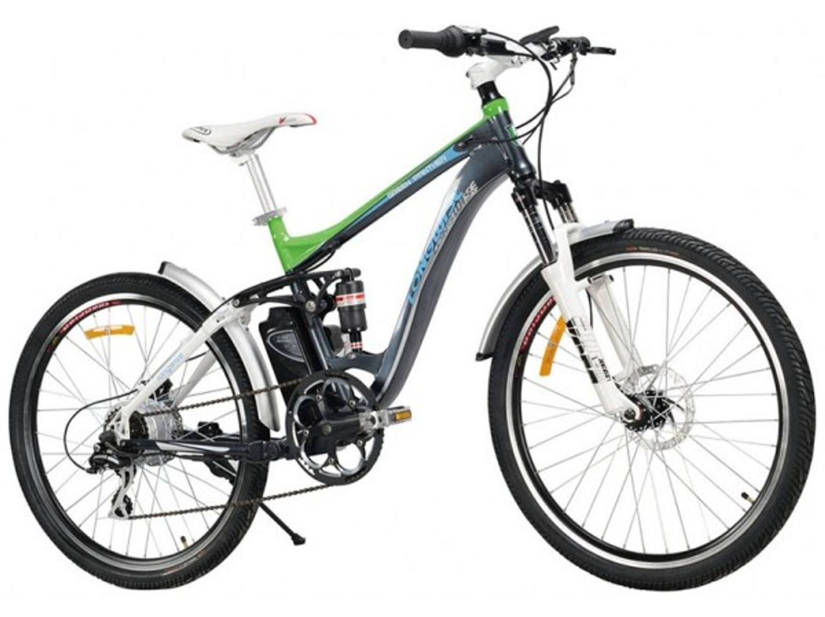
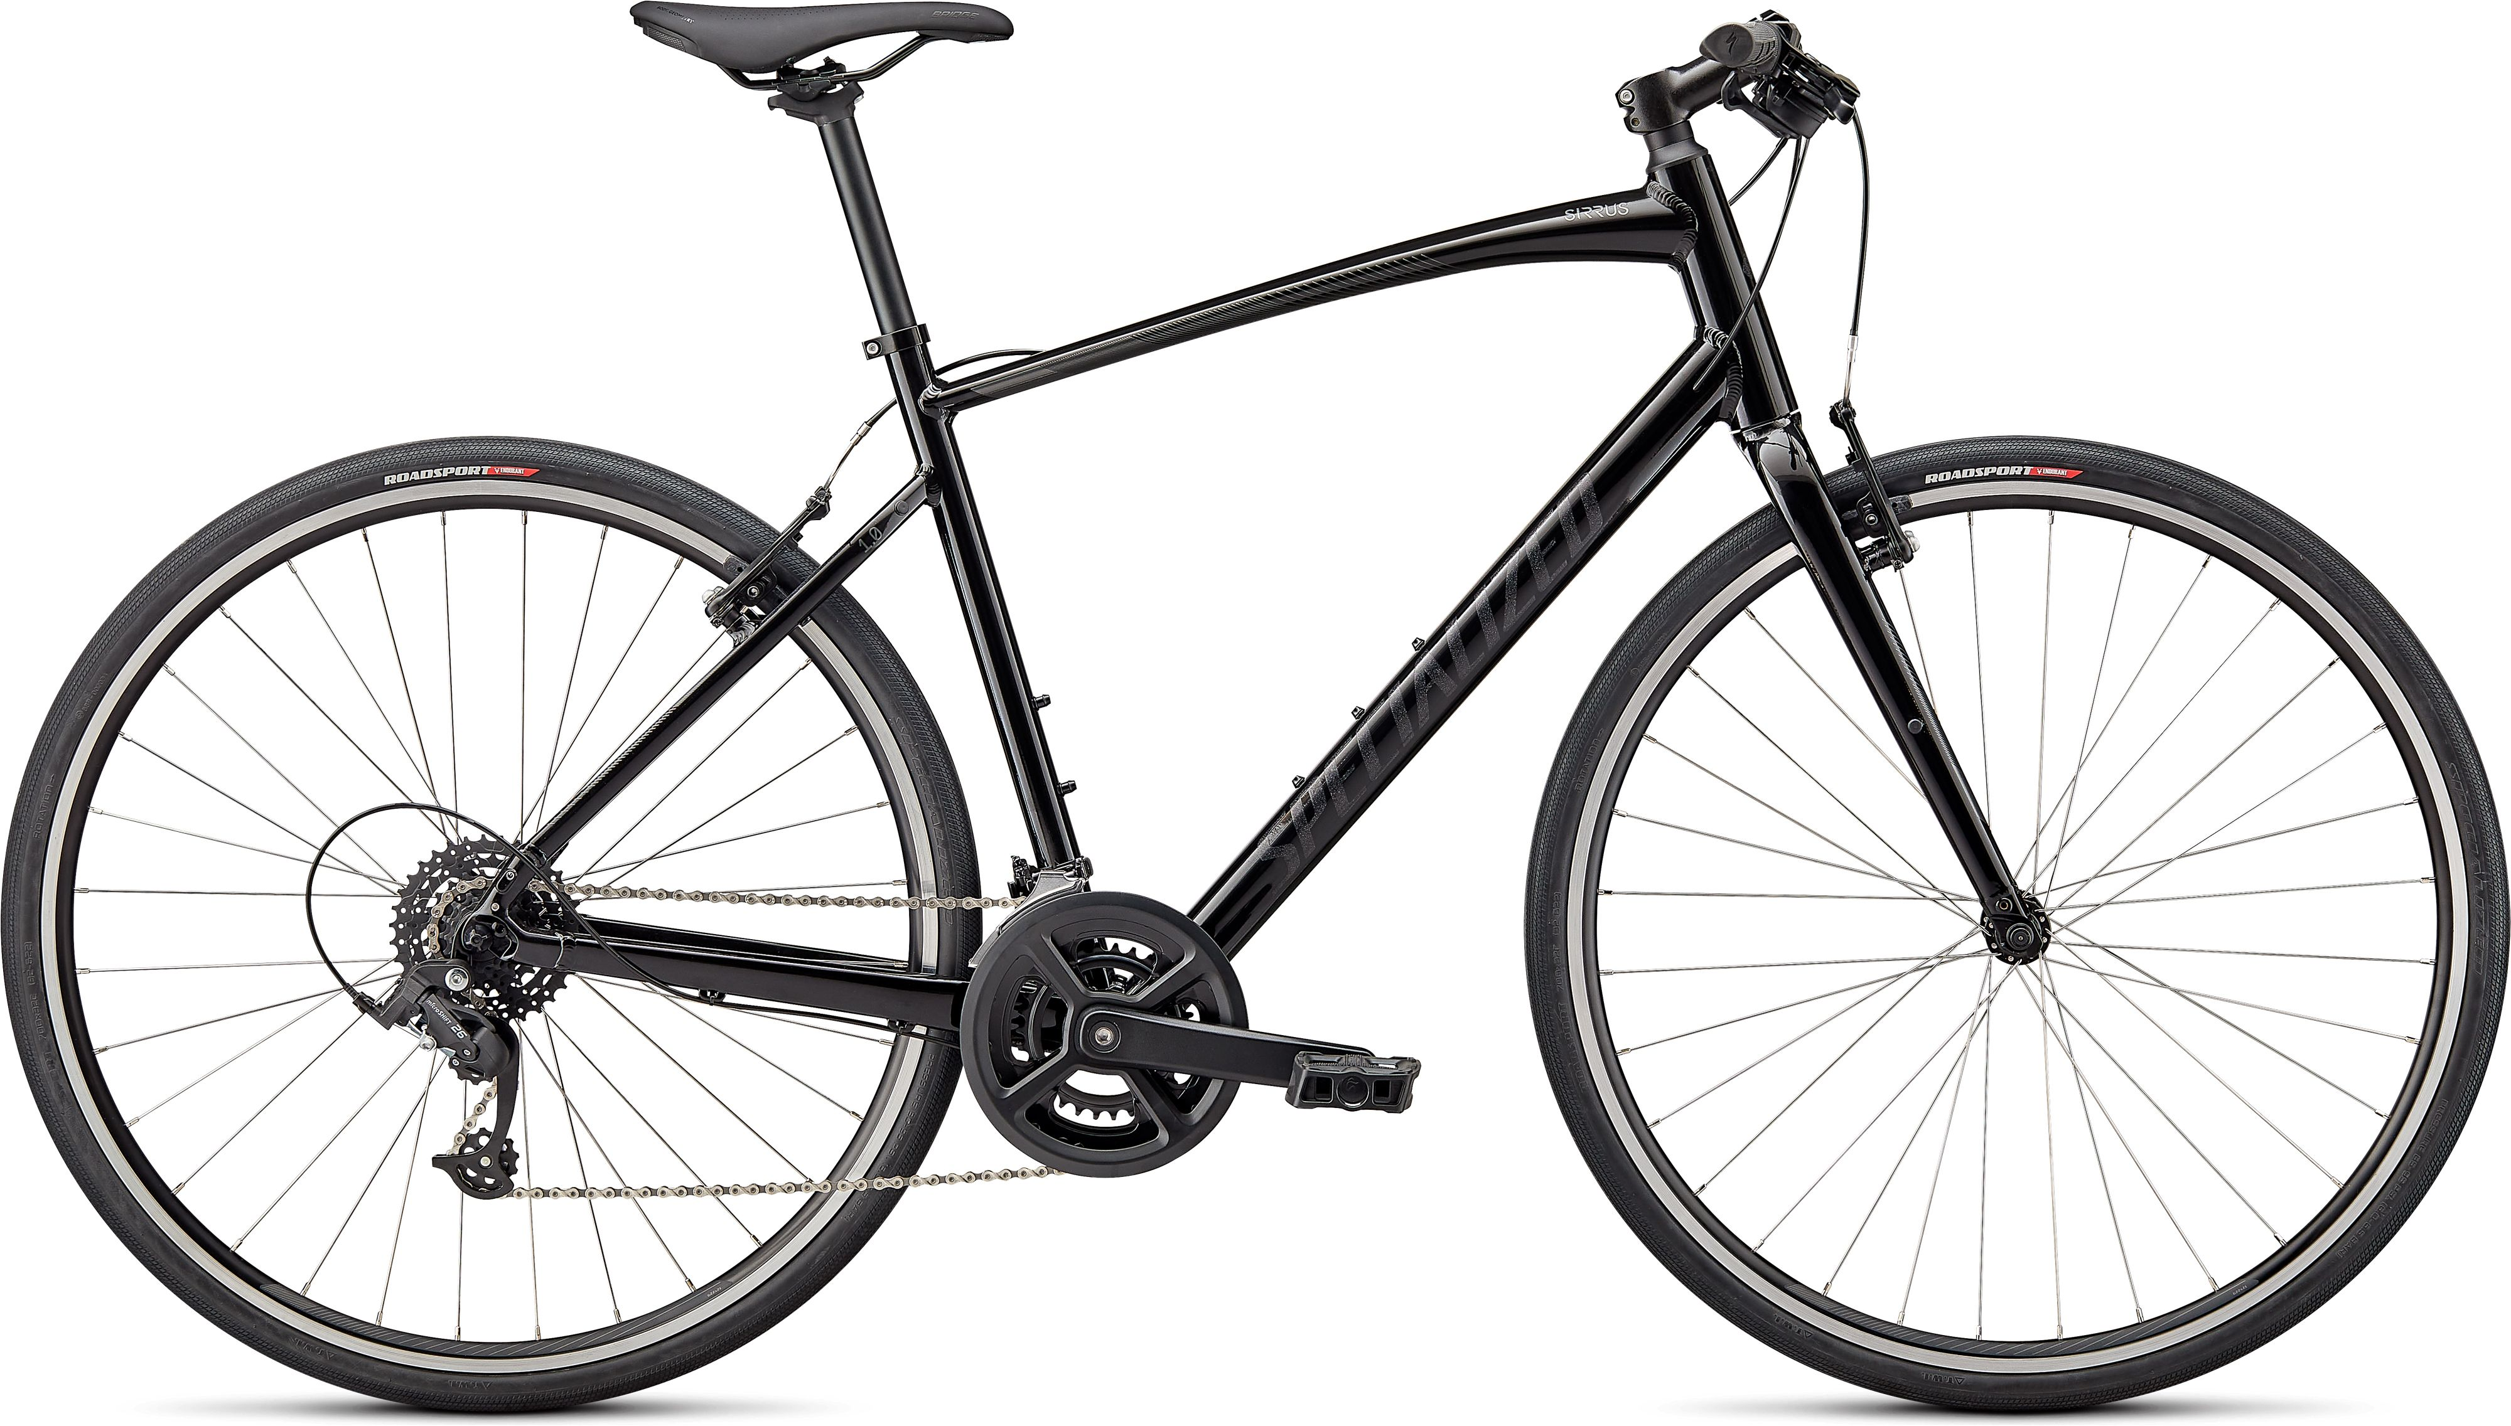
Implementation Plan
Recommended bikes for High Balance customers
Mountain bikes
(long-distance)
High performance and quality
Custom bike

Slide 16
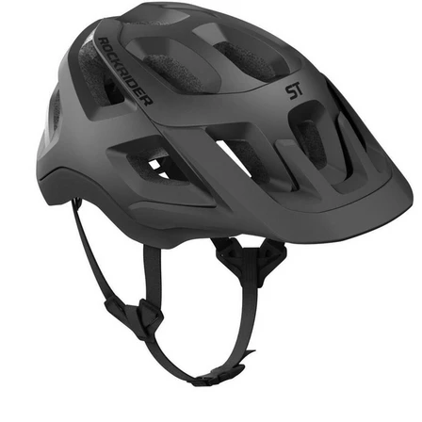
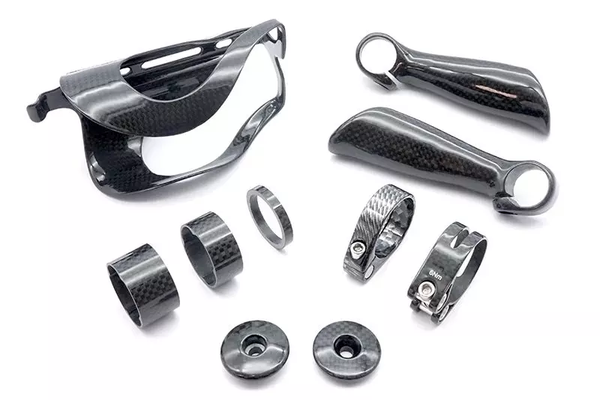
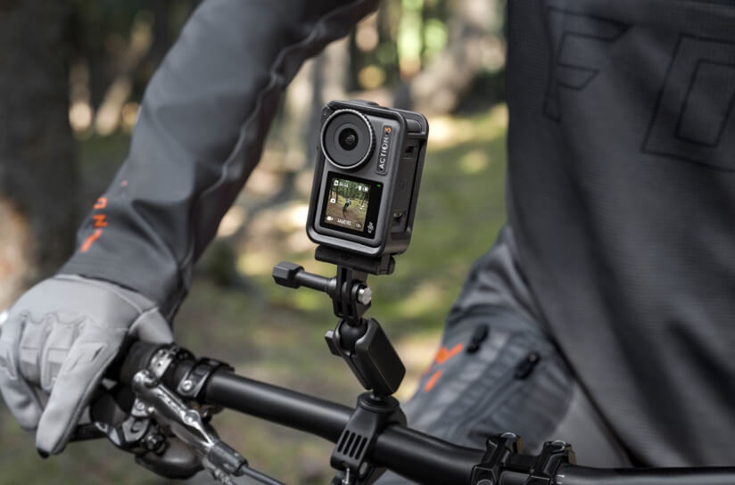
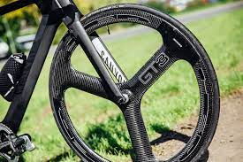
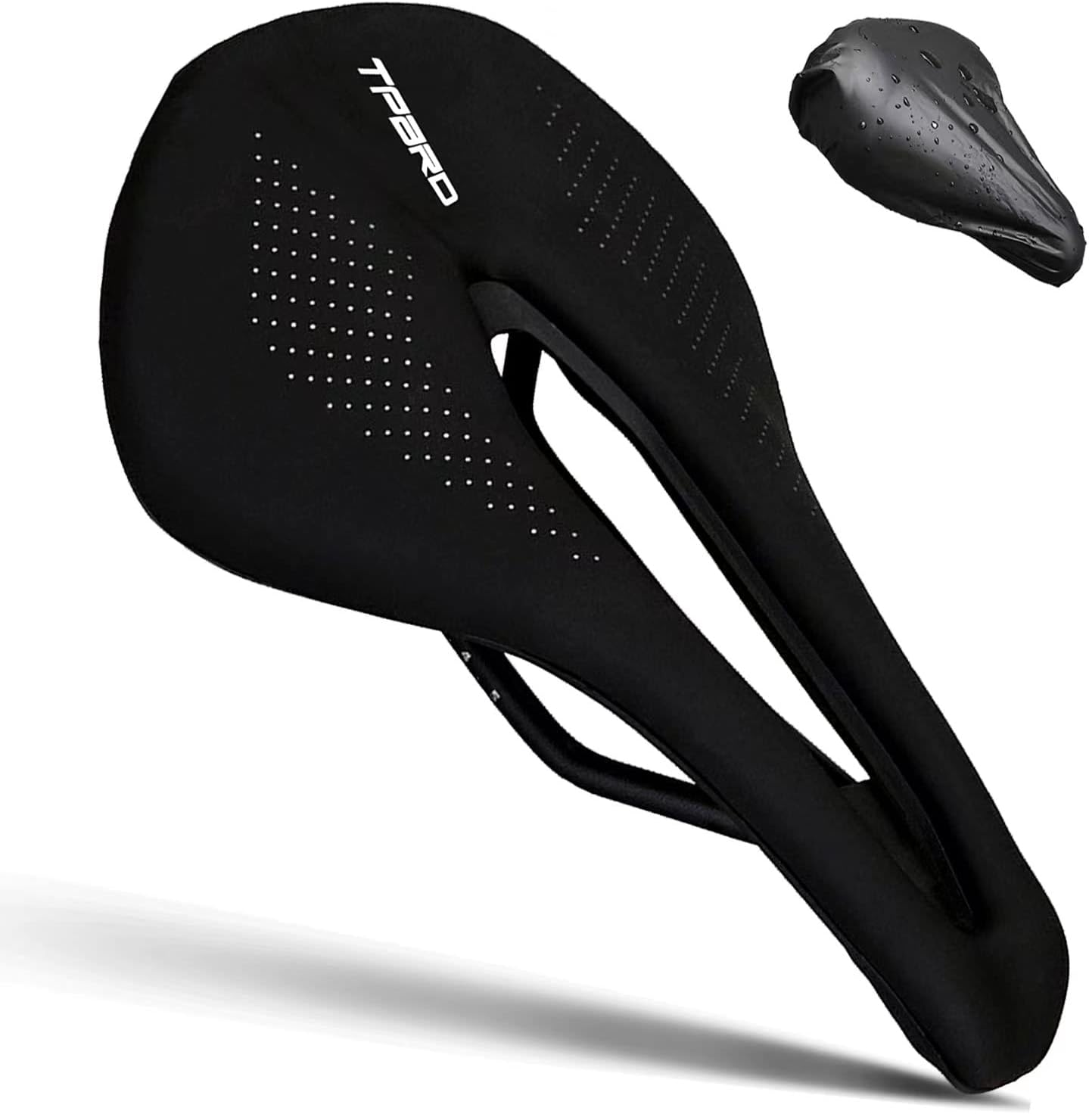
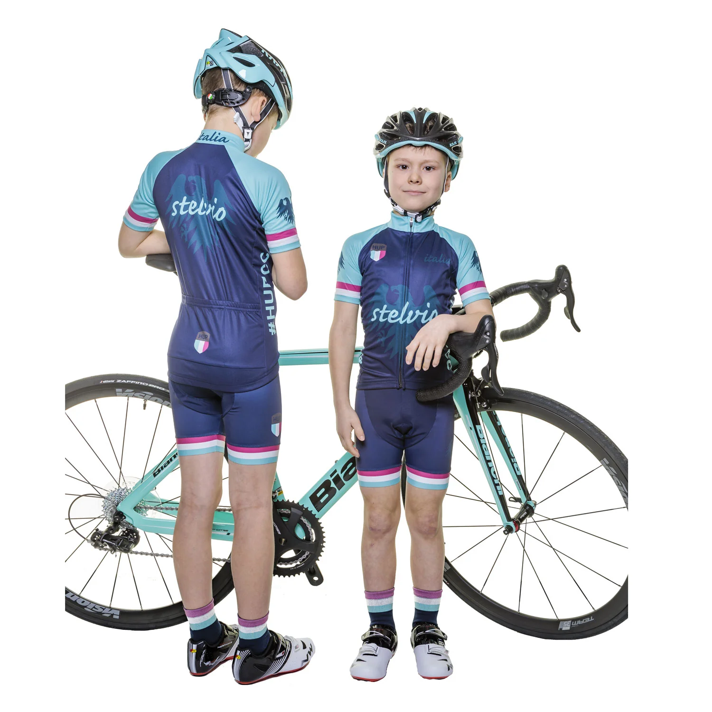
Implementation Plan
Recommended accessories for High Balance customers
High Quality Helmets
Carbon fiber accessories
Bike camera
Aero dynamic wheels
Saddle
Children's Cycling Apparel

Slide 17
Impacts and Benefits
Touring Bikes:
Touring-3000 Promotion.
Touring-1000 Promotion.
Volume Discount (11 to 14, 15 to 24, 25 to 40, 41 to 60, over 60).
Mountain Bikes:
Mountain-100 Clearance Sale:
Mountain Tire Sale:
Half-Price Pedal Sale.
Volume Discount (11 to 14, 15 to 24, 25 to 40, 41 to 60, over 60.
Road Bikes:
Road-650 Overstock.
Sport Helmet Discount-2002 and Sport Helmet Discount-2003.
LL Road Frame Sale.
Volume Discount (11 to 14, 15 to 24, 25 to 40, 41 to 60, over 60):.
No Discount.
Touring promotions :
Target right customers preferences which enhance their loyalty and increase their satisfaction.
Mountain promotions:
Increase market shares.
Selling outdated inventory.
free up capital and space.
Discount Band:
enhance loyalty.
reduce shipping cost.
order larger amount .

Slide 18
Impacts and Benefits
Loyalty programs Increase customer retentions
61% of customers believe that surprise gifts and offers are the best way to engage customers.[9]
Community building increase customer sales and loyalty
84% of buyers are more likely to buy a product recommended from someone they know or close family member. [12]
Point system increase new customers
Theskimm newspaper ambassador program attributes in 20% of growth in their companies subscribers ( 1.3 million digital subscriber) [13]
Personalization recommendation increase repeated orders
According to Monetate Personalization development studies 78% of businesses with a full or partial personalization strategy experienced revenue growth [14]

Slide 19
Conclusion
New customers are ordering less frequently than old customers though old customers are fewer (2230 customers). moderate customer and low income customers are eighty seven percent of our total customers. High balance customers prefer premium and high quality bikes.
Resellers are not taking full advantage of promotions. Most mountain resellers are running the same promotion . Valuable resellers Store had fewer discount despite their large orders.
Personalized Recommendation by collecting data on customers ,Personalized Email Marketing, Website and App Integration.
On Boarding Email implementation using email marketing automation tool , email series, Rewarding your customers , Community building , Points System, Staying up-to-date, timely follow-Ups , send gifts and surprises, and Points System.
Recommend the right bikes and accessories for customers by clear Categorization, High quality image, detailed product description , and video Demonstrations.
Targeting the right touring promotions increase customer satisfaction.
Diversifying Mountain promotions increase market shares, sell outdated inventory, and free up capital and space.
Discount Band enhance loyalty of customers, reduces shipping cost, and encourage them order larger amounts .
Loyalty programs Increase customer retentions
community building increase customer sales and loyalty
point system increase new customers
Personalization recommendation increase repeated orders

Slide 20
Questions
and Answers

Slide 21
Thank you

Slide 22
References
Turn insights into smarter marketing (no date) Mailchimp. Available at: https://mailchimp.com/insights/ (Accessed: 29 October 2023). [1]
Analytics technology and integrations - analytics 360 (no date) Google. Available at: https://marketingplatform.google.com/about/analytics-360/features/ (Accessed: 29 October 2023). [2]
WInchester, A. (2023) How to add product recommendations to your website, Software Development Sydney | Zoho Partner Australia | Zoho Developer Melbourne | CRM Development Company | Facebook Bot Development - Engaging by Design. Available at: https://humanpixel.com.au/how-to-add-product-recommendations-to-your-website/ (Accessed: 29 October 2023) . [3]
Dimitriou, M. (2023) 20 email onboarding examples you can use to increase customer loyalty in 2023, HubSpot Blog. Available at: https://blog.hubspot.com/service/email-onboarding-sequence (Accessed: 29 October 2023). [4]
Bernazzani, S. (2022) The beginner’s guide to building a customer loyalty program, HubSpot Blog. Available at: https://blog.hubspot.com/service/customer-loyalty-program (Accessed: 29 October 2023). [5]
UU1100 by Zooz Bikes. Revival Cycles. (n.d.). https://revivalcycles.com/products/uu1100-by-zooz-bikes?variant=40444244099137&currency=USD&utm_medium=cpc&utm_source=google&utm_content=&utm_campaign=17572492550&utm_term=&matchtype=&gclid=EAIaIQobChMIl-Kg46egggMVUOBRCh0E6QQUEAQYASABEgJtofD_BwE [6]
Amazon Best Sellers: Best BMX Bikes. (n.d.). https://www.amazon.com/best-sellers-bmx-bikes/zgbs/sporting-goods/3403611 [7]
https://raffisport.com/shop/sports/cycling/26-electric-mountain-bike-green-panther-e-bike/?gad_source=1&gclid=EAIaIQobChMI1PingLWgggMVnYhoCR1dhAcDEAQYAiABEgKd9vD_BwE [8]
61% of customers believe that surprise gifts and offers are the best way to engage customers. Saleslion. (n.d.). https://saleslion.io/sales-statistics/61-of-customers-believe-that-surprise-gifts-and-offers-are-the-best-way-to-engage-customers/ [9]
Solomon, M. (2018, March 12). These customer service habits can drive a company to rival Zappos, Nordstrom, virgin. Forbes. https://www.forbes.com/sites/micahsolomon/2018/03/10/the-customer-service-habit-initiative-drive-yourself-to-be-as-good-as-zappos-nordstrom-virgin/?sh=6159941c5267 [10]
Infinit-O. (2020, January 7). 10 Zappos stories that will change the way you look at Customer Service Forever. Infinit. https://resourcecenter.infinit-o.com/blog/10-zappos-stories-that-will-change-the-way-you-look-at-customer-service-forever/ [11]

Slide 23
References
Karpis, P. (2021, December 10). Why building community is critical to your brand’s success. Forbes. https://www.forbes.com/sites/paulinaguditch/2018/11/29/why-building-community-is-critical-to-your-brands-success/?sh=634039633458 [12]
Buhr, S. (2016, May 10). TheSkimm on how to rapidly grow an audience of engaged millennials. TechCrunch. https://techcrunch.com/2016/05/09/theskimm-on-a-better-way-to-serve-the-news-to-young-professionals/ [13]
Monetate, (2019) Personalization Development Study. https://info.monetate.com/rs/092-TQN-434/images/2019_Personalization_Development_Study_US.pdf [14]

