Slide 1
Pizza Sales Analysis
Presented By
Khaled Iskandarani
Date: 7/29/2024

Slide 2
Outline
Introduction
Data Sources
Data Cleaning and preparation
Key findings and Recommendations
Data Visualization
Data Model
Implementation Plan
Conclusion
Thank you

Slide 3
Introduction
Pizza Restaurant is a restaurant that sells pizzas of various types.
Provide insights and recommendations to address these challenges:
Daily Customers and Peak Hours.
Count of Pizzas in An Order and Best Sellers.
Yearly, Monthly, and Quarterly Revenue.
Pizzas to take off menu.
Pizzas that requires Promotions.
Most and Least Used Ingredients

Slide 4
Data Sources
Pizza Place Sales A year's worth of sales from a fictitious pizza place, including the date and time of each order and the pizzas served, with additional details on the type, size, quantity, price, and ingredients.

Slide 5
Data Cleaning and Preparation
Data Source: MavenAnalytics.
Data Extraction and Transformation: data-extraction.docx
Data Validation :data-validation.docx
Data Tools : Sql Server Management Studio.

Slide 6
Key findings and Recommendations
Key Findings
Recommendation
The Peak Hours are from (12 to 13 p.m) and from (16 to 19 p.m).
The off-peaks are from (9 to 11 a.m) and from (21 to 23 p.m)
Increase kitchen and customer service staff during busy times.
Ensure sufficient ingredients and supplies are available during peak hours.
Prepare common items in advance for faster service.
Use online or phone ordering to reduce wait times.
Offer special deals during off-peak hours to balance customer flow.

Slide 7
Key findings and Recommendation
Key Findings
Recommendations
Top Pizzas: Classic Deluxe Pizza, Barbecue Chicken Pizza, Hawaiian Pizza, Pepperoni Pizza, Thai Chicken Pizza, and California Chicken Pizza.
Prioritize stocking ingredients for your top pizzas to prevent shortage and having necessary items.
Keep track of ingredients usage patterns to forecast on-demand.
Offer promotions like Top Pizza + Lesser-Known Pizza Combo to encourage trying something new.
Consider negotiating with suppliers for better bulk offers preserving quality.

Slide 8
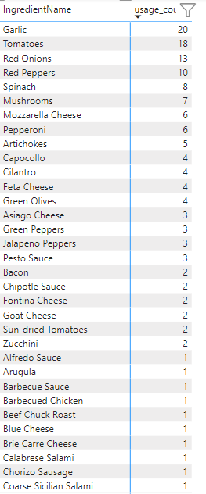
Key findings and Recommendation
Most And Least Used Ingredients
Recommendations
Order less of less frequently used ingredients to prevent overstocking .
Consider adjusting recipes or creating new ones that use these ingredients more efficiently.
Use seasonal or promotional menus to incorporate less frequently used ingredients.
Better pricing, consistent quality and priority delivery with suppliers from knowing most used ingredients.
maintain minimum stock levels to ensure you never run out of key ingredients.

Slide 9
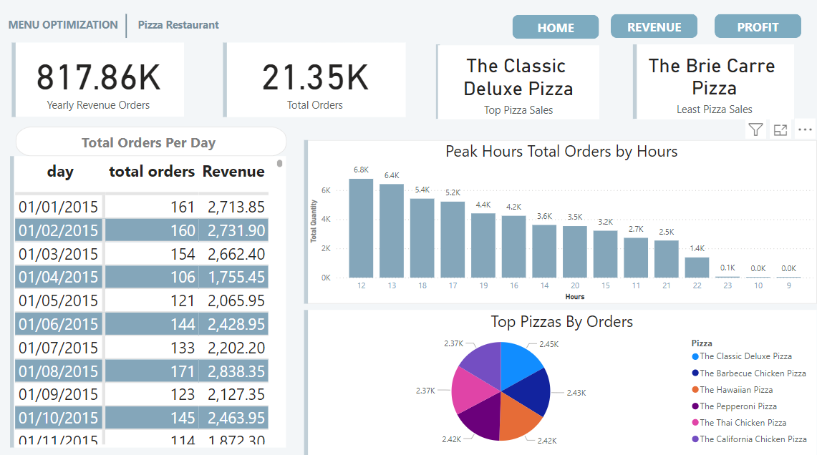
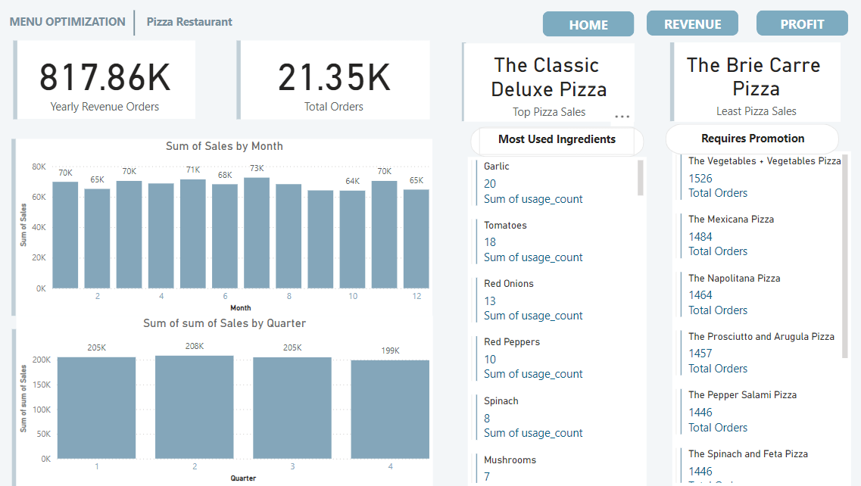
Data Visualization
Home Page
Revenue Page

Slide 10
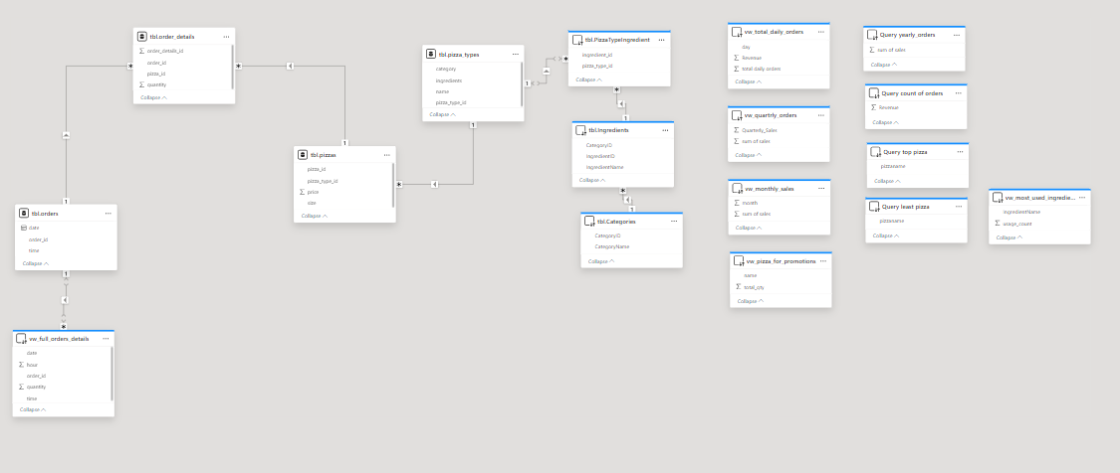
Data Model

Slide 11
Peak Hours Implementation Plan
Ensure Timely Delivery with suppliers. Especially before peak hours.
Create a dynamic staffing schedule that increases the number of employees
during peak hours (12 PM - 1 PM and 4 PM - 7 PM) and reduces it during slower periods.
Ensure proper storage facilities are available to keep pre-prepared items fresh and safe.
Develop protocols to pre-preparing ingredients pics in advanced during off-peak hours.

Slide 12
Top Pizzas
Implementation Plan
Stock Management:
Set Par Levels: Establish minimum stock levels (par levels) for these ingredients to ensure you never run out.
Regular Orders: Schedule regular inventory checks and place orders to maintain stock levels.
Create Combo Deals:
Design Combos: Develop promotions that pair a popular pizza with a lesser-known one, such as “Top Pizza + Lesser-Known Pizza Combo”.
Pricing Strategy: Set attractive pricing for these combos to encourage customers to try new items.
Promotion Strategy:
Marketing Channels: Promote these deals through social media, your website, email newsletters, and in-store signage.
Track Performance: Monitor the effectiveness of these promotions and customer response

Slide 13
Ingredients Usage
Implementation Plan
Recipe Development:
Review Current Recipes: Identify existing recipes that could incorporate less frequently used ingredients.
Create New Recipes: Develop new recipes that feature these ingredients, ensuring they add value and appeal to customers.
Develop Seasonal Menus:
Plan Menus: Create seasonal menus that feature less frequently used ingredients to take advantage of specific times of the year.
Design Promotions: Develop promotional campaigns around these seasonal items to attract customer interest.
Set Par Levels:
Determine Minimum Levels: Establish minimum stock levels (par levels) for key ingredients to ensure availability during peak times.
Implement Reordering System: Set up an automatic reordering system that triggers when stock falls below par levels.

Slide 14
Conclusion
To address key challenges in managing your pizza restaurant, focus on optimizing staffing during peak hours and streamlining kitchen operations. Highlight and promote your top-selling pizzas while considering special deals for them. Regularly review revenue trends to make informed financial decisions and adjust your menu by removing underperforming pizzas. Use targeted promotions to boost sales of pizzas needing a push. Efficiently manage ingredient inventory by ordering less of infrequently used items and ensuring a steady supply of popular ones. By implementing these strategies, you can improve efficiency, boost sales, and enhance customer satisfaction.

Slide 15
Thank you

