Slide 1

Retail Analysis
Presented By
Khaled Iskandarani
Submitted to
The Spark Foundation
Date:12/7/2023

Slide 2
Outline
Introduction
Data Sources
Data Cleaning and preparation
Key findings and Recommendations
Data Visualization
Implementation Plan
Conclusion
Thank you
References

Slide 3
Introduction
Superstore sales is a Regional sales company that sells for both products for consumers, corporates and home offices.
Provide insights and recommendations to address these challenges:
Low Sales in South and Central Region.
Low Profit Margin in some cities and Regions
Impact of Discount conflicts on profit margin.
Low sales in product categories.

Slide 4
Data Sources
“SampleSuperStore" from SparkFoundation
It contains Store Table with different attributes from cities to sales and profit.
The data is about international business that sells globally.

Slide 5
Data Cleaning and Preparation
Data Source : https://bit.ly/3i4rbWl.
Data Extraction and Transformation: Data-extraction.docx
Data Validation :Data-validation.docx
Data Tools : Sql Server Management Studio,DAX.

Slide 6
Key findings and Recommendations
Profit
Recommendation
Burlington city is causing us losing profit (-3,311 $)
We are losing in city by profit like Philadelphia (-13,837 $)
Use standard shipping mode instead of shipping at the same day
Implementing points system , staying up-to-date, timely follow-ups instead of giving high discount that can cause low gross margin

Slide 7
Key findings and Recommendation
Sales
Recommendations
South Region is the least region with sales
Furniture is the least gross margin and sales
Implement customer Loyalty programs
Don’t ship at the same day it make lower margin profit
Cost optimization Negotiate with suppliers, explore alternative materials, and implement efficiency measures in the production process.

Slide 8
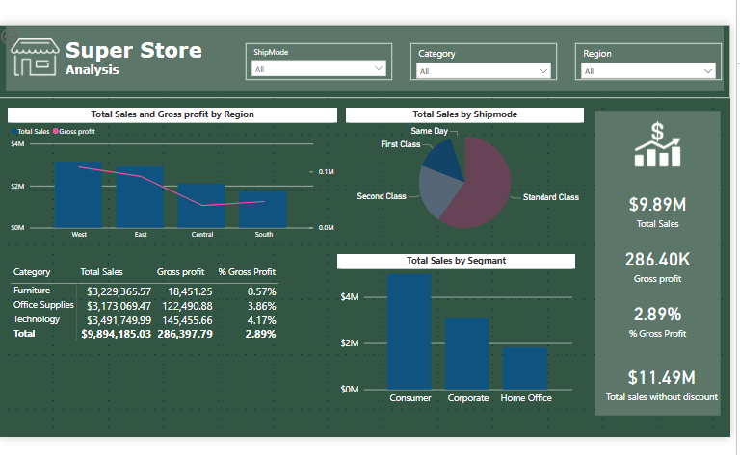
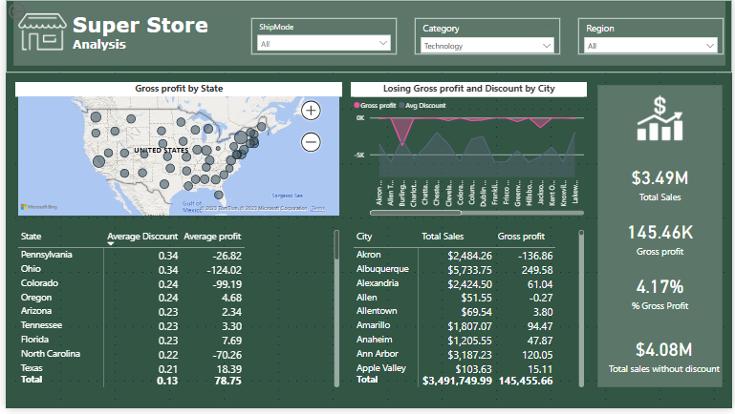
Data Visualization
Sales Page
Profit Page

Slide 9
Implementation Plan
loyalty programs [5]
Reward your customers (exclusive promotion)
Community building ( Making events like extreme sports) [11]
Points System (theskimm ambassador program)[13]
Staying up-to-date
Timely Follow-Ups
Send gifts and surprises [10]

Slide 10
Conclusion
Targeting the right promotions increase customer satisfaction.
Discount Band enhance loyalty of customers, reduces shipping cost, and encourage them order larger amounts .
Loyalty programs Increase customer retentions
community building increase customer sales and loyalty
point system increase new customers

Slide 11
Thank you

Slide 12
References
Bernazzani, S. (2022) The beginner’s guide to building a customer loyalty program, HubSpot Blog. Available at: https://blog.hubspot.com/service/customer-loyalty-program (Accessed: 29 October 2023). [5]
can drive a company to rival Zappos, Nordstrom, virgin. Forbes. https://www.forbes.com/sites/micahsolomon/2018/03/10/the-customer-service-habit-initiative-drive-yourself-to-be-as-good-as-zappos-nordstrom-virgin/?sh=6159941c5267 [10]
Infinit-O. (2020, January 7). 10 Zappos stories that will change the way you look at Customer Service Forever. Infinit. https://resourcecenter.infinit-o.com/blog/10-zappos-stories-that-will-change-the-way-you-look-at-customer-service-forever/ [11]
Buhr, S. (2016, May 10). TheSkimm on how to rapidly grow an audience of engaged millennials. TechCrunch. https://techcrunch.com/2016/05/09/theskimm-on-a-better-way-to-serve-the-news-to-young-professionals/ [13]

