Slide 1
Khaled Iskandarani

Slide 2

Sport Analysis
Presented By
Khaled Iskandarani
Submitted to
The Spark Foundation
Date:12/15/2023

Slide 3
Outline
Introduction
Data Sources
Data model diagram
Data Cleaning and preparation
Key findings
Data Visualization
Conclusion
Thank you
References

Slide 4
Introduction
Indian Premier League (better known as IPL) is a short format (T-20) Mens Cricket tournament that is hosted in India.
Provide insights and recommendations to address these challenges:
Most balls bowled per season
Top ten wicket takers
Top ten fielders
Highest strike rate
Relationship between strike rate and balls played
Average of wins by wickets/runs for teams
Bowling average by teams

Slide 5
Data Sources
“EDA-Indian Premier League 2008-2019"
It contains two tables matches and deliveries.
The data is about Indian Premier League games from 2008 to 2019.

Slide 6
Data Cleaning and Preparation
Data Source : https://bit.ly/34SRn3b.
Data Extraction and Transformation: documents\Data-extraction.docx
Data Validation :documents\Data-validation.docx
Data Tools : Sql Server Management Studio, DAX, Microsoft Excel.

Slide 7
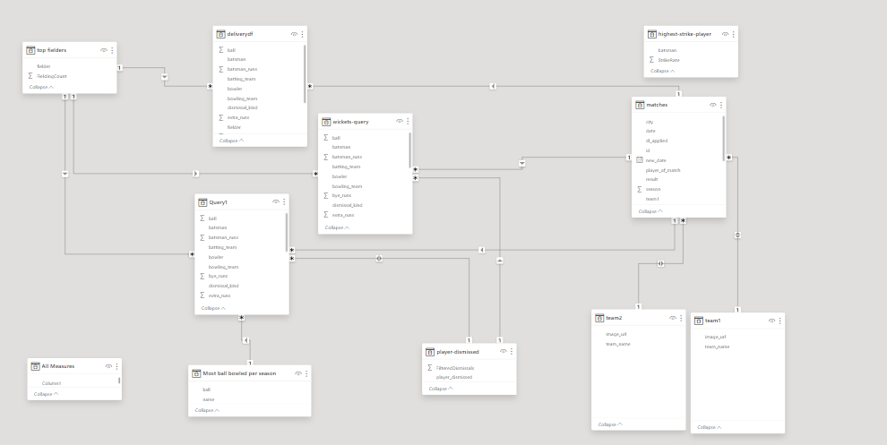
Data Model Diagram

Slide 8
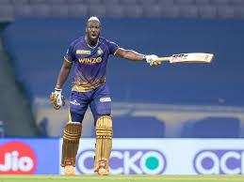
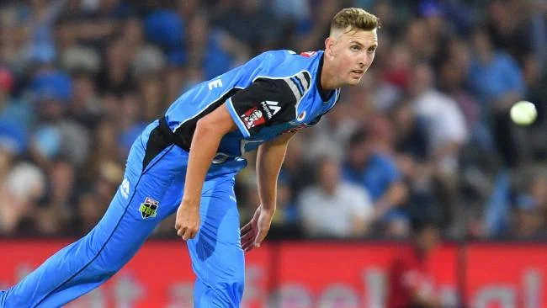
Key findings
MS Dhoni
Andre Russell has the highest strike rate.
Billy Stanlake has scored 5 runs from 2 balls- which makes his strike rate as high as 250.00.
when players play a lot of matches the strike rates get fixed near a nearly constant value.

Slide 9
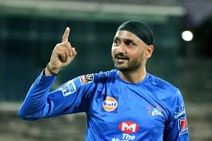
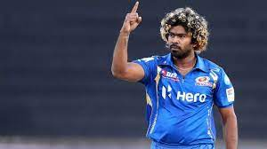
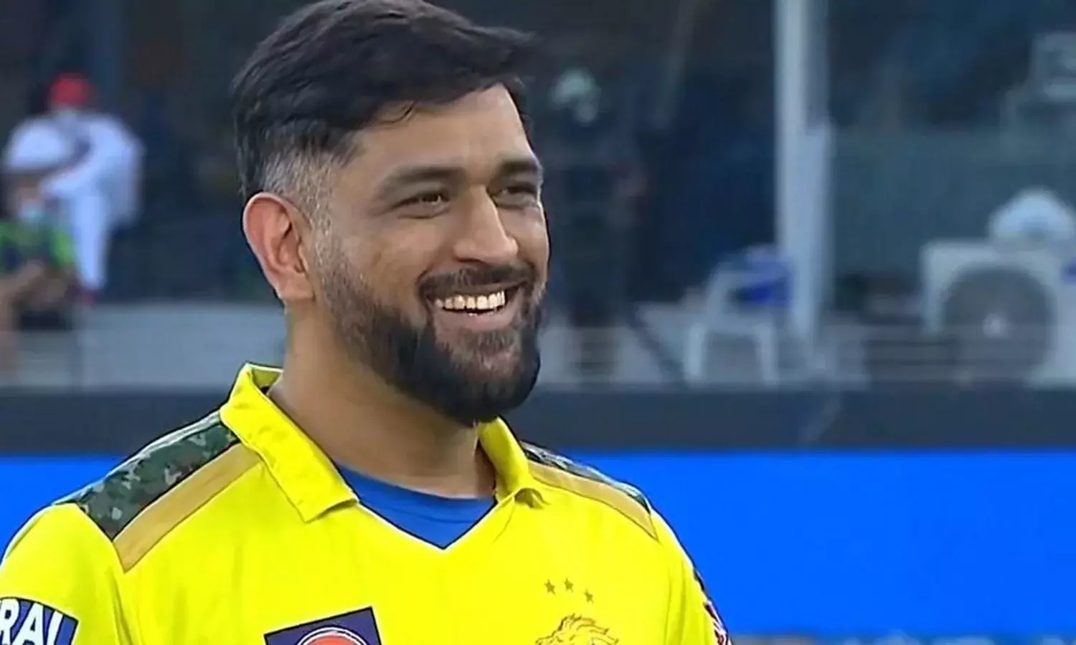
Key findings
MS Dhoni
Harbhajan Singh was the most ball bowled per season.
SL Malinga is the highest wicket taker of all time followed by A Mishra.[1]
Mahendra Dhoni is best fielder and wicket keeper[2]

Slide 10
Key findings
MS Dhoni
The second innings Batting and Bowling averages are less as compared to the first innings.
While the majority of teams have secured victories with an average margin of 10 or more runs, only two teams, Gujarat Lions and Kochi Tuskers Kerala, have exhibited values below 5.

Slide 11
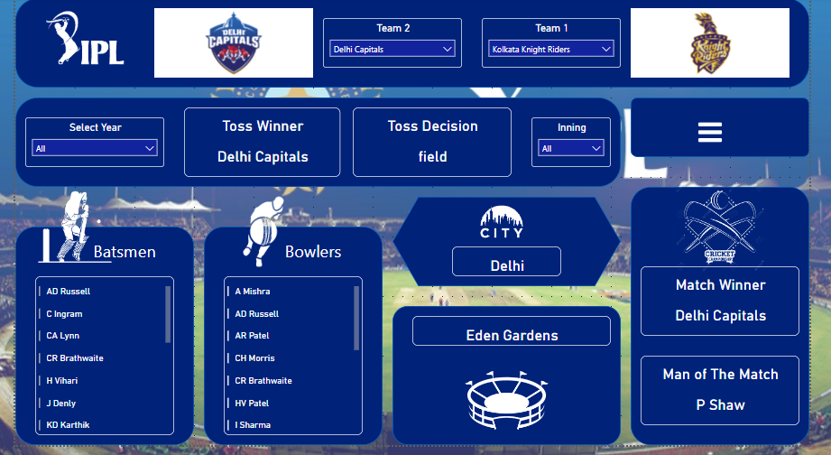
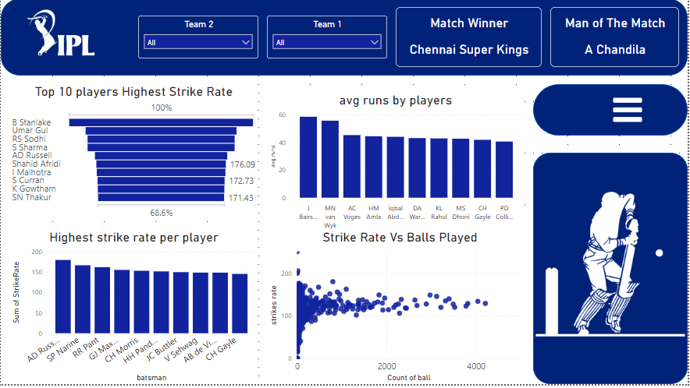
Data Visualization
Overview Page
Batsman Page

Slide 12
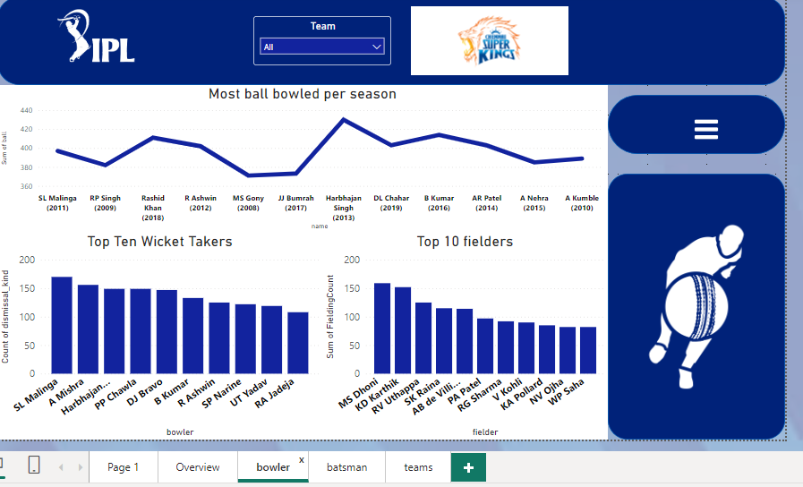
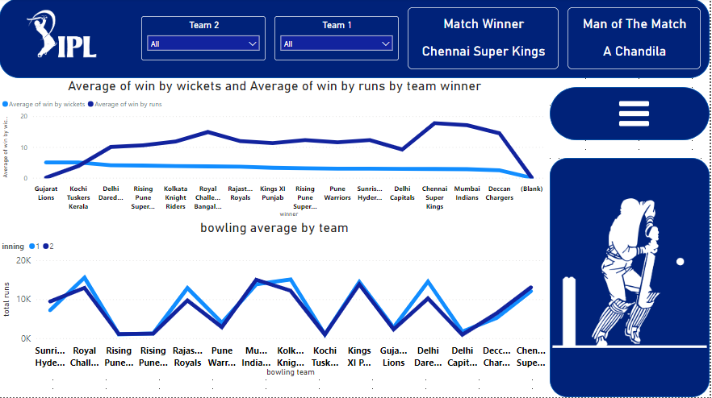
Data Visualization
Bowler Page
teams Page

Slide 13
Conclusion
The Batting and Bowling Averages of most of teams are better in the First innings-as compared to the second innings.
when players play a lot of matches the strike rates get fixed near a nearly constant value.
The above analysis gives us the IPL matches and stats of different top players.

Slide 14
Thank you

Slide 15
References
sl malinga wicket taker - Google Search. (n.d.). https://www.google.com/search?q=sl+malinga+wicket+taker&client=firefox-b-d&sca_esv=590984977&tbm=vid&sxsrf=AM9HkKkOtZdvJwadTd5fl46XbvsgwOmiTw:1702584414258&source=lnms&sa=X&ved=2ahUKEwi7w9iZ3Y-DAxXZif0HHXCADLUQ_AUoAXoECAQQAw&biw=1366&bih=643&dpr=1#fpstate=ive&vld=cid:417e3910,vid:nclPaVQmCHc,st:0 [1]
Xtra Innings. (2021, October 24). 10 Lightning fast stumpings of MS Dhoni || [Video]. YouTube. https://www.youtube.com/watch?v=fYM2VRrCPQ4[2]

