Slide 1

Game
JavaScript
The programming language of the web

Slide 2

About the Game JavaScript
Netscape wanted to make the web more Dynamic
So It thought about how about making a scripting language.
Netscape hired Brendan Eich for that reason.
To defend this idea, Netscape needs a prototype.
So Eich made the prototype in 10 days
JavaScript first name was mocha ☺
JavaScript Second name was Live Script
Brendan Eich
JavaScript third and final name was JavaScript
JavaScript Inventor
No … No… It has another name EchmaScript

Slide 3
Start Game

Slide 4
1
level
Data, Variables, Operators, Decisions, Loops

Slide 5
Hello world Example
window.alert(‘Hello World’)
OR
document.write(‘Hello World’);
OR
console.log(‘Hello World’);

Slide 6
JavaScript Syntax
JavaScript is case sensitive
JavaScript statements are separated by semicolons (;) (optional But Best Practice).
Variable Names follows this rules:
the first character must be a letter, an underscore (_), or a dollar sign ($).
Subsequent characters may be letters, digits, underscores, or dollar signs.
Var is not equal to var
We will know Why later !
$dollar (√ ) _underScore (√ ) name (√ ) 12twelve (x)
$do22ar twelve12

Slide 7
Variables : declaring a variable
var name;
OR
var name, age, email;
OR
var name, age=12;

Slide 8
Data Types
String
Number
Boolean
Array
Object
Null
Undefined
Primary
Data Types
Composite
Data Types
Special
Data Types

Slide 9
Data Types : Primary
String
Number
Boolean
Any character array or text quoted
Any Numeric value but not quoted
Has only two values true or false
Examples:
var str1=“hello JS”;
var str2=’11.26’;
var str3=’false’;
Examples:
var num1= 8;
var num2= 11.26;
Example:
var isBool= true;
var isStr= false;

Slide 10
Data Types : Special
Null
undefined
This describes the no valid value ,
And has only one value null
The undefined value is returned when you declare a variable that has never had a value assigned to it.
Examples:
var thisIsNull = null;
Examples:
var num1; //num1 is undefined

Slide 11
Data Types : JavaScript is Dynamic
var var1;
//its type is undefined
var1 =“ahmed”;
//its type is string
var1 =12;
//its type is number
var1 = true;
//its type is boolean

Slide 12
Data Types : how to check on the variable type
var name;
typeof name; //undefined
name =“ahmed”;
typeof name; //string
name = null;
typeof name; //object How??
Built in 10 days ☺

Slide 13
Operators: Arithmetic
Operator | Example | Same As
= | x = y | x = y
+= | x += y | x = x + y
-= | x -= y | x = x - y
*= | x *= y | x = x * y
/= | x /= y | x = x / y
%= | x %= y | x = x % y

Slide 14
operator
String
Number
Boolean

Slide 15
Operators: Logical
Operator | Description
== | equal to
=== | equal value and equal type
!= | not equal
!== | not equal value or not equal type
> | greater than
< | less than
>= | greater than or equal to
<= | less than or equal to
? | ternary operator

Slide 16

Fight No#1
==
===

Slide 17
Operators: Type
Operator | Description
typeof | Returns the type of a variable
instanceof | Returns true if an object is an instance of an object type

Slide 18
Conditions
if
Condition 1
Commands 1
else if
Condition 2
Commands 2
else if
Condition n
Commands n
else
Default
Default Commands

Slide 19
Conditions : falsy values
if (name) {
alert(“hi”);
}else{
alert(“Bye”);
}
If name has falsy value it will execute the code in the Else statement
So what is the falsy values :
0 , false, null ,undefined, “”

Slide 20
While Loop
Condition:
(Green === true && Red === false)
while
{
Command:
Car.move();
}

Slide 21









For Loop
5
for(var i=0;i<5;i++){
Bottle.fill(cup,water);
i=5
i=2
i=3
i=4
i=0
i=1
< 5
= 5
For loop will finish executing here
}

Slide 22
Fight No#2
Continue
Break

Slide 23
alert
alert(text);
Return : Doesn’t Return any value
alert(“Hello JavaScript!”);
OR
var greetings = “Hello JavaScript!”;
alert(greetings);

Slide 24
prompt
prompt(text, default return value);
Return : String
var person = prompt("Please enter your name", “Ahmed");
alert(person); //person = Ahmed

Slide 25
confirm
confirm(message)
Return : Boolean
var isReady = confirm(“Are you ready?");
if(isReady){
alert(“Yes”);
}else{
alert(“No”);
}

Slide 26
Excellent, You have exceed level 1
1
level

Slide 27
2
level
Scope, Functions, Objects, Strings, Arrays & Math

Slide 28
Functions
Function
name
Parameters
Commands
Return Values
function name(parameter1, parameter2, parameter3) { code to be executed
return true; }
function multiply(num1,num2) { var result = num1 * num2;
return result; }
Calling it:
var result = multiply(3,4);
alert(result); // result = 12

Slide 29
Scope
Global Scope
var globalVar = 0;
function1
function2
{
var funcOneVar = 1;
globalVar++;
console.log(globalVar);
console.log(funcTwoVar);
}
{
var funcTwoVar = 4;
globalVar++;
console.log(funcTwoVar);
console.log(funcOneVar);
}
function1();
function2();
console.log(globalVar);
console.log(funcOneVar);
Result:
1
Undefined
4
Undefined
2
undefined

Slide 30
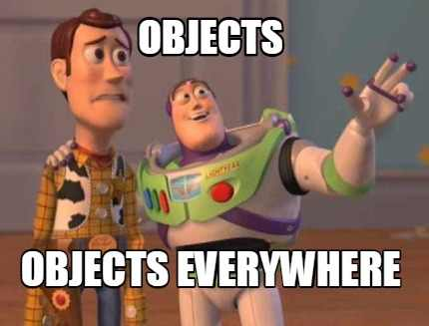
Objects
Everything in JavaScript is an Object

Slide 31
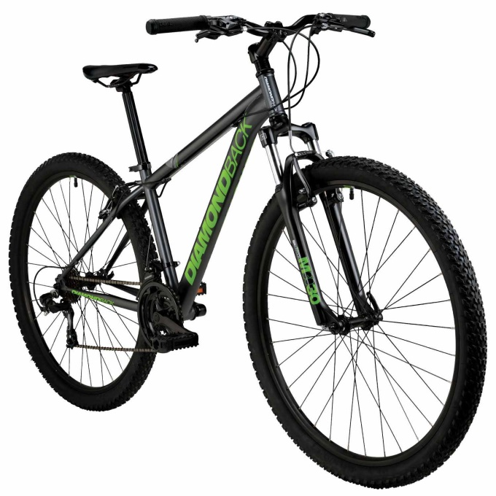
Objects (cont…)
It has characteristics
Properties
Bike.color
Bike.height
Bike.width
Bike.weight
Bike.move()
Bike.stop()
Bike.brake()
Bike.jump()
Bike is an Object
Methods
It does some actions

Slide 32

Objects (cont…)
var obj = {
name: ‘ali’,
age: 19,
isEgyptian: true
}
‘name’
:
“ali”
Keys
‘age’
:
19
Values
‘isEgyptian’
:
true
That’s Enough for now !

Slide 33
Play with Strings
var message = “this is string and we will change it”
valueOf()
slice()
substr()
replace()
toUpperCase()
toLowerCase()
charAt()
charCodeAt()
Code Break
</>

Slide 34
Play with Numbers
var myNum = 11.25
Number()
parseInt()
parseFloat()
toFixed()
toPrecision()
toString()
toExponential()
Code Break
</>

Slide 35
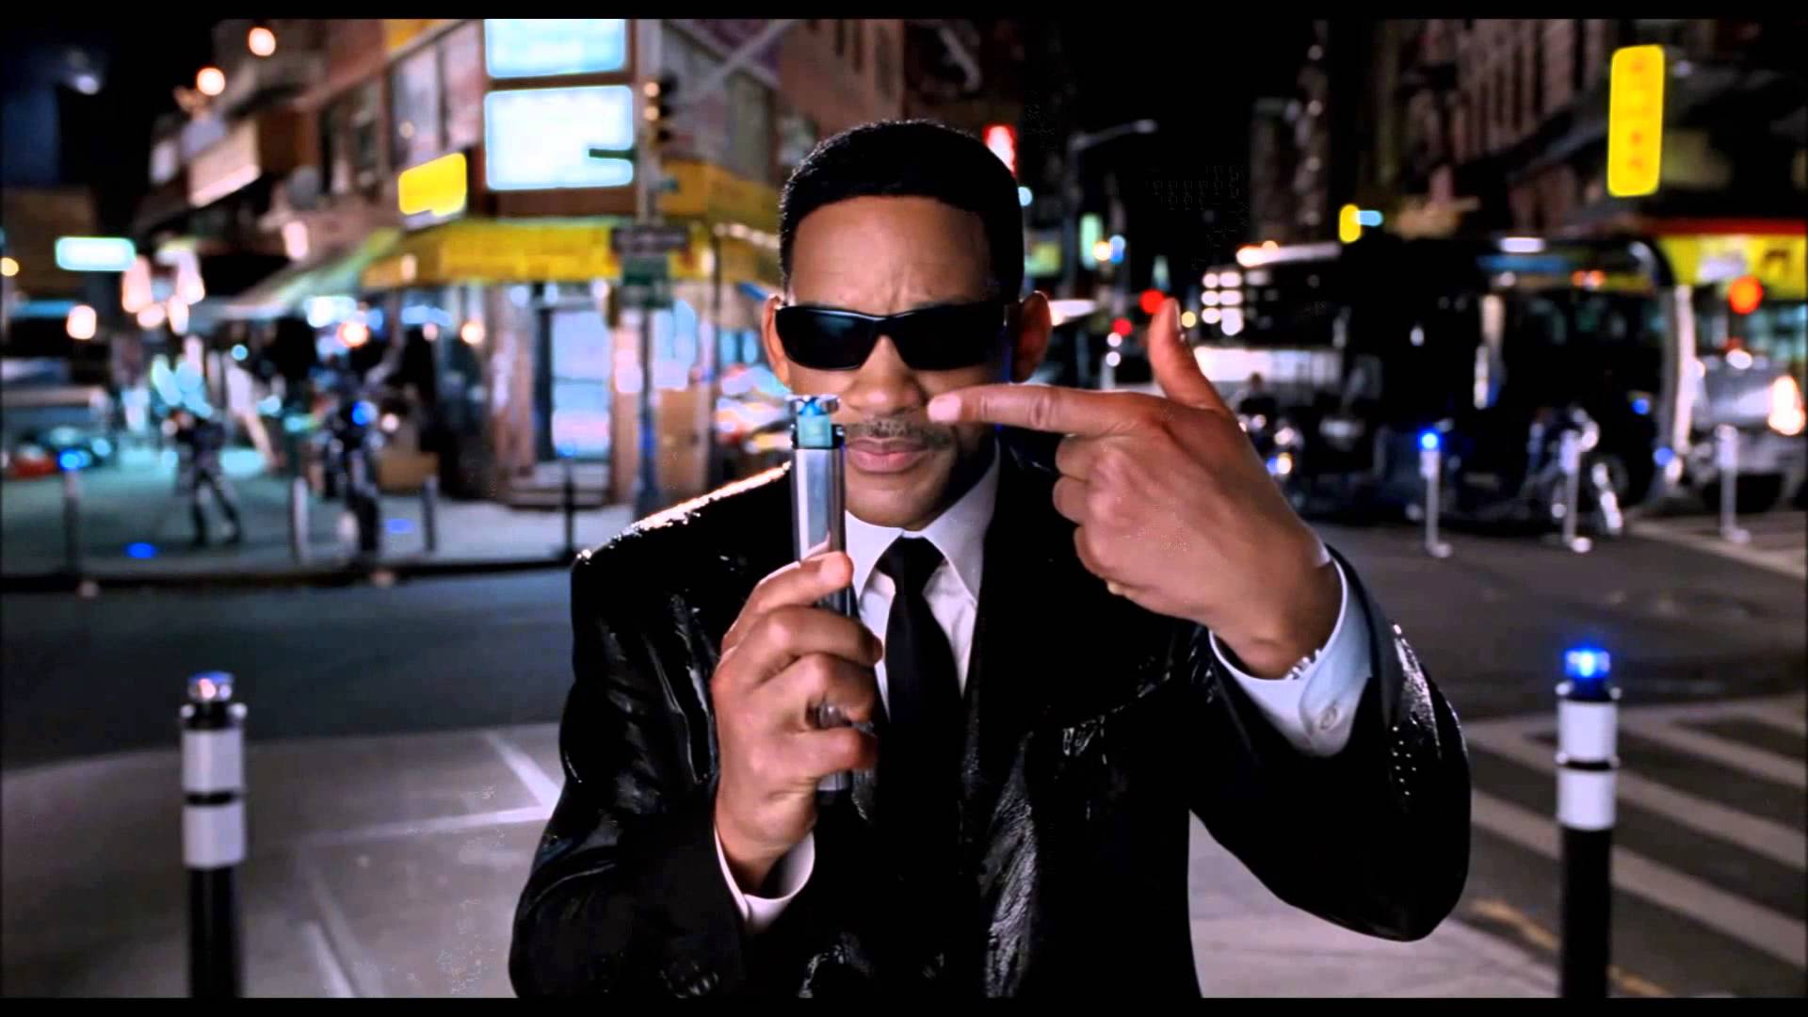
Arrays
Arrays are a special kind of objects, with numbered indexes.

Slide 36
Arrays (cont…)
var myArr = [“string”, 11, true, null];
‘0’
:
“string”
‘1’
:
11
Keys(Indexes)
Values
‘2’
:
true
‘3’
:
null
Length: 4
Object
myArr[50] = “no50”;
‘50’
:
“no50”
Length: 51

Slide 37
Play with Arrays
var myArr = [“string”, 11, true, null];
toString()
Join()
pop()
push()
shift()
unshift()
splice()
slice()
sort()
reverse()
concat()
Code Break
</>

Slide 38
Play with Math
var power = Math.pow(2,2); //4
min()
max()
pow()
sqrt()
random()
ceil()
floor()
round()
Code Break
</>

Slide 39
Play with Date
var date = new Date();
Code Break
</>

Slide 40
Labs: Character Game
“this is javaScript course”
i
[2,5,15]

Slide 41

Labs: Bottle Game

Slide 42
Labs: fizzBuzz Game
Can be divided
By 3 & 5
fizzBuzz
Can be divided
By 3
Can be divided
By 5

Slide 43
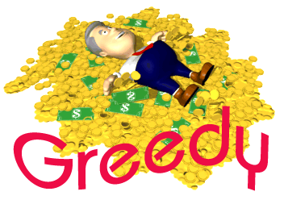
Labs: Greedy Game
1 dollar = 100 cent
1 quarter = 25 cent
1 dime = 10 cent
1 nickel = 5 cent

Slide 44
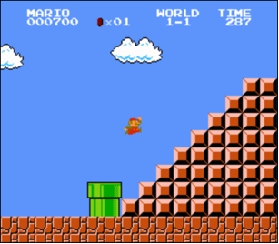
Labs: Mario Game (Bonus)
#
##
###
####
#####
######
#######

Slide 45

Labs: Who I am Game? (Bonus)

Slide 46
Excellent, You have exceed level 2
2
level

Slide 47
Thank You
E-mail Address : ahmedmowd@gmail.com

