Slide 1

Drupal 7
Khaled Alhourani

Slide 2
Twittering
Use hashtag #DamasMeetup

Slide 3
Me
Who Am I?
Khaled Alhourani! you know me name now.
Where do I work?
Holooli & Meedan
What do I do?
Senior Web Developer (mostly in Drupal)
Twitter?
@khaledalhourani

Slide 4

By Hala & Zaher
Bab Elhara :)

Slide 5
Drupal History Question
Do you know Drupal?
What about Drupal 6?
And Drupal 5?
Also, Drupal 4? 3? 2? 1??

Slide 6
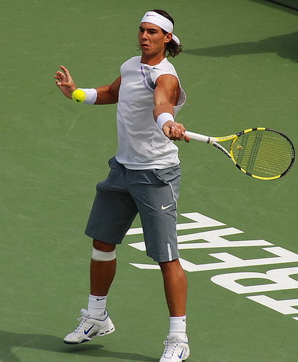
Who is using Drupal?
http://www.flickr.com/photos/franz88/1092341611/

Slide 7
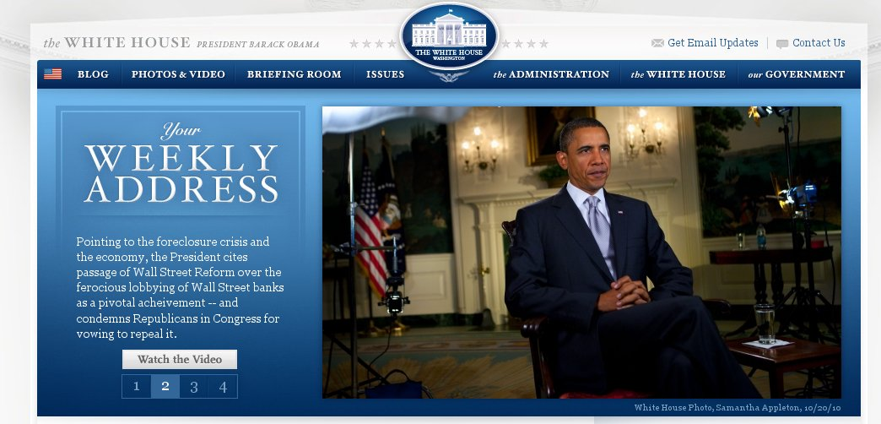
Who is using Drupal?

Slide 8
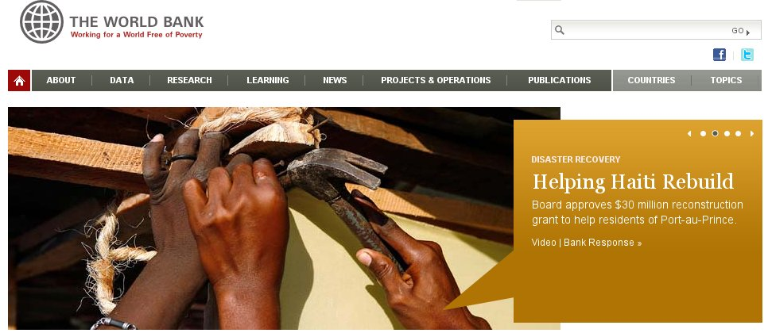
Who is using Drupal?

Slide 9
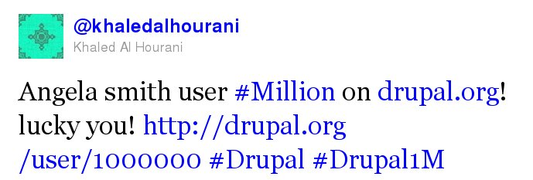
Statistics
Drupal Core downloads (345,165 from 17 - 23 Oct) and it's getting higher every week!
More than 1 Million user on Drupal.org!

Slide 10
New Database Abstraction Layer (PDO)
Query builders for INSERT, UPDATE, DELETE, MERGE, and SELECT queries. [example]
master/slave replication, transactions, multi-insert queries.

Slide 11
Security
New password hashing, useful for goernments projects!
Update modules from your dashboard, just like wordpress :)

Slide 12
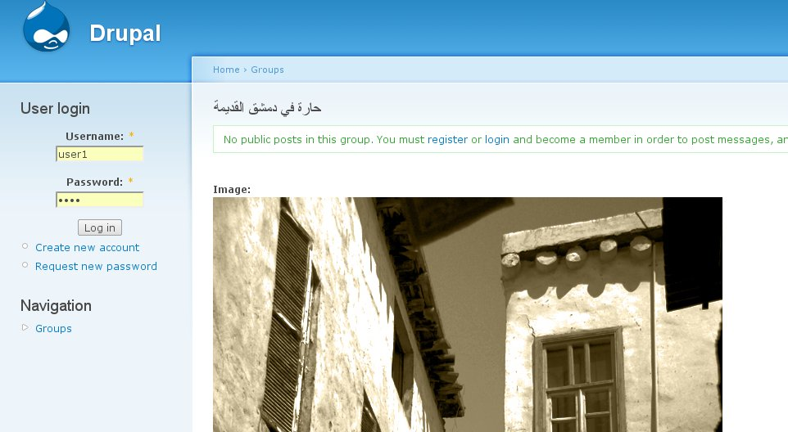
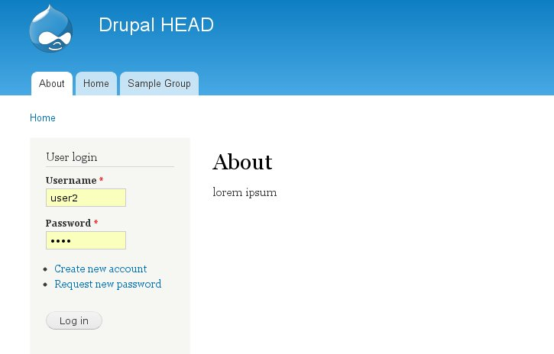
Theme System (1)
Better default theme “Bartik” (I still love bluemarine!)

Slide 13
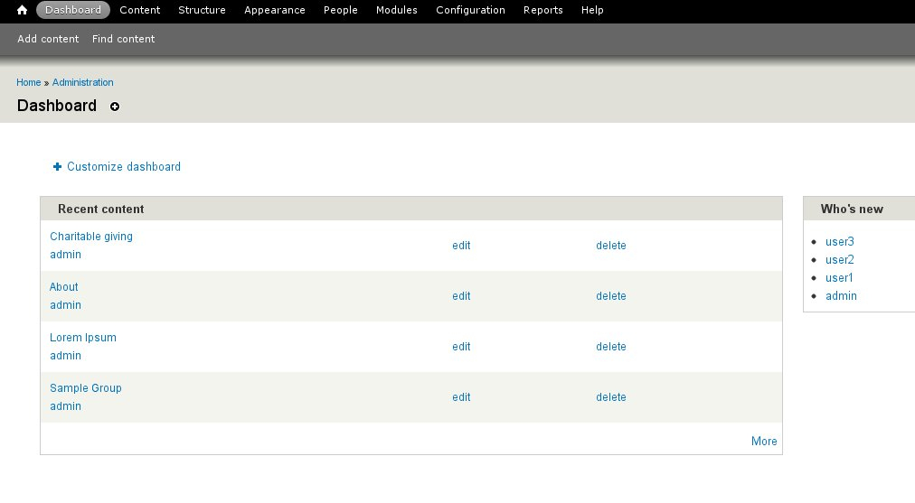
Theme System (2)
Admin theme! “Seven”

Slide 14
Theme System (3)
They said better theme hooks, didn't deal with it yet!
  function ThemeName_preprocess_html(&$vars)
  Hooks is a great thing in Drupal, will talk about another time!

Slide 15
Awesome Contrib in Core
CCK in core (now called Fields)
File & Image Upload in Core!
ImageCache too!!

Slide 16
Translation system
Translatable fields support.
Many cool stuff in contrib, will be schedule to D8 :(

Slide 17
Other Changes
JavaScript
Usability
User System

