Slide 1
Credit Analysis
Big Data Project
Submitted To Eng. Omar Samir
By Team 10

Slide 2
Agenda
01. Problem Description
02. Project Pipeline
Credit Analysis Description
1- Data Preprocessing
2- Bivariate Analysis
3- Univariate Analysis
03. Models Training
04. Results And Evaluation
05. Future Work
Train Several Models
Evaluate model on f1-score
What to do for better prediction
<number>
5/22/22

Slide 3
Problem Description
Consider you are a Data Analyst with a private bank or a loan distribution firm. Your organization receives many applications in a given day. You need to predict whether he/she will be defaulters.
We worked on Current_app data set to analyze loan applications whether or not clients are defaulters. The data set has 307511 rows and 122 columns.
3
5/22/22

Slide 4
Project Pipeline
Data Preprocessing
Check Invalid Values
Outliers Detection
Check and Visualize Nan Values
Fill Nan Values
3
5/22/22

Slide 5
Project Pipeline
Bivariate Analysis
Continuous Vs Continuous Analysis
Continuous Vs Target (Binary Categorical)
Binary Categorical Vs Binary Categorical
4
Annual Review
5/22/22

Slide 6
Project Pipeline
Bivariate Analysis
Binary Categorical Vs Target (Binary Categorical)
Multiple Categorical Vs Continuous
Multiple Categorical Vs Categorical
5
Annual Review
5/22/22

Slide 7
Project Pipeline
Univariate Analysis
Distribution of defaulters and non-defaulters
Distribution of applicant’s gender
Occupation Type Distribution
6
Annual Review
5/22/22

Slide 8
Data Preprocessing

Slide 9
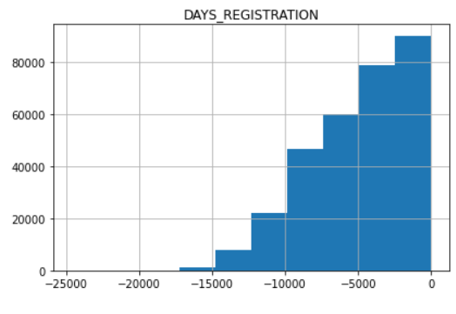
Check Invalid Values Data Preprocessing
Check if any features has invalid values and correct it
9
Annual Review
5/22/22

Slide 10
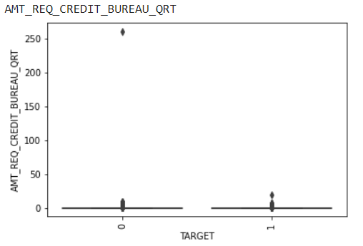
Outliers Detection Data Preprocessing
Check if there are extreme values and drop example with extreme values
10
Annual Review
5/22/22

Slide 11
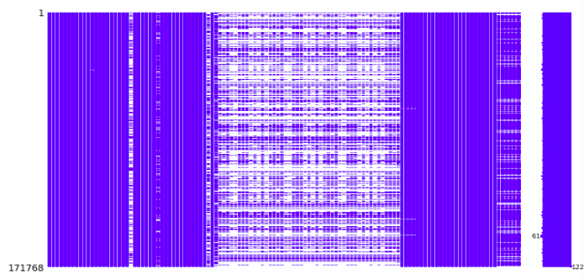
Check and Visualize Nan Values Data Preprocessing
Visualize Nan Values in dataset using Missingno Library
11
Annual Review
5/22/22

Slide 12
Fill Nan Values Data Preprocessing
Remove Nan Values as follow:
Recommended 1: Drop columns with Nan values larger than 50%
Columns decreased from 122 to 73 columns.
Recommended 2: Fill columns with Nan values less than 13%
Drop remaining rows with Nan values
The output dataset after this step has the shape of (83997, 77)
12
Annual Review
5/22/22

Slide 13
Bivariate Analysis

Slide 14
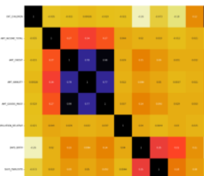
Continuous Vs Continuous Analysis Bivariate Analysis
Compute correlation between continuous features to remove dependent features.
12
Annual Review
5/22/22

Slide 15
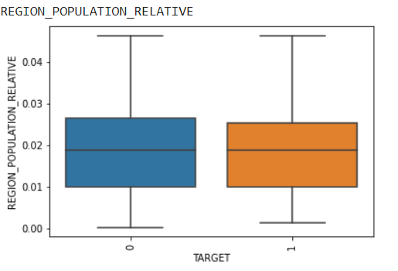
Continuous Vs Target (Binary Categorical) Bivariate Analysis
Draw box plot for continuous features Vs output target to and check if distribution changes for each class. Remove features that have same distribution for both classes
14
Annual Review
5/22/22

Slide 16
Binary Categorical Vs Binary Categorical Bivariate Analysis
To find correlation between binary categorical features we used PEARSON’R method. Remove dependent features with correlation r larger than 0.85 and p-value less than 0.05.
15
Annual Review
5/22/22

Slide 17
Binary Categorical Vs Target (Binary Categorical) Bivariate Analysis
We used same method (PEARSON’R) to remove features with correlation r less than 0.04 with output or p-value less than 0.05.
16
Annual Review
5/22/22

Slide 18
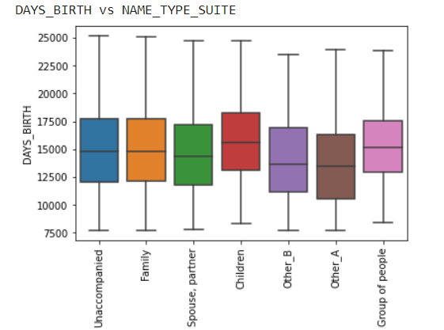
Multiple Categorical Vs Continuous Bivariate Analysis
Draw box plot for continuous features Vs output target to and check if distribution change for each class. Remove features that have different distribution for all classes
17
Annual Review
5/22/22

Slide 19
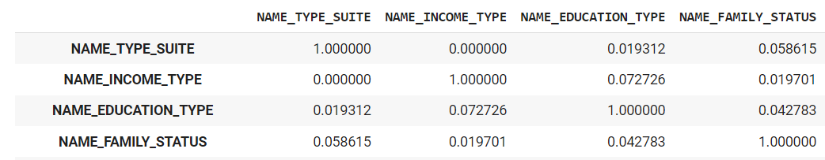
Multiple Categorical Vs Categorical Bivariate Analysis
we used Chi-Square test to calculate the correlation between multi-categorical features. Remove dependent features with correlation larger than 0.85 and features that have correlation with response feature of value less than 0.05.
18
Annual Review
5/22/22

Slide 20
Univariate Analysis

Slide 21
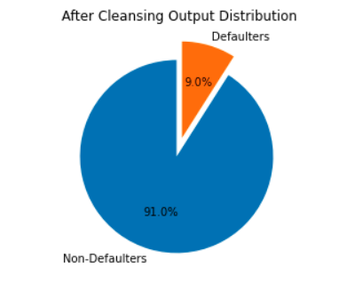
Distribution of defaulters and non-defaulters Univariate Analysis
Our dataset has 91% non-Defaulters and 9% Defaulters so our dataset is imbalanced
19
Annual Review
5/22/22

Slide 22
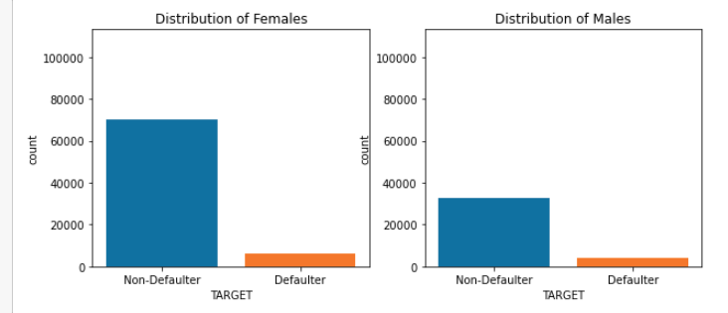
Distribution of applicant’s gender Univariate Analysis
The number of non-Defaulters for men is less than the number of defaulters
21
Annual Review
5/22/22

Slide 23
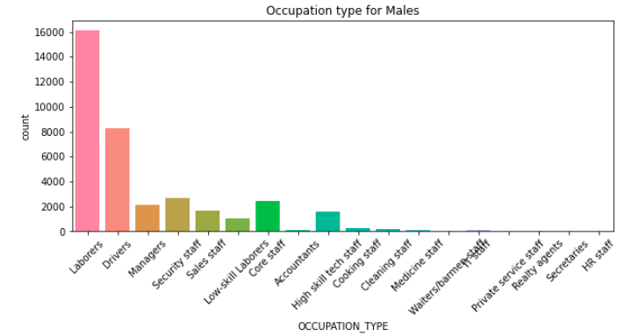
Occupation Type Distribution Univariate Analysis
majority of male clients are laborers followed by drivers
22
Annual Review
5/22/22

Slide 24
Models Training
We used Logistic regression from Statsmodels library to find out the significance of features in prediction. We removed features that have p-value less than 0.05 which indicates that features are not significant for prediction.
23
Annual Review
5/22/22

Slide 25
Models Training

Slide 26
Models Training
We used Logistic regression to find out the significance of features in prediction.
We removed features that have p-value less than 0.05.
Then we implemented Stochastic Logistic Regression using MapReduce
24
Annual Review
5/22/22

Slide 27
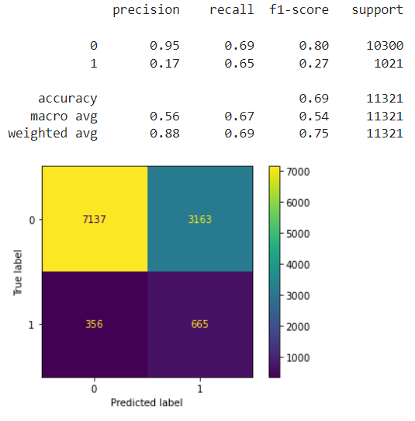
Results And Evaluation
Logistic Regression model achieved on the test data
26
Annual Review
5/22/22

Slide 28

Results And Evaluation
Stochastic Logistic Regression on Over Sampled data using MapReduce
27
Annual Review
5/22/22

Slide 29
Other Trails

Slide 30
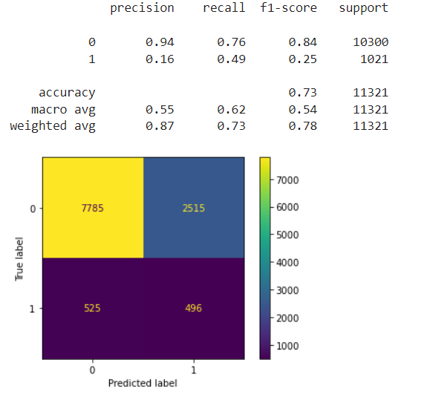
Results And Evaluation
Decision Tree model trained on the over sampled data achieved the following on test
28
Annual Review
5/22/22

Slide 31
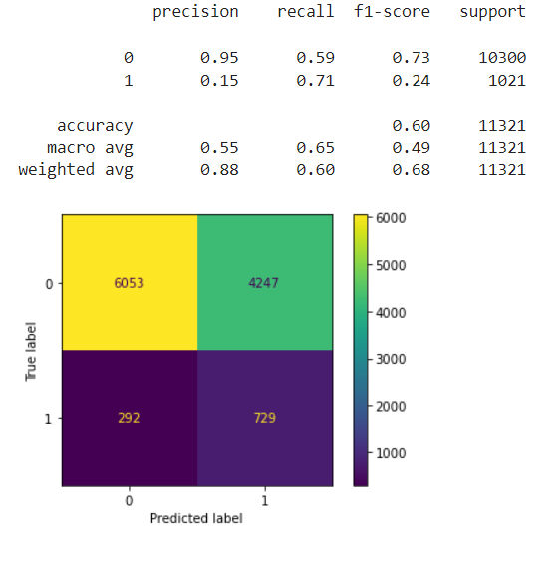
Results And Evaluation
KNN model trained on the over sampled data achieved the following on test data
30
Annual Review
5/22/22

Slide 32
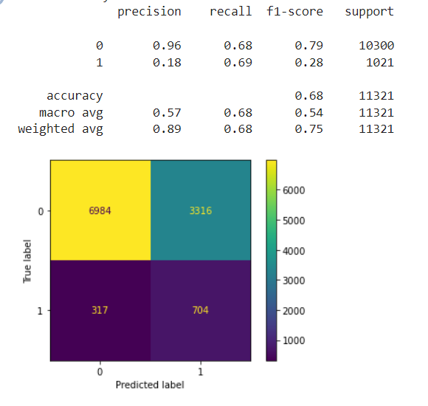
Results And Evaluation
SVM model trained on the over sampled data achieved the following on test data
31
Annual Review
5/22/22

Slide 33
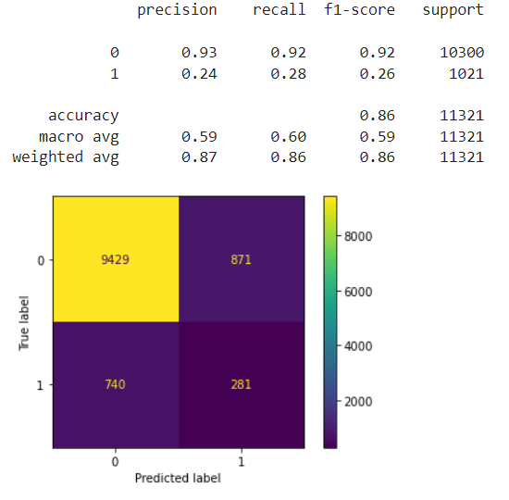
Results And Evaluation
Random Forest model trained on the over sampled data achieved the following on test data
<number>
Annual Review
5/22/22

Slide 34
Best Model
Best Model Based on F1-Score is Support Vector Machine trained on Over-Sampled Data achieved the following on test data
 | Accuracy | F1-Score defaulters | F1-Score Non-defaulter
SVM | 68% | 28% | 80%
34
Annual Review
5/22/22

Slide 35
Future Work We can work on collecting more data of class 1 to achieve some sort of balance which will be useful for our prediction.

Slide 36

Thank you
Team 10
Notes:
<number>

