Slide 1

Note: The data and information in this document is reflective of a hypothetical situation and client. This document is to be used for KPMG Virtual Internship purposes only.
Sprocket Central Pty Ltd
Data analytics approach
Khaled Ahmed Ashoush

Slide 2
Note: The data and information in this document is reflective of a hypothetical situation and client. This document is to be used for KPMG Virtual Internship purposes only.
Agenda
Introduction
Data Exploration
Model Development
Interpretation

Slide 3
Problem Statement:
Note: The data and information in this document is reflective of a hypothetical situation and client. This document is to be used for KPMG Virtual Internship purposes only.
Introduction
Sprocket Central Pty Ltd , a medium size bikes & cycling accessories organization, has given us a new list of 1000 potential customers with them demographics and attributes. (However, these customers do not have prior transaction history with the organization.)

Slide 4
Our goal:
Note: The data and information in this document is reflective of a hypothetical situation and client. This document is to be used for KPMG Virtual Internship purposes only.
Introduction
The marketing team at Sprocket Central Pty Ltd
want to know about useful customer insights which
could help optimize resource allocation for targeted
marketing. Hence, improve performance by
focusing on high value customers.

Slide 5
About Dataset:
Note: The data and information in this document is reflective of a hypothetical situation and client. This document is to be used for KPMG Virtual Internship purposes only.
Introduction
Sprocket Central Pty Ltd provided us 3 datasets:
Customer Demographic
Customer Addresses
Transactions data
New Customer List (which is the target data)

Slide 6
Steps Taken:
Note: The data and information in this document is reflective of a hypothetical situation and client. This document is to be used for KPMG Virtual Internship purposes only.
Introduction
Data Cleaning → Cleaned for better quality
Data Transformation → Merged the
transactions, customer demographic, customer address
Using RFM technique to segment customers
Data Exploration → Explore the data to reveal insights

Slide 7
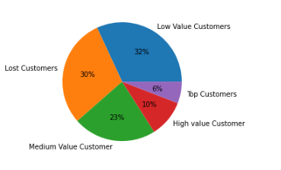
Note: The data and information in this document is reflective of a hypothetical situation and client. This document is to be used for KPMG Virtual Internship purposes only.
Data Exploration
Customer Segments
Insights
30% of our customers are lost Customers, and 32% of our customers are Low value Customers. Based on recent transaction history.
Place any supporting images, graphs, data or extra text here.

Slide 8
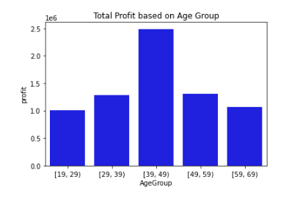
Note: The data and information in this document is reflective of a hypothetical situation and client. This document is to be used for KPMG Virtual Internship purposes only.
Data Exploration
Total Profit based on different Age Groups
Insights:
The customers between 30 to 49 age are the most
profitable in terms of recent transaction history
with more than 19 lacs profit.

Slide 9
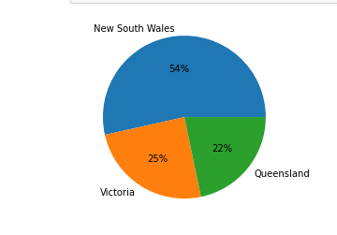
Note: The data and information in this document is reflective of a hypothetical situation and client. This document is to be used for KPMG Virtual Internship purposes only.
Data Exploration
Total Profit based on State
Insight
Customers living in New South wales are the most
profitable customers with more than 50% profit
among the other States.
Place any supporting images, graphs, data or extra text here.

Slide 10
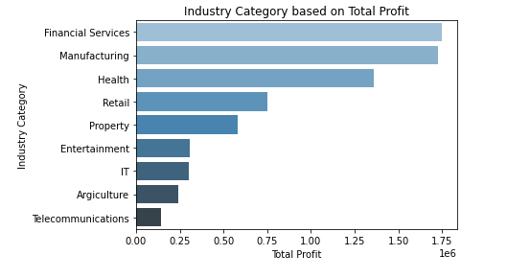
Note: The data and information in this document is reflective of a hypothetical situation and client. This document is to be used for KPMG Virtual Internship purposes only.
Data Exploration
Total Profit based on customers Industry
Insight:
The customers related to Financial Service and
Manufacturing showing most profit with 18 lacs +
profit.
Place any supporting images, graphs, data or extra text here.

Slide 11
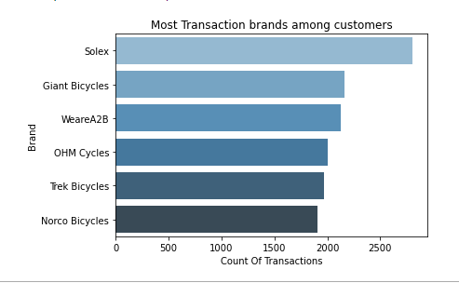
Note: The data and information in this document is reflective of a hypothetical situation and client. This document is to be used for KPMG Virtual Internship purposes only.
Data Exploration
Most purchased brands among customers
Insight:
Customers buys more Solex brand among the other
brands with transaction count of more than 3000.
Place any supporting images, graphs, data or extra text here.

Slide 12
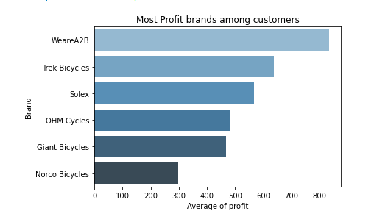
Note: The data and information in this document is reflective of a hypothetical situation and client. This document is to be used for KPMG Virtual Internship purposes only.
Data Exploration
Most profit brands among customers
Insight:
However, Customers buys more Solex brand among the other
brands with transaction count of more than 3000.
The most profit brand is WeareA2B with average profit 800
Place any supporting images, graphs, data or extra text here.

Slide 13
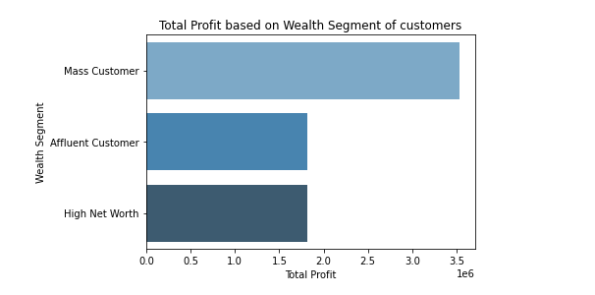
Note: The data and information in this document is reflective of a hypothetical situation and client. This document is to be used for KPMG Virtual Internship purposes only.
Data Exploration
Total Profit based on Wealth Segment of customers
Insights:
The mass customer are the most profitable segment
among the three segments as nearly 50% of the
profit is made by this segment.
Place any supporting images, graphs, data or extra text here.

Slide 14
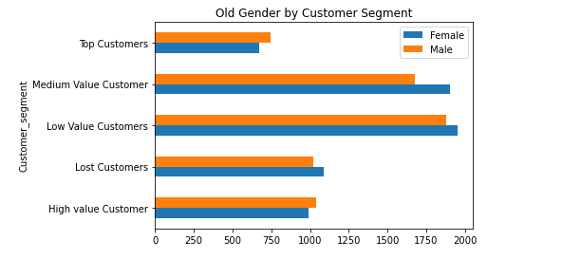
Note: The data and information in this document is reflective of a hypothetical situation and client. This document is to be used for KPMG Virtual Internship purposes only.
Data Exploration
Gender based on Customer Segments
Insights:
The Medium and low values customers are the largest segment and Female exceed male
among the three segments
Place any supporting images, graphs, data or extra text here.

Slide 15
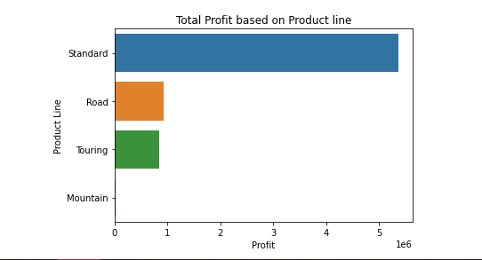
Note: The data and information in this document is reflective of a hypothetical situation and client. This document is to be used for KPMG Virtual Internship purposes only.
Data Exploration
Most purchased products among customers
Insight
Standard product are most buyable products by
customers among the other product with more than
10000 + transactions took place
Place any supporting images, graphs, data or extra text here.

Slide 16
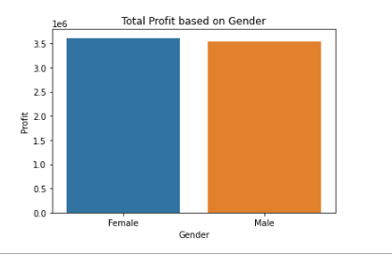
Note: The data and information in this document is reflective of a hypothetical situation and client. This document is to be used for KPMG Virtual Internship purposes only.
Data Exploration
Total Profit based on Gender
Insight
Male and Female customers do same profit in general
Place any supporting images, graphs, data or extra text here.

Slide 17
Marketing team should deploy the targeted model based on -
Note: The data and information in this document is reflective of a hypothetical situation and client. This document is to be used for KPMG Virtual Internship purposes only.
Model Development
Customer between age 30 to 49.
30% of our customers are lost Customers, and 32% of our customers are Low value Customers. Based on recent transaction history. Using RFM technique.
Customers in the Mass Consumer Segment.
Customers related to Financial Services and Manufacturing Industries.
Solex brand and Standard product as the top priority.
The most profit brand is WeareA2B
Customers living in New South Wales.

Slide 18
Note: The data and information in this document is reflective of a hypothetical situation and client. This document is to be used for KPMG Virtual Internship purposes only.
Appendix

Slide 19
Note: The data and information in this document is reflective of a hypothetical situation and client. This document is to be used for KPMG Virtual Internship purposes only.
Appendix
This is an optional slide where you may place any supporting items.

