Slide 1


Graduation Project Presentation
“Twitter Sentiment Analysis”
Prepared by:
1- Abdel Rahman Mahmoud Rashad
2- Abdel Rahman Sobhy Saleh
3- Abdel Rahman Tarek Mahmoud
4- Bishoy Alper Aziz
5- Khaled Mohamed Abdel Hamid 6- Yasser El-Sayed Mohamed
Supervised by:
Dr. Diaa El-Din Mohamed Fayed

Slide 2
Twitter Sentiment Analysis

Slide 3
Table of contents
Introduction
Approach
Methodology
system work
Interface
Q/A

Slide 4
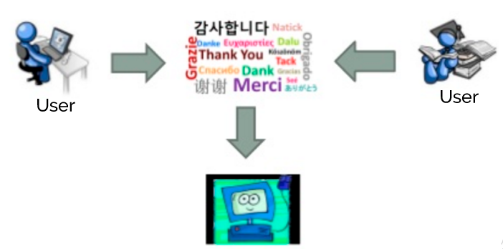
INTRODUCTION
Data Mining & Natural Language processing (NLP)
What Natural Language Processing (NLP) is using for?

Slide 5


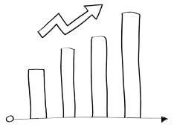
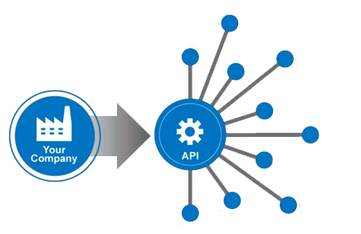


…INTRODUCTION
Sentiment Analysis ?
Why is Sentiment Analysis important?
Why Twitter ?
310+ Million
6000
500 Million

Slide 6
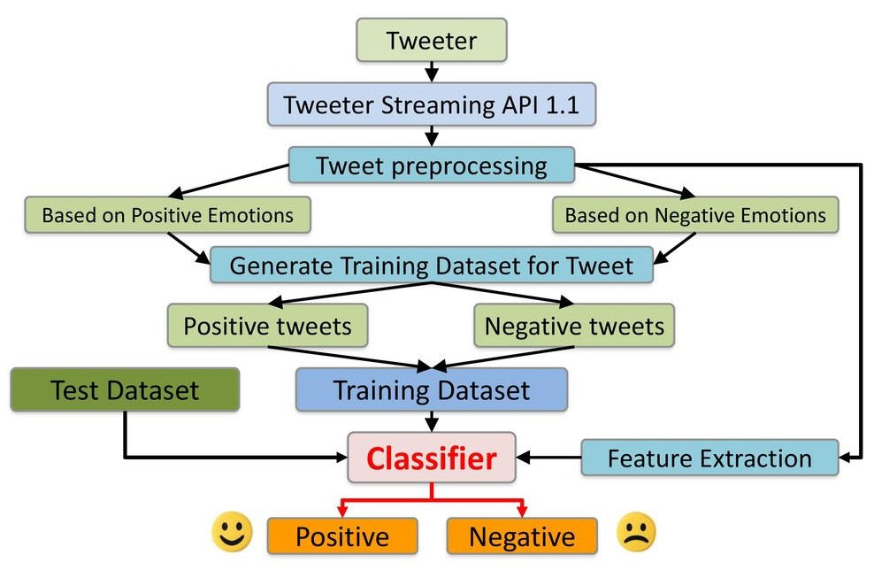
Approach:
non-English Tweets
Replacing Emoticons by their polarity
Remove URL,, Hashtags, Numbers
Replace Sequence of Repeated Characters eg. ‘coooooooool’ by ‘coool’

Slide 7
Tools and Technology
Python 3.0
NLTK Package
HTML && CSS && JavaScript && ASP.NET
Twitter API && Google API

Slide 8
Methodology:
Naive Bayes
SVM
Sentiwordnet

Slide 9
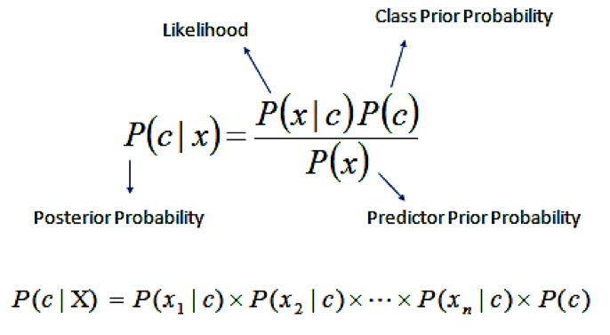
Naive Bayes
What is Naive Bayes Algorithm?
- Easy to build
- Works like :
P(c|x) from P(c), P(x) and P(x|c).
What are the Pros and Cons of Naive Bayes?

Slide 10
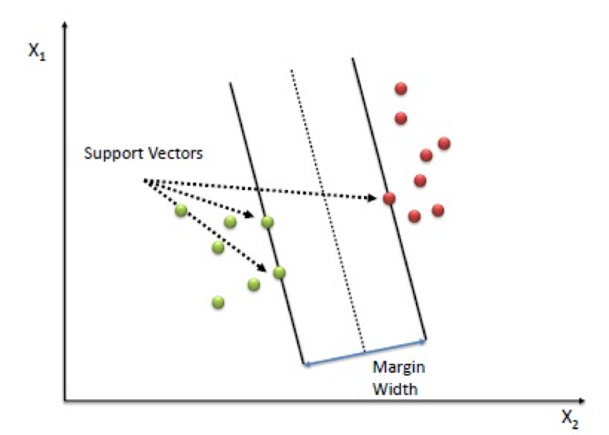
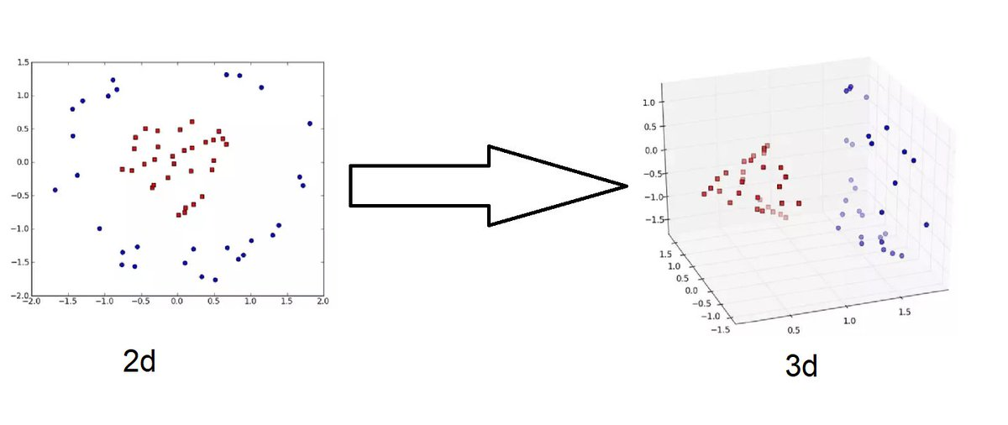
Support Vector Machine (SVM)
What is Support Vector Machine (SVM)?

Slide 11
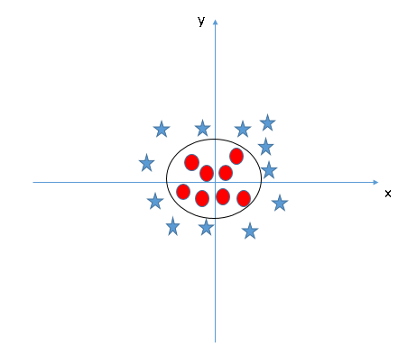
kernel trick

Slide 12
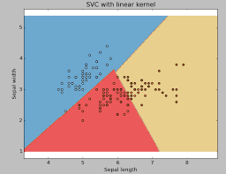
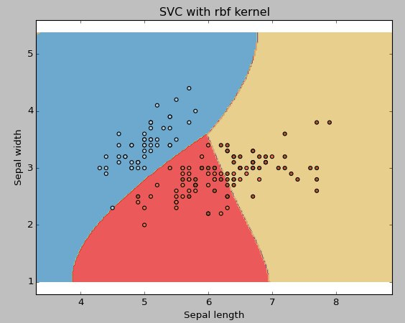

Slide 13
Use SVM in sentiment analysis
Need is a way to transform a piece of text into a vector of numbers
Counting frequency of words - calculating frequencies use TF-IDF. - every text in our dataset is represented as a vector with thousands or tens of thousands of dimensions. - Choosing a kernel function.

Slide 14
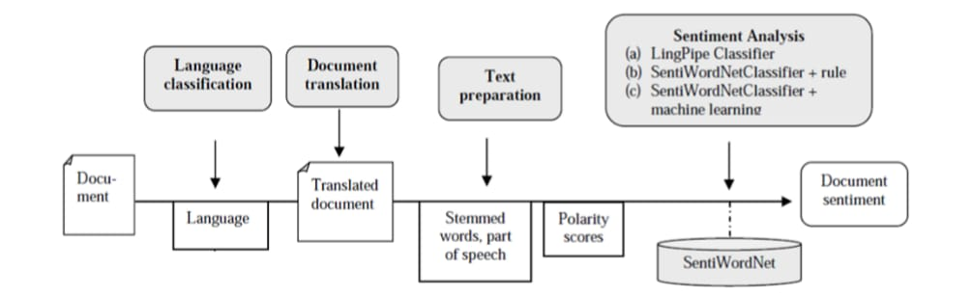
Sentiwordnet
What is Sentiwordnet Algorithm?
How sentiwordnet algorithm work?
there are three different approaches were implemented and evaluated
lingpipe classifier
sentiwordnet classifier with classification rule
sentiwordnet classifier with machine learning

Slide 15
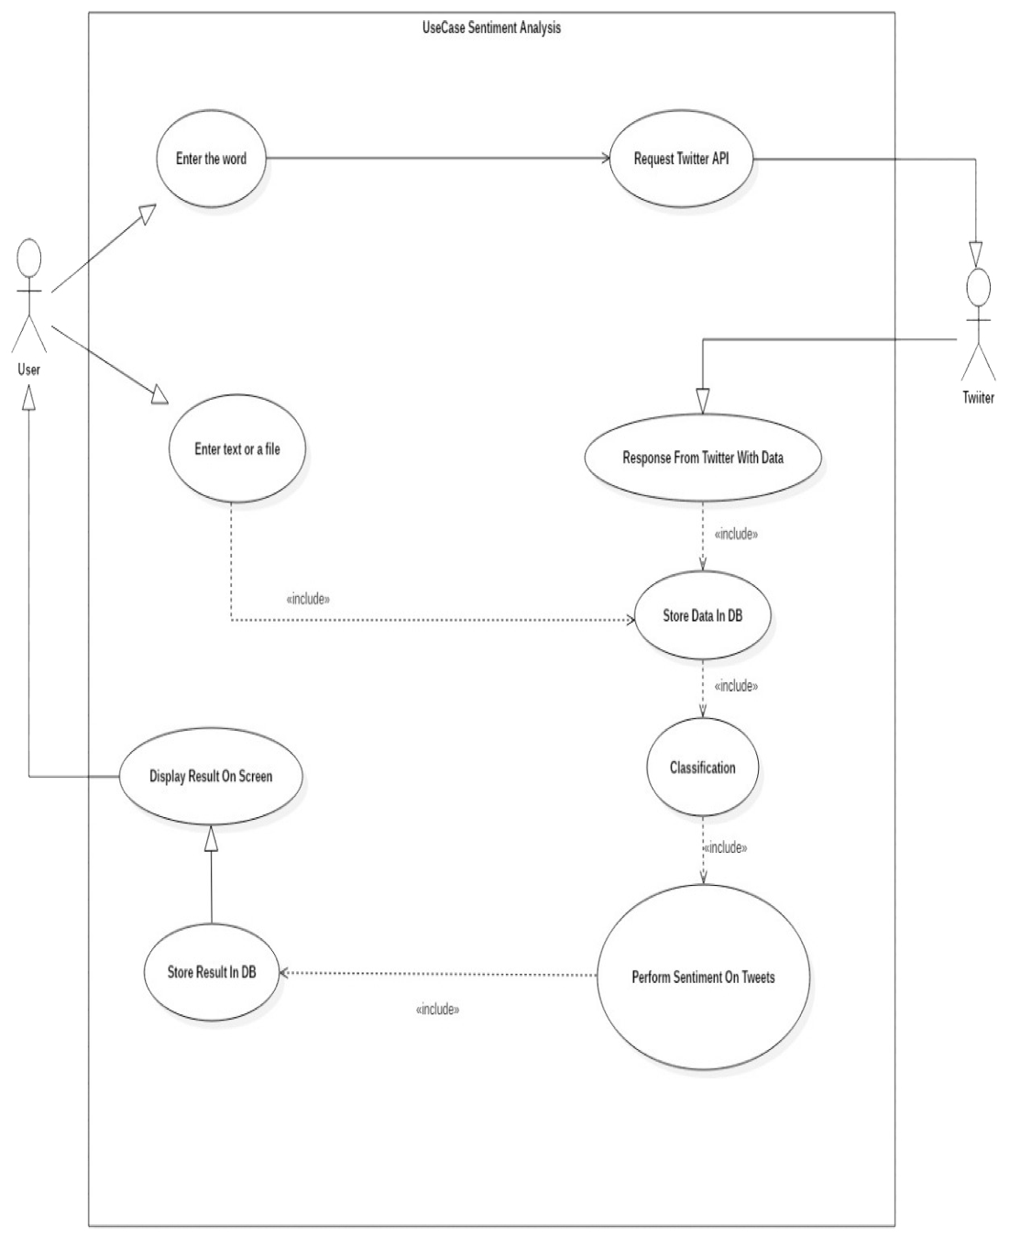
Use Case Diagram

Slide 16
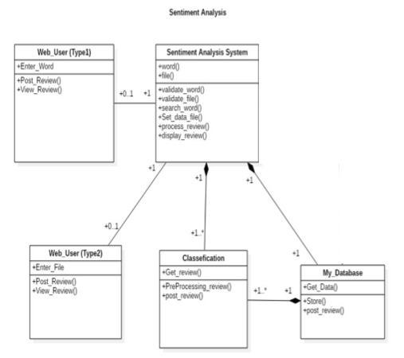
Class diagram

Slide 17
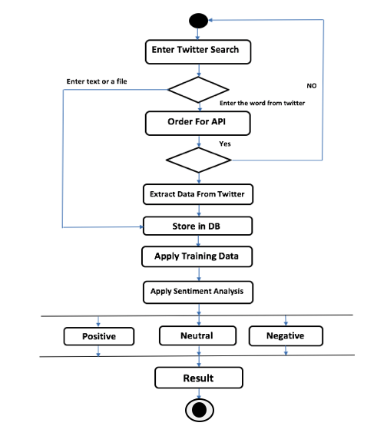
Activity diagram

Slide 18
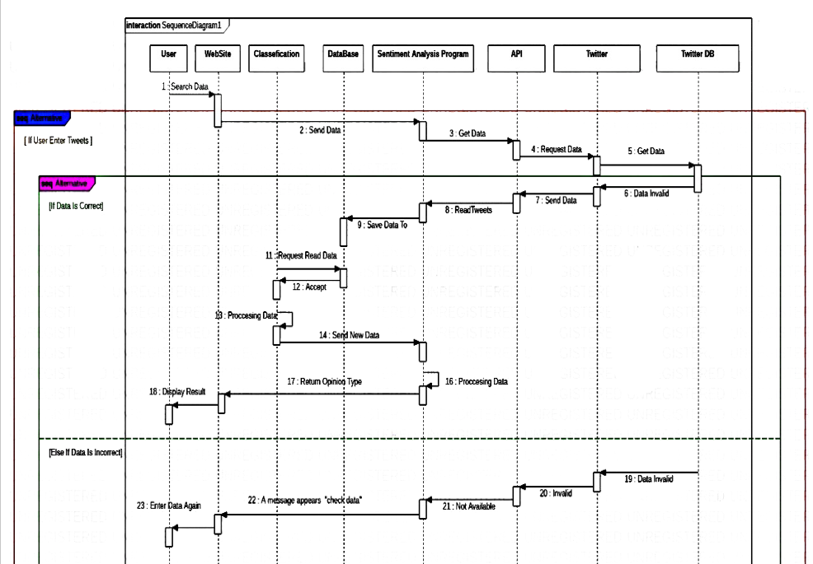
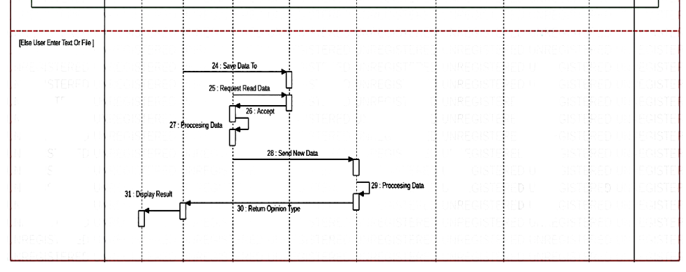
Sequence diagram

Slide 19
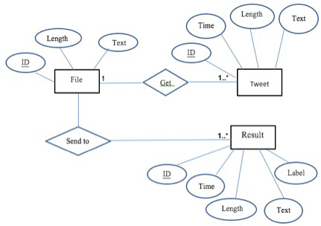
Entity Relationship Diagram “ERD”

Slide 20
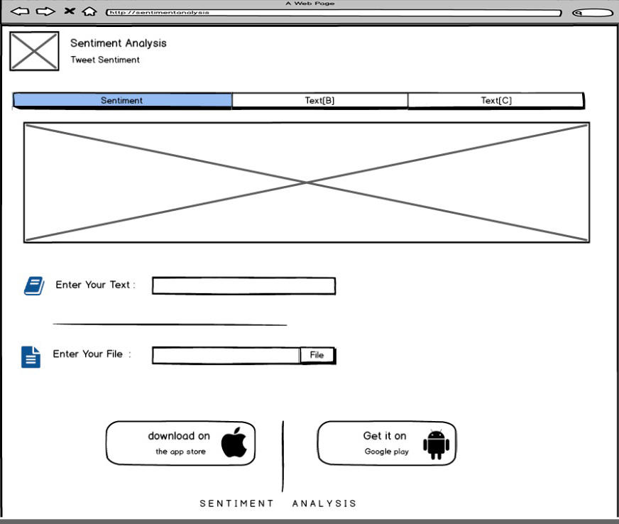
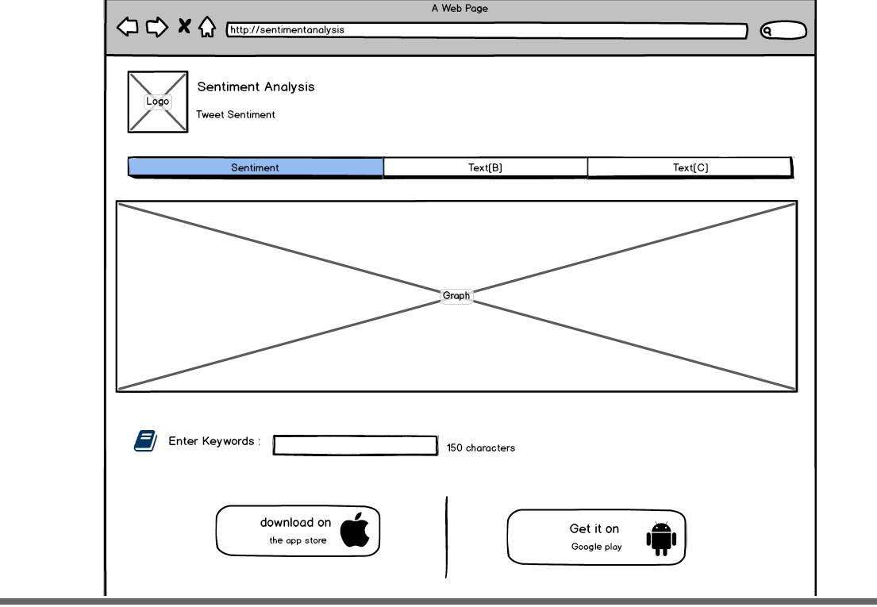
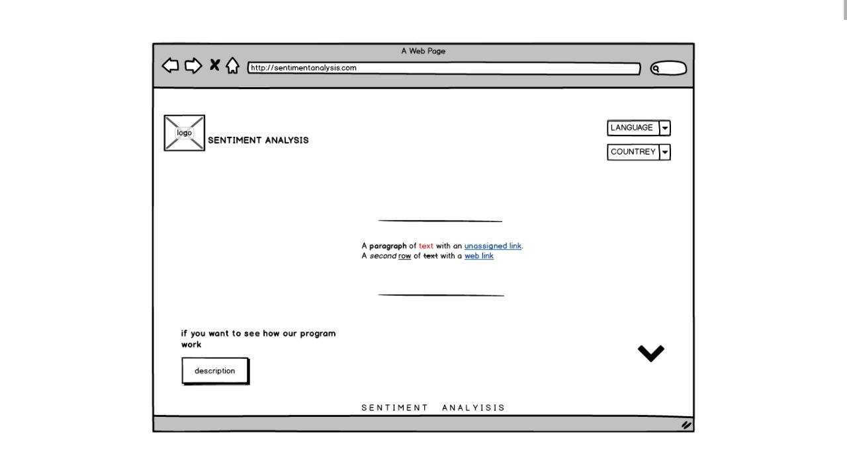
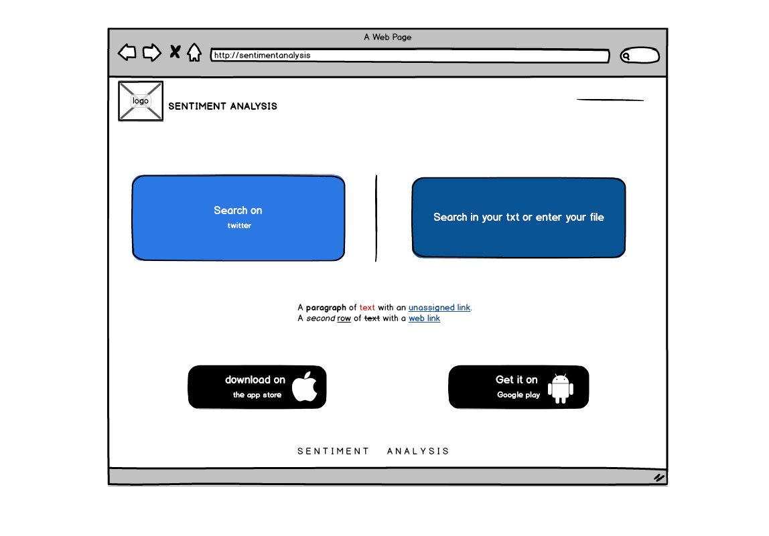
User interface of system .. What will be
page1
page2
page3
page4

Slide 21
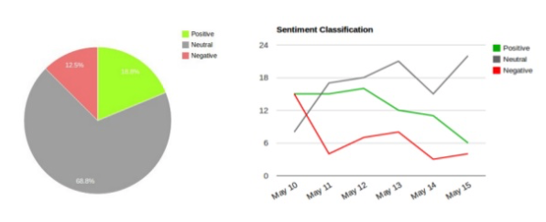
Result and Output
Google Chart Tools
Pie Chart and Line Chart

Slide 22
REFERENCES:
http://help.sentiment140.com/for-students
https://units.imamu.edu.sa/rcentres/en/asa/Pages/Lessone1.aspx
https://ethraarab.wordpress.com/2015/04/27/data-mining-and-machine-learning
https://s3.amazonaws.com/ppt-download/finalyear-170810032309.pdf
https://www.slideshare.net/rachitgoel16/twitter-sentimentanalysis-jiit201314
https://www.analyticsvidhya.com/blog/2017/09/understaing-support-vector-machine-example-code
https://monkeylearn.com/text-classification-support-vector-machines-svm
https://www.analyticsvidhya.com/blog/2017/09/naive-bayes-explained/
https://nekst-online.nl/sentiment-analysis-using-support-vector-machines
http://www.cs.cornell.edu/~tj/publications/joachims_98a.pdf
http://ijcsit.com/docs/Volume%207/vol7issue1/ijcsit2016070142.pdf
https://arrow.dit.ie/cgi/viewcontent.cgi?article=1000&context=ittpapnin
https://www.researchgate.net/publication/267249616_Reviews_Classification_Using_SentiWordNet_Lexicon

Slide 23
Thank You!
Q/A

