Slide 1
SMART HOME
PROJECT
Alex 39

Slide 2

OUR TEAM
khaled mohamed Ahmed ------- kh.dayem@gmail.com
Mazen Hamdi Ahmed ------- mazen.3132000@gmail.com
Youssef Adel Mahmoud ------- youssefadel692000@gmail.com
Amr Moussa Abdallah ------- AmrMousa412@gmail.com
Ibrahim Yosry Hosny ------- ibrahim.yosry222@gmail.com
Rewaa mohamed Elfaham ------- rewaaelfaham4@gmail.com

Slide 3
1- Hardware
2- Software Layers
3- LIB
4- HAL DRIVER
5- MCAL DRIVER
6- Application
Contents

Slide 4
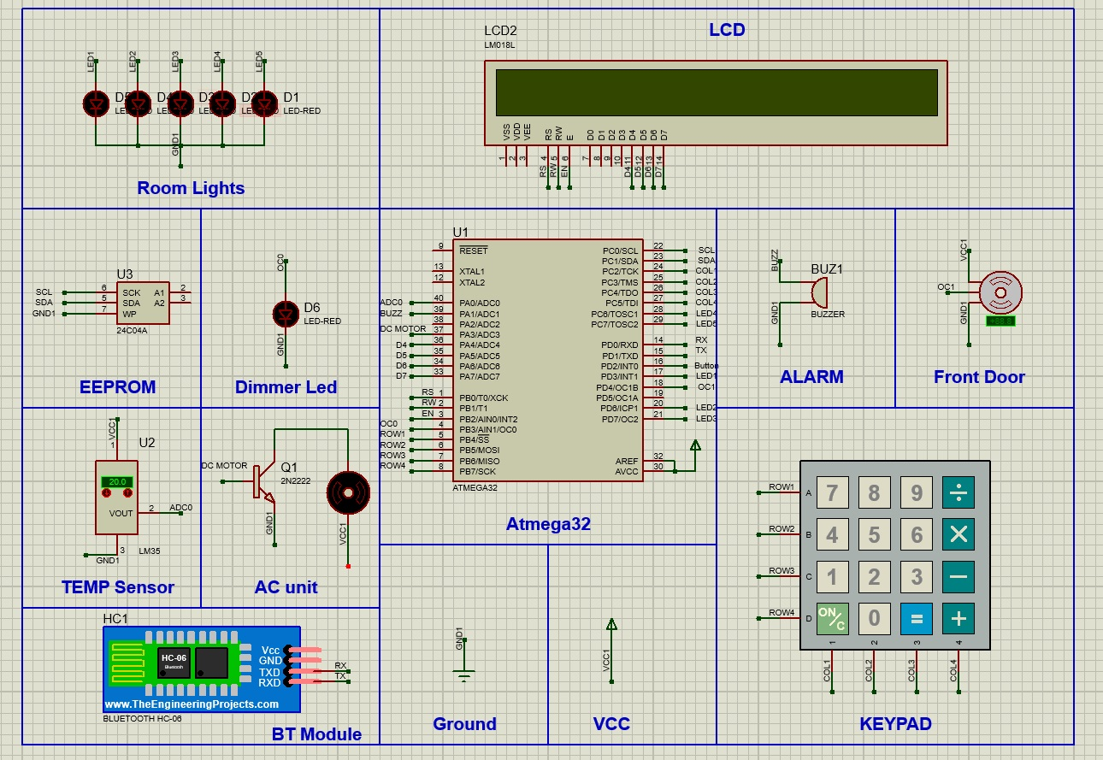
HARDWARE
DESIGN

Slide 5
1- ATMEGA32 MCU
2- 40*2 LCD
3- KEYPAD
4- ALARM BUZZER
5- LEDS
6- DC MOTOR
7- SERVO MOTOR
8- BT MODULE HC-06
9- LM35 TEMP SENSOR
10- EEPROM I2C
11- DIMMER
HARDWARE
DESIGN

Slide 6
APP
L
I
B
SOFTWARE
LAYERS
HAL
MCAL

Slide 7
LIB
LAYER
STD_TYPES : this file provides all the standard ES variables in bit size for consistent variable management
BIT_MATH : this filer provides all the bitwise operations needed for ease of use
VECT_NUM : this filer provide all the interrupt ISR vectors as macros for portability

Slide 8
MCAL
LAYER
ADC : this driver is used to convert temp sensor analog input to a readable digital signal
DIO : this driver is used to digital read or write to a certain pin allowing power to LEDS and motors
GIE : this driver controls the general interrupt of the system for more dynamic program flow
TIMER0 : this 8-bit timer is used to generate PWM signal to control the dimmer LED brightness

Slide 9
MCAL
LAYER
UART : this communication protocol is used to send and receive data to/from BT-MODULE
I2C : communication protocol used to access the external EEPROM (READ/WRITE)
TIMER1 : this 10-bit timer is used to generate PWM signal with precise duty cycle to control servo motor angle of rotation

Slide 10
HAL
LAYER
LCD : this module is used to send massages to the user
KEYPAD : this module is used to receive massages from the user
LM35 : this temperature sensor is used to calculate the room temperature to control the AC unit
BT-MODULE : this module is used to allow wireless use of the system (TX/RX)

Slide 11
HAL
LAYER
EEPROM : this i2c memory is used to store username and password
BUZZER : this is used as an anti theft alarm for security
SERVO : this is used to open or close the home door
DC MOTOR : this is used to simulate the fan in the AC unit

Slide 12
APP
LAYER
User interface :It is consisting of two files User_interface.h
and User_interface.c
Admin interface :It is consisting of two files Admin_interface.h and Admin_interface.c
Check_file:t is consisting of two files Check_file.h
and Check_file.c
main : it is file.c. it is contains the code that gets executed when the program is run.

Slide 13
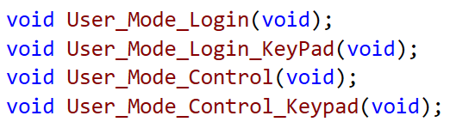
APP
LAYER
User interface : In usere file you found all user mode code (rigestration and control )
Function Prototypes:

Slide 14
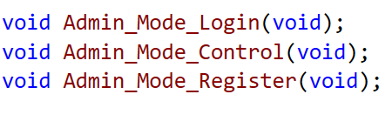
APP
LAYER
Admin interface : In Admin file you found all Admin mode code (rigestration and control )
Function Prototypes:

Slide 15
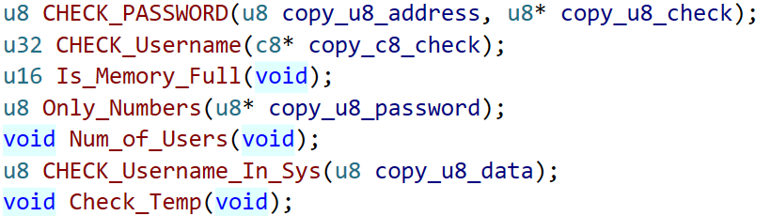
APP
LAYER
Check_file :This file write for ckeck the password of user , admin and its user name
check file has function to control room tempruter
Function Prototypes:

Slide 16
Project Link
https://github.com/khaleddayem/SMART-HOME/tree/main

Slide 17
THANK YOU
ALEX 39 GROUP

