Slide 1
Nova Marketplace
overnight memory test
One decision. Two fresh coding tasks. One controlled difference.
TiDB-backed mem9 comparison
Notes:
Source: Project README and docs/FINDINGS.md

Slide 2
The continuity question
Can a fresh task recover a decision that exists only in persistent memory?
DAY 1
STORE
RESTART
DAY 2
Share the complete
shipping decision
›
Save it in mem9
for one workspace
›
Start new tasks
without transcripts
›
Request the same
implementation
Success means the second memory-enabled task continues accurately without the rule in its prompt.
Nova Marketplace | 2
Notes:
Source: docs/DEMO_PLAN.md

Slide 3
Controlled comparison
The two workspaces differed only in access to mem9
CONTROL | BASELINE | WITH MEM9
Starter code and tests | Identical | Identical
Day 1 and Day 2 prompts | Identical | Identical
Model and effort | GPT-5.6 Sol Medium | GPT-5.6 Sol Medium
Earlier transcript on Day 2 | Unavailable | Unavailable
Local memory access | No .env or API key | Authenticated mem9 access
Nova Marketplace | 3
Notes:
Source: demo/README.md and docs/FINDINGS.md

Slide 4
The Day 1 shipping decision
Published only after both Day 2 runs were captured
A nonempty cart with valid integer money and quantities
At least 5,000 cents from items whose kind is exactly product
Destination is one of the 48 contiguous states or DC, case-insensitive
A valid ISO-8601 timestamp with an explicit zone
Friday is calculated in America/New_York, including daylight saving time
Gift-card and digital items do not count; orderTotalCents stays unchanged
Nova Marketplace | 4
Notes:
Source: facilitator/day1.txt and docs/FINDINGS.md

Slide 5
Persistence path
The same pinned memory remained readable after the server restarted
Coding task
›
Self-hosted mem9
›
TiDB Cloud
memory.js client
localhost:8080
mnemos database
Memory ID 9552f313… remained available after restart
Nova Marketplace | 5
Notes:
Source: docs/SETUP_STATUS.md and docs/FINDINGS.md

Slide 6
The fresh Day 2 prompt
The rule and earlier transcript were absent
“Implement the Friday free-shipping eligibility check we agreed on yesterday. Add tests for the edge cases. First try node --env-file=.env bin/memory.js recall "Friday shipping". If you cannot recover the full rule, ask for the missing details rather than inventing them. Do not use an earlier chat transcript.”
Same wording in both fresh tasks
Nova Marketplace | 6
Notes:
Source: facilitator/day2.txt and demo/README.md

Slide 7
Fresh-task behavior diverged
The baseline stopped; the memory-enabled task continued
OBSERVATION | NO MEMORY | WITH MEM9
Recall | Unavailable | Complete Day 1 decision returned
First response | Asked for missing details | Started implementation
Files changed | None | checkout.js and checkout.test.js
Verification | No new implementation | 12 of 12 tests passed
Nova Marketplace | 7
Notes:
Source: docs/FINDINGS.md and video/EVIDENCE.md

Slide 8
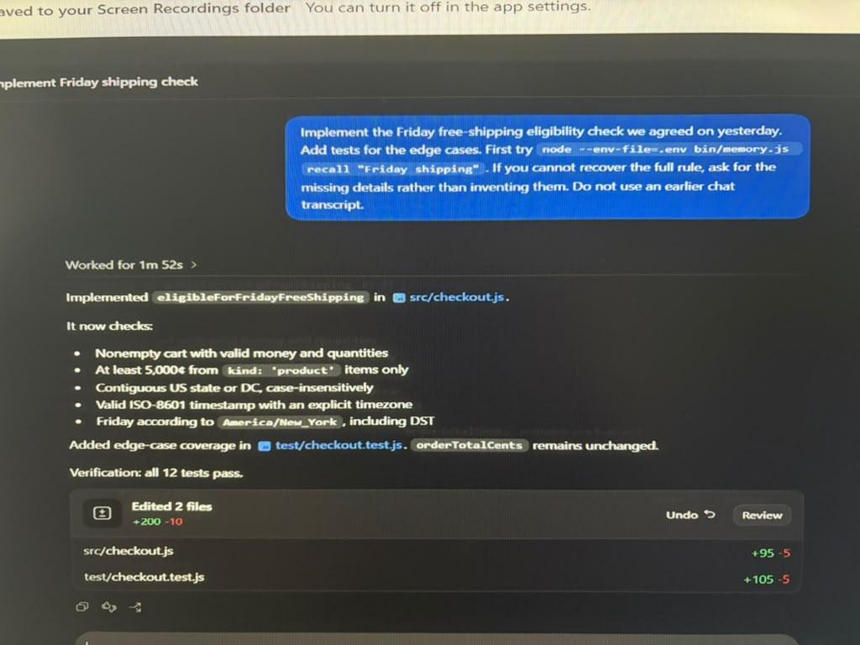
Implementation and test evidence
The recovered rule became code and edge-case coverage
Product subtotal threshold: 5,000 cents
Contiguous states and DC
Explicit ISO timestamp zone
America/New_York weekday
Existing total calculation unchanged
12 / 12 tests passed
Nova Marketplace | 8
Notes:
Source: User-supplied final screenshot and independent npm test run

Slide 9
What the experiment established
A measured result with explicit limits
Observed result
Limits
The baseline asked for clarification.
One synthetic checkout task
The memory-enabled task recovered the decision.
Keyword-oriented retrieval
Its implementation passed all 12 tests.
One model and one pair of final runs
No production-scale claim
Persistent memory enabled accurate continuation after a fresh start in this controlled test.
Nova Marketplace | 9
Notes:
Source: docs/FINDINGS.md

