Slide 1

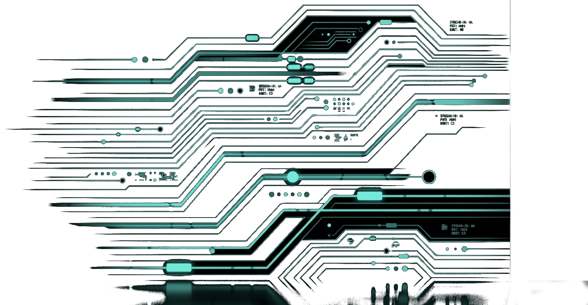

HELWAN UNI.
Faculty of Engineering
Department of Biomedical Engineering
Single-Channel ECG Sleep Stage Classification
Using 1D ResNet-34 on MESA Dataset
Five experimental variants · 5-class sleep staging
Supervisor:
Dr. Ibrahim Sadek
Eng. Merna Mansour
Eng. Veronicaa William

Slide 2
HELWAN UNI.
Faculty of Engineering
Department of Biomedical Engineering
TEAM MEMBERS
Baraa Tariq
Eslam Mohamed
Khaled Maayouf
BIO3609 – Biomedical Signal Processing Third Year – Biomedical Engineering Department Academic Year 2025-2026
GitHub: https://github.com/khaledmaaiof-bot/Sleep-Stages-Classification.git

Slide 3
HELWAN UNI.
Faculty of Engineering
Department of Biomedical Engineering
Why sleep staging matters
Diagnose sleep apnea, insomnia, epilepsy, depression
Gold standard = Polysomnography (PSG) → expensive, obtrusive, lab-based
Requires EEG, EOG, EMG, ECG, airflow, SpO₂
The research question
Can we classify sleep stages using only one ECG channel?
Why ECG?
Wearable-friendly (smartwatches, patches)
Heart rate variability (HRV) reflects autonomic changes during sleep
Enables at-home, longitudinal monitoring
Based on MESA Sleep Study [1] and sleep medicine literature

Slide 4
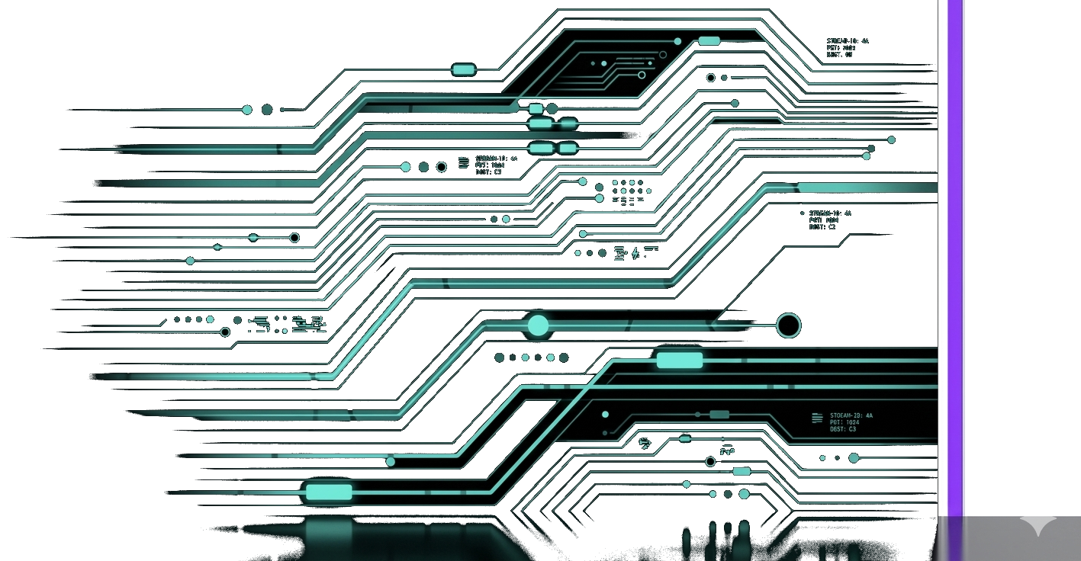
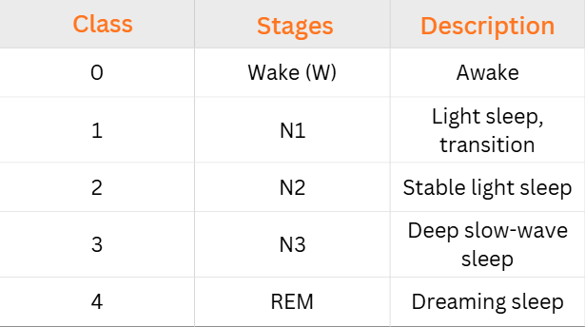
HELWAN UNI.
Faculty of Engineering
Department of Biomedical Engineering
Task Definition
5 sleep stages (30-second epochs)
Challenge: N1 is physiologically subtle on ECG alone

Slide 5
HELWAN UNI.
Faculty of Engineering
Department of Biomedical Engineering
Dataset – MESA Sleep Study
Multi-Ethnic Study of Atherosclerosis (MESA)
Overnight polysomnography with ECG + expert annotations
Annotated in 30-second epochs by sleep specialists
Our extraction:
Single ECG channel only (no EEG, EMG, EOG)
Resampled to 256 Hz → 7,680 samples per window
Bandpass filter: 0.5 – 40 Hz
Split: 80% train / 10% val / 10% test (stratified)

Slide 6
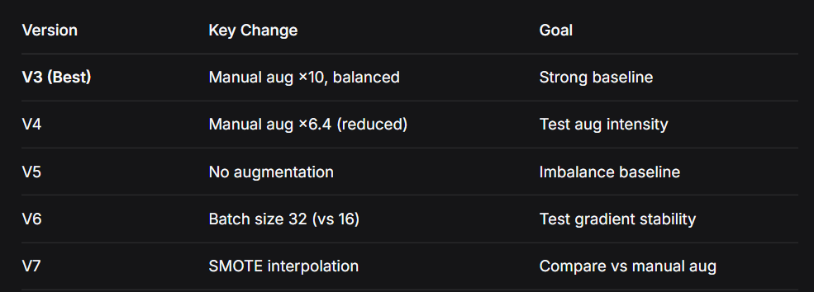
HELWAN UNI.
Faculty of Engineering
Department of Biomedical Engineering
Five Experimental Variants – Overview
We systematically compared five data balancing strategies:
All other components (model, split, loss) kept identical → fair comparison

Slide 7
HELWAN UNI.
Faculty of Engineering
Department of Biomedical Engineering
Data Preprocessing Pipeline
Step-by-step (identical for all variants):
Read EDF + XML annotation (pyEDFlib)
Extract ECG channel (label contains 'ECG'/'EKG')
Bandpass filter (0.5–40 Hz, zero-phase Butterworth)
Resample to 256 Hz (uniform sampling)
Parse XML sleep stages → map to 0–4 integer labels
Slice 30-second windows (7,680 samples)
Z-score normalize per window (mean=0, std=1)
Stratified split BEFORE any augmentation → prevents data leakage

Slide 8
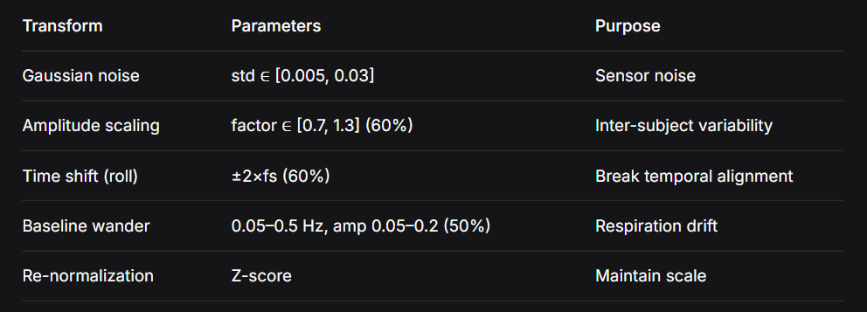
HELWAN UNI.
Faculty of Engineering
Department of Biomedical Engineering
Manual Augmentation (V3, V4, V6)
augment_ecg() – stochastic transformations:

Slide 9
HELWAN UNI.
Faculty of Engineering
Department of Biomedical Engineering
Manual Augmentation (V3, V4, V6)
Balancing logic:
Compute target = min_class_count × oversample_factor
Minority classes → synthetic samples
Majority classes → random downsampling

Slide 10
HELWAN UNI.
Faculty of Engineering
Department of Biomedical Engineering
SMOTE (V7) – A Different Approach
SMOTE = Synthetic Minority Over-sampling Technique
Generates samples by linear interpolation between real samples in feature space
No signal-domain transforms
Our implementation:
K-neighbors = 5
Oversample factor = 10× min class
Majority classes not downsampled
Key limitation:
Linearly interpolated ECG windows may not be physiologically valid

Slide 11
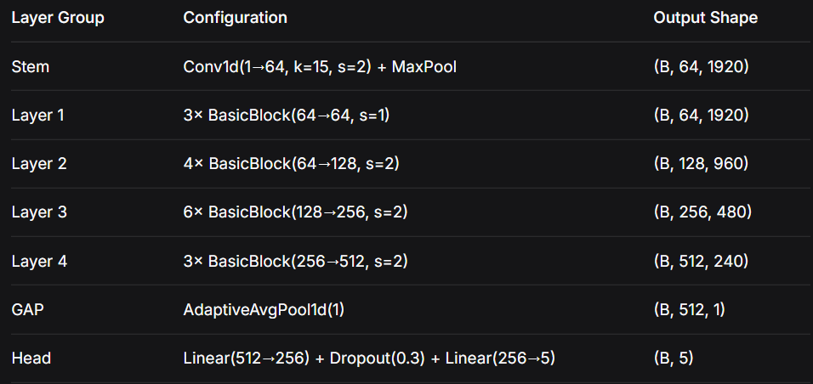
HELWAN UNI.
Faculty of Engineering
Department of Biomedical Engineering
Model Architecture – 1D ResNet-34
Adapted for time-series ECG (~21M parameters)
Residual connections enable deep training without degradation

Slide 12
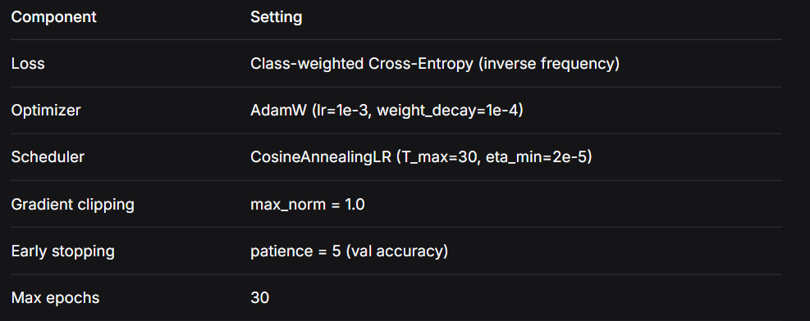

HELWAN UNI.
Faculty of Engineering
Department of Biomedical Engineering
Training Configuration (Shared)
Why class weights?
Natural class imbalance (N1 and N3 are rare) → penalizes errors on minority classes more strongly

Slide 13
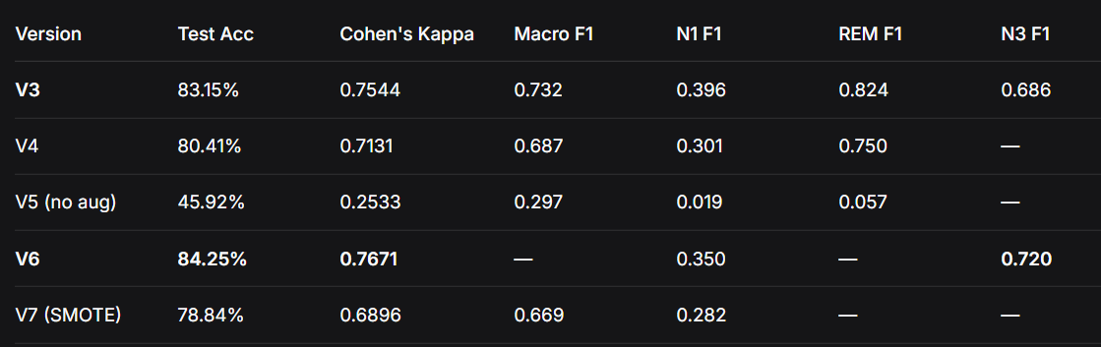
HELWAN UNI.
Faculty of Engineering
Department of Biomedical Engineering
Key Results – Test Performance
V6 achieved highest test accuracy (84.25%) and Kappa (0.7671)

Slide 14
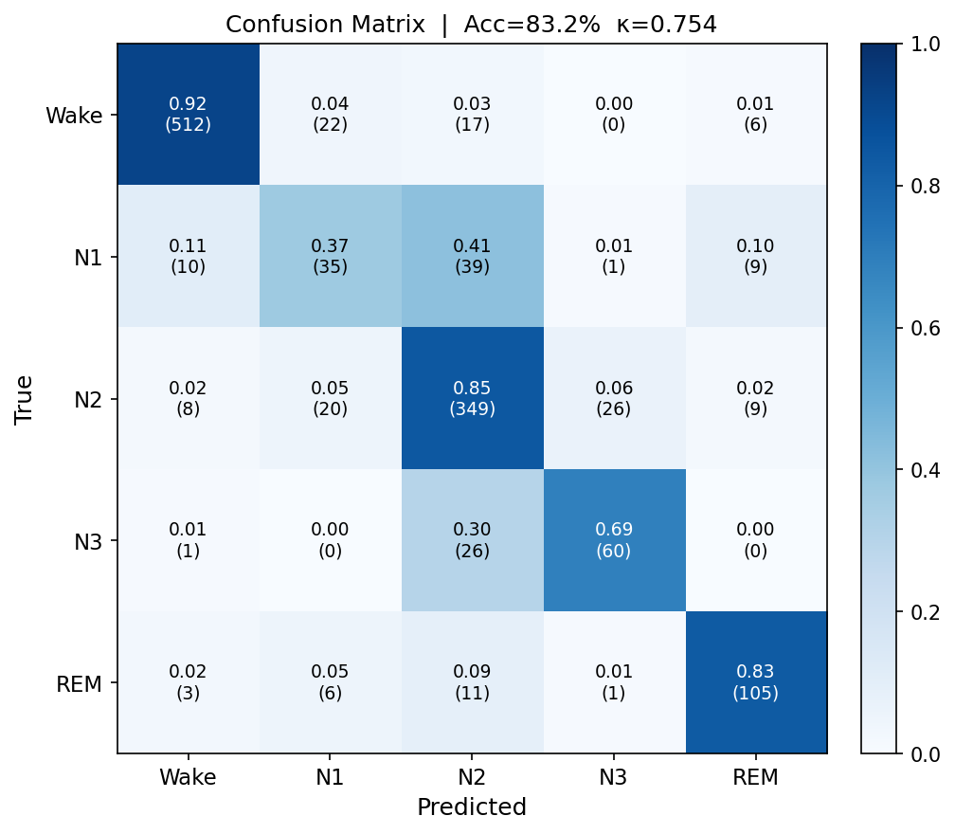
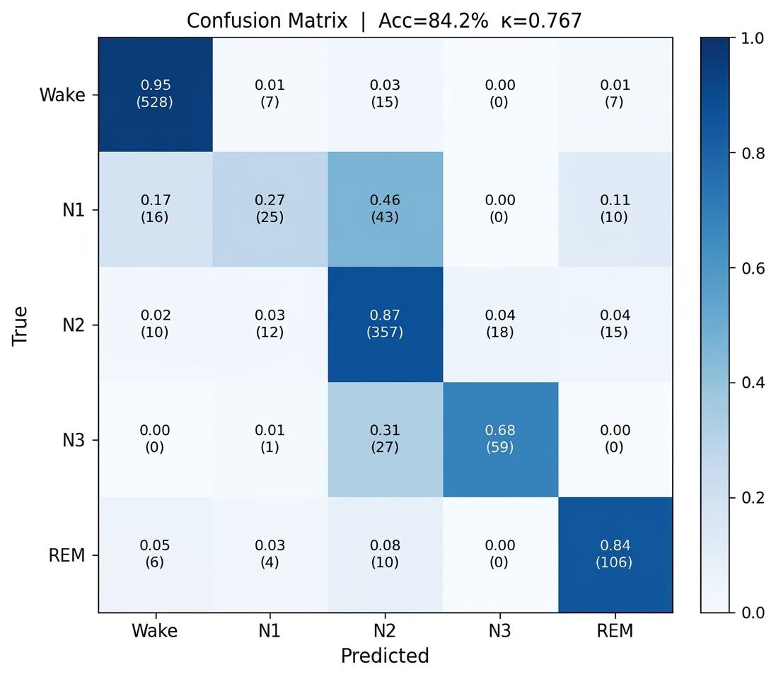
HELWAN UNI.
Faculty of Engineering
Department of Biomedical Engineering
Confusion Matrix V3
Confusion Matrix V6

Slide 15
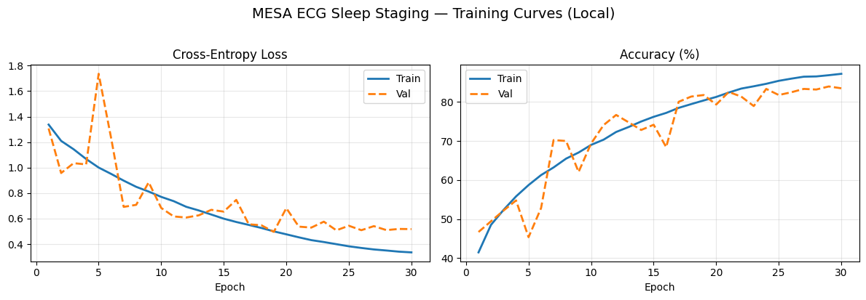
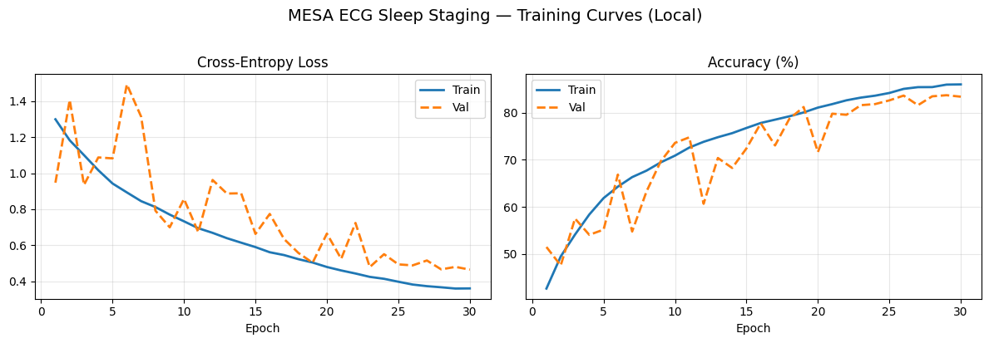
HELWAN UNI.
Faculty of Engineering
Department of Biomedical Engineering
V3 Training curve
V6 Training curve

Slide 16
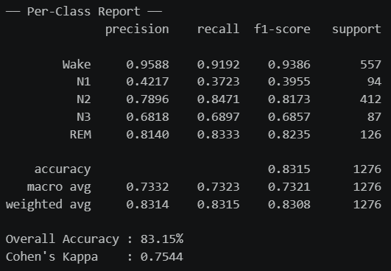
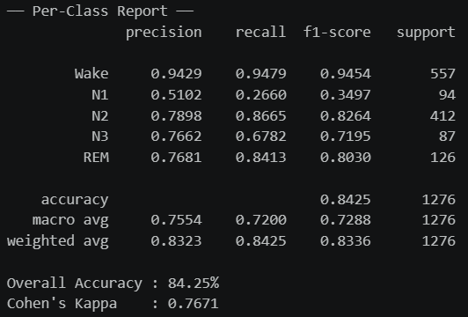
HELWAN UNI.
Faculty of Engineering
Department of Biomedical Engineering
Per Class Report V3
Per Class Report V6

Slide 17
HELWAN UNI.
Faculty of Engineering
Department of Biomedical Engineering
Confusion Matrix Analysis (V6 Best Performer)
Key observations:
Wake → excellent (92% correct, only 3% to N2)
N2 → very good (85% correct)
REM → good (83% correct)
N3 → good (69% correct, 30% confused with N2)
Increasing the oversampling ratio from 6.4x (V4) to 10x (V3) significantly boosted the N1 classification accuracy from 23% to 37%.

Slide 18
HELWAN UNI.
Faculty of Engineering
Department of Biomedical Engineering
Confusion Matrix Analysis (V6 Best Performer)
Common error patterns (physiologically expected):
- N1 ↔ N2 confusion (adjacent stages, subtle HRV differences)
- N3 ↔ N2 confusion (deep vs light slow-wave)
Best overall: V6 (84.25% Acc, Kappa=0.767)

Slide 19
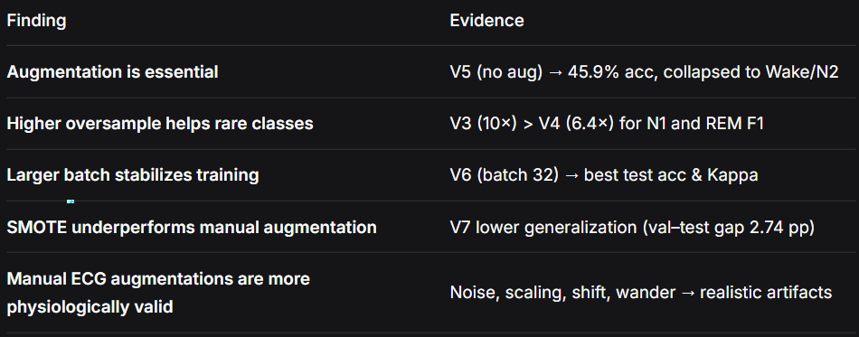
HELWAN UNI.
Faculty of Engineering
Department of Biomedical Engineering
Version Comparison – What We Learned

Slide 20
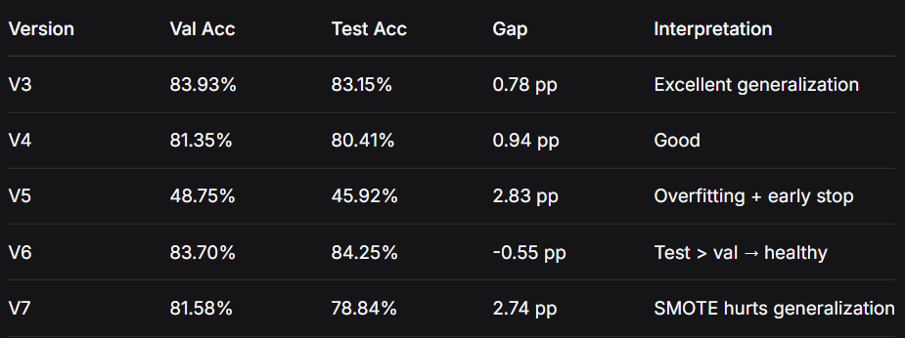
HELWAN UNI.
Faculty of Engineering
Department of Biomedical Engineering
Val–Test Generalization Gap
V6 is the only version where test accuracy exceeded validation accuracy

Slide 21
HELWAN UNI.
Faculty of Engineering
Department of Biomedical Engineering
Limitations & Challenges
Physiological limitations:
N1 is inherently ambiguous on ECG alone
Cannot capture EEG-specific markers (spindles, K-complexes, delta waves)
Technical limitations:
SMOTE-generated ECGs not physiologically guaranteed
Performance may degrade for arrhythmias not in MESA
Clinical limitations:
Not approved for clinical diagnosis (research only)
Requires reliable R-peak detection (motion artifacts in wearables)

Slide 22
HELWAN UNI.
Faculty of Engineering
Department of Biomedical Engineering
Conclusions
Yes, a single-channel ECG can classify sleep stages
Best model (V6): 84.25% test accuracy, Kappa = 0.7671
Manual ECG augmentation (noise, scaling, shift, wander) outperforms SMOTE
Larger batch size (32) improves gradient stability and generalization
Oversampling is critical – without it, model collapses (V5: 45.9%)
N1 remains challenging – future work needs better features or multimodal data

Slide 23
HELWAN UNI.
Faculty of Engineering
Department of Biomedical Engineering
References
https://arxiv.org/abs/2412.01929
https://link.springer.com/article/10.1007/s40846-021-00646-8
https://www.semanticscholar.org/paper/5dac6c758ab1c2b0763e7cc4fb0ef28baa9c4c06
https://ieeexplore.ieee.org/document/10681551
[GitHub Repository Link]

Slide 24
HELWAN UNI.
Faculty of Engineering
Department of Biomedical Engineering
THANK YOU

