Slide 1

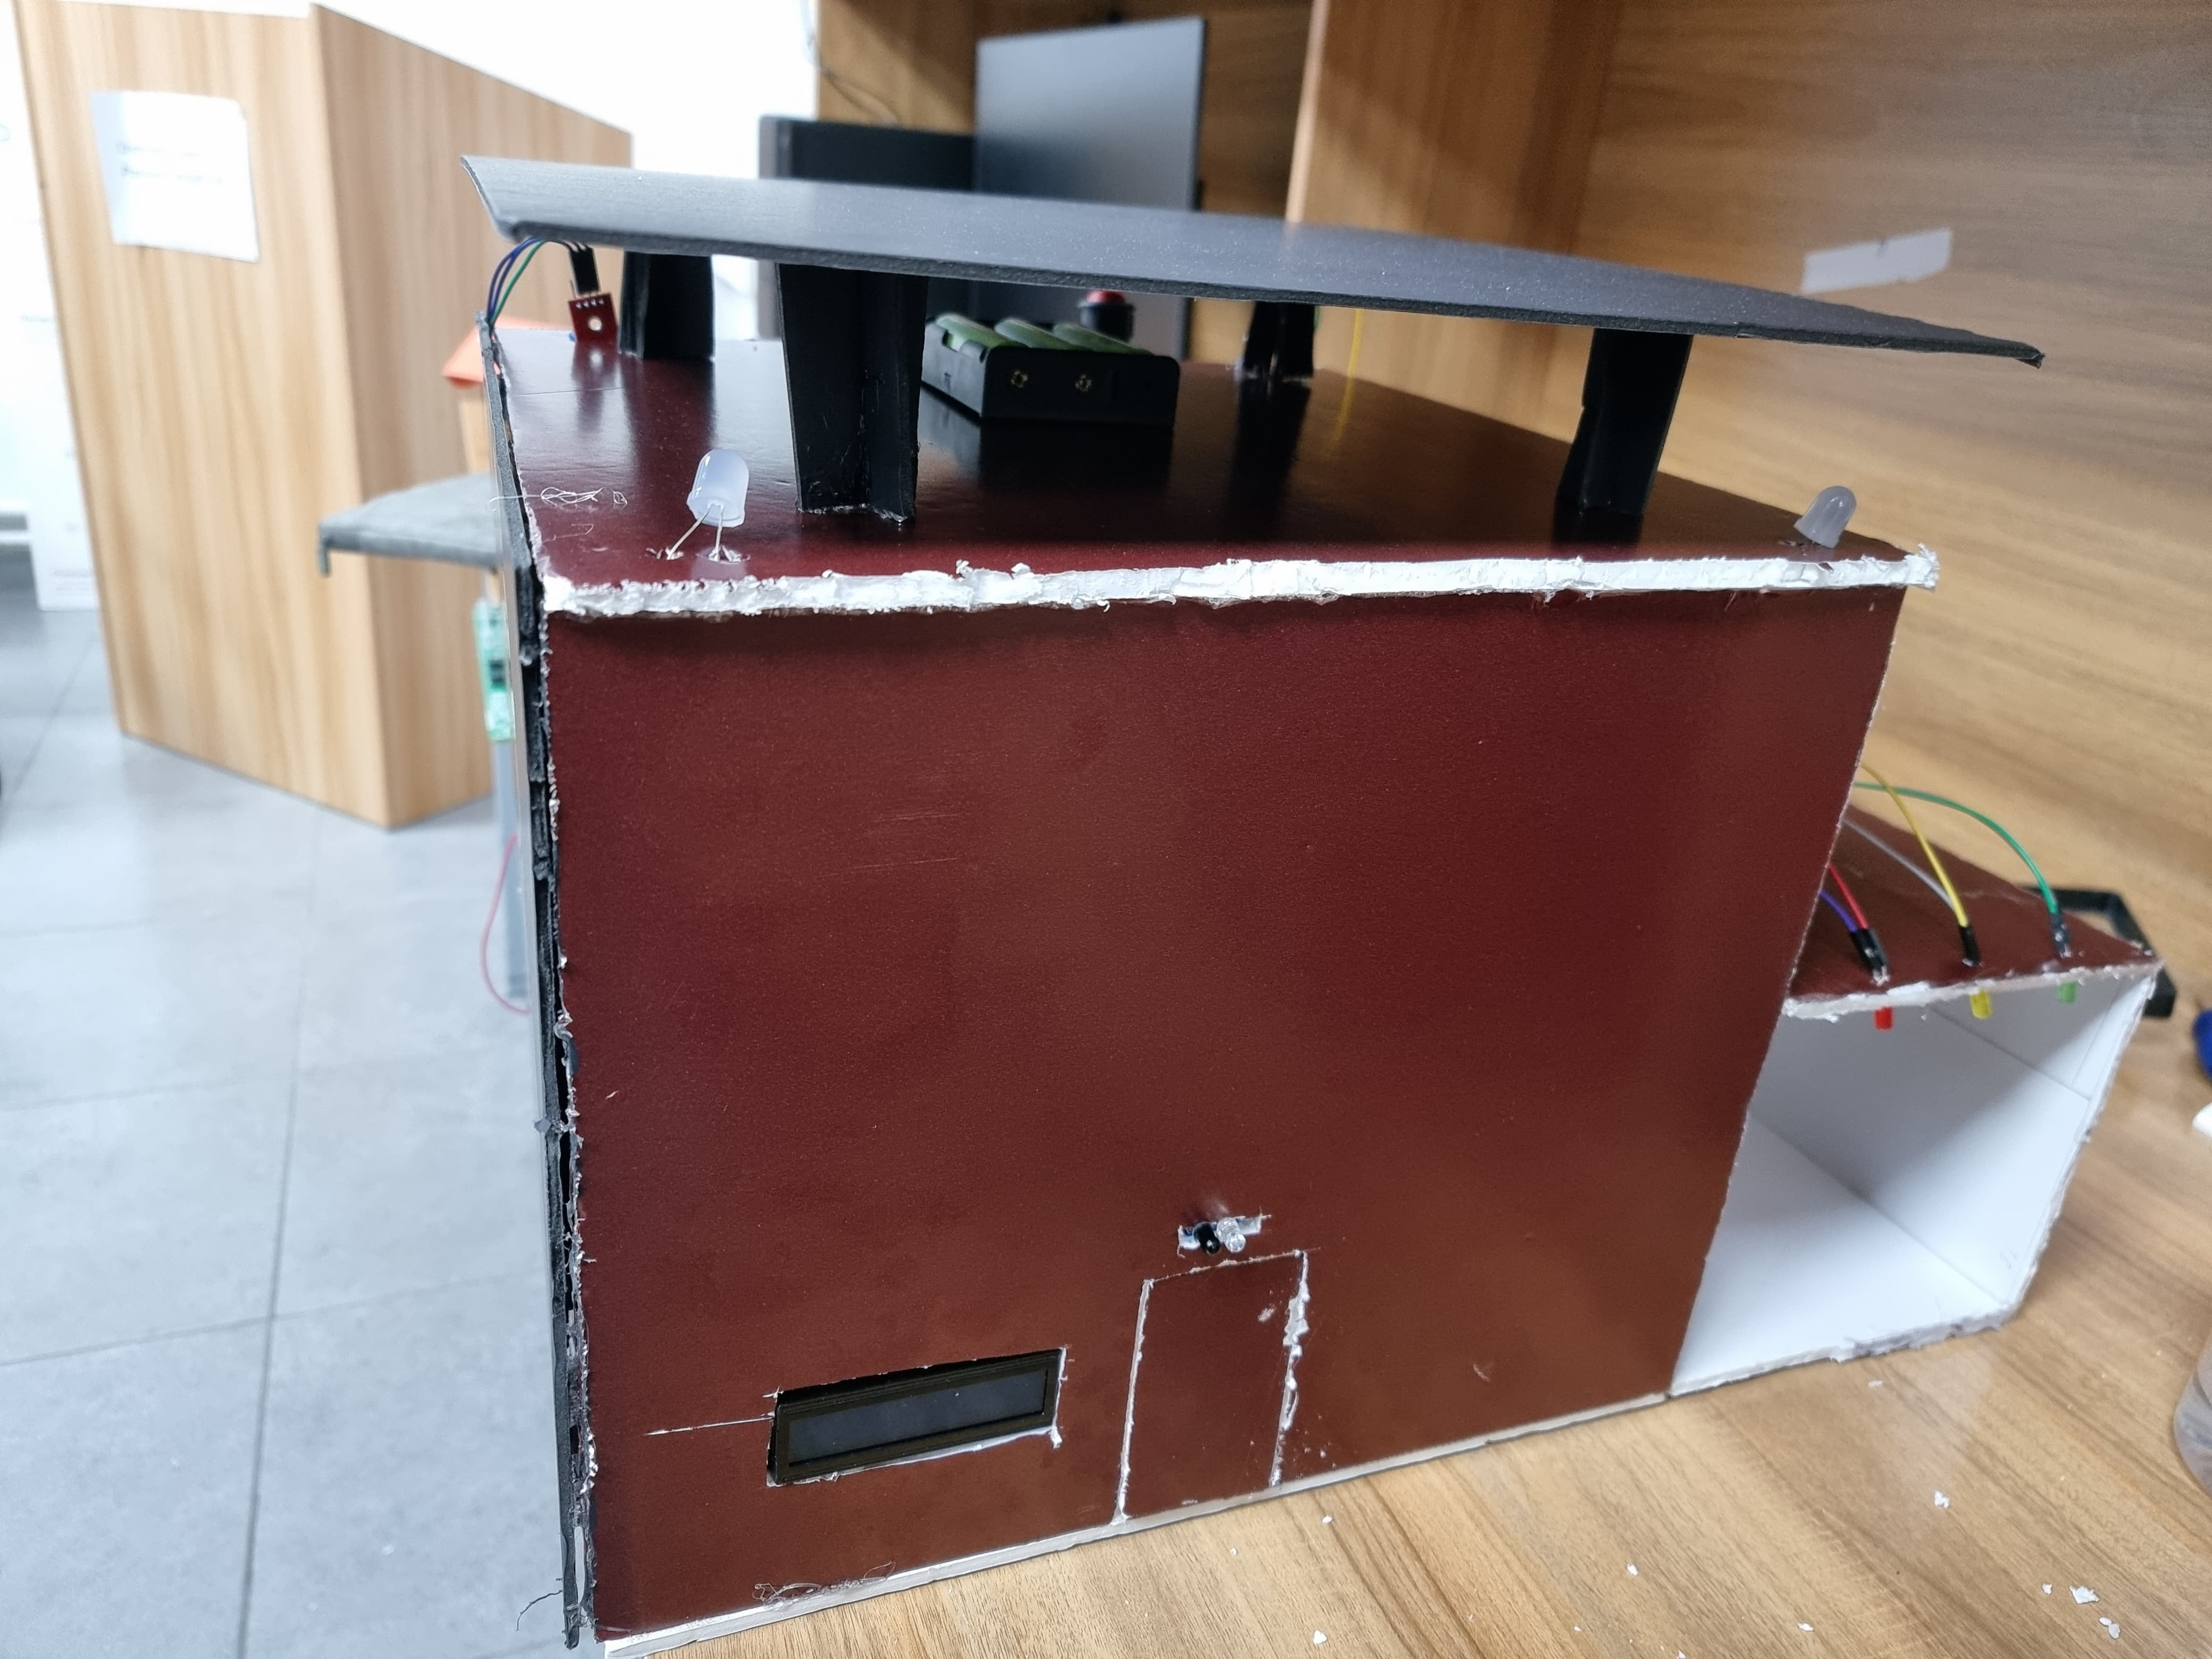
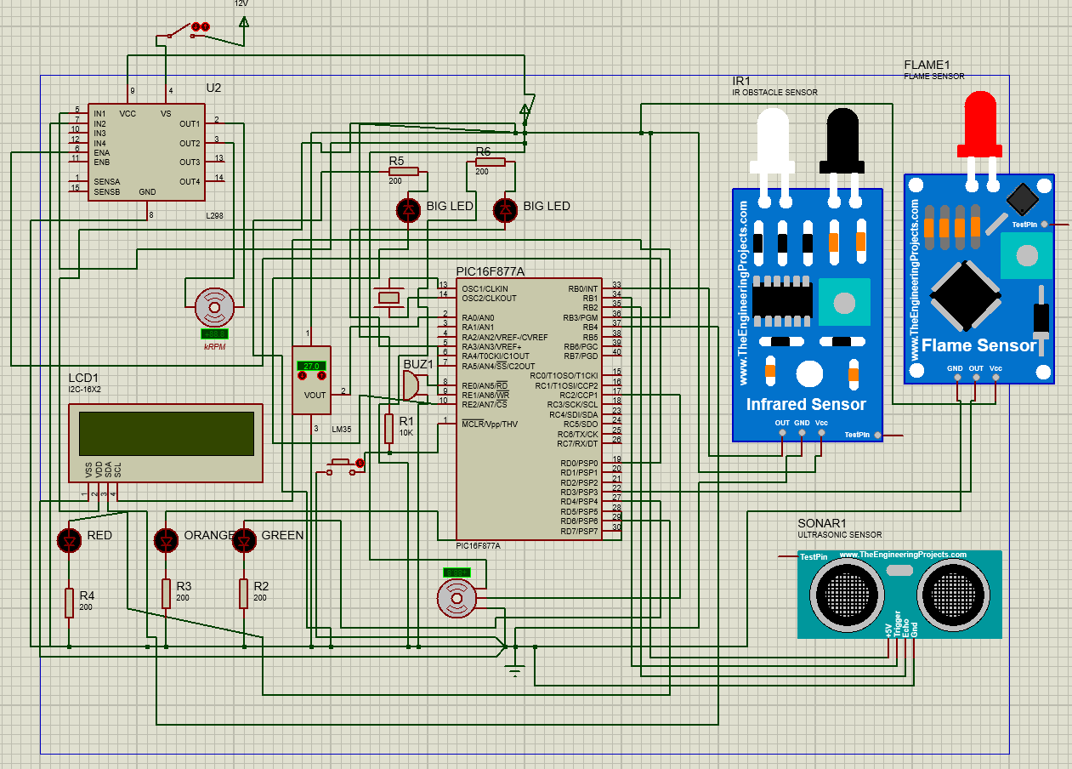
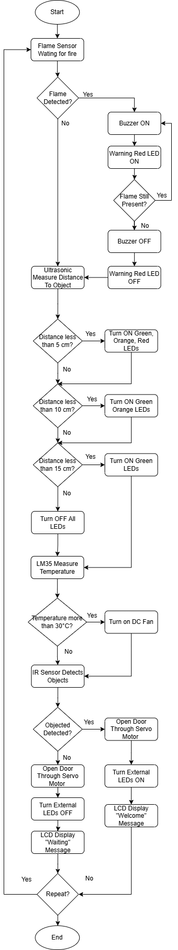
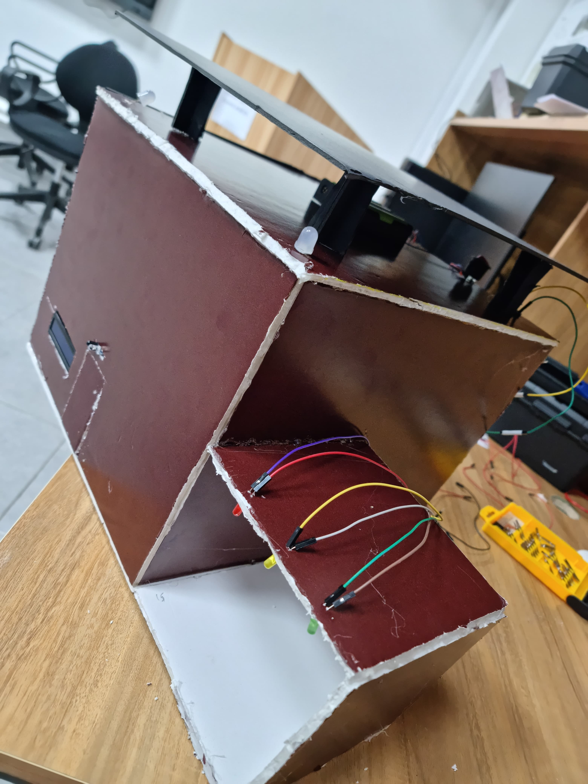
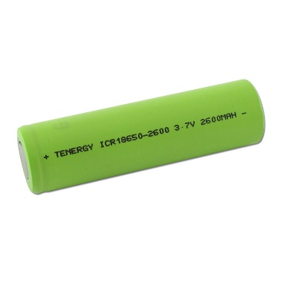
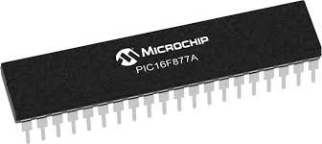
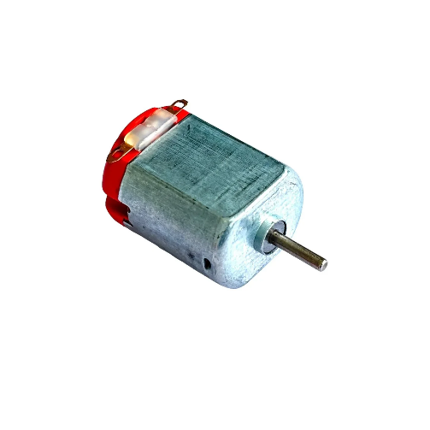
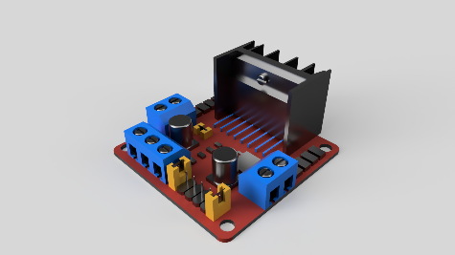
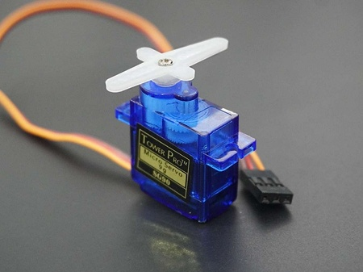
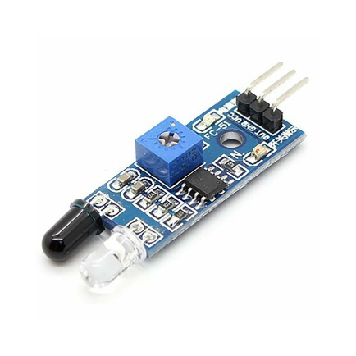
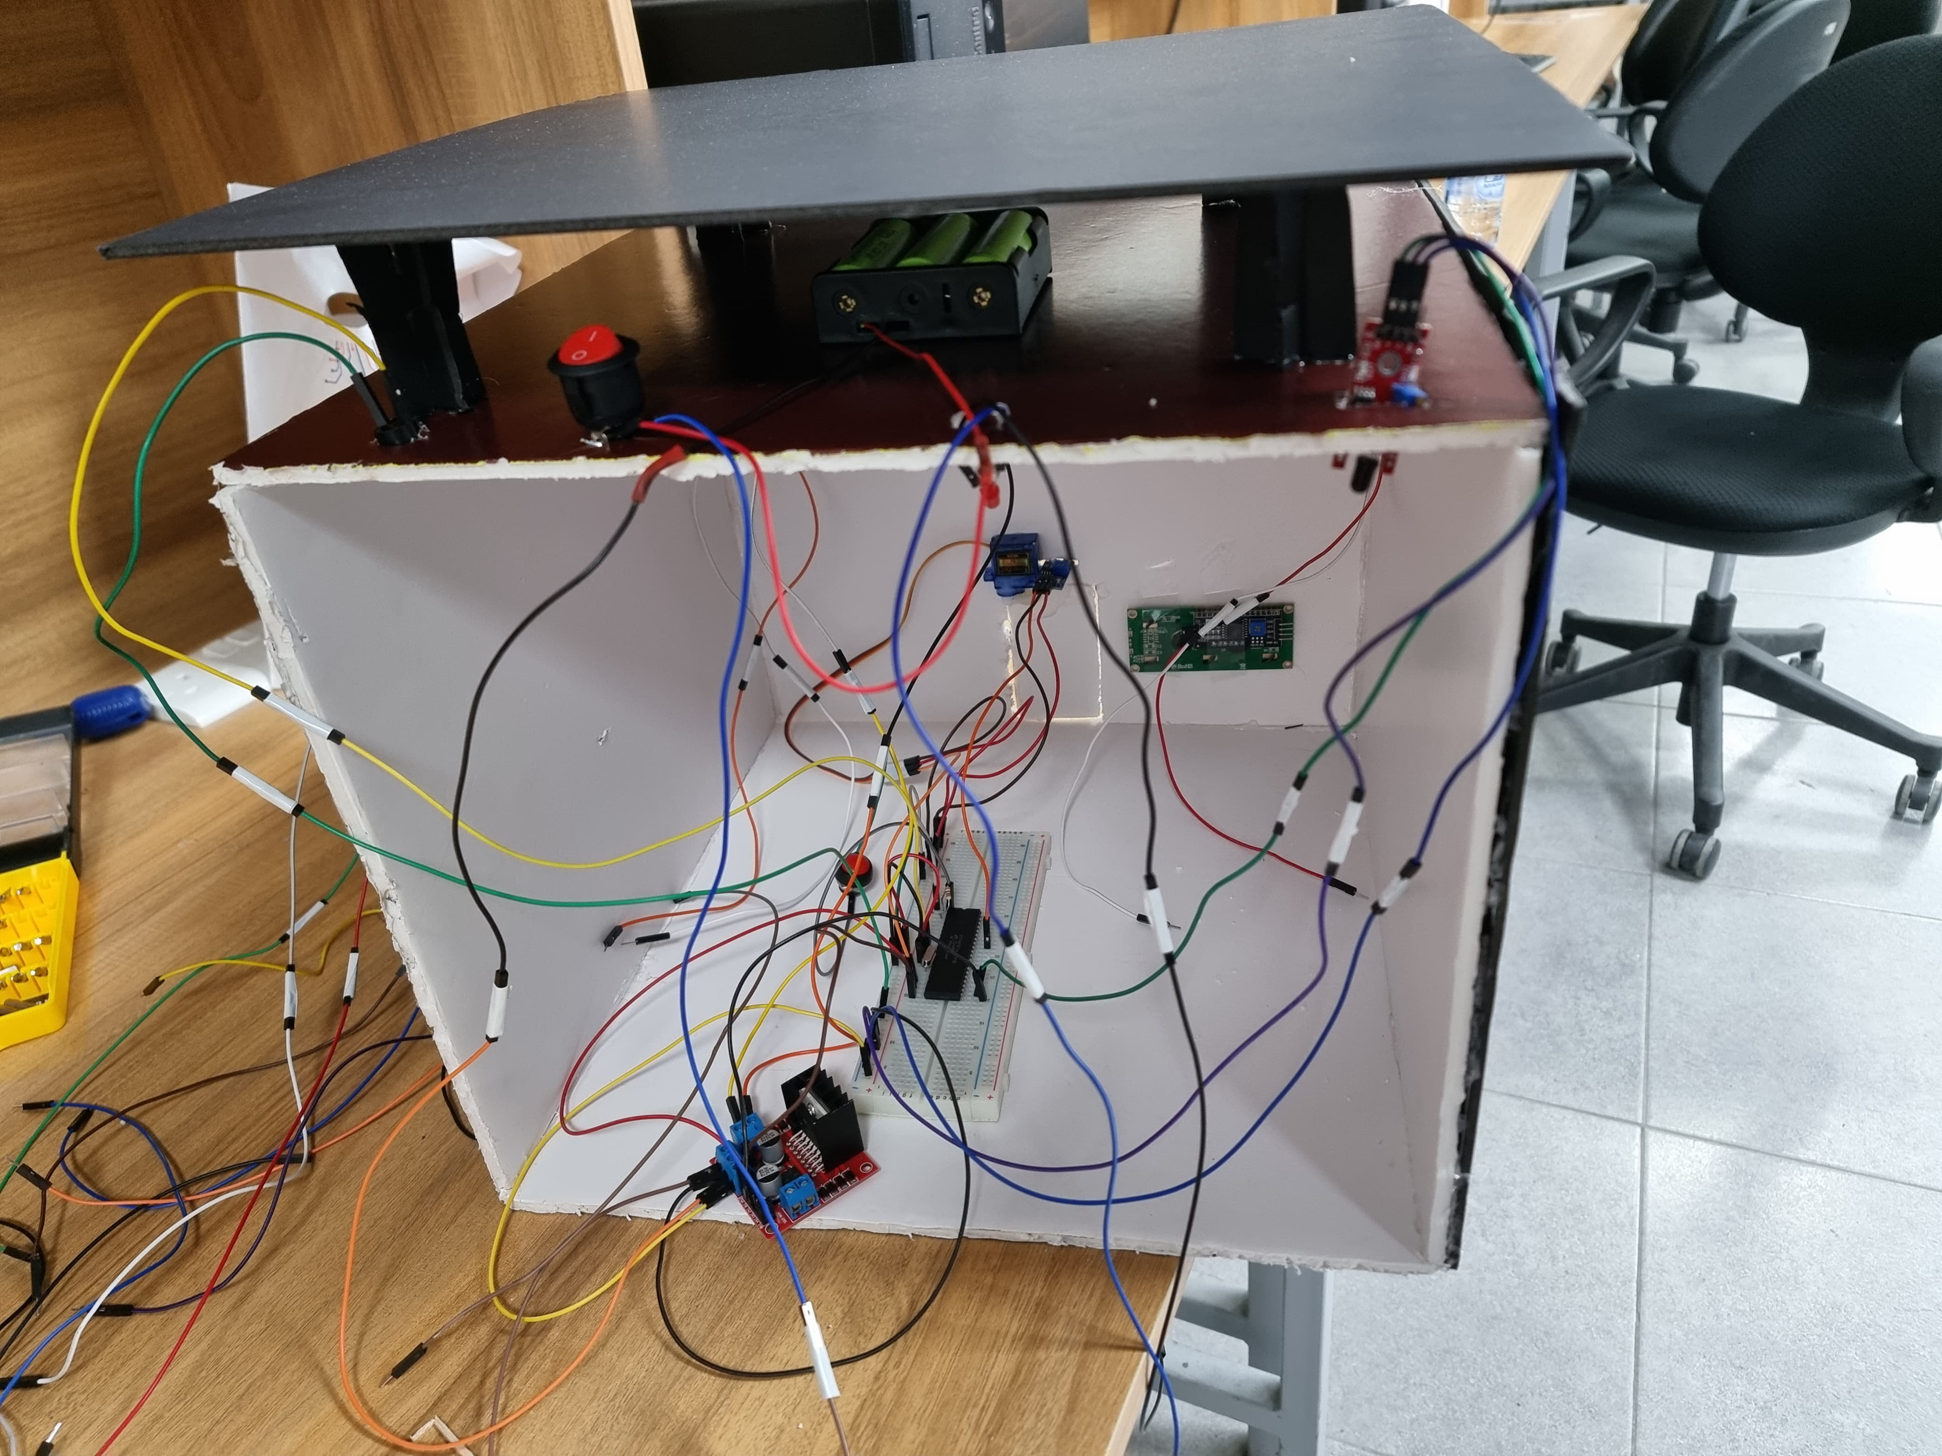
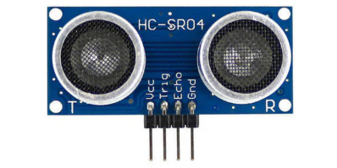
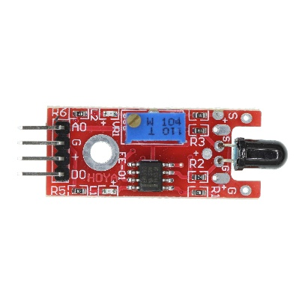
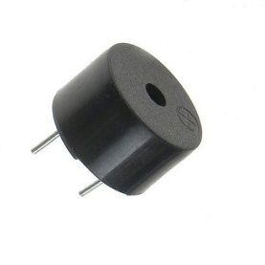
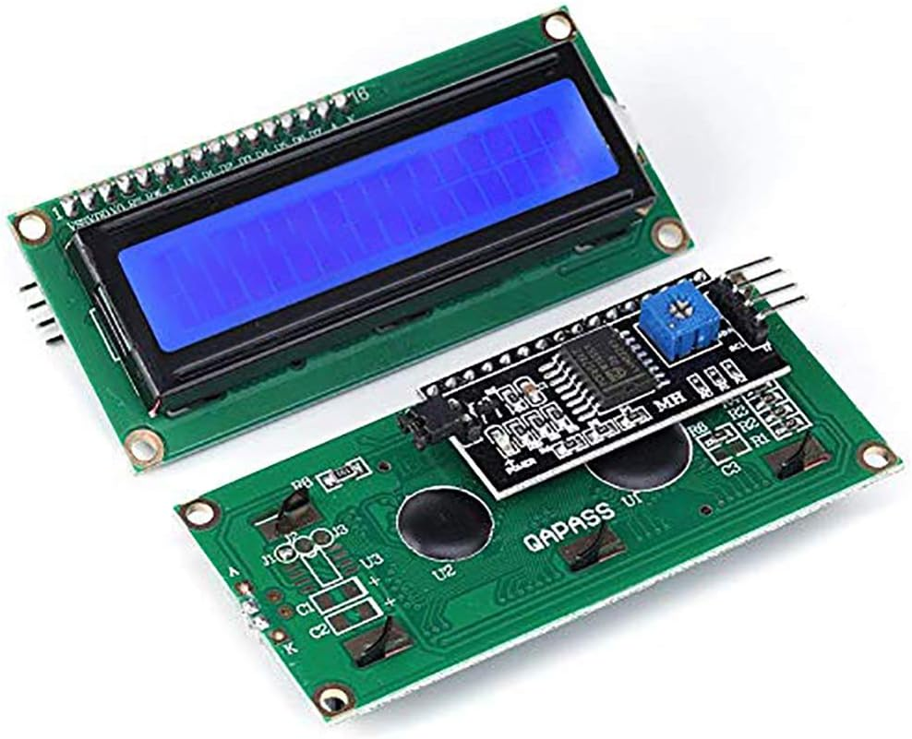
Smart Embedded Home System
A. Aljamal, K. Magablih, and A. Juma
Supervisor: Dr. Belal Sababha
Embedded Systems Final Design Project, Spring 2025
King Abdullah II School of Engineering
Princess Sumaya University for Technology
Introduction
The project aims to design a smart home system that automates and monitors various functions like automation, climate control, and assistance. Leveraging the PIC P16F877A microcontroller, the system will integrate multiple sensors and actuators to provide efficient, cost-effective, and user-friendly home automation system. Functionalities include automatic lighting control when an object is detected outside the front door, door automation using servo motors, a cooling fan based on a temperature sensor, flame alarm, and parking assistance in the garage to help the vehicles measure the distance between itself and the wall. This stand-alone embedded system includes power regulation, CCP-driven tasks, and interrupt-based functionalities.
Results
After integrating all the hardware components and the software code, the system is modeled in the figures, the MCU was the central hub for controlling everything, making a good choice for a smart home system; as can be seen in Figure 3, the smart parking system consists of ultrasonic sensor, buzzer, and LED lights. Also, the IR sensor is shown which accounts for opening the front door and lighting up the external lights, in addition to the LCD that displays a message for people outside the door. In Figure 4, the whole systems connection is shown on the breadboard, and we can see the lithium-ion batteries that are powering the system, and the flame sensor, in addition to the H-bridge that is doing power regulation and powering the DC motor. Finally, the internal components are shown in Figure 5, where the DC fan, lightings, flame buzzers are shown.
Figure 4: House Front
Figure 5: Breadboard Connections
Figure 6: House Internals
Design
The home system was designed using PIC16F877A, the microcontroller was programmed in C language on microC pro for PIC environment; the system utilized IR sensors for flame and object detection, ultrasonic sensor for distance measurement, DC motor for cooling fan that is logically controlled using LM35 temperature sensor, servo motor for door movement, and a LCD; other components include a breadboard, LEDs, buzzers, resistors, push buttons, and H-bridge. The system’s electrical diagram, which shows all the used components and their connections, is shown in figure 1. The system works in a logical manner shown in figure 2.
Figure 1: Circuit Diagram
Figure 2: Hardware Components
Figure 3: Flowchart
Conclusion
The project advances modern home convenience, integrating various sensors and actuators and other components with the PIC16F877A microcontroller to be programmed to simulate real-life situations where light automation, residents security, environmental control are needed in a cost-effective approach. The embedded system project took us deeply into microcontroller programming and we learned a lot from this experience. Although the project contained many components and ideas which made it challenging, we worked as a team to accomplish the goals of the project.

