Slide 1
Data Mining
Practical Machine Learning Tools and Techniques
Slides for Chapter 8, Data transformations
of Data Mining by I. H. Witten, E. Frank,
M. A. Hall, and C. J. Pal

Slide 2
Data transformations
Attribute selection: Scheme-independent and scheme-specific
Attribute discretization: Unsupervised, supervised, error- vs entropy-based, converse of discretization
Projections: principal component analysis (PCA), random projections, partial least-squares, independent component analysis (ICA), text, time series
Sampling: Reservoir sampling
Dirty data: Data cleansing, robust regression, anomaly detection
Notes:
3/16/2026
2
2

Slide 3
Just apply a learner? NO!
Scheme/parameter selection
Treat selection process as part of the learning process to avoid optimistic performance estimates
Modifying the input:
Data engineering to make learning possible or easier
Modifying the output
Converting multi-class problems into two-class ones
Notes:
3/16/2026
3
3

Slide 4
Machine learning research steps
Data gathering (lab experiments)
Preprocessing
Normalization, standardization, missing values
Feature selection
Filter, wrapper and embedded methods
Model formation (data mining)
Parameter tuning, avoiding over or under fitting
Model evaluation
Cross-validation
Ensemble learning

Slide 5
Common mistakes
Rushing to the modeling step
Only trying a few “popular” approaches
Using the default settings of a package
Over-fitting or under-fitting at different levels
Using wrong/unsuitable performance measures
Not paying enough attention to outliers
The curse of dimensionality

Slide 6
Attribute selection
Attribute selection is often important in practice
For example, adding a random (i.e., irrelevant) attribute can significantly degrade C4.5’s performance
Problem: C4.5’s built-in attribute selection is based on smaller and smaller amounts of data
Instance-based learning is particularly susceptible to irrelevant attributes
Number of training instances required increases exponentially with number of irrelevant attributes
Exception: naïve Bayes can cope well with irrelevant attributes
Note that relevant attributes can also be harmful if they mislead the learning algorithm
Notes:
3/16/2026
6
6

Slide 7
Scheme-independent attribute selection
Filter approach to attribute selection: assess attributes based on general characteristics of the data
In this approach, the attributes are selected in a manner that is independent of the target machine learning scheme
One method: find smallest subset of attributes that separates data
Another method: use a fast learning scheme that is different from the target learning scheme to find relevant attributes
E.g., use attributes selected by C4.5 and 1R, or coefficients of linear model, possibly applied recursively (recursive feature elimination)
Notes:
3/16/2026
7
7

Slide 8
Scheme-independent attribute selection
Attribute weighting techniques based on instance-based learning can also be used for filtering
Original approach for doing this cannot find redundant attributes (but a fix has been suggested)
Correlation-based Feature Selection (CFS):
Correlation between attributes measured by symmetric uncertainty:
Goodness of subset of attributes measured by breaking ties in favour of smaller subsets
Notes:
3/16/2026
8
8

Slide 9
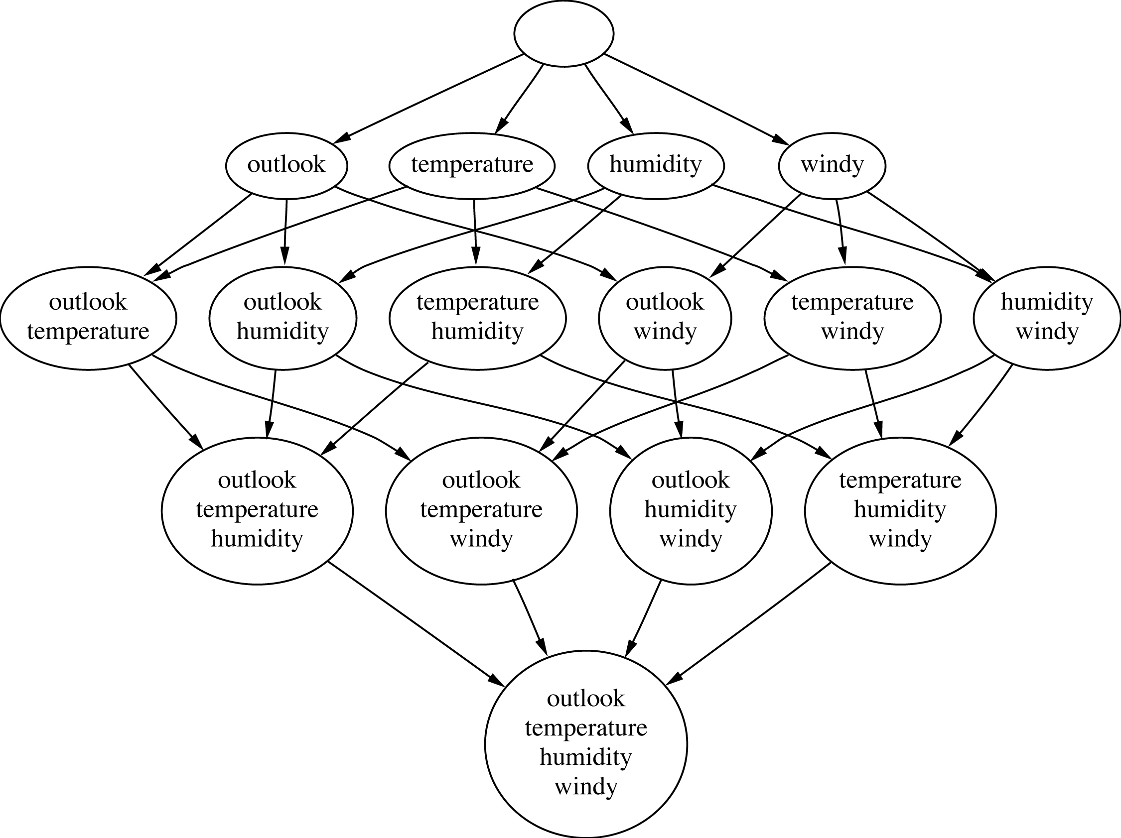
Attribute subsets for weather data
Notes:
3/16/2026
9
9

Slide 10
Searching the attribute space
Number of attribute subsets is exponential in the number of attributes
Common greedy approaches:
forward selection
backward elimination
More sophisticated strategies:
Bidirectional search
Best-first search: can find optimum solution
Beam search: approximation to best-first search
Genetic algorithms
Notes:
3/16/2026
10
10

Slide 11
Scheme-specific selection
Wrapper approach to attribute selection: attributes are selected with target scheme in the loop
Implement “wrapper” around learning scheme
Evaluation criterion: cross-validation performance
Time consuming in general
greedy approach, k attributes => k² time
prior ranking of attributes => linear in k
Can use significance test to stop cross-validation for a subset early if it is unlikely to “win” (race search)
Can be used with forward, backward selection, prior ranking, or special-purpose schemata search
Scheme-specific attribute selection is essential for learning decision tables
Efficient for decision tables and Naïve Bayes
Notes:
3/16/2026
11
11

Slide 12
Attribute discretization
Discretization can be useful even if a learning algorithm can be run on numeric attributes directly
Avoids normality assumption in Naïve Bayes and clustering
Examples of discretization we have already encountered:
1R: uses simple discretization scheme
C4.5 performs local discretization
Global discretization can be advantageous because it is based on more data
Apply learner to
k -valued discretized attribute or to
k – 1 binary attributes that code the cut points
The latter approach often works better when learning decision trees or rule sets
Notes:
3/16/2026
12
12

Slide 13
Discretization: unsupervised
Unsupervised discretization: determine intervals without knowing class labels
When clustering, the only possible way!
Two well-known strategies:
Equal-interval binning
Equal-frequency binning (also called histogram equalization)
Unsupervised discretization is normally inferior to supervised schemes when applied in classification tasks
But equal-frequency binning works well with naïve Bayes if the number of intervals is set to the square root of the size of dataset (proportional k-interval discretization)
Notes:
3/16/2026
13
13

Slide 14
Discretization: supervised
Classic approach to supervised discretization is entropy-based
This method builds a decision tree with pre-pruning on the attribute being discretized
Uses entropy as splitting criterion
Uses the minimum description length principle as the stopping criterion for pre-pruning
Works well: still the state of the art
To apply the minimum description length principle, the “theory” is
the splitting point (can be coded in log₂[N – 1] bits)
plus class distribution in each subset (a more involved expression)
Description length is the number of bits needed for coding both the splitting point and the class distributions
Compare description lengths before/after adding split
Notes:
3/16/2026
14
14

Slide 15
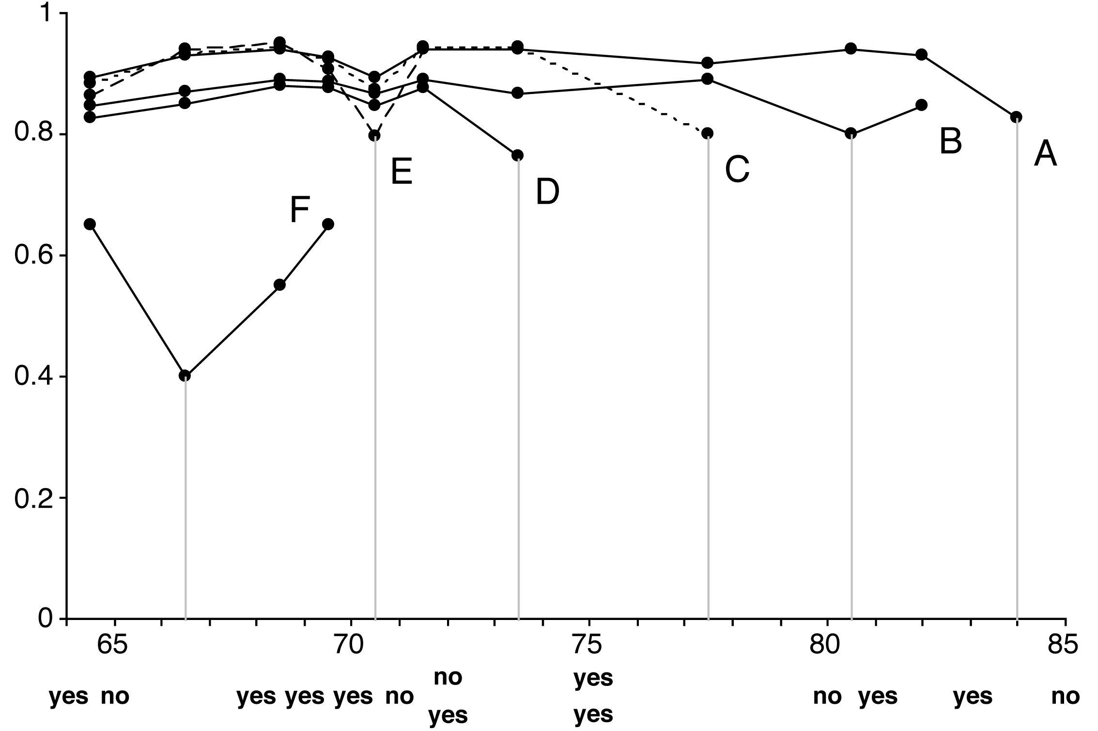
Example: temperature attribute
Temperature
64 65 68 69 70 71 72 72 75 75 80 81 83 85
Play
Yes No Yes Yes Yes No No Yes Yes Yes No Yes Yes No
Notes:
3/16/2026
15
15

Slide 16
Formula for MDL stopping criterion
Can be formulated in terms of the information gain
Assume we have N instances
Original set: k classes, entropy E
First subset: k₁ classes, entropy E₁
Second subset: k₂ classes, entropy E₂
If the information gain is greater than the expression on the right, we continue splitting
Results in no discretization intervals for the temperature attribute in the weather data
Notes:
3/16/2026
16
16

Slide 17
Supervised discretization: other methods
Can replace top-down procedure by bottom-up method
This bottom-up method has been applied in conjunction with the chi-squared test
Continue to merge intervals until they become significantly different
Can use dynamic programming to find optimum k-way split for given additive criterion
Requires time quadratic in the number of instances
But can be done in linear time if error rate is used instead of entropy
However, using error rate is generally not a good idea when discretizing an attribute as we will see
Notes:
3/16/2026
17
17

Slide 18
Error-based vs. entropy-based
Question: could the best discretization ever have two adjacent intervals with the same class?
Wrong answer: No. For if so,
Collapse the two
Free up an interval
Use it somewhere else
(This is what error-based discretization will do)
Right answer: Surprisingly, yes.
(and entropy-based discretization can do it)
Notes:
3/16/2026
18
18

Slide 19
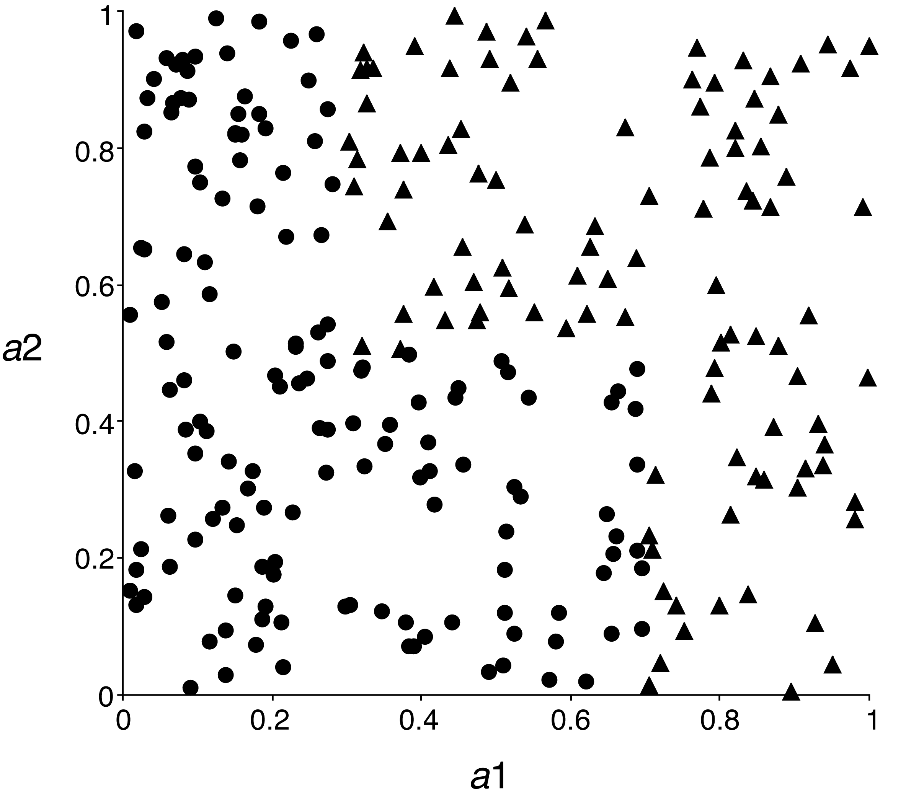
Error-based vs. entropy-based
A 2-class, 2-attribute problem
Entropy-based discretization can detect change of class distribution
Notes:
3/16/2026
19
19

Slide 20
The converse of discretization
Make nominal values into “numeric” ones
Can use indicator attributes (as in IB1)
Makes no use of potential ordering information if “nominal” attribute is actually ordinal
Alternative: code an ordered nominal attribute into binary ones as in M5’
Inequalities are explicitly represented as binary attributes, e.g., temperature < hot in the weather data
Can be used for any ordered attribute
Better than coding ordering into an integer (which implies a metric)
In general: can code binary partition of a set of attribute values as a binary attribute
Notes:
3/16/2026
20
20

Slide 21
Projections
Simple transformations can often make a large difference in performance
Example transformations (not necessarily for performance improvement):
Difference of two date attributes
Ratio of two numeric (ratio-scale) attributes
Concatenating the values of nominal attributes
Encoding cluster membership
Adding noise to data
Removing data randomly or selectively
Obfuscating the data
Notes:
3/16/2026
21
21

Slide 22
Principal component analysis
Unsupervised method for identifying the important directions in a dataset
We can then rotate the data into the (reduced) coordinate system that is given by those directions
PCA is a method for dimensionality reduction
Algorithm:
Find direction (axis) of greatest variance
Find direction of greatest variance that is perpendicular to previous direction and repeat
Implementation: find eigenvectors of the covariance matrix of the data
Eigenvectors (sorted by eigenvalues) are the directions
Notes:
3/16/2026
22
22

Slide 23
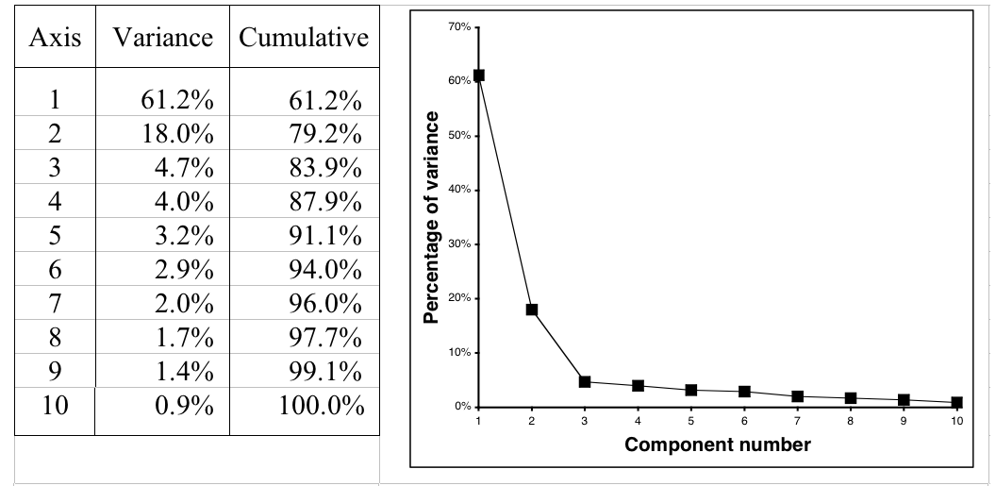
Example: 10-dimensional data
Data is normally standardized or mean-centered for PCA
Can also apply this recursively in a tree learner
Notes:
3/16/2026
23
23

Slide 24
Random projections
PCA is nice but expensive: cubic in number of attributes
Alternative: use random directions instead of principal components
Surprising: random projections preserve distance relationships quite well (on average)
Can use them to apply kD-trees to high-dimensional data
Can improve stability by using ensemble of models based on different projections
Different methods for generating random projection matrices have been proposed
Notes:
3/16/2026
24
24

Slide 25
Partial least-squares regression
PCA is often used as a pre-processing step before applying a learning algorithm
When linear regression is applied, the resulting model is known as principal components regression
Output can be re-expressed in terms of the original attributes because PCA yields a linear transformation
PCA is unsupervised and ignores the target attribute
The partial least-squares transformation differs from PCA in that it takes the class attribute into account
Finds directions that have high variance and are strongly correlated with the class
Applying PLS as a pre-processing step for linear regression yields partial least-squares regression
Notes:
3/16/2026
25
25

Slide 26
An algorithm for PLS
Start with standardized input attributes
Attribute coefficients of the first PLS direction:
Compute the dot product between each attribute vector and the class vector in turn, this yields the coefficients
Coefficients for next PLS direction:
Replace attribute value by difference (residual) between the attribute's value and the prediction of that attribute from a simple regression based on the previous PLS direction
Compute the dot product between each attribute's residual vector and the class vector in turn, this yields the coefficients
Repeat from 3
Notes:
3/16/2026
26
26

Slide 27
Independent component analysis (ICA)
PCA finds a coordinate system for a feature space that captures the covariance of the data
In contrast, ICA seeks a projection that decomposes the data into sources that are statistically independent
Consider the “cocktail party problem,” where people hear music and the voices of other people: the goal is to un-mix these signals
ICA finds a linear projection of the mixed signal that gives the most statistically independent set of transformed variables

Slide 28
Correlation vs. statistical independence
PCA is sometimes thought of as a method that seeks to transform correlated variables into linearly uncorrelated ones
Important: correlation and statistical independence are two different criteria
Uncorrelated variables have correlation coefficients equal to zero – entries in a covariance matrix
Two variables A and B are considered independent when their joint probability is equal to the product of their marginal probabilities:

Slide 29
ICA and Mutual Information
Mutual information (MI) measures the amount of info one can obtain from one random variable given another one
It can be used as an alternative criterion for finding a projection of data
We can aim to minimize the mutual information between the dimensions of the data in a linearly transformed space
Assume a model s = Ax, where A is an orthogonal matrix, x is the input data and s is its decomposition into its sources
Fact: minimizing the MI between the dimensions of s corresponds to finding a transformation matrix A so that
the estimated probability distribution of the sources p(s) is as far from Gaussian as possible and
the estimates s are constrained to be uncorrelated

Slide 30
ICA & FastICA
A popular technique for performing independent component analysis is known as fast ICA
Uses a quantity known as the negentropy J(s) = H(z) – H(s), where
z is a Gaussian random variable with the same covariance matrix as s and
H(.) is the “differential entropy,” defined as
Negentropy measures the departure of s’s distribution from the Gaussian distribution
Fast ICA uses simple approximations to the negentropy allowing learning to be performed more quickly.

Slide 31
Text to attribute vectors
Many data mining applications involve textual data (e.g., string attributes in ARFF)
Standard transformation: convert string into bag of words by tokenization
Attribute values are binary, word frequencies (f_{ij}), log(1+f_{ij}), or TF × IDF:
Many configuration options:
Only retain alphabetic sequences?
What should be used as delimiters?
Should words be converted to lowercase?
Should stopwords be ignored?
Should hapax legomena be included? Or even just the k most frequent words?
Notes:
3/16/2026
31
31

Slide 32
Time series
In time series data, each instance represents a different time step
Some simple transformations:
Shift values from the past/future
Compute difference (delta) between instances (i.e., “derivative”)
In some datasets, samples are not regular but time is given by timestamp attribute
Need to normalize by step size when transforming
Transformations need to be adapted if attributes represent different time steps
Notes:
3/16/2026
32
32

Slide 33
Sampling
Sampling is typically a simple procedure
What if training instances arrive one by one but we don't know the total number in advance?
Or perhaps there are so many that it is impractical to store them all before sampling?
Is it possible to produce a uniformly random sample of a fixed size? Yes.
Algorithm: Reservoir sampling
Fill the reservoir, of size r, with the first r instances to arrive
Subsequent, instances replace a randomly selected reservoir element with probability r/i, where i is the number of instances seen so far
Notes:
3/16/2026
33
33

Slide 34
Automatic data cleansing
To (potentially) improve a decision tree:
Remove misclassified instances, then re-learn!
Better (of course!):
Human expert checks misclassified instances
Attribute noise vs. class noise
Attribute noise should be left in the training set (i.e., do not train on clean set and test on dirty one)
Systematic class noise (e.g., one class substituted for another): leave in training set
Unsystematic class noise: eliminate from training set, if possible
Notes:
3/16/2026
34
34

Slide 35
Robust regression
“Robust” statistical method => one that addresses problem of outliers
Possible ways to make regression more robust:
Minimize absolute error, not squared error
Remove outliers (e.g., 10% of points farthest from the regression plane)
Minimize median instead of mean of squares (copes with outliers in x and y direction)
Least median of squares regression finds the narrowest strip covering half the observations
Expensive to compute
Notes:
3/16/2026
35
35

Slide 36
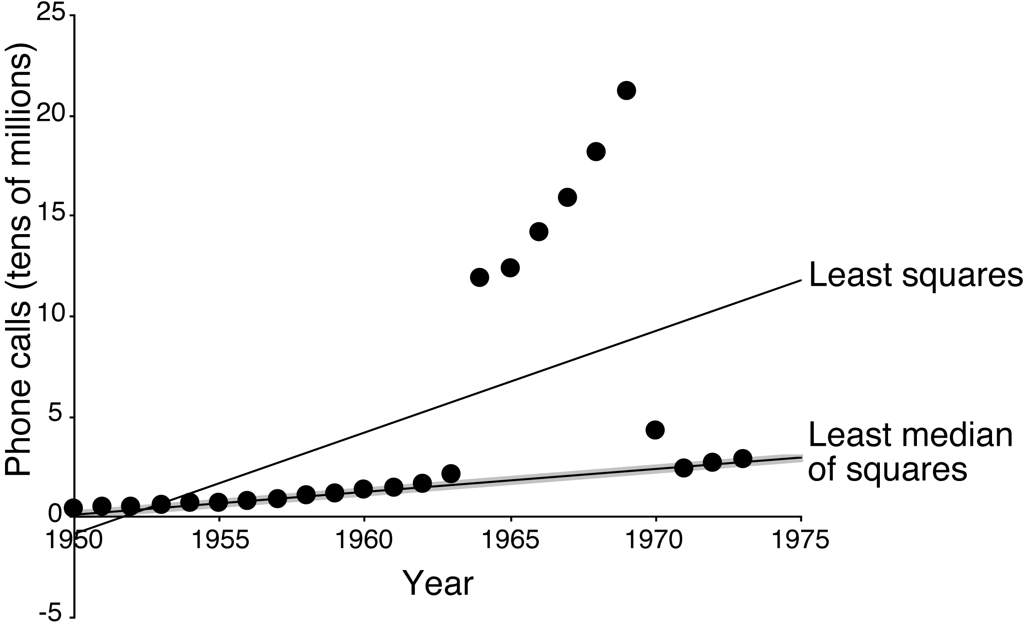
Example: least median of squares
Number of international phone calls from Belgium, 1950–1973
Notes:
3/16/2026
36
36

Slide 37
Detecting anomalies
Visualization can help to detect anomalies
Automatic approach: apply committee of different learning schemes, e.g.,
decision tree
nearest-neighbor learner
Support Vector Machines
Conservative consensus approach: delete instances incorrectly classified by all of them
Problem: might sacrifice instances of small classes
Notes:
3/16/2026
37
37

Slide 38
One-Class Learning
Usually training data is available for all classes
Some problems exhibit only a single class at training time
Test instances may belong to this class or a new class not present at training time
This the problem of one-class classification
Predict either target or unknown
Note that, in practice, some one-class problems can be re-formulated into two-class ones by collecting negative data
Other applications truly do not have negative data, e.g., password hardening
Notes:
3/16/2026
38
38

Slide 39
Outlier detection
One-class classification is often used for outlier/anomaly/novelty detection
First, a one-class models is built from the dataset
Then, outliers are defined as instances that are classified as unknown
Another method: identify outliers as instances that lie beyond distance d from percentage p of training data
Density estimation is a very useful approach for one-class classification and outlier detection
Estimate density of the target class and mark low probability test instances as outliers
Threshold can be adjusted to calibrate sensitivity
Notes:
3/16/2026
39
39

Slide 40
Using artificial data for one-class classification
Can we apply standard multi-class techniques to obtain one-class classifiers?
Yes: generate artificial data to represent the unknown non-target class
Can then apply any off-the-shelf multi-class classifier
Can tune rejection rate threshold if classifier produces probability estimates
Too much artificial data will overwhelm the target class!
But: unproblematic if multi-class classifier produces accurate class probabilities and is not focused on misclassification error
Generate uniformly random data?
Curse of dimensionality – as # attributes increases it becomes infeasible to generate enough data to get good coverage of the space
Notes:
3/16/2026
40
40

Slide 41
Generating artificial data
Idea: generate data that is close to the target class
T – target class, A – artificial class
Generate artificial data using appropriate distribution P(X | A)
Data no longer uniformly distributed -> must take this distribution into account when computing membership scores for the one-class model
Want P(X | T), for any instance X; we know P(X | A)
Train probability estimator P(T | X) on two classes T and A
Then, rewrite Bayes' rule:
For classification, choose a threshold to tune rejection rate
How to choose P(X | A)? Apply a density estimator to the target class and use resulting function to model the artificial class
Notes:
3/16/2026
41
41

Slide 42
Transforming multiple classes to binary ones
Some learning algorithms only work with two class problems
Sophisticated multi-class variants exist in many cases but can be very slow or difficult to implement
A common alternative is to transform multi-class problems into multiple two-class ones
Simple methods:
Discriminate each class against the union of the others – one-vs.-rest
Build a classifier for every pair of classes – pairwise classification
Notes:
3/16/2026
42
42

Slide 43
Weka implementations
Attribute selection
CfsSubsetEval (correlation-based attribute subset evaluator)
ConsistencySubsetEval (measures class consistency for a given set of attributes, in the consistencySubsetEval package)
ClassifierSubsetEval (uses a classifier for evaluating subsets of attributes, in the classifierBasedAttributeSelection package)
SVMAttributeEval (ranks attributes according to the magnitude of the coefficients learned by an SVM, in the SVMAttributeEval package)
ReliefF (instance-based approach for ranking attributes)
WrapperSubsetEval (uses a classifier plus cross-validation)
GreedyStepwise (forward selection and backward elimination search)
LinearForwardSelection (forward selection with a sliding window of attribute choices at each step of the search, in the linearForwardSelection package)
BestFirst (search method that uses greedy hill-climbing with backtracking)
RaceSearch (uses the race search methodology, in the raceSearch package)
Ranker (ranks individual attributes according to their evaluation)

Slide 44
Weka implementations
Learning decision tables: DecisionTable
Discretization
Discretize (unsupervised and supervised versions)
PKIDiscretize (proportional k-interval discretization)
PrincipalComponents and RandomProjection
FastICA (independent component analysis, in the StudentFilters package)
StringToWordVector (text to attribute vectors)
PLSFilter (partial least squares transformation)
Resampling and reservoir sampling

Slide 45
Weka implementations
OneClassClassifier
Implements one-class classification using artificial data (available in the oneClassClassifier package)
Many other preprocessing tools are available:
Arithmetic operations; time-series operations; obfuscation; generating cluster membership values; adding noise; various conversions between numeric, binary, and nominal attributes; and various data cleansing operations

