Slide 1
An Introduction to WEKA
CSCI/ARTI 8950 – Machine Learning

Slide 2
Content
What is Weka? (Installing, Applications )
Pre-Processing in Weka ( Filtering, Sampling, Removing, Editing, exporting)
Classification in Weka ( SVM, NN, J48, NB)
Other tabs in Explorer ( Clustering, Association Rules, Select Attribute, Visualization)
References
Package Manager

Slide 3
What is WEKA?
Waikato Environment for Knowledge Analysis
It’s a data mining/machine learning tool developed by Department of Computer Science, University of Waikato, New Zealand.
Weka is a collection of machine learning algorithms for data mining tasks.
Weka is an open-source software issued under the GNU General Public License.

Slide 4

Download and Install WEKA
Website: https://ml.cms.waikato.ac.nz/weka
Support multiple platforms (written in java):
Windows, Mac OS X and Linux
Weka Documentation :
https://waikato.github.io/weka-wiki/documentation/

Slide 5
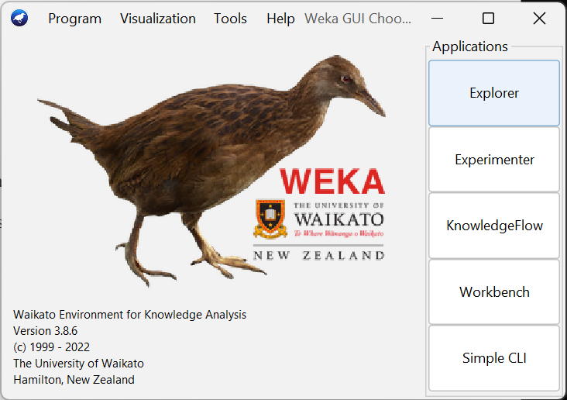
Application GUI
“The Explorer” (exploratory data analysis)
“The Experimenter” (experimental environment)
“The KnowledgeFlow” (new process model inspired interface)
The Workbench
Simple CLI (Command prompt)

Slide 6
Weka Explorer
Classify: Train and test learning
2
Cluster: Learn clusters for the data.
3
Associate: Learn association rules
4
Select attributes: Select the most relevant
5
Visualize: View 2D plot
6
Preprocess: Choose and modify the data
1

Slide 7
Pre-Processing
Data can be imported from a file in various formats: ARFF, CSV, C4.5, Json, binary
Data can also be read from a URL or from an SQL database (using JDBC)
Pre-processing tools in WEKA are called “filters”
WEKA contains filters for: Discretization, normalization, resampling, attribute selection, transforming and combining attributes

Slide 8
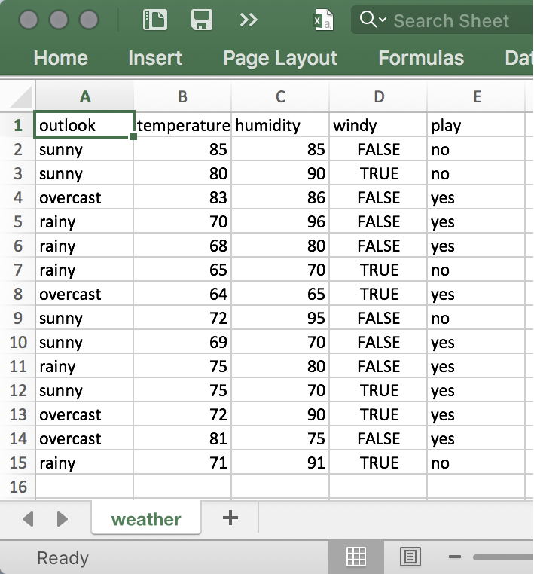
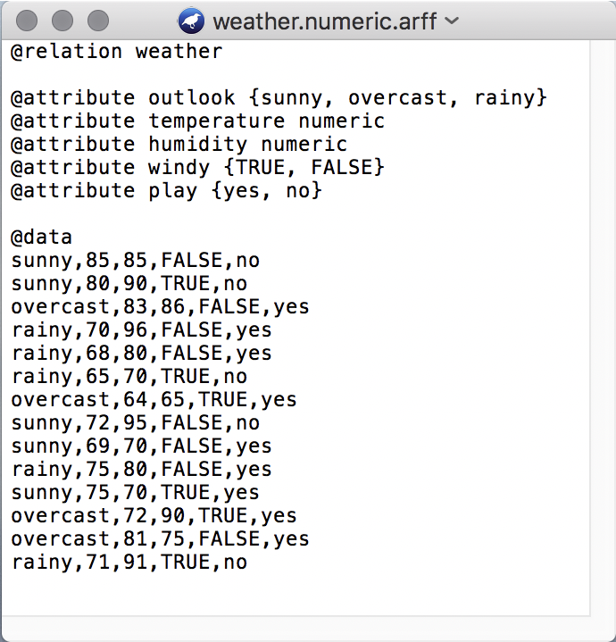
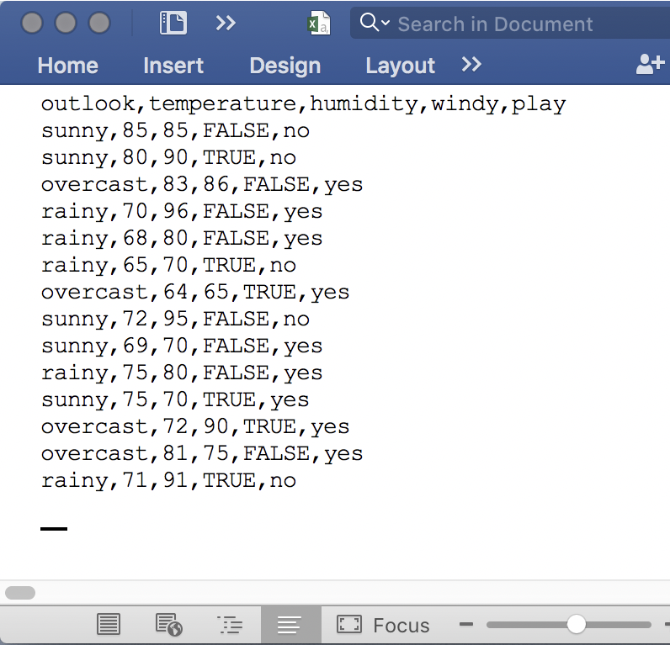
Data Types:
Spreadsheet
ARFF
CSV

Slide 9
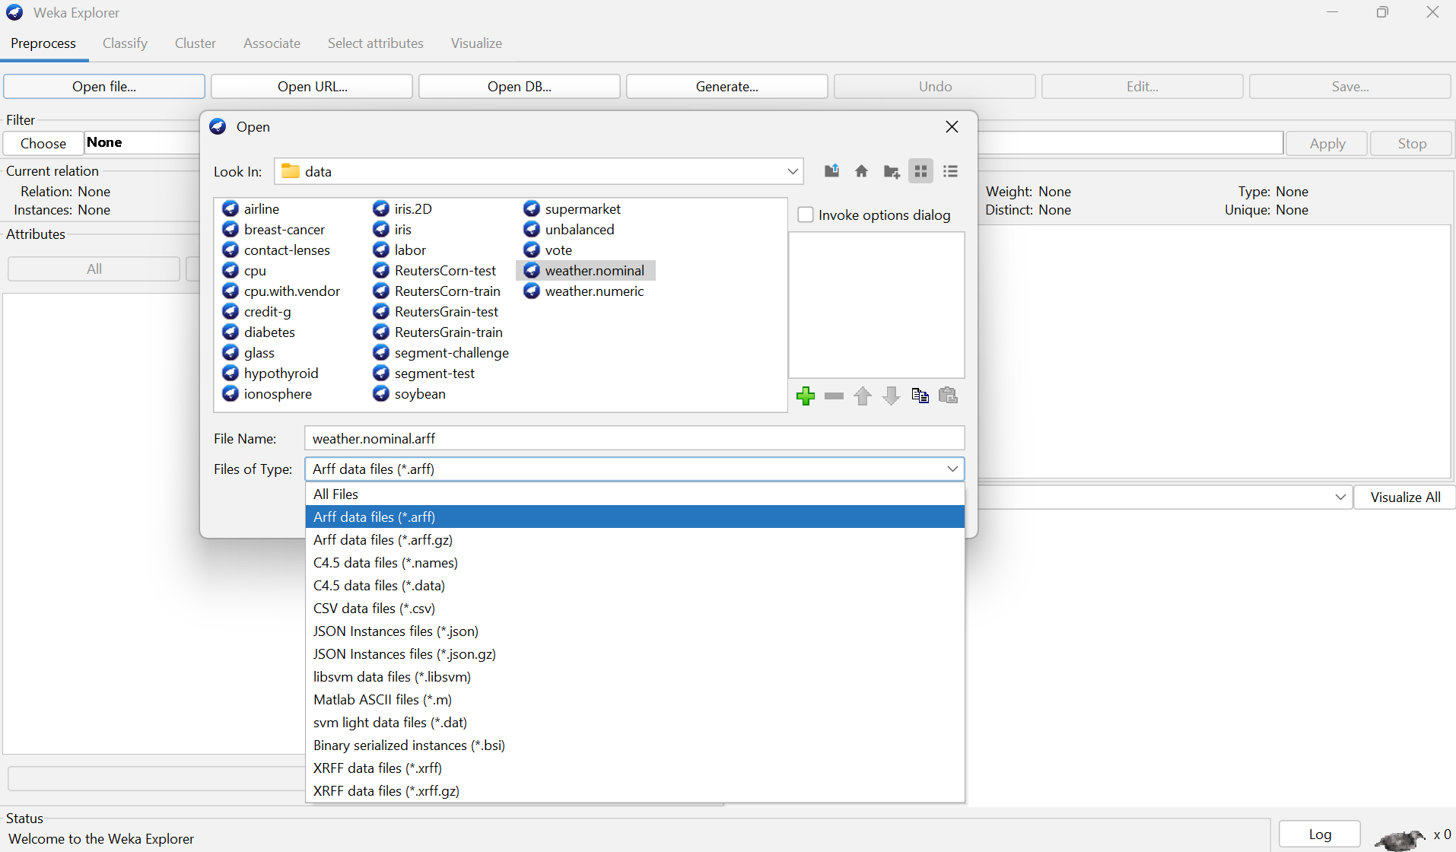
Selecting Dataset

Slide 10
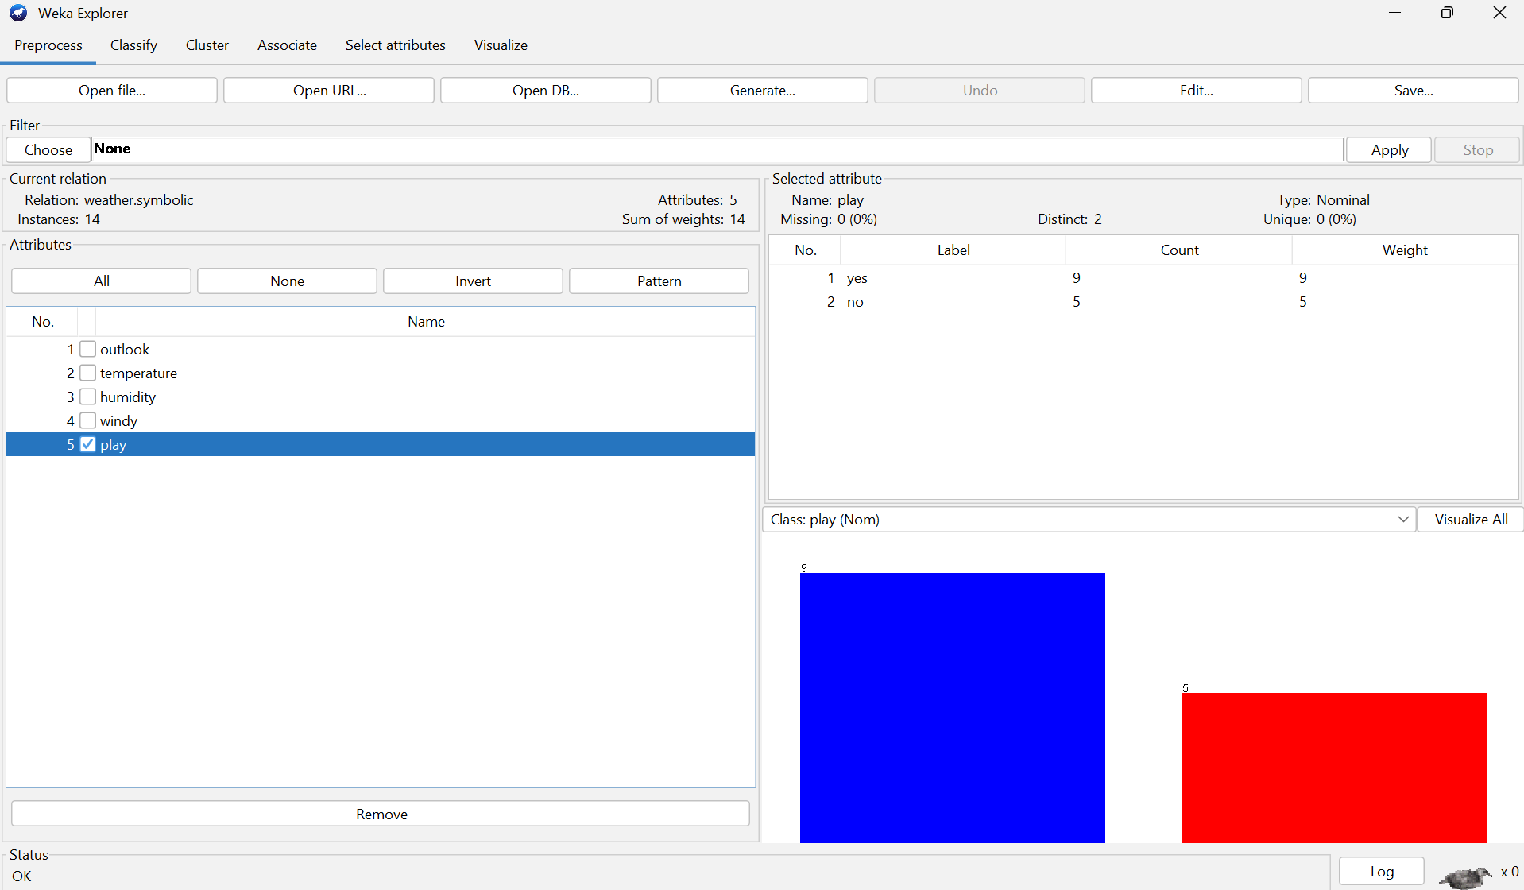
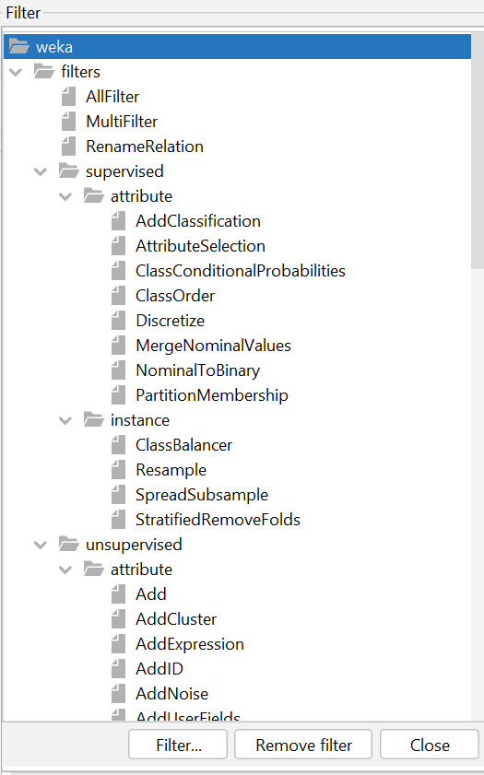
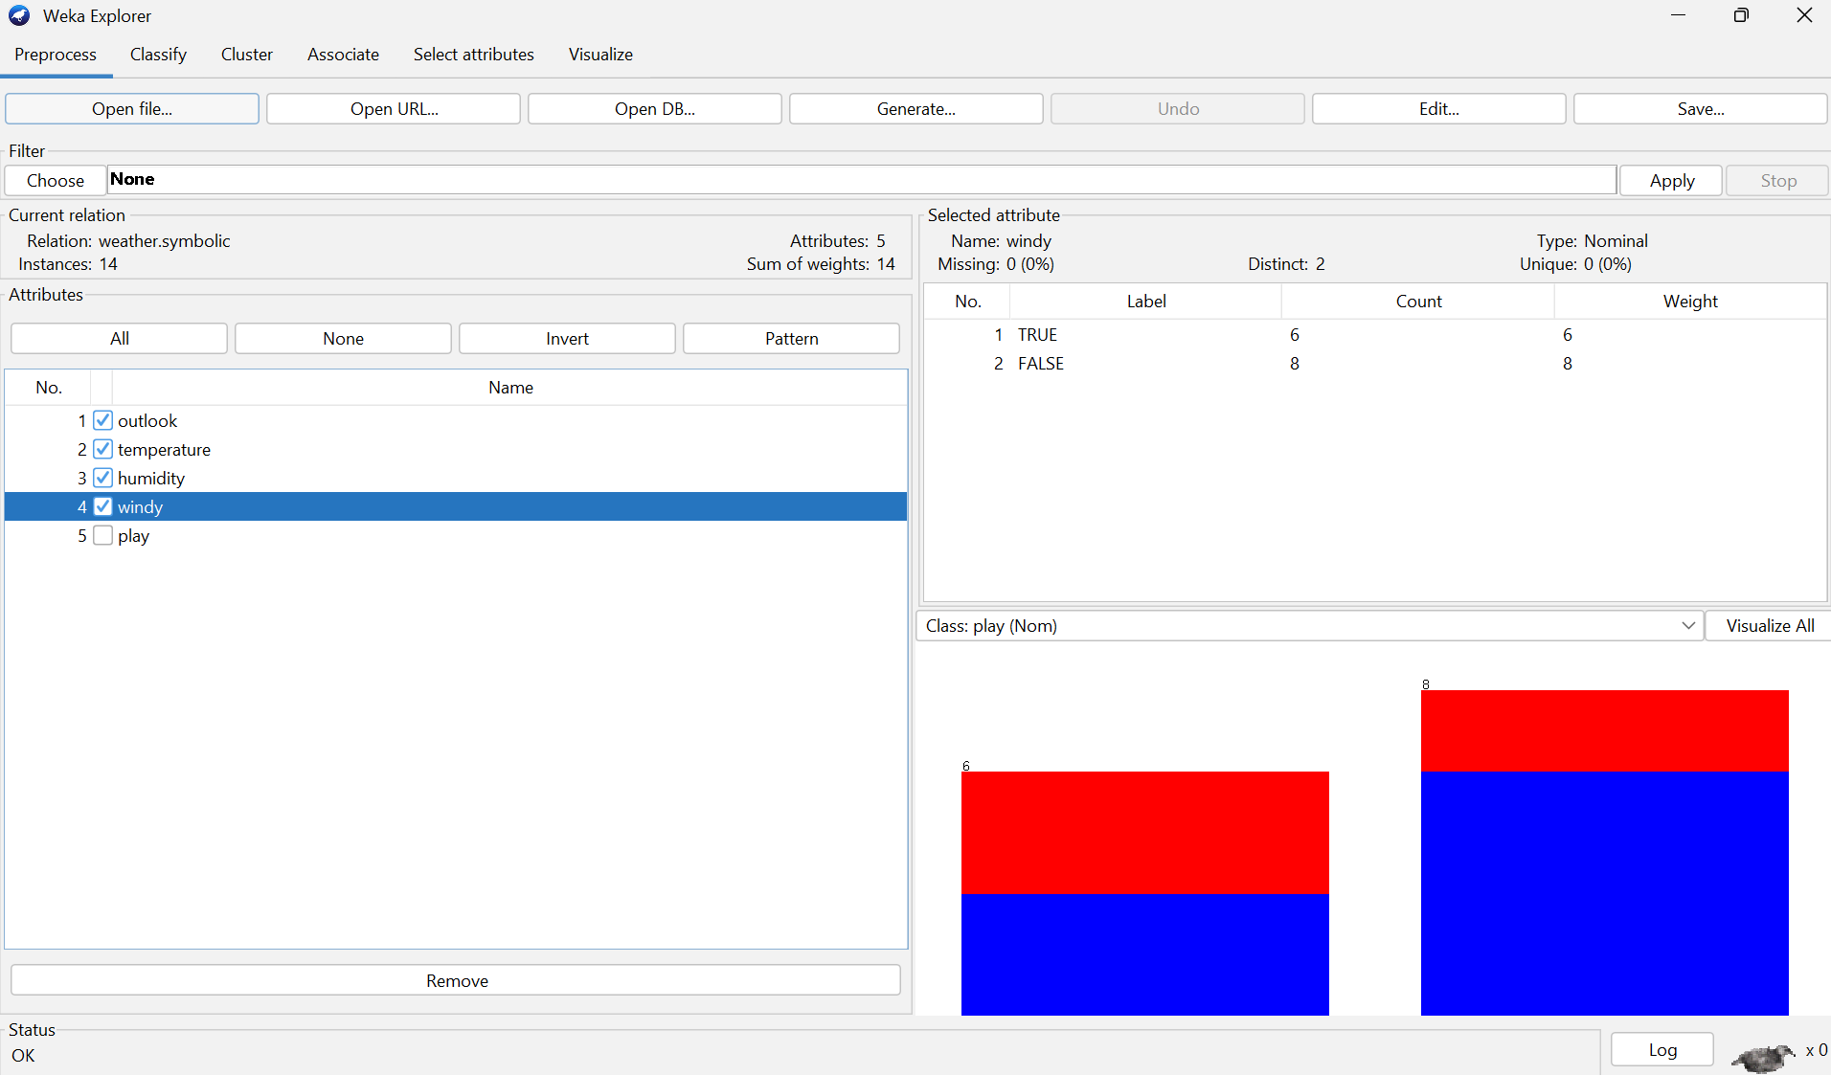
Preprocessing

Slide 11
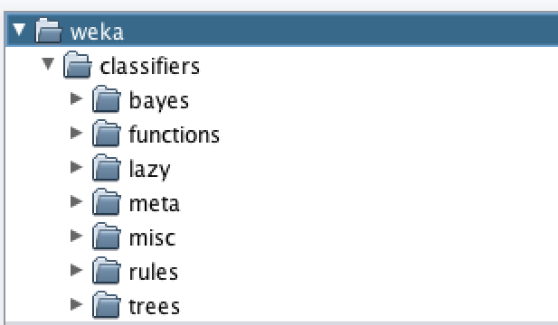
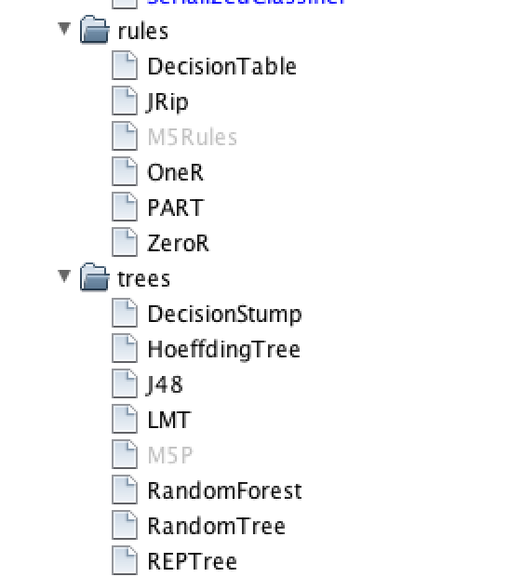
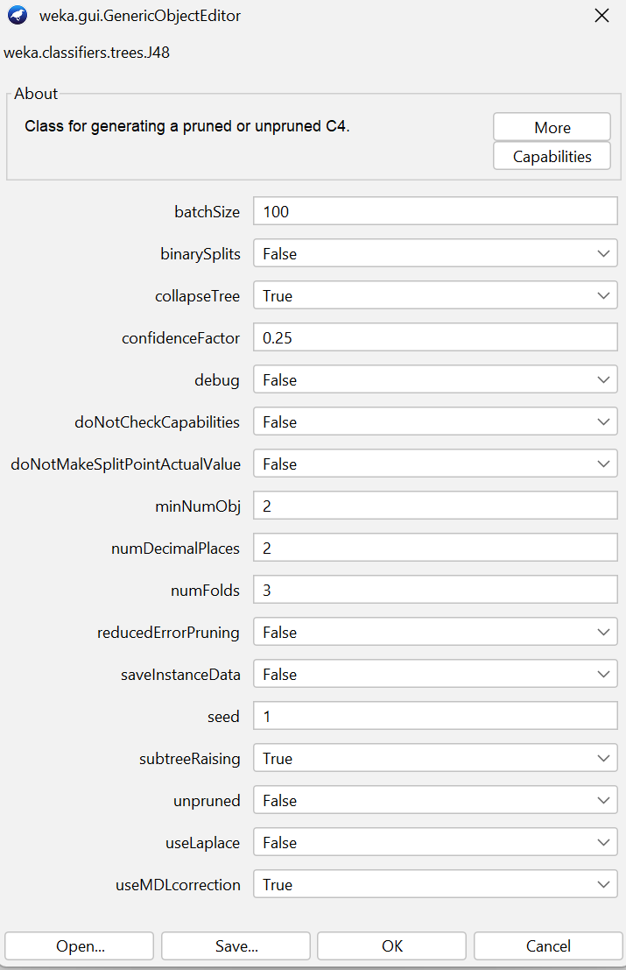
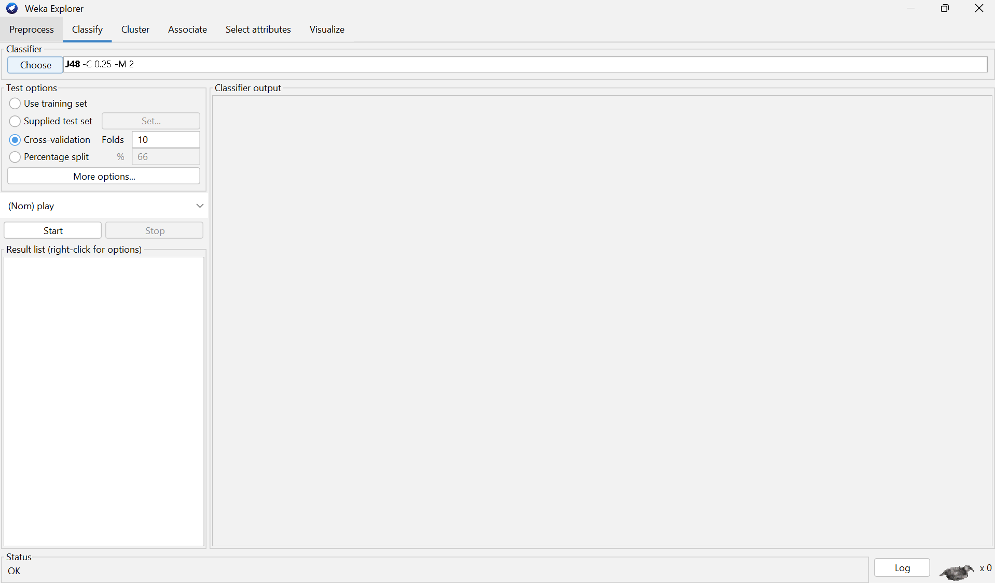
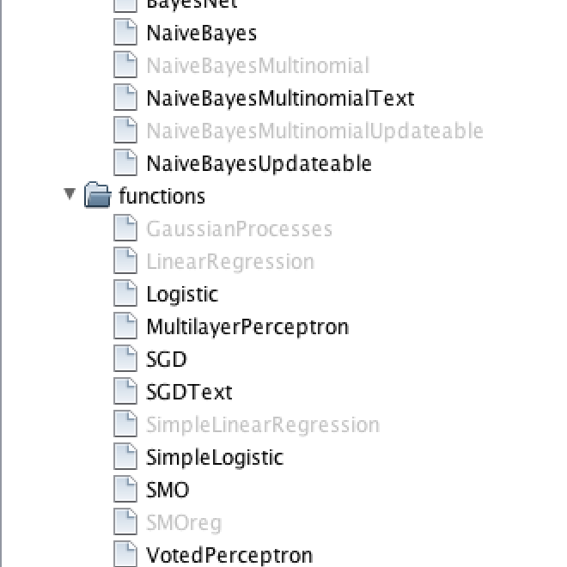
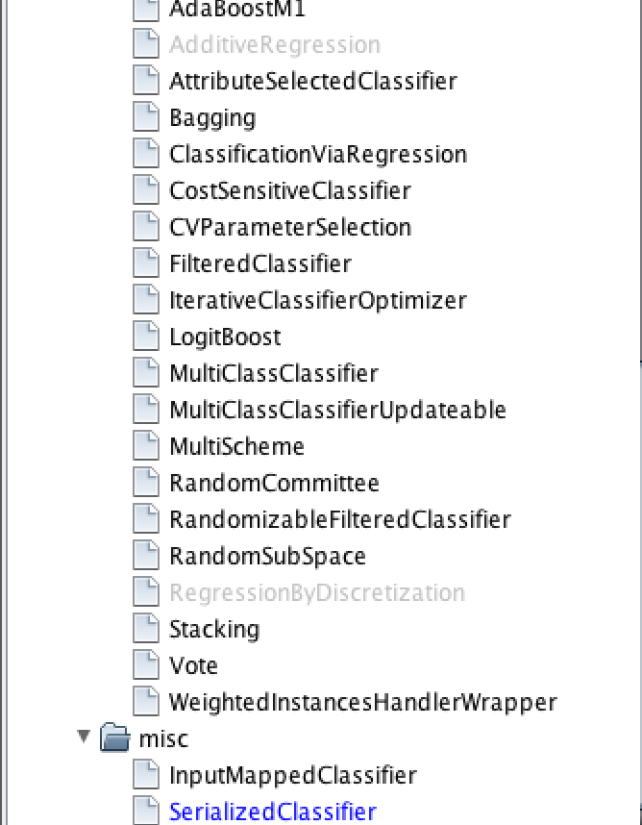
Classifiers
General properties
Specific properties
Specific properties

Slide 12
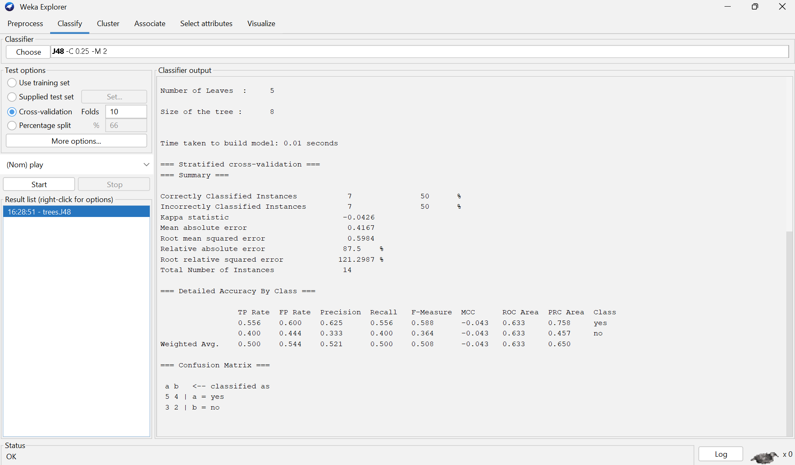
The Classification Algorithm’s Result

Slide 13
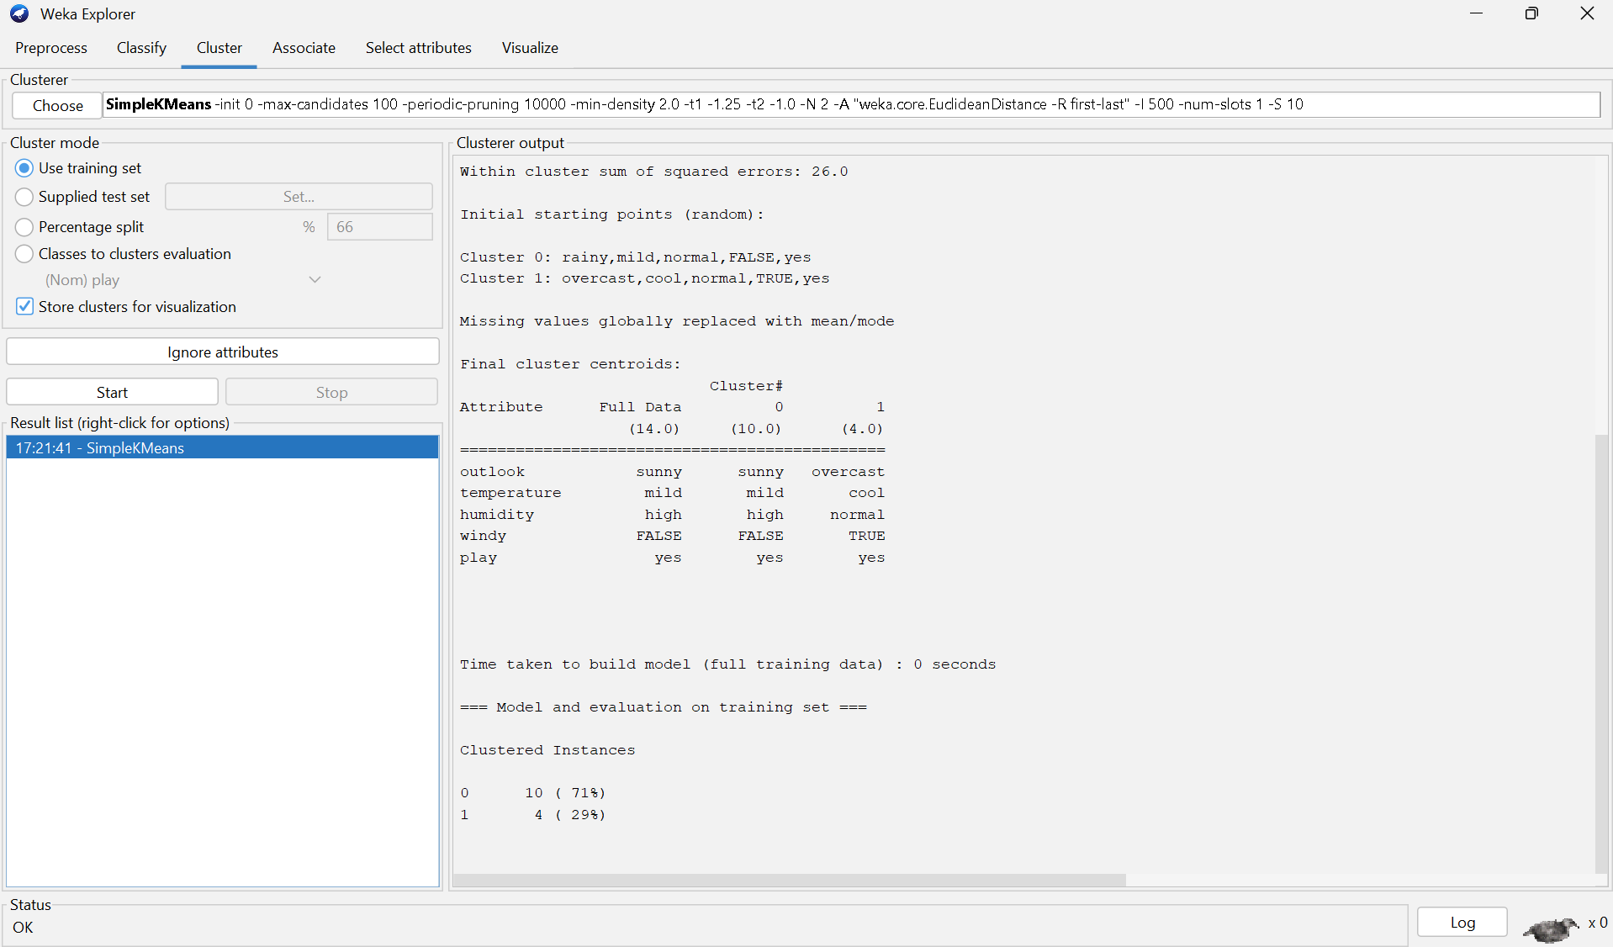
Explorer: clustering data
WEKA contains “clusters” for finding groups of similar instances in a dataset.
Implemented schemes are:
k-Means, EM, Cobweb, X-means, FarthestFirst.
Given k, the k-means algorithm is implemented in four steps:
Partition objects into k nonempty subsets
Compute seed points as the centroids of the clusters of the current partition (the centroid is the center, i.e., mean point, of the cluster)
Assign each object to the cluster with the nearest seed point
Go back to Step 2, stop when no more new assignment

Slide 14
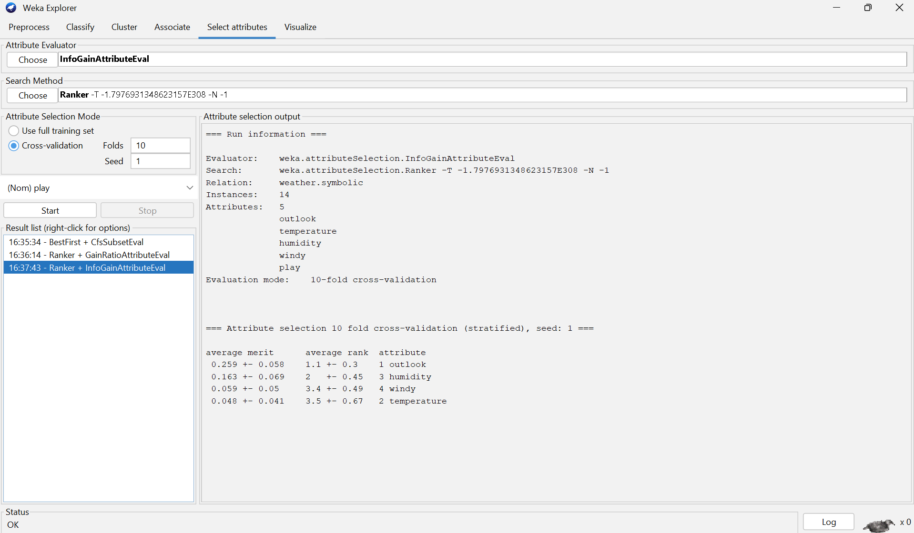
Select Attributes

Slide 15
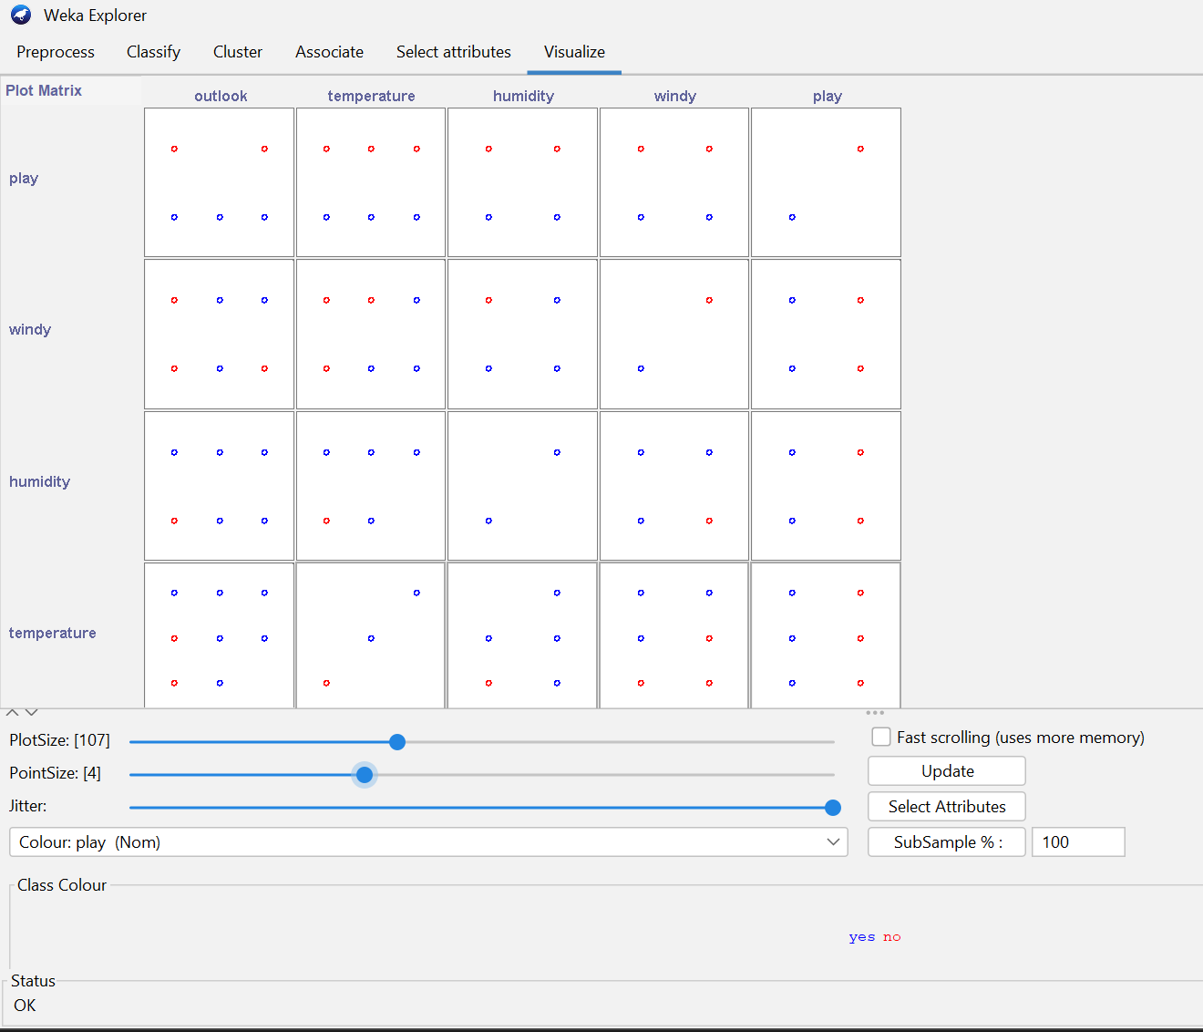
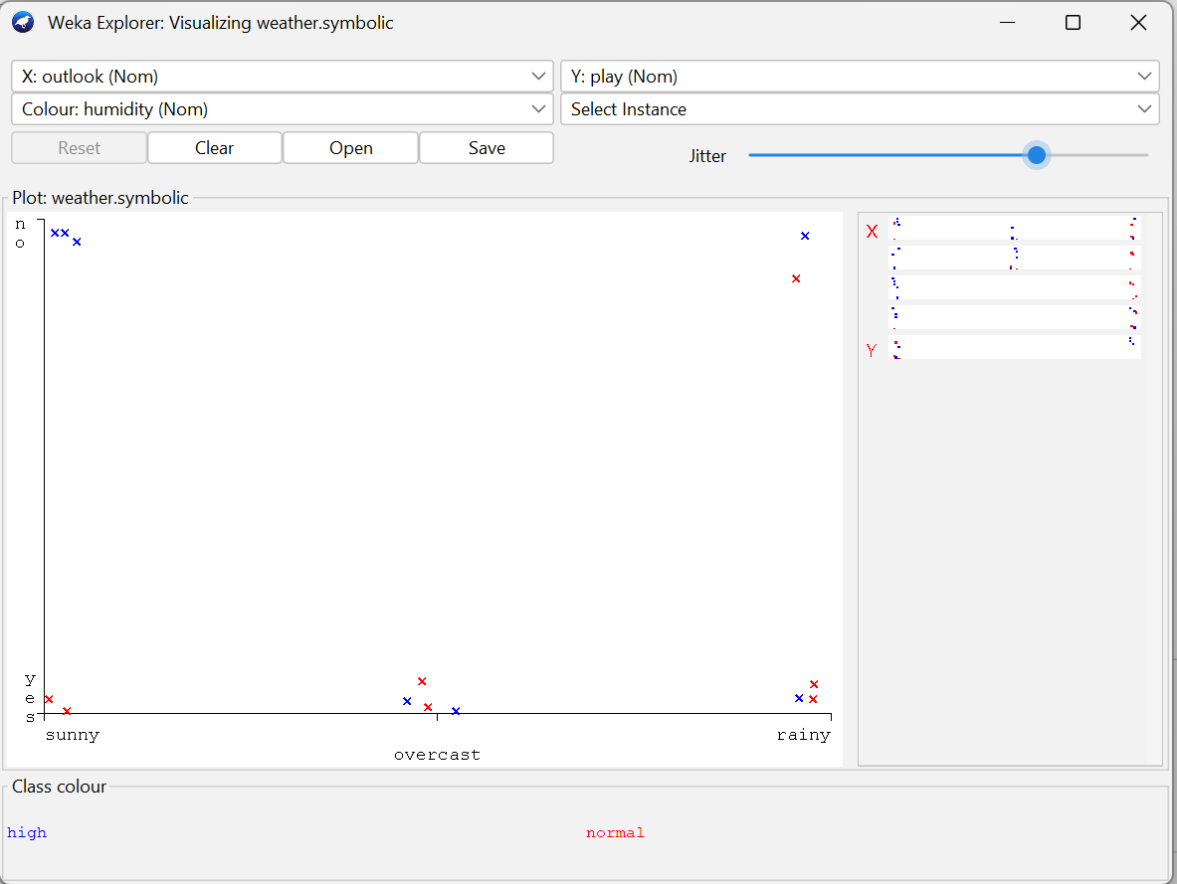
Visualization

Slide 16
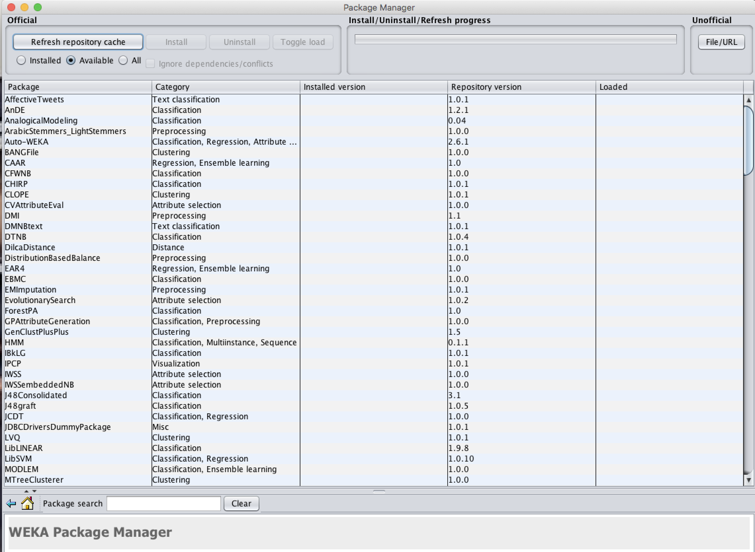
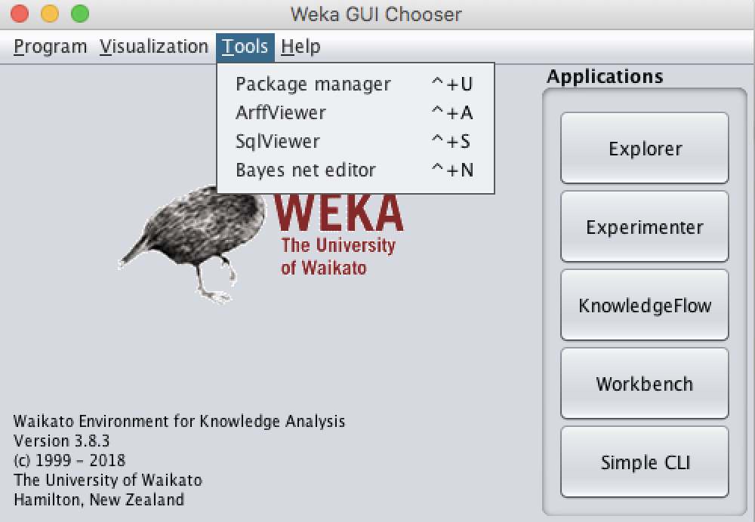
Package Manager

Slide 17
References
WEKA website: http://www.cs.waikato.ac.nz/~ml/weka/index.html
Machine Learning with WEKA: A presentation demonstrating all graphical user interfaces (GUI) in Weka.
WEKA Data Mining Book: Ian H. Witten and Eibe Frank, Data Mining: Practical Machine Learning Tools and Techniques (Second Edition)
WEKA Wiki: http://weka.sourceforge.net/wiki/index.php/Main_Page
Others: Jiawei Han and Micheline Kamber, Data Mining: Concepts and Techniques, 2nd ed.

Slide 18
Thank you

