Slide 1
Parameter control
Chapter 8

Slide 2
Motivation 1
An EA has many strategy parameters, e.g.
mutation operator(s) and mutation rate
crossover operator(s) and crossover rate
selection mechanism and selection pressure (e.g. tournament size)
population size
Good parameter values facilitate good performance
Q1 How to find good parameter values ?

Slide 3
Motivation 2
EA parameters are usually rigid (constant during a run)
BUT
an EA is a dynamic, adaptive process
THUS
optimal parameter values may vary during a run
Q2: How to vary parameter values?

Slide 4
Parameter tuning
Parameter tuning: the traditional way of testing and
comparing different values before the “real” run
Problems:
user mistakes in settings can be sources of errors or sub-optimal performance
costs much time
parameters interact: exhaustive search is not practical
good values may become bad during the run

Slide 5
Parameter control
Parameter control: setting values on-line, during the
actual run, e.g.
predetermined time-varying schedule p = p(t)
using feedback from the search process
encoding parameters in chromosomes and relying on natural selection
Problems:
finding optimal p is hard, finding optimal p(t) may be harder
still user-defined feedback mechanism, how to ``optimize"?
when would natural selection work for strategy parameters?

Slide 6
Example
Task to solve:
  min f(x₁,…,x_{n})
  L_{i} ≤ x_{i} ≤ U_{i} for i = 1,…,n bounds
  g_{i} (x) ≤ 0 for i = 1,…,q inequality constraints
  h_{i} (x) = 0 for i = q+1,…,m equality constraints
Algorithm:
  EA with real-valued representation (x₁,…,x_{n})
  arithmetic averaging crossover
  Gaussian mutation: x’ _{i} = x_{i} + N(0, σ)
  standard deviation σ is called mutation step size

Slide 7
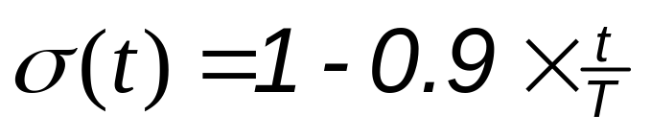
Varying mutation step size: option1
Replace the constant σ by a function σ(t)
0 ≤ t ≤ T is the current generation number
Features:
  changes in σ are independent from the search progress
  strong user control of σ by the above formula
  σ is fully predictable
  a given σ acts on all individuals of the population

Slide 8
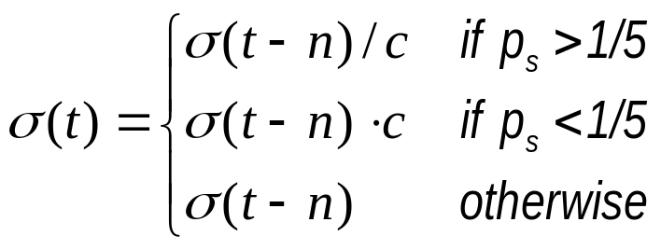
Varying mutation step size: option2
Replace the constant σ by a function σ(t) updated after
every n steps by the 1/5 success rule (cf. ES chapter):
Features:
  changes in σ are based on feedback from the search progress
  some user control of σ by the above formula
  σ is not predictable
  a given σ acts on all individuals of the population

Slide 9
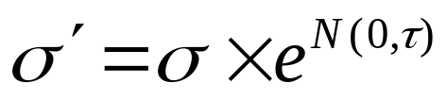
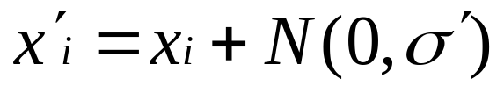
Varying mutation step size: option3
Assign a personal σ to each individual
Incorporate this σ into the chromosome: (x₁, …, x_{n}, σ)
Apply variation operators to x_{i}‘s and σ
Features:
  changes in σ are results of natural selection
  (almost) no user control of σ
  σ is not predictable
  a given σ acts on one individual

Slide 10
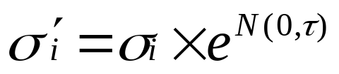

Varying mutation step size: option4
Assign a personal σ to each variable in each individual
Incorporate σ’s into the chromosomes: (x₁, …, x_{n}, σ₁, …, σ _{n})
Apply variation operators to x_{i}‘s and σ_{i}‘s
Features:
  changes in σ_{i} are results of natural selection
  (almost) no user control of σ_{i}
  σ_{i} is not predictable
  a given σ_{i} acts on 1 gene of one individual

Slide 11
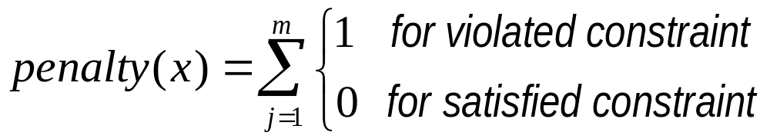
Example cont’d
Constraints
  g_{i} (x) ≤ 0 for i = 1,…,q inequality constraints
  h_{i} (x) = 0 for i = q+1,…,m equality constraints
are handled by penalties:
eval(x) = f(x) + W × penalty(x)
where

Slide 12
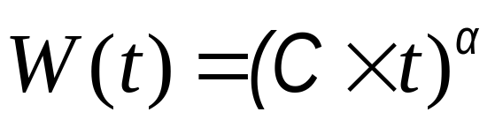
Varying penalty: option 1
Replace the constant W by a function W(t)
0 ≤ t ≤ T is the current generation number
Features:
  changes in W are independent from the search progress
  strong user control of W by the above formula
  W is fully predictable
  a given W acts on all individuals of the population

Slide 13
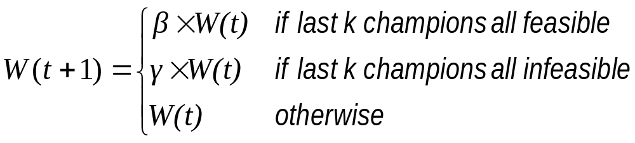
Varying penalty: option 2
Replace the constant W by W(t) updated in each generation
β < 1, γ > 1, β × γ ≠ 1 champion: best of its generation
Features:
  changes in W are based on feedback from the search progress
  some user control of W by the above formula
  W is not predictable
  a given W acts on all individuals of the population

Slide 14
Varying penalty: option 3
Assign a personal W to each individual
Incorporate this W into the chromosome: (x₁, …, x_{n}, W)
Apply variation operators to x_{i}‘s and W
Alert:
eval ((x, W)) = f (x) + W × penalty(x)
while for mutation step sizes we had
eval ((x, σ)) = f (x)
this option is thus sensitive “cheating” ⇒ makes no sense

Slide 15
Lessons learned from examples
Various forms of parameter control can be distinguished by:
primary features:
  what component of the EA is changed
  how the change is made
secondary features:
  evidence/data backing up changes
  level/scope of change

Slide 16
What
Practically any EA component can be parameterized and
thus controlled on-the-fly:
representation
evaluation function
variation operators
selection operator (parent or mating selection)
replacement operator (survival or environmental selection)
population (size, topology)

Slide 17
How
Three major types of parameter control:
deterministic: some rule modifies strategy parameter without feedback from the search (based on some counter)
adaptive: feedback rule based on some measure monitoring search progress
self-adaptive: parameter values evolve along with solutions; encoded onto chromosomes they undergo variation and selection

Slide 18
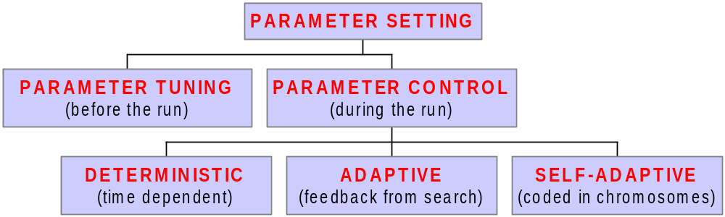
Global taxonomy

Slide 19
Evidence informing the change
The parameter changes may be based on:
time or nr. of evaluations (deterministic control)
population statistics (adaptive control)
  progress made
  population diversity
  gene distribution, etc.
relative fitness of individuals created with given values (adaptive or self-adaptive control)

Slide 20
Evidence informing the change
Absolute evidence: predefined event triggers change, e.g. increase p_{m} by 10% if population diversity falls under threshold x
Direction and magnitude of change is fixed
Relative evidence: compare values through solutions created with them, e.g. increase p_{m} if top quality offspring came by high mut. Rates
Direction and magnitude of change is not fixed

Slide 21
Scope/level
The parameter may take effect on different levels:
environment (fitness function)
population
individual
sub-individual
Note: given component (parameter) determines possibilities
Thus: scope/level is a derived or secondary feature in the
classification scheme

Slide 22
Refined taxonomy
Combinations of types and evidences
  Possible: +
  Impossible: -
 | Deterministic | Adaptive | Self-adaptive
Absolute | + | + | -
Relative | - | + | +

Slide 23
Evaluation / Summary
Parameter control offers the possibility to use appropriate values in various stages of the search
Adaptive and self-adaptive parameter control
  offer users “liberation” from parameter tuning
  delegate parameter setting task to the evolutionary process
  the latter implies a double task for an EA: problem solving + self-calibrating (overhead)
Robustness, insensitivity of EA for variations assumed
  If no. of parameters is increased by using (self)adaptation
  For the “meta-parameters” introduced in methods

