Slide 1
Differential Evolution
A population-based evolutionary algorithm for continuous optimization
Concepts • Operators • Algorithm • Example • Practical guidance

Slide 2
1. What is Differential Evolution?
Differential Evolution (DE) was introduced by Storn and Price in the 1990s.
An evolutionary optimization method designed especially for continuous-valued decision variables.
Maintains a population of candidate solutions and improves them over generations.
Creates new candidates by adding scaled differences between population members to an existing vector.
Uses selection to keep the better candidate according to the objective function.
Key idea: population differences provide an adaptive search direction without gradients.
2

Slide 3
2. Problem Formulation
Typical continuous optimization problem
minimize f(x), x = (x₁, x₂, …, x_D)
Decision vector x contains D real-valued variables.
Each variable may have lower and upper bounds: L_j ≤ x_j ≤ U_j.
DE does not require derivatives, convexity, or a smooth objective function.
It can therefore be useful when the objective is nonlinear, noisy, discontinuous, or expensive to differentiate.
3

Slide 4
3. Population Representation
Population
Target Vector
Trial Vector
A set of NP candidate vectors.
Example: NP = 8 solutions.
The current solution being considered for replacement.
A newly generated candidate created by mutation + crossover.
xᵢ = [xᵢ₁, xᵢ₂, …, xᵢD]
The population provides the raw material for generating new search directions.
DE typically uses real-valued vectors directly—no binary encoding is required.
4

Slide 5
4. Mutation: The Core DE Operation
A common strategy is DE/rand/1
vᵢ = xᵣ₁ + F · (xᵣ₂ − xᵣ₃)
xᵣ₁
xᵣ₂ − xᵣ₃
F
Base vector chosen from the population.
A difference vector: an adaptive search direction.
Scale factor controlling the size of the differential step.
5

Slide 6
5. Crossover: Build the Trial Vector
Binomial crossover mixes target and mutant components.
uᵢⱼ = { vᵢⱼ if randⱼ ≤ CR or j = jrand; xᵢⱼ otherwise }
CR (crossover rate) is typically between 0 and 1.
jrand guarantees that at least one component comes from the mutant vector.
Higher CR generally allows more mutant components into the trial vector.
Mutation proposes a direction; crossover controls how much of that proposal is used.
6

Slide 7
6. Selection: Survival of the Better Candidate
DE uses one-to-one, greedy selection.
xᵢ(next) = uᵢ if f(uᵢ) ≤ f(xᵢ); otherwise xᵢ
The trial competes directly with its target vector.
For minimization, the lower objective value survives.
For maximization, reverse the comparison.
This simple selection step makes every accepted replacement non-worse under the chosen objective.
7

Slide 8
7. The Complete DE Workflow
1
2
3
4
5
Initialize
Mutate
Crossover
Select
Repeat
Randomly generate NP vectors within bounds.
Create vᵢ using population differences.
Combine vᵢ with target xᵢ to form uᵢ.
Keep whichever candidate has the better objective value.
Continue until a stopping criterion is met.
8

Slide 9
8. Pseudocode
Initialize population X = {x₁, …, xNP}
Evaluate f(xᵢ) for every vector
while stopping criterion is not met:
for each target vector xᵢ:
choose distinct r₁, r₂, r₃ ≠ i
vᵢ ← xᵣ₁ + F · (xᵣ₂ − xᵣ₃)
uᵢ ← crossover(xᵢ, vᵢ, CR)
if f(uᵢ) ≤ f(xᵢ):
xᵢ ← uᵢ
return best vector found
10

Slide 10
9. Important Parameters
DE is relatively simple, but parameter choices affect search behavior.
Population size (NP)
Scale factor (F)
Crossover rate (CR)
Larger populations increase diversity and objective evaluations, but also increase computational cost.
Controls the magnitude of differential mutation. Larger values can encourage broader moves.
Controls how much of the mutant vector enters the trial vector.
Stopping criterion
Common choices include a maximum number of evaluations/generations, an objective threshold, or lack of improvement.
11

Slide 11
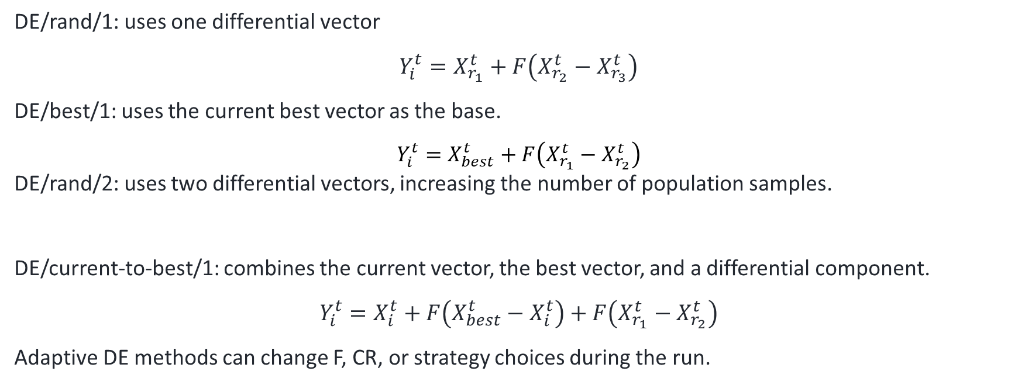
10. Common DE Variants
The notation often describes the mutation strategy.
DE/rand/1: uses one differential vector
$$Y_{i}^{t}=X_{r_{1}}^{t}+F\left(X_{r_{2}}^{t}−X_{r_{3}}^{t}\right)$$
DE/best/1: uses the current best vector as the base.
$$Y_{i}^{t}=X_{best}^{t}+F\left(X_{r_{1}}^{t}−X_{r_{2}}^{t}\right)$$
DE/rand/2: uses two differential vectors, increasing the number of population samples.
DE/current-to-best/1: combines the current vector, the best vector, and a differential component.
$$Y_{i}^{t}=X_{i}^{t}+F\left(X_{best}^{t}−X_{i}^{t}\right)+F\left(X_{r_{1}}^{t}−X_{r_{2}}^{t}\right)$$
Adaptive DE methods can change F, CR, or strategy choices during the run.
$$Y_{i}^{t}=X_{r_{1}}^{t}+F\left(X_{r_{2}}^{t}−X_{r_{3}}^{t}\right)+F\left(X_{r_{4}}^{t}−X_{r_{5}}^{t}\right)$$
12

Slide 12
11. Strengths and Limitations
Strengths
Limitations
• Derivative-free
• Simple vector-based representation
• Effective for many nonlinear continuous problems
• Population differences adapt search directions
• Few core operators and parameters
• Can require many objective evaluations
• Performance depends on F, CR, population size, and strategy
• Basic DE can stagnate or lose diversity
• Constraint handling needs explicit design
• Discrete/combinatorial problems may require specialized adaptations
13

Slide 13
12. DE vs. Genetic Algorithms
Both are evolutionary algorithms, but their search operators differ.
Representation
Variation
Search signal
DE: usually real-valued vectors.
GA: can use binary, real-valued, permutation, or other encodings.
DE: differential mutation + crossover.
GA: commonly selection + crossover + mutation.
DE: population differences directly define mutation steps.
GA: mutation/crossover depend on the chosen encoding and operators.
14

Slide 14
13. Applications
Engineering design and parameter optimization
Machine learning: hyperparameter and model parameter optimization
Control and system identification
Scheduling and planning when a continuous formulation is available
Signal/image processing and numerical model calibration
Hybrid optimization: DE can be combined with local search or problem-specific heuristics
15

Slide 15
14. Practical Implementation Checklist
1. Define the decision variables, bounds, and objective function.
2. Choose a population size and initialize feasible vectors.
3. Select a mutation strategy and values for F and CR.
4. Handle bounds and constraints explicitly.
5. Track the best objective value and preserve the corresponding solution.
6. Use a reproducible random seed for experiments.
7. Run multiple independent trials when comparing stochastic algorithms.
8. Report objective evaluations—not only generations—when computational cost matters.
16

Slide 16
15. References & Further Reading
Storn, R. & Price, K. (1997). Differential Evolution – A Simple and Efficient Heuristic for Global Optimization over Continuous Spaces. Journal of Global Optimization, 11, 341–359.
Price, K., Storn, R. M., & Lampinen, J. A. (2005). Differential Evolution: A Practical Approach to Global Optimization. Springer.
Das, S. & Suganthan, P. N. (2011). Differential Evolution: A Survey of the State-of-the-Art. IEEE Transactions on Evolutionary Computation, 15(1), 4–31.
Tanabe, R. & Fukunaga, A. S. (2013). Success-History Based Parameter Adaptation for Differential Evolution. IEEE CEC.
17

