Slide 1
CSCI/ARTI 8950 Machine Learning
Lecture Notes 1: Course Overview
Khaled Rasheed
Professor
School of Computing
Member
Institute for Artificial Intelligence
University of Georgia

Slide 2
General Information
Instructor: Khaled Rasheed (khaled@uga.edu)
Syllabus & Course Website:
https://khaledmrasheed.github.io/MLcourse/
Time and Location:
M 4:35pm-5:30pm; TR: 4:35pm-5:55pm (Boyd 222,221)
Office Hours and Location:
Thursday 10:00am – 12:00pm (Boyd 543)

Slide 3
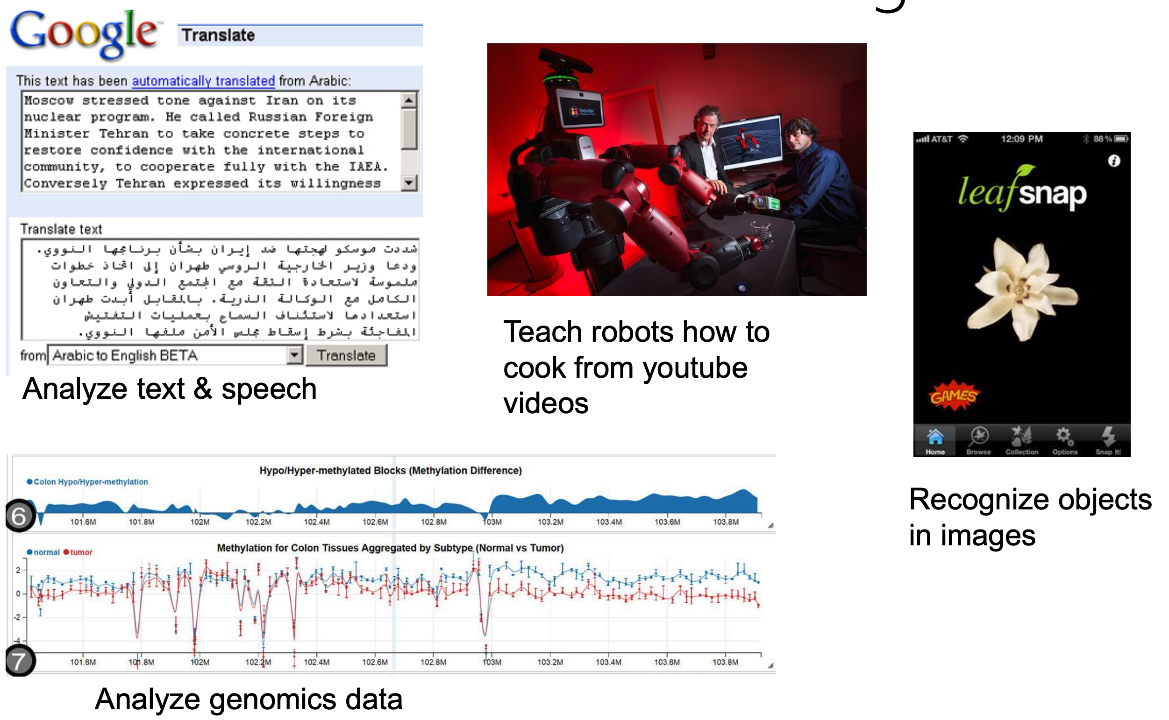
What Can We Do with Machine Learning?

Slide 4
Machine Learning
Paradigm: “Programming by example”
Replace “human writing code” with “human supplying data”
Most central issue: generalization
How to generalize from “training” examples to “test” examples?
Difficulties include noise, over and under fitting, big data .. etc.

Slide 5
A Growing and Fast-Moving Field
Broad applicability
Finance, robotics, vision, machine translation, Bioinformatics, medicine, etc.
Close connection between theory and practice
Open field, lots of room for new work!

Slide 6
Course Goals
By the end of the semester, you should be able to
Look at a problem
Identify if ML is an appropriate solution
If so, identify what types of algorithms might be applicable
Apply those algorithms, compare and improve performance
Write a high-quality report or paper
This course is not
A complete survey of ML algorithms
A theoretical study of ML
A course devoted to Deep Learning or Large Language Models
A tutorial on ML toolkits such as Scikit-Learn, TensorFlow, …

Slide 7
ML Related Courses at UGA
Machine Learning
CSCI 8950 Machine Learning
CSCI 8945 Advanced Representation Learning
CSCI 8265 Trustworthy Machine Learning
CSCI 8951 Large-Scale Optimization for Machine Learning
Artificial Intelligence
CSCI 4550/6550 Artificial Intelligence
CSCI 4560/6560 Evolutionary Computation
CSCI 8050 Knowledge-Based Systems
CSCI 8820 Computer Vision and Pattern Recognition
CSCI 8920 Decision Making under Uncertainty
Data Science
CSCI 3330/4360/6360 Data Science I/II
CSCI 4380/6380 Data Mining
CSCI 8955 Advanced Data Analytics
CSCI 8960 Privacy-Preserving Data Analysis
Incomplete list

Slide 8
Style of Course
Graduate level course
Present an overview of machine learning approaches, models and applications
Lectures (by instructor and guest lecturers)
Readings before lectures (by students)
Paper review and presentation (by students)
Research-oriented learning with a course project
Homework and midterm (open notes)

Slide 9
Recommended Textbooks
[Main, Free] A Course in Machine Learning
by Hal Daumé III http://ciml.info/
Machine Learning
by Tom Michell
[Free] Pattern Recognition and Machine Learning
by Christopher Bishop

Slide 10
Recommended Prerequisites
CSCI 6380 Data Mining or CSCI 6550 Artificial Intelligence or CSCI 6560 Evolutionary computation or other machine learning or data science courses
Understanding the concepts of data structures and basic computer algorithms
Solid mathematics / statistics / programming background would be very helpful

Slide 11
Tentative Topics
Decision Trees
Geometry and Nearest Neighbors
Clustering
Perceptron
Multiclass Classification
Bias and Fairness
Linear Models
Probabilistic Models
Neural Networks
Evolutionary Computation
Ensemble Learning
Deep Learning

Slide 12
Tentative Schedule
Course overview (by instructor)
An overview of machine learning (by instructor)
Lectures on Topics (by instructor)
Midterm Exam [Projected letter grades will be given after midterm]
Paper review and presentations (by students)
Project proposal, status reports and final presentations (by students)
Guest lectures (throughout)

Slide 13
Grading Breakdown
Homework (20%)
Submitted via eLC; Late submissions will be penalized by deducting 10% of the score for each calendar day beyond the due date
Group study is allowed with proper acknowledgement
Midterm Exam (20%)
Paper Review (10%): 5 papers, 2% each
Paper Presentation (10%)
Term Project and term paper (40%)

Slide 14
Paper Review & Presentation
Papers/Topics will be posted on the course website
Please sign up for paper presentation as soon as possible
You are encouraged to suggest other interesting ML papers for presentation but should be approved by the instructor.

Slide 15
Paper Review
Each student will be required to review 5 papers and submit your review reports on eLC
The reviewed papers should be chosen from the papers that will be presented in class (posted on the course homepage)
Suggested outline of review
Main idea and contributions
Summarize the methodology and major experimental findings
Discuss the strengths and weaknesses of the paper

Slide 16
Paper Presentation
Each student will present ONE paper
The presenter should prepare slides for a 20 minutes talk, which should address the following points:
Motivation & Related Work
Problem Statement & Methodology
Experiments
Conclusions & Discussions
The presenter will lead another 5 minutes discussion, and need to prepare at least 2 discussion questions on the paper’s content, pros/cons, and future works.

Slide 17
Course Project
Individual or group (no more than four students) research project
Can be on any topic related to the course
Tentative timeline
Late September: Brainstorming and project proposal submission
Mid November: Project status report presentation
Final Exam date: Final project presentation and project report due on December 9th , 2026. All students must participate
Detailed requirements of proposal and final report will be announced

Slide 18
Course Project Suggestions
Kaggle Challenges
www.Kaggle.com
Compare Ideas/Algorithms
Compare, tune and combine the state-of-the-art algorithms, derive solutions, and validate them on benchmark datasets
New Modeling/Applications
Identify a new setting or new application of ML model; Encouraged to explore interdisciplinary research

Slide 19
Course Project Suggestions
Identify an open problem from your current research projects, and try to design ML models to improve the system performance
Practical application problems from Science and Engineering make for excellent course projects
Check the recent published papers on top-tier machine learning conferences (e.g., ICML, ICMLA), and try to develop an improved version
The high-quality course project reports might be converted into paper submissions for future ML venues

