Slide 1
GADO: A Genetic Algorithm for Design Optimization
Khaled Rasheed School of Computing University of Georgia
khaled@uga.edu

Slide 2
















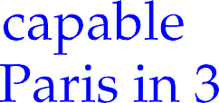




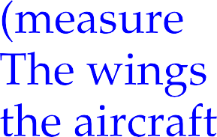

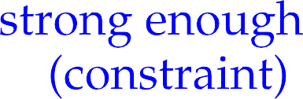






Slide 3


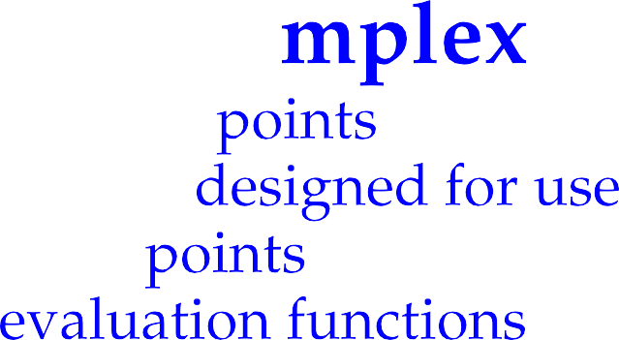












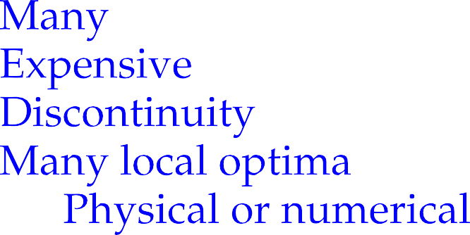



Slide 4


















Slide 5


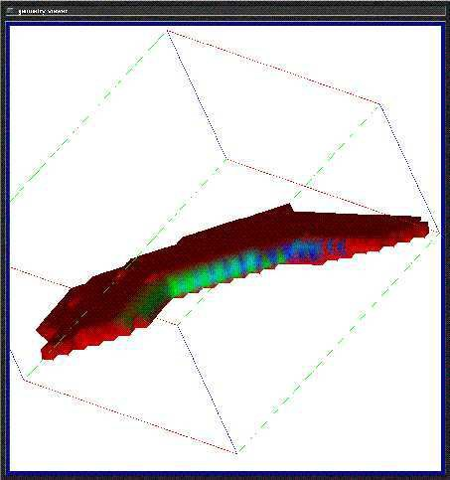

Slide 6






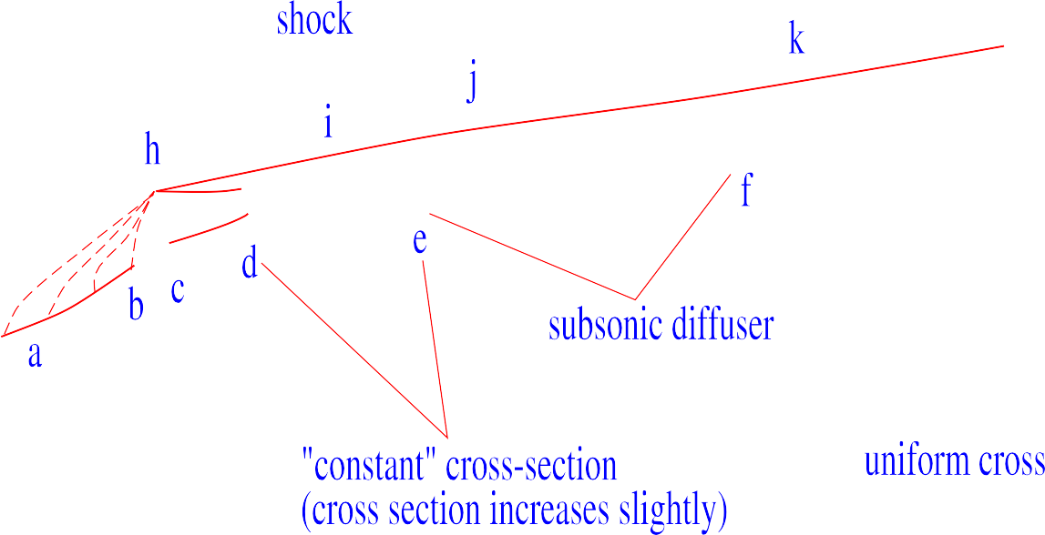



Slide 7






















Slide 8

















Slide 9

























































Slide 10


































Slide 11


Slide 12
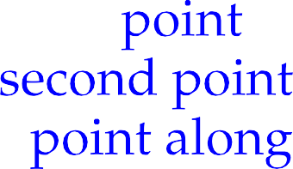











Slide 13




















Slide 14














Slide 15







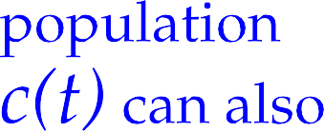









Slide 16
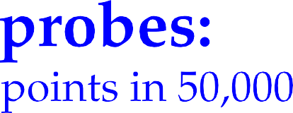







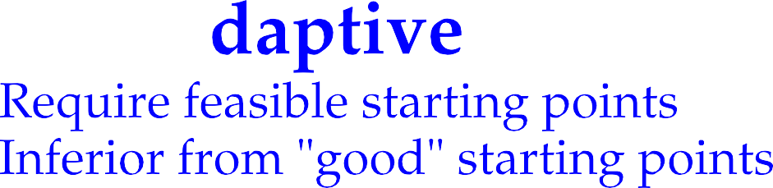


Slide 17





























Slide 18










Slide 19







Slide 20













Slide 21


































Slide 22










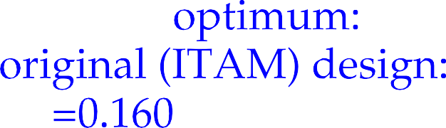





Slide 23






Slide 24









Slide 25










Slide 26













Slide 27











Slide 28













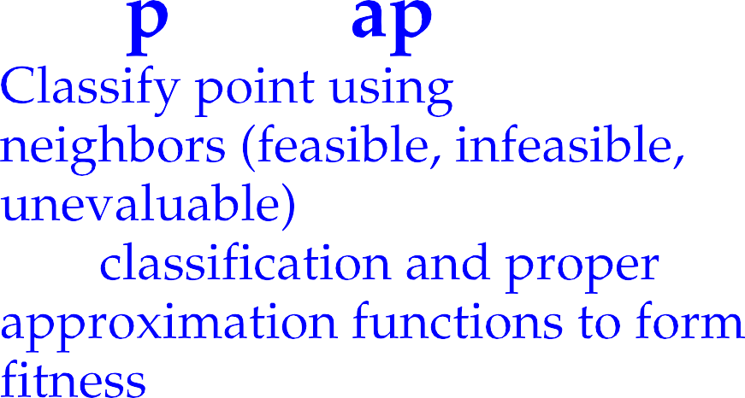









Slide 29

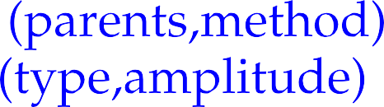

Slide 30















































Slide 31
















Slide 32








































Slide 33











Slide 34










