Slide 1
Data Mining
Practical Machine Learning Tools and Techniques
Slides for Chapter 12, Ensemble learning
of Data Mining by I. H. Witten, E. Frank,
M. A. Hall and C. J. Pal

Slide 2
Ensemble learning
Combining multiple models
The basic idea
Bagging
Bias-variance decomposition, bagging with costs
Randomization
Random forests, rotation forests
Boosting
AdaBoost, the power of boosting
Additive regression
Numeric prediction, additive logistic regression
Interpretable ensembles
Option trees, alternating decision trees, logistic model trees
Stacking

Slide 3
Combining multiple models
Basic idea: build different “experts”, let them vote
Advantage:
often improves predictive performance
Disadvantage:
usually produces output that is very hard to analyze
but: there are approaches that aim to produce a single comprehensible structure

Slide 4
Bagging
Combining predictions by voting/averaging
Each model receives equal weight
“Idealized” version:
Sample several training sets of size n (instead of just having one training set of size n)
Build a classifier for each training set
Combine the classifiers’ predictions
Learning scheme is unstable => almost always improves performance
Unstable learner: small change in training data can make big change in model (e.g., when learning decision trees)

Slide 5
Bias-variance decomposition
The bias-variance decomposition is used to analyze how much restriction to a single training set affects performance
Assume we have the idealized ensemble classifier discussed on the previous slide
We can decompose the expected error of any individual ensemble member as follows:
Bias = expected error of the ensemble classifier on new data
Variance = component of the expected error due to the particular training set being used to built our classifier
Total expected error = bias + variance
Note (A): we assume noise inherent in the data is part of the bias component as it cannot normally be measured
Note (B): multiple versions of this decomposition exist for zero-one loss but the basic idea is always the same

Slide 6
More on bagging
The idealized version of bagging improves performance because it eliminates the variance component of the error
Note: in some pathological hypothetical situations the overall error may increase when zero-one loss is used (i.e., there is negative “variance”)
The bias-variance decomposition was originally only known for numeric prediction with squared error where the error never increases
Problem: we only have one dataset!
Solution: generate new datasets of size n by sampling from the original dataset with replacement
This is what bagging does and even though the datasets are all dependent, bagging often reduces variance, and, thus, error
Can be applied to numeric prediction and classification
Can help a lot if the data is noisy
Usually, the more classifiers the better, with diminishing returns

Slide 7
Bagging classifiers
Model generation
Let n be the number of instances in the training data
For each of t iterations:
Sample n instances from training set
(with replacement)
Apply learning algorithm to the sample
Store resulting model
Classification
For each of the t models:
Predict class of instance using model
Return class that is predicted most often

Slide 8
Bagging with costs
Bagging unpruned decision trees is known to produce good probability estimates
Where, instead of voting, the individual classifiers' probability estimates are averaged
Note: this can also improve the zero-one loss
Can use this with the minimum-expected cost approach for learning problems with costs
Note that the minimum-expected cost approach requires accurate probabilities to work well
Problem: ensemble classifier is not interpretable
MetaCost re-labels the training data using bagging with costs and then builds a single tree from this data

Slide 9
Randomization and random forests
Can randomize learning algorithm instead of input
Some algorithms already have a random component: e.g., initial weights in a neural net
Most algorithms can be randomized, e.g., greedy algorithms:
Pick N options at random from the full set of options, then choose the best of those N choices
E.g.: attribute selection in decision trees
More generally applicable than bagging: e.g., we can use random subsets in a nearest-neighbor classifier
Bagging does not work with stable classifiers such as nearest neighbor classifiers
Can be combined with bagging
When using decision trees, this yields the famous random forest method for building ensemble classifiers

Slide 10
Rotation forests: motivation
Bagging creates ensembles of accurate classifiers with relatively low diversity
Bootstrap sampling creates training sets with a distribution that resembles the original data
Randomness in the learning algorithm increases diversity but sacrifices accuracy of individual ensemble members
This is why random forests normally require hundreds or thousands of ensemble members to achieve their best performance
So-called rotation forests have the goal of creating accurate and diverse ensemble members

Slide 11
Rotation forests
Combine random attribute sets, bagging and principal components to generate an ensemble of decision trees
An iteration of the algorithm for creating rotation forests, building k ensemble members, involves
Randomly dividing the input attributes into k disjoint subsets
Applying PCA to each of the k subsets in turn
Learning a decision tree from the k sets of PCA directions
Further increases in diversity can be achieved by creating a bootstrap sample in each iteration before applying PCA
Performance of this method compares favorably to that of random forests on many practical datasets

Slide 12
Boosting
Bagging can easily be parallelized because ensemble members are created independently
Boosting is an alternative approach
Also uses voting/averaging
But: weights models according to performance
Iterative: new models are influenced by performance of previously built ones
Encourage new model to become an “expert” for instances misclassified by earlier models
Intuitive justification: models should be experts that complement each other
Many variants of boosting exist, we cover a couple

Slide 13
Boosting using AdaBoost.M1
Model generation
Assign equal weight to each training instance
For t iterations:
Apply learning algorithm to weighted dataset,
store resulting model
Compute model’s error e on weighted dataset
If e = 0 or e ≥ 0.5:
Terminate model generation
For each instance in dataset:
If classified correctly by model:
Multiply instance’s weight by e/(1-e)
Normalize weight of all instances
Classification
Assign weight = 0 to all classes
For each of the t (or less) models:
For the class this model predicts
add –log e/(1-e) to this class’s weight
Return class with highest weight

Slide 14
Comments on AdaBoost.M1
Boosting needs weights … but
can adapt learning algorithm ... or
can apply boosting without weights:
Resample data with probability determined by weights
Disadvantage: not all instances are used
Advantage: if error > 0.5, can resample again
The AdaBoost.M1 boosting algorithm stems from work in computational learning theory
Theoretical result:
Training error decreases exponentially as iterations are performed
Other theoretical results:
Works well if base classifiers are not too complex and
their error does not become too large too quickly as more iterations are performed

Slide 15
More comments on boosting
Continue boosting after training error = 0?
Puzzling fact: generalization error continues to decrease!
Seems to contradict Occam’s Razor
Possible explanation: consider margin (confidence), not just error
A possible definition of margin: difference between estimated probability for true class and nearest other class (between –1 and 1)
Margin continues to increase with more iterations
AdaBoost.M1 works well with so-called weak learners; only condition: error does not exceed 0.5
Example of weak learner: decision stump
In practice, boosting sometimes overfits if too many iterations are performed (in contrast to bagging)

Slide 16
Additive regression
Using statistical terminology, boosting is a greedy algorithm for fitting an additive model
More specifically, it implements forward stage-wise additive modeling
Forward stage-wise additive modeling for numeric prediction:
Build standard regression model (e.g., regression tree)
Gather residuals, learn model predicting residuals (e.g. another regression tree), and repeat
To predict, simply sum up individual predictions from all regression models

Slide 17
Comments on additive regression
Additive regression greedily minimizes squared error of ensemble if base learner minimizes squared error
Note that it does not make sense to use additive regression with standard multiple linear regression
Why? Sum of linear regression models is a linear regression model and linear regression already minimizes squared error
But: can use forward stage-wise additive modeling with simple linear regression to implement multiple linear regression
Idea: build simple (i.e., one-attribute) linear regression models in each iteration of additive regression, pick attribute that yields lowest error
Use cross-validation to decide when to stop performing iterations
Automatically performs attribute selection!
A trick to combat overfitting in additive regression: shrink predictions of base models by multiplying with pos. constant < 1
Caveat: need to start additive regression with initial model that predicts the mean, in order to shrink towards the mean, not 0

Slide 18

Additive logistic regression
Can apply additive regression in conjunction with the logit transformation to get an algorithm for classification
More precisely, an algorithm for class probability estimation
Probability estimation problem is transformed into a regression problem
Regression scheme is used as base learner (e.g., regression tree learner)
Implemented using forward stage-wise algorithm: at each stage, add base model that maximizes the probability the of data
We consider two-class classification in the following
If f_{j} is the jth regression model, and a is an instance, the ensemble predicts probability for the first class (compare to logistic regression model)

Slide 19
LogitBoost
Model generation
For j = 1 to t iterations:
For each instance a[i]:
Set the target value for the regression to
z[i] = (y[i] – p(1|a[i])) / [p(1|a[i]) × (1-p(1|a[i])]
Set the weight of instance a[i] to p(1|a[i]) × (1-p(1|a[i])
Fit a regression model f[j] to the data with class
values z[i] and weights w[i]
Classification
Predict 1st class if p(1 | a) > 0.5, otherwise predict 2nd class
Greedily maximizes probability if base learner minimizes squared error
Difference to AdaBoost.M1: optimizes probability/likelihood instead of a special loss function called exponential loss
Can be extended to multi-class problems
Overfitting avoidance: shrinking and cross-validation-based selection of the number of iterations apply

Slide 20
Option trees
Ensembles are not easily interpretable
Can we generate a single model?
One possibility: “cloning” the ensemble by using large amounts of artificial data that is labeled by the ensemble
Another possibility: generating a single structure that represents an ensemble in a compact fashion
Option tree: decision tree with option nodes
Idea: follow all possible branches at option node
Predictions from different branches are merged using voting or by averaging probability estimates

Slide 21
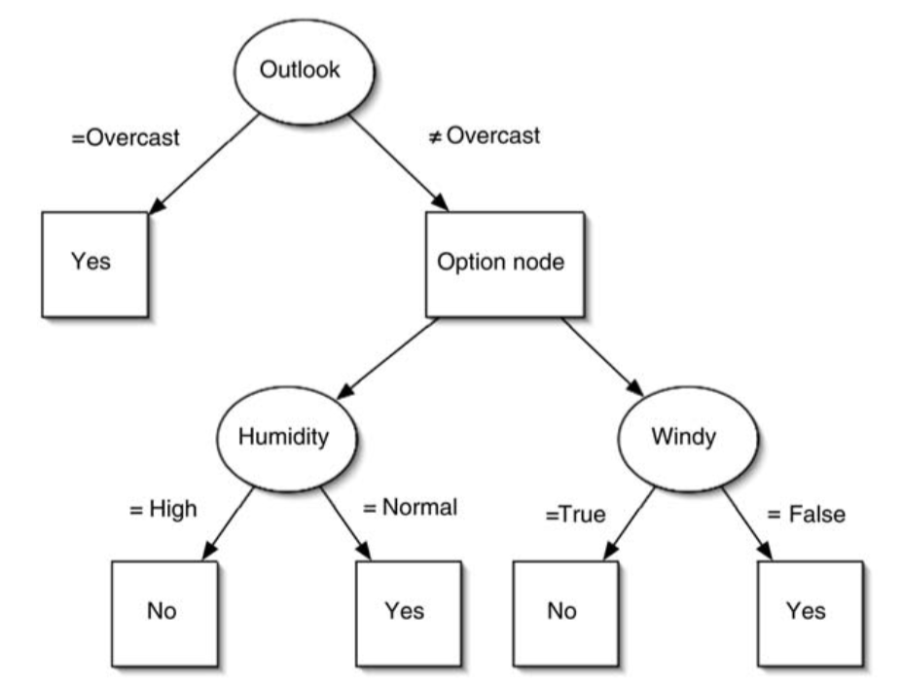
Example
Can be learned by modifying a standard decision tree learner:
Create option node if there are several equally promising splits (within a user-specified interval)
When pruning, error at option node is average error of options

Slide 22
Alternating decision trees
Can also grow an option tree by incrementally adding nodes to it using a boosting algorithm
The resulting structure is called an alternating decision tree, with splitter nodes and prediction nodes
Prediction nodes are leaf nodes if no splitter nodes have been added to them yet
Standard alternating tree applies to 2-class problems but the algorithm can be extended to multi-class problems
To obtain a prediction from an alternating tree, filter the instance down all applicable branches and sum the predictions
Predictions from all relevant predictions nodes need to be used, whether those nodes are leaves or not
Predict one class or the other depending on whether the sum is positive or negative

Slide 23
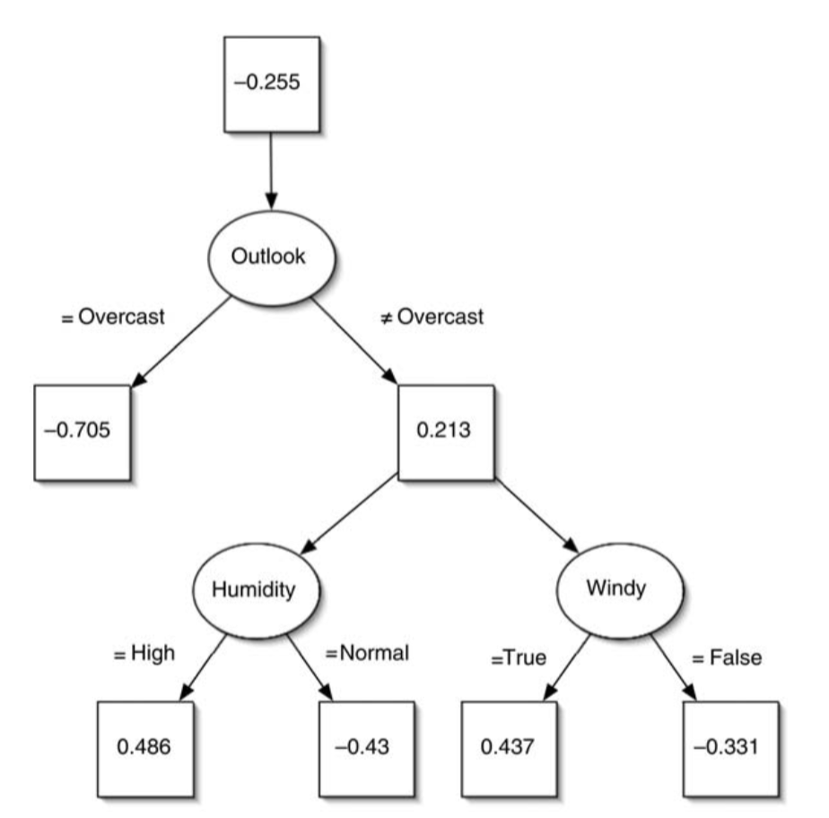
Example tree

Slide 24
Growing alternating trees
An alternating tree is grown using a boosting algorithm, e.g., the LogitBoost algorithm described earlier:
Assume that the base learner used for boosting produces a single conjunctive if-then rule in each boosting iteration (an if-then rule for least-squares regression if LogitBoost is used)
Each rule could simply be added into the current alternating tree, including the numeric prediction obtained from the rule
Problem: tree would grow very large very quickly
Solution: base learner should only consider candidate regression rules that extend existing branches in the alternating tree
An extension of a branch adds a splitter node and two prediction nodes (assuming binary splits)
The standard approach chooses the best extension among all possible extensions applicable to the tree, according to the loss function used
More efficient heuristics can be employed instead

Slide 25
Logistic model trees
Alternating decision trees may still be difficult to interpret
The number of prediction nodes that need to be considered for any individual test instance increases exponentially with the depth of tree in the worst case
But: can also use boosting to build decision trees with linear models at the leaves (trees without options)
These trees are often more accurate than standard decision trees but remain easily interpretable because they lack options
Algorithm for building logistic model trees using LogitBoost:
Run LogitBoost with simple linear regression as the base learner (choosing the best attribute for linear regression in each iteration)
Interrupt boosting when the cross-validated accuracy of the additive model no longer increases
Once that happens, split the data (e.g., as in the C4.5 decision tree learner) and resume boosting in the subsets of data that are generated by the split
This generates a decision tree with logistic regression models at the leaves
Additional overfitting avoidance: prune tree using cross-validation-based cost-complexity pruning strategy from CART tree learner

Slide 26
Stacking
Question: how to build a heterogeneous ensemble consisting of different types of models (e.g., decision tree and neural network)
Problem: models can be vastly different in accuracy
Idea: to combine predictions of base learners, do not just vote, instead, use meta learner
In stacking, the base learners are also called level-0 models
Meta learner is called level-1 model
Predictions of base learners are input to meta learner
Base learners are usually different learning schemes
Caveat: cannot use predictions on training data to generate data for level-1 model!
Instead use scheme based on cross-validation

Slide 27
Generating the level-1 training data
Training data for level-1 model contains predictions of level-0 models as attributes; class attribute remains the same
Problem: we cannot use the level-0 models predictions on their training data to obtain attribute values for the level-1 data
Assume we have a perfect rote learner as one of the level-0 learner
Then, the level-1 learner will learn to simply predict this level-0’s learners predictions, rendering the ensemble pointless
To solve this, we generate the level-1 training data by running a cross-validation for each of the level-0 algorithms
Then, the predictions (and actual class values) obtained for the test instances encountered during the cross-validation are collected
This pooled data obtained from the cross-validation for each level-0 model is used to train the level-1 model

Slide 28
More on stacking
Stacking is hard to analyze theoretically: “black magic”
If the base learners can output class probabilities, use those as input to meta learner instead of plain classifications
Makes more information available to the level-1 learner
Important question: which algorithm to use as the meta learner (aka level-1 learner)?
In principle, any learning scheme
In practice, prefer “relatively global, smooth” models because
base learners do most of the work and
this reduces the risk of overfitting
Note that stacking can be trivially applied to numeric prediction too

