Slide 1
Machine Learning and Evolutionary Computation
Khaled Rasheed
Computer Science Department
University of Georgia

Slide 2
Outline
Machine Learning
  Decision Trees
  Neural Networks
Evolutionary Computation
  Genetic Algorithms
Ongoing Research

Slide 3
What is Learning?
Learning by being told (Knowledge Compilation)
  Example: Teacher states rules of grammar
Learning from examples (Inductive Learning)
  Example: Teacher shows examples of good and bad sentences
Learning by discovery (Automated theory formation)
  Example: Student talks and teacher corrects his grammar

Slide 4
What is Machine Learning?
Simon says:”Learning denotes changes in the system that enable the system to do the same task … more effectively next time.”
Example tasks:
  Classify an object as an instance (or non-instance) of a general concept defined on examples. (Inductive Learning)
  Solve a problem more efficiently. (Speedup Learning)

Slide 5
Inductive Learning
Given a set of positive examples (i.e. belonging to the concept) and negative examples
Find a hypothesis that can classify new examples as positive or negative
The hypothesis could be a rule, decision tree, neural network, computer program …etc.
The inductive learner takes the examples and outputs the hypothesis
Can be easily extended to multi-class problems and continuous prediction problems

Slide 6
Inductive learning example
How would you classify X?
+ + + + + _
+ + X + _ _
+ + + _ _ _
+ + _ _ _ _
+ + _ _ _ _ _

Slide 7
Inductive learning example
How would you classify X now?
+ + + + + _
+ + X _+ _ _
+ + + _ _ _
+ + _ _ _ _
+ + _ _ _ _ _

Slide 8
How can we classify unseen examples?
Need inductive bias (assumption) to favor one hypothesis over another)
Example: positive and negative examples can be separated by a straight line
Example: points that are close in Euclidean distance have the same classification
Example: Occam’s razor: choose the simplest hypothesis that accounts for the observations

Slide 9
Inductive learning methods
Decision tree learning
  Suitable for problems with discrete targets
  Bias: Smaller trees generalize better
  Give human readable results and very fast
Neural networks
  Suitable for continuous as well as discrete targets
  Bias: Nearby points tend to have the same classification
  Can approximate any function (theoretically)

Slide 10
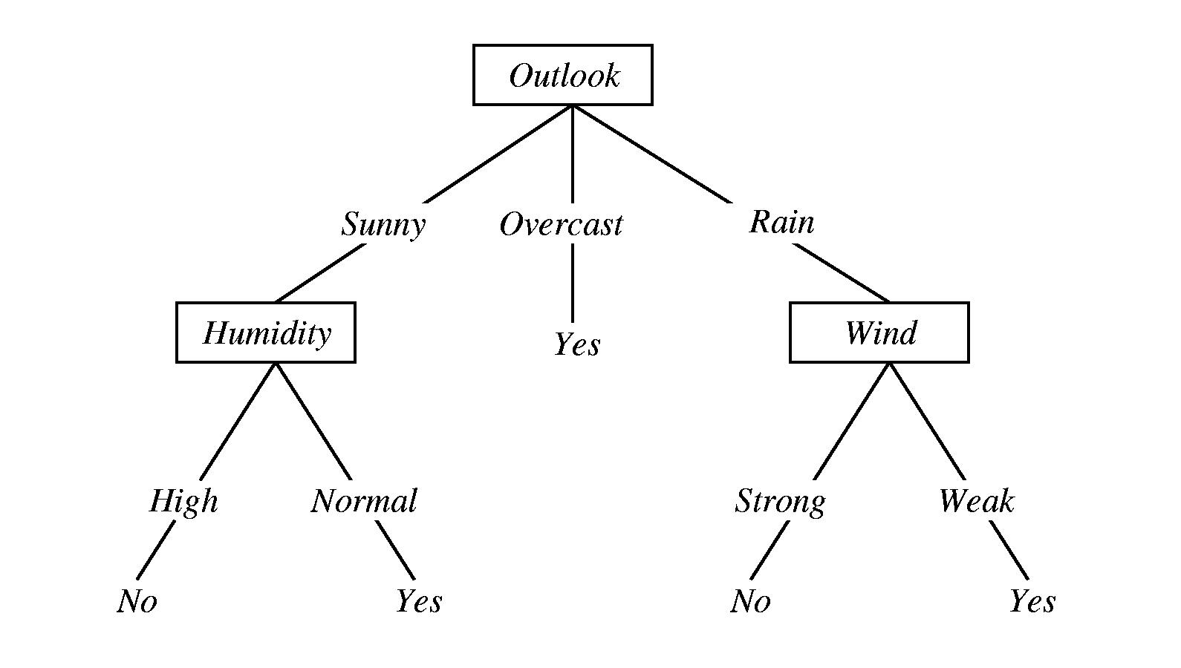
Decision tree example

Slide 11
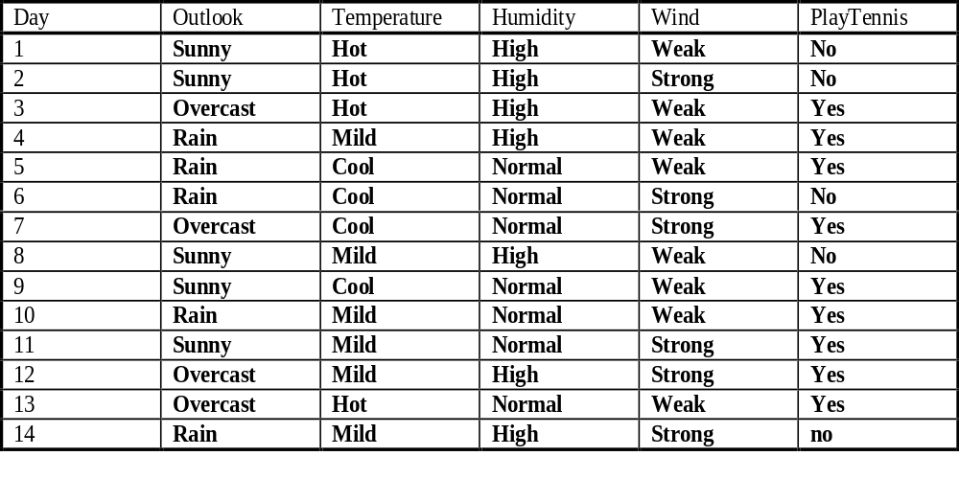
Data for the decision tree

Slide 12
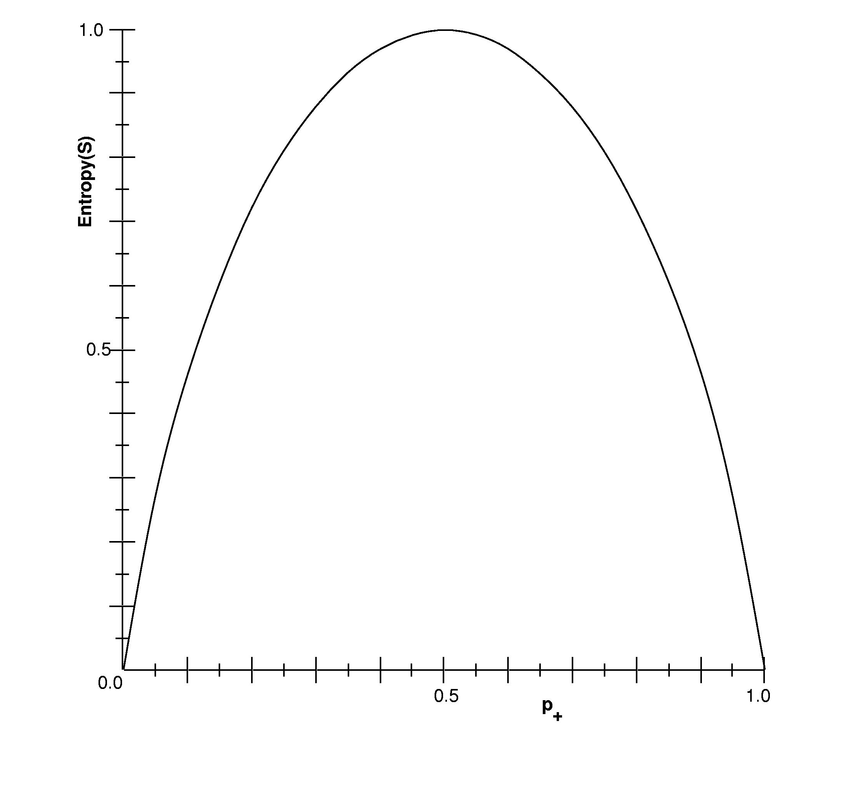
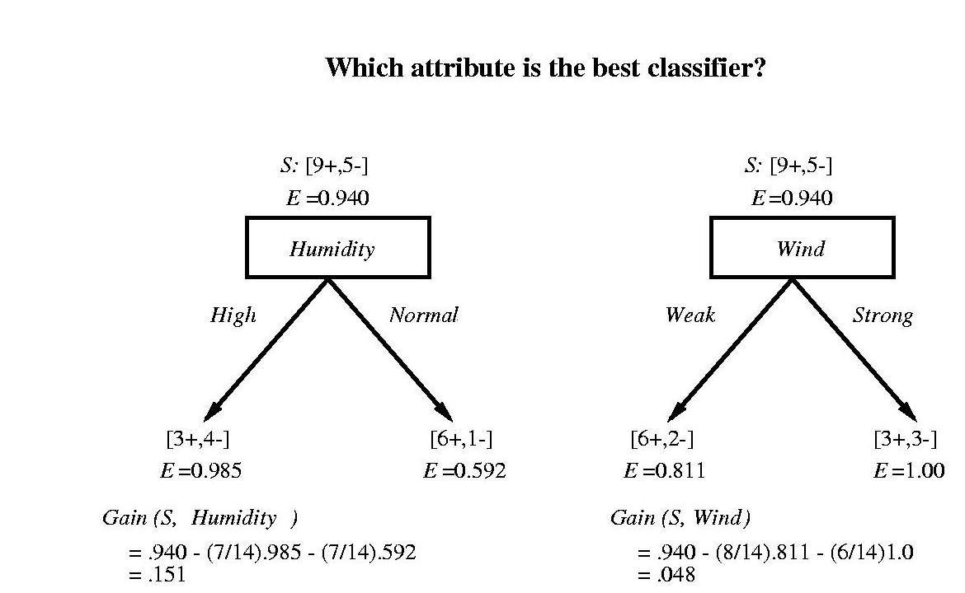
How is a decision tree constructed?

Slide 13
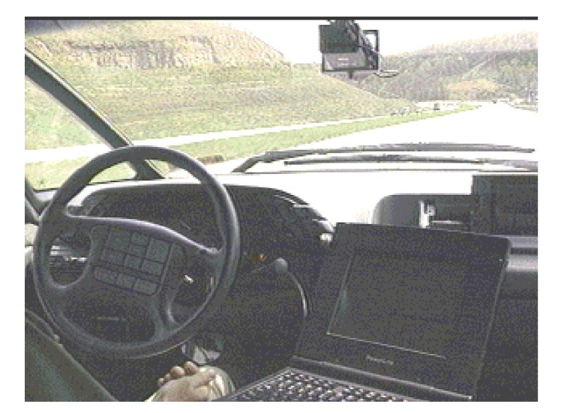
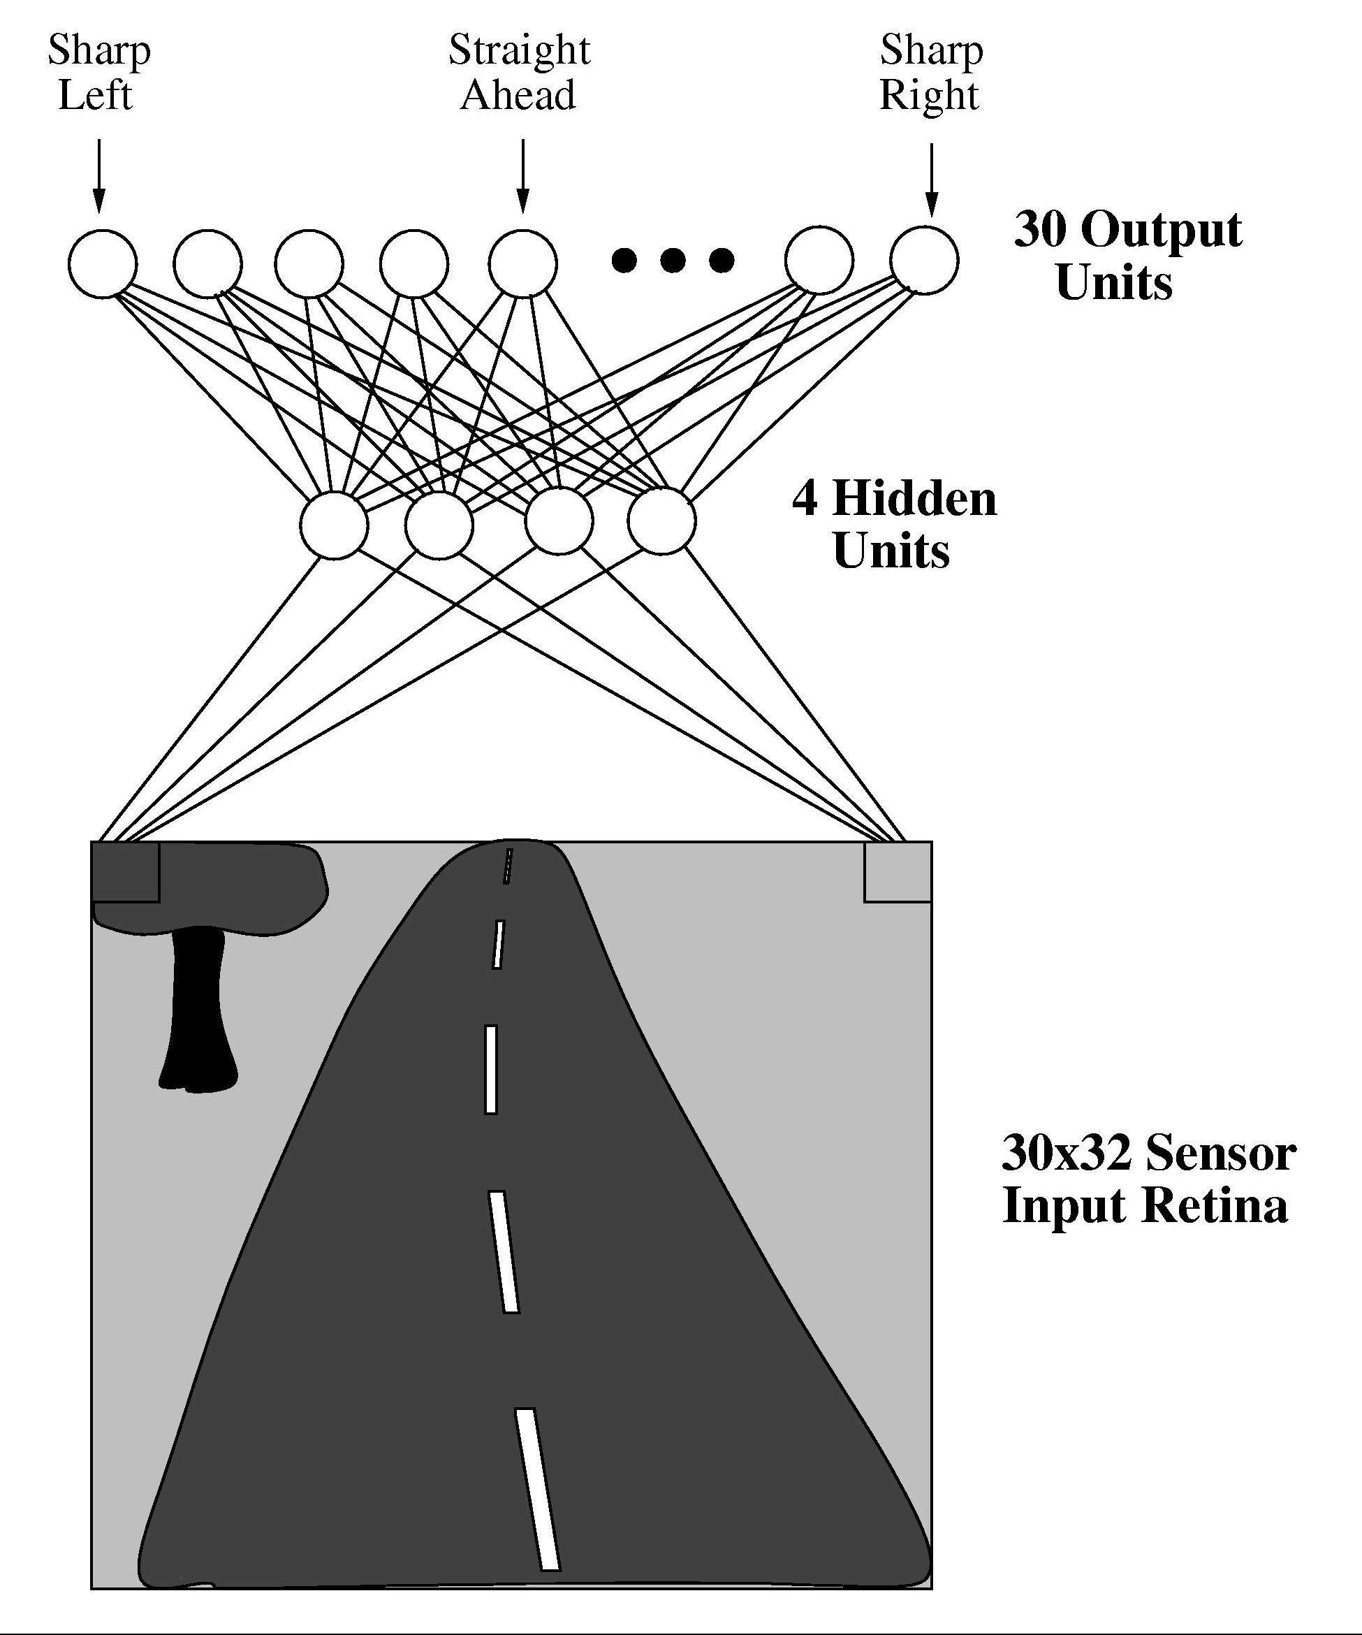
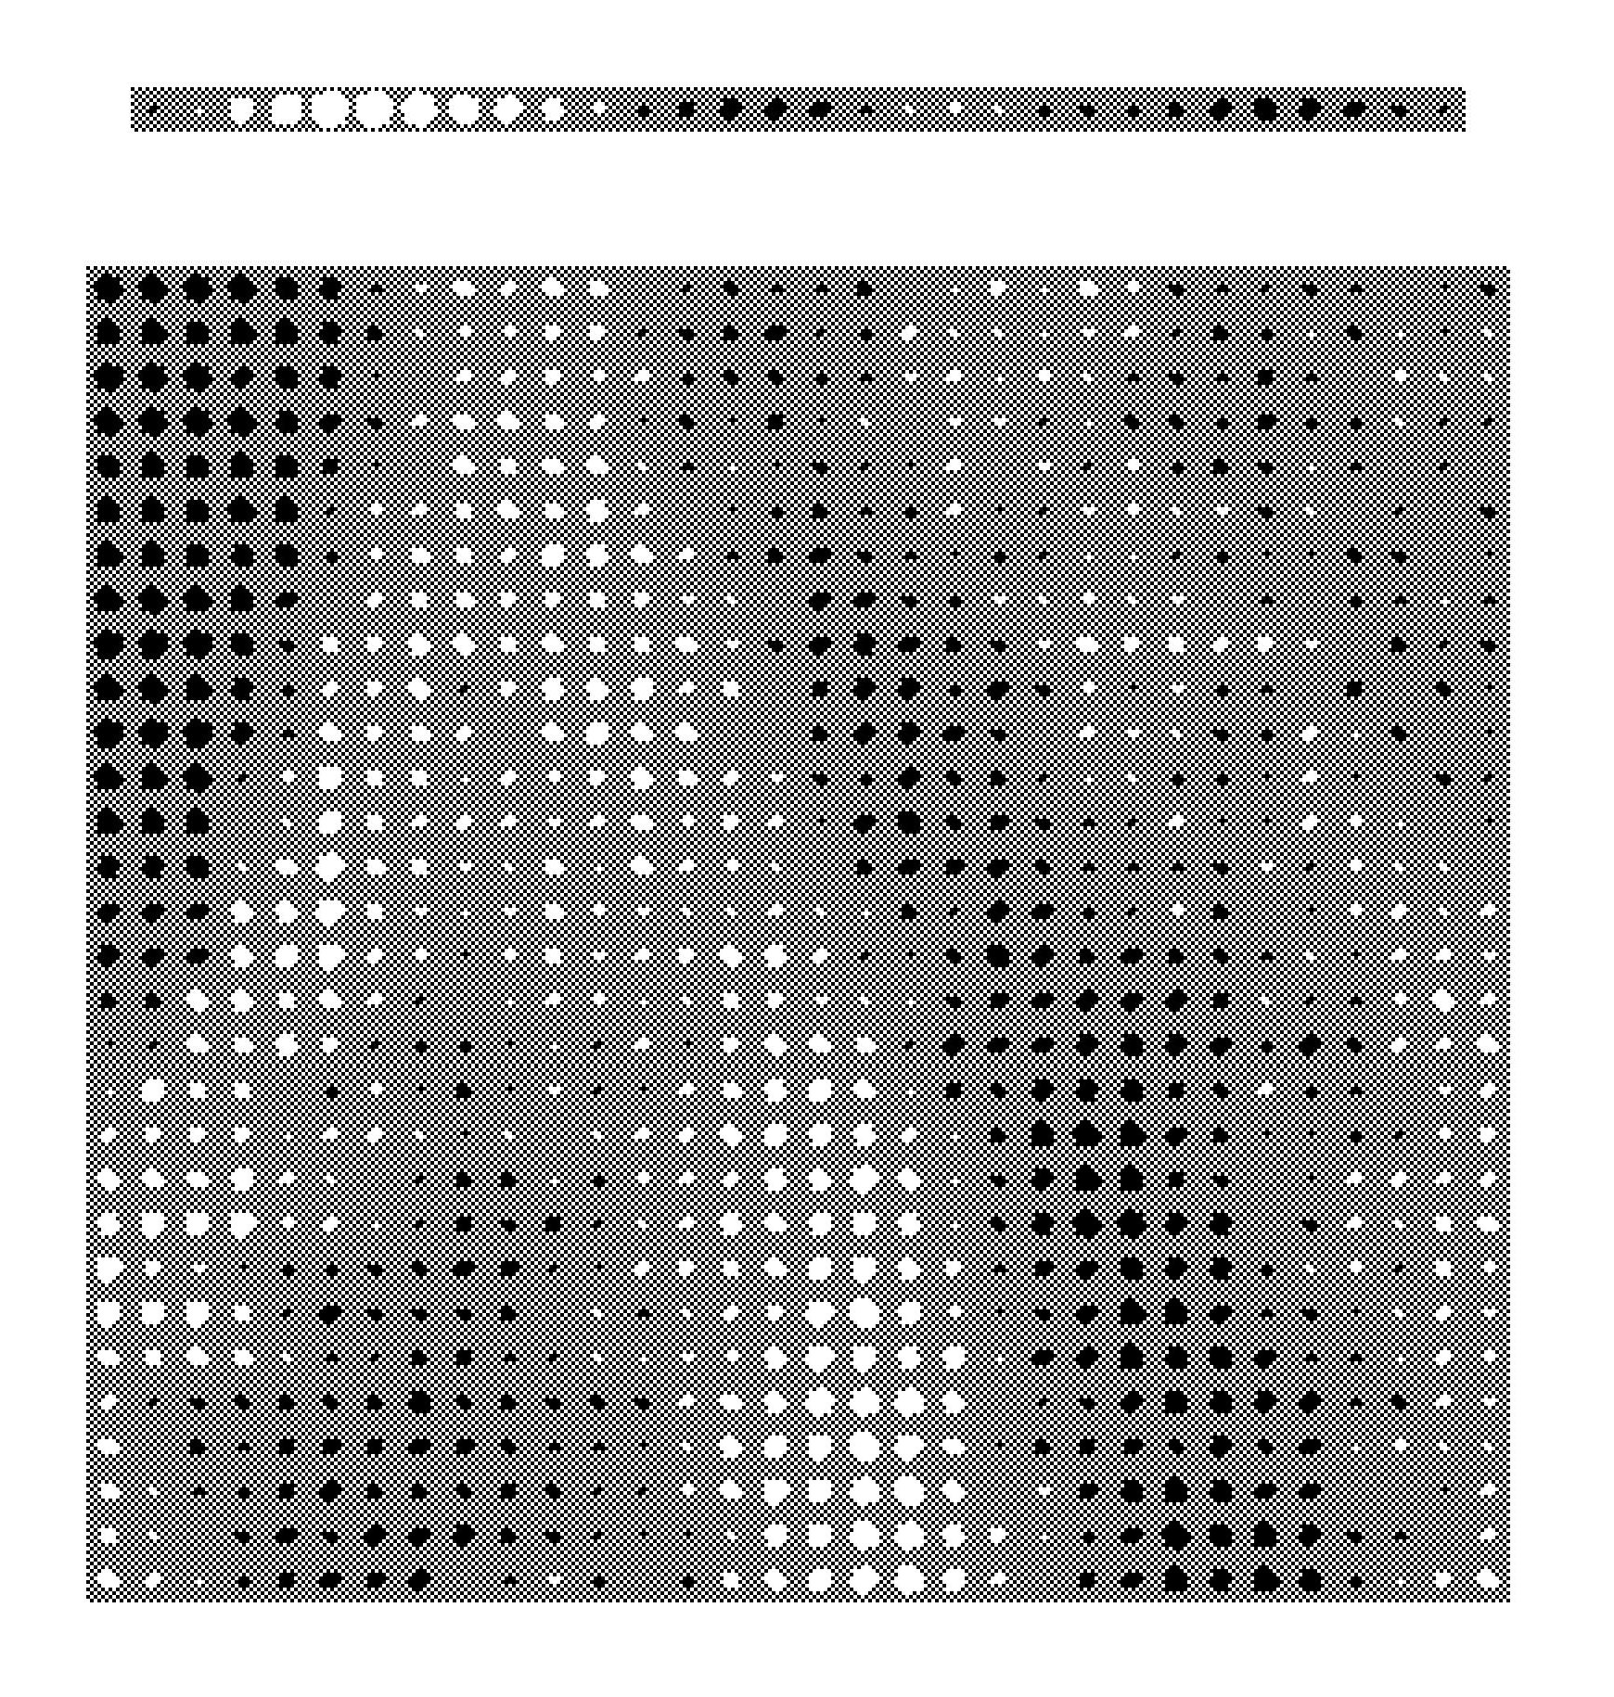
Neural network example

Slide 14
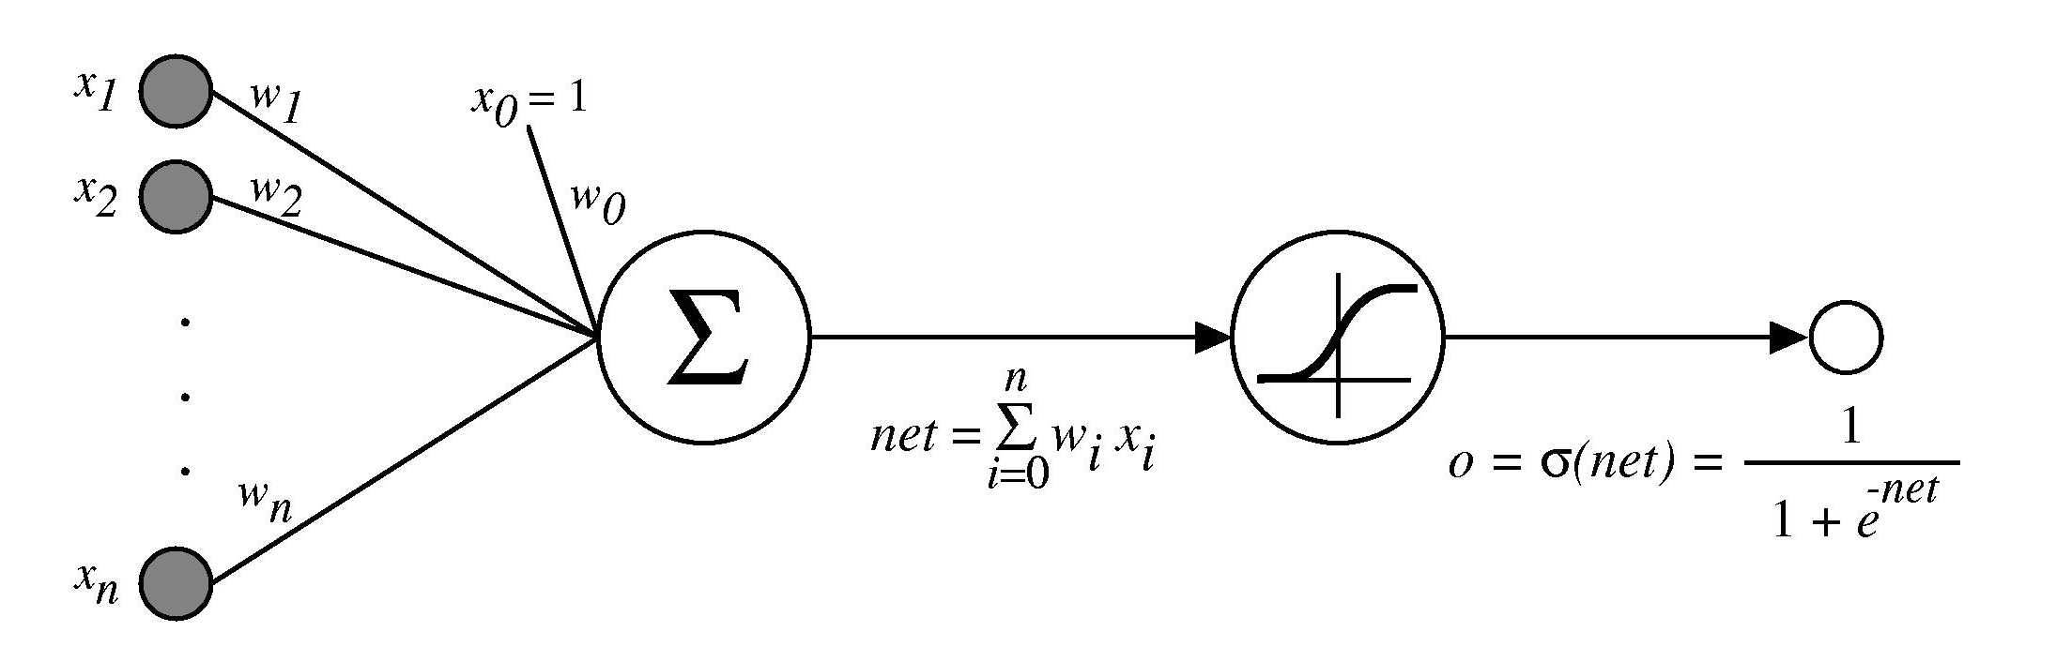
Artificial neuron

Slide 15
Machine learning research steps
Data gathering (lab experiments)
Feature selection
Model formation (data mining)
Model evaluation and improvement

Slide 16
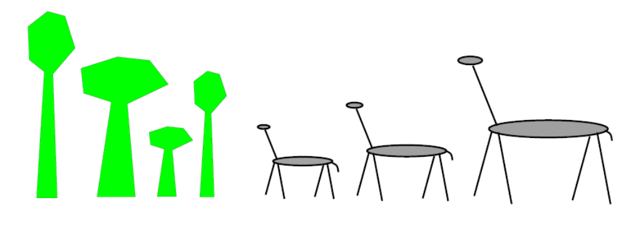
Evolutionary Computation
In the forest:
  Fitness is proportional to height
  Natural selection changes proportions

Slide 17
Evolutionary Algorithms
Maintain a population of potential solutions
New solutions are generated by selecting, combining and modifying existing solutions
  Crossover
  Mutation
Objective (fitness) function drives selection:
  Parenthood: high fitness
  Replacement: low fitness

Slide 18
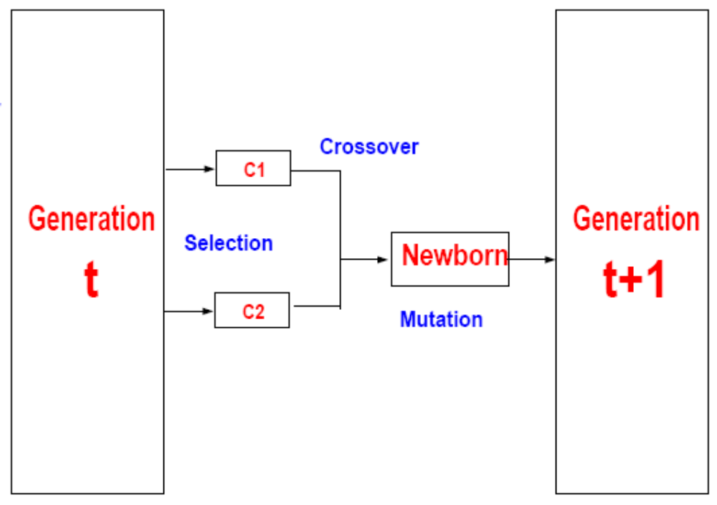
Elements of a generational genetic algorithm
Representation
Fitness function
Initialization
Selection strategy
Crossover
Mutation

Slide 19
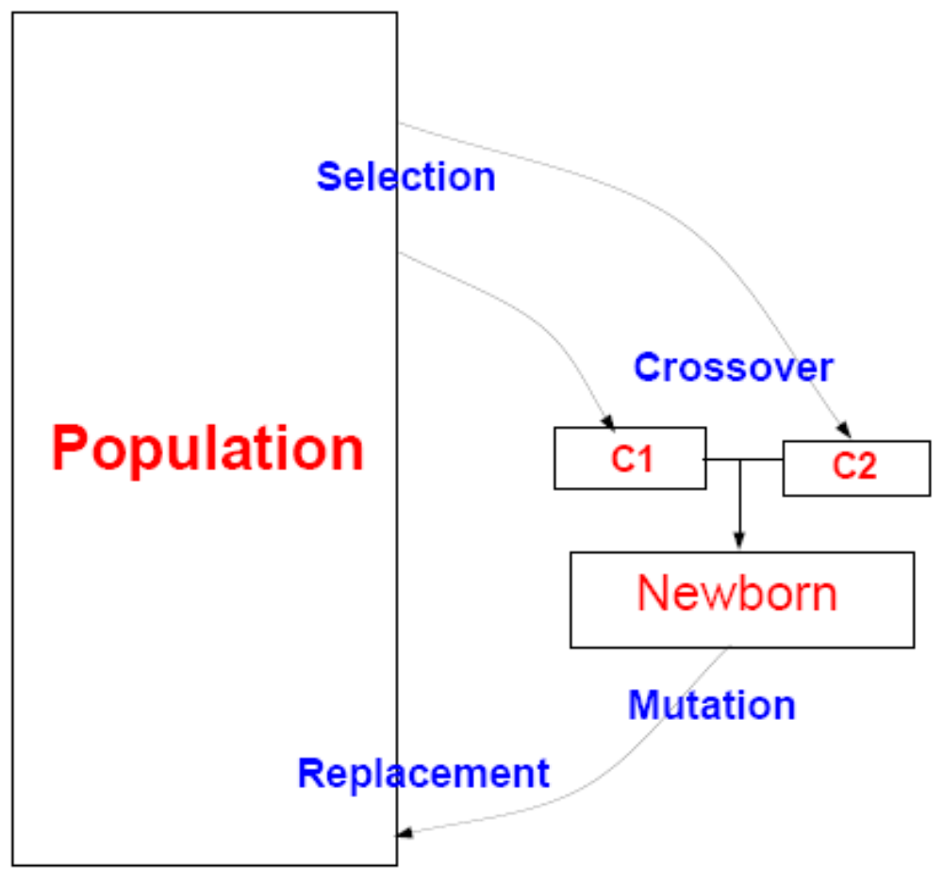
Elements of a steady-state genetic algorithm
Representation
Fitness function
Initialization
Selection strategy
Crossover
Mutation
Replacement strategy

Slide 20
EC approaches
Genetic Algorithms
Evolution Strategies
Genetic Programming
Evolutionary Programming
Classifier Systems

Slide 21
Recent & Ongoing Bioinformatics Research
Biomaterial modeling
Gene classification and Metagenomics
Identifying driver and passenger mutations in protein kinases
Alzheimer disease prediction using clinical data

