Slide 1
Multi-objective Steady State GA’s for engineering design
Deepti Chafekar
Jiang Xuan
Khaled Rasheed
Computer Science Dept., University of Georgia

Slide 2
MULTI-OBJECTIVE ENGINEERING OPTIMIZATIONS
Conflicting objectives
Complex search space with many constraints
Small feasible region
Expensive evaluation (simulators)
Search for Pareto optimal solutions
  (set of trade-off solutions)

Slide 3
STEADY-STATE GA vs GENERATIONAL GA
 | STEADY-STATE | GENERATIONAL
Advantage | -Retain feasible points (Higher selection pressure) | -Good diversity maintenance
Disadvantage | -Converges faster (Hard to keep diversity) | -More evaluations (might be too expensive)
➔ Keep diversity is the key!!!!!

Slide 4
OUR STRATEGY
GADO (Our base for both GA’s)
  Steady state GA
  Highly efficient and robust
    Guided crossover
    Adaptive penalty method
    Screening module (decides whether to evaluate a point ➔ save time)
  Good Diversity Maintenance
    Replacement (crowding technique)
    Diversity maintenance module (reseeding,rejection of near redundant points)
OEGADO (Objective Exchange GADO )
  Parallel Concurrent GAs
  Each GA optimize one objective
  Exchange information about its objective with others
OSGADO (Objective Switching GADO)
  Sequential GA
  Single GA switches focus between multiple objectives

Slide 5
OEGADO (Objective Exchange GADO) for two objectives
1. Both the GAs are run concurrently with each GA optimizing one of the two objectives while also forming a reduced model of it.
2. At intervals equal to twice the population size, each GA exchanges its reduced model with the other GA.
3. Informed operators are used. The IOs generate multiple children and use the reduced model to compute the approximate fitness of these children. The best child is selected to be the newborn.
4. The true fitness function is then called to evaluate the actual fitness of the newborn corresponding to the current objective.
5. The individual is then added to the population using the replacement strategy.
6. Steps 2 through 5 are repeated till the maximum number of evaluations is exhausted.

Slide 6
OSGADO (Objective Switching GADO)
The GA maintains the same population through out
Regular genetic operators are used (no approximations formed)
After a certain number of evaluations, the GA switches objectives
Stop when maximum number of evaluations is reached

Slide 7
RESULTS (OEGADO, OSGADO vs NSGA II)
NSGAII is a non dominated sorting algorithm with elitism (the best known to us)
OEGADO & OSGADO performed equally well as NSGA II in simple problems
OEGADO & OSGADO performed better than NSGA II in difficult problems and in some problems found better Pareto-optimal solutions in fewer objective evaluations
OEGADO performed consistently very well

Slide 8
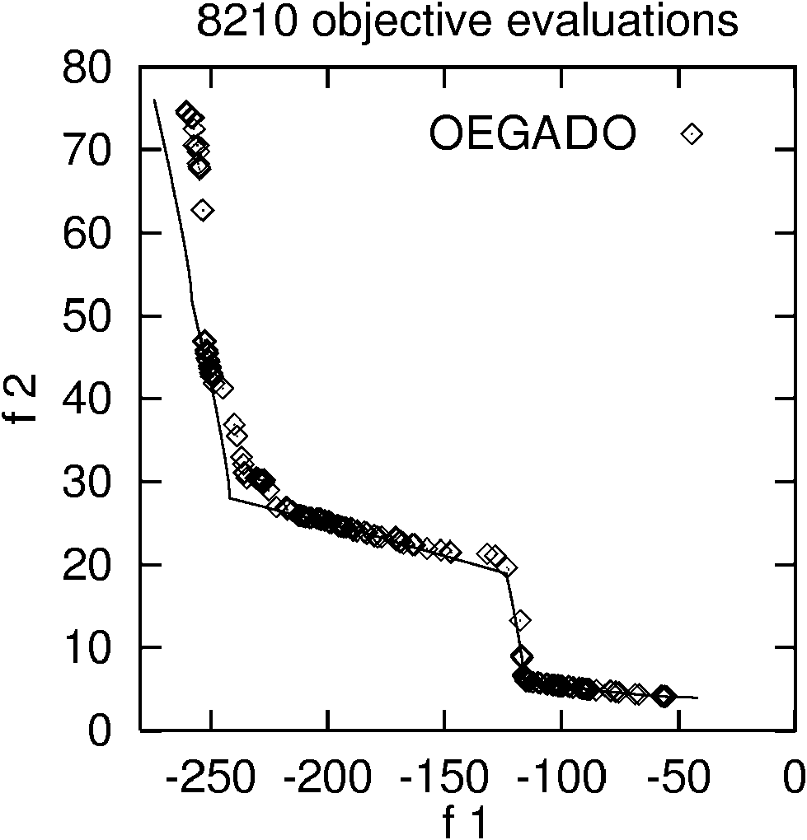
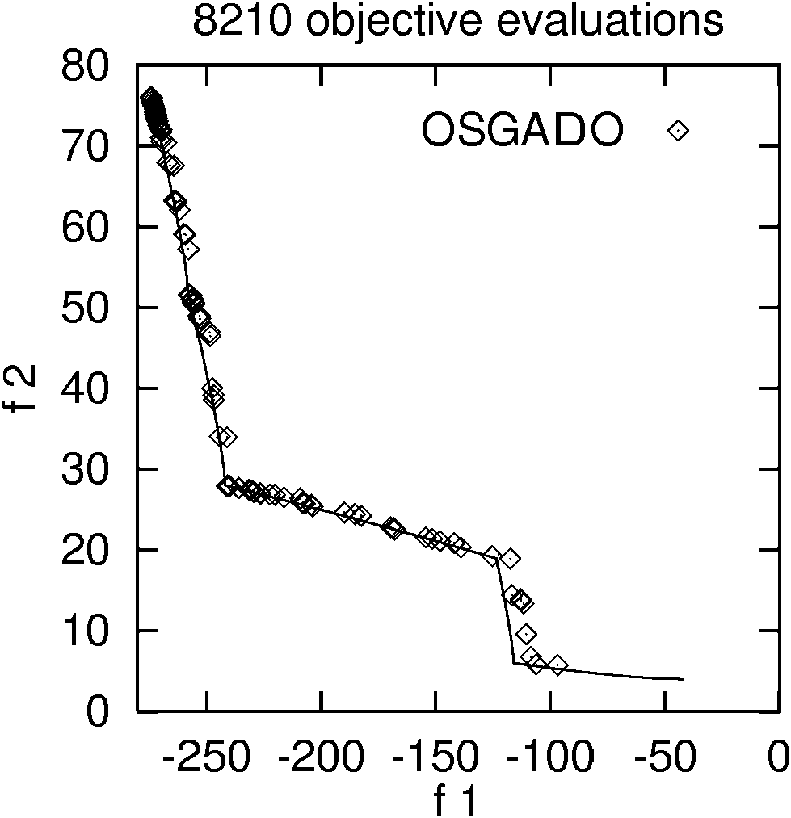
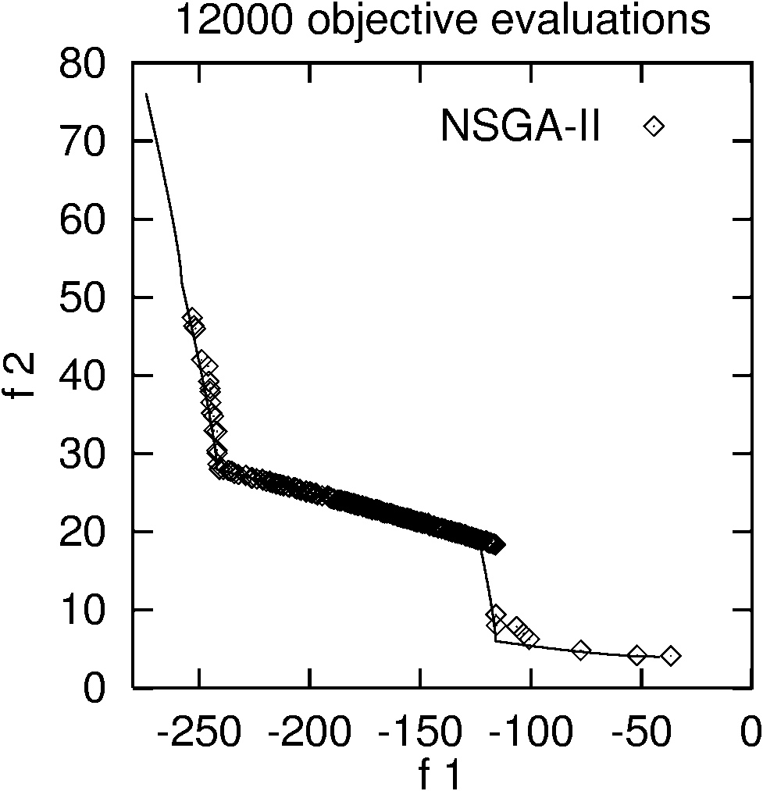
RESULTS (for relatively difficult benchmark OSY)
- OEGADO and OSGADO outperformed NSGA II

Slide 9
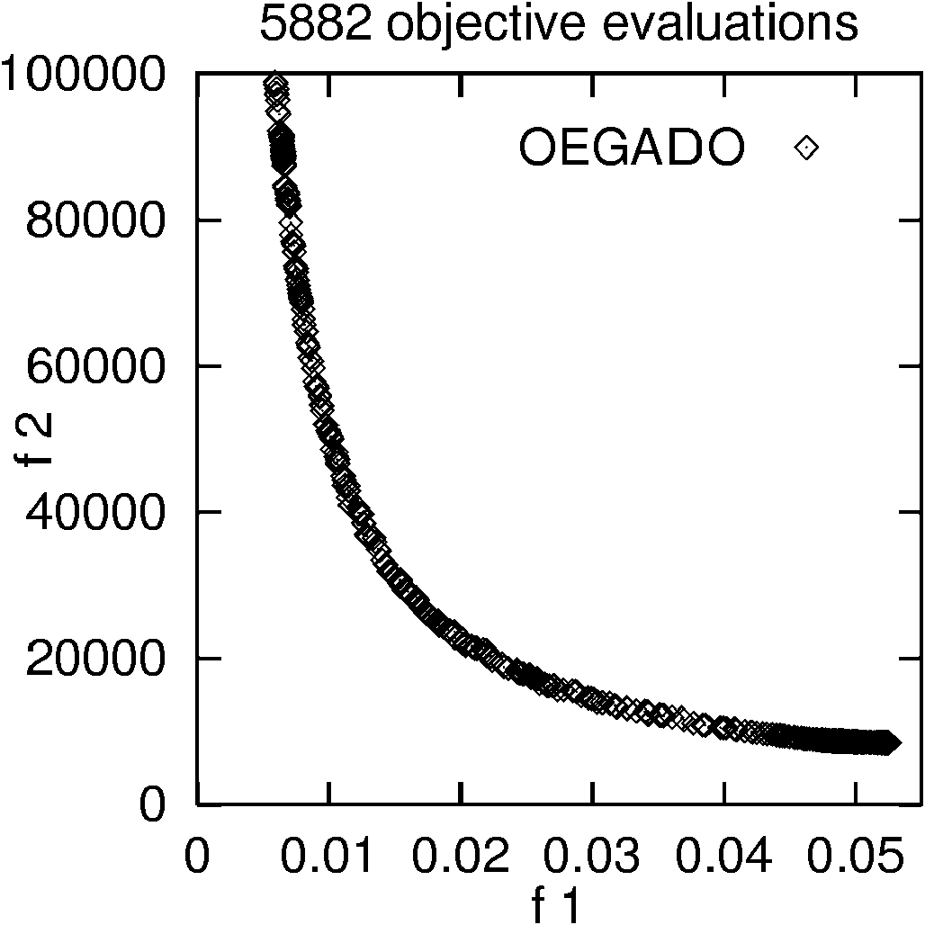
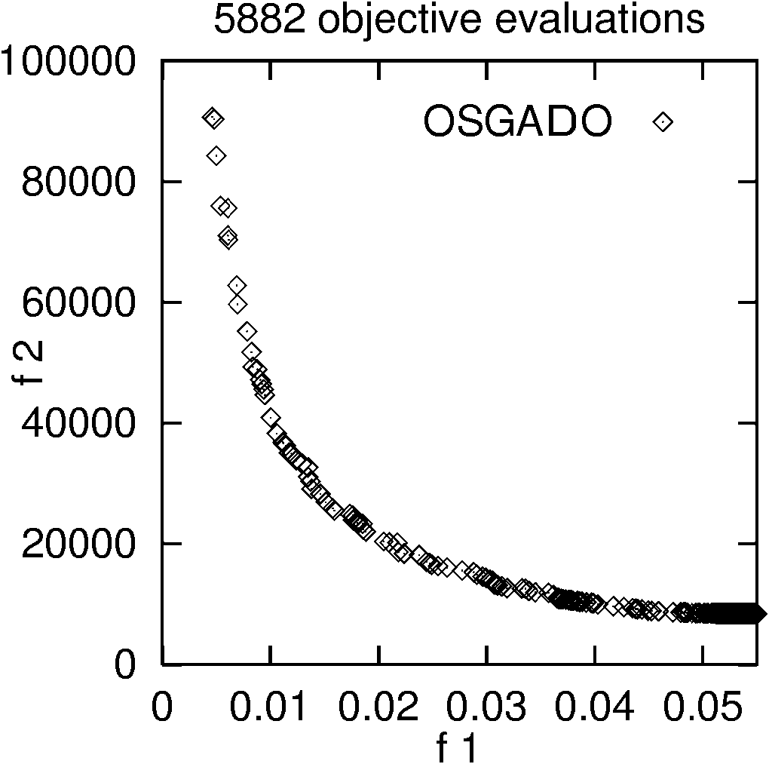
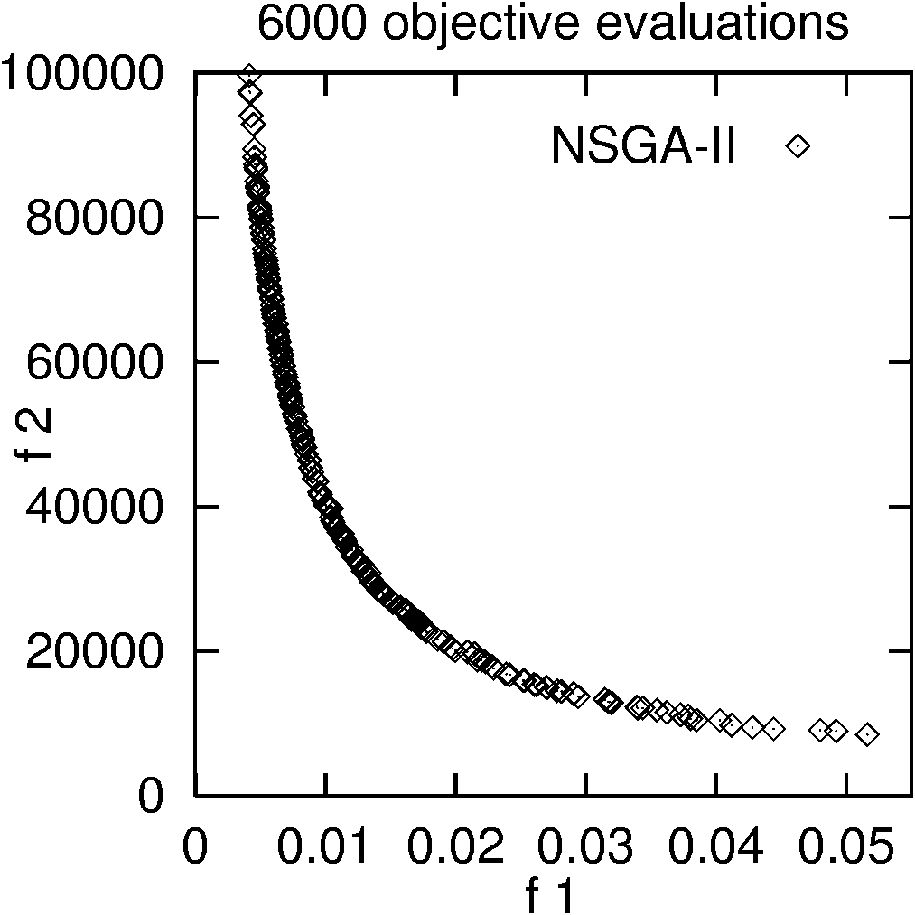
RESULTS (Two-bar Truss design)
  OEGADO had best performance, OSGADO found better solutions for f2 than the other two.

Slide 10
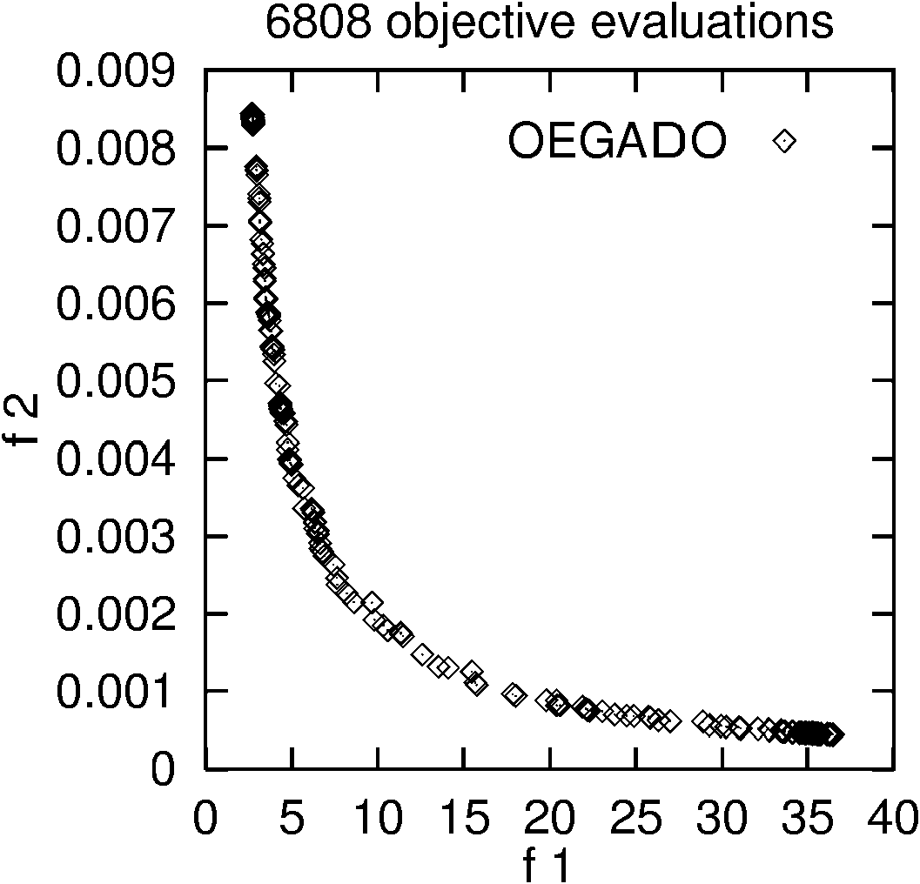
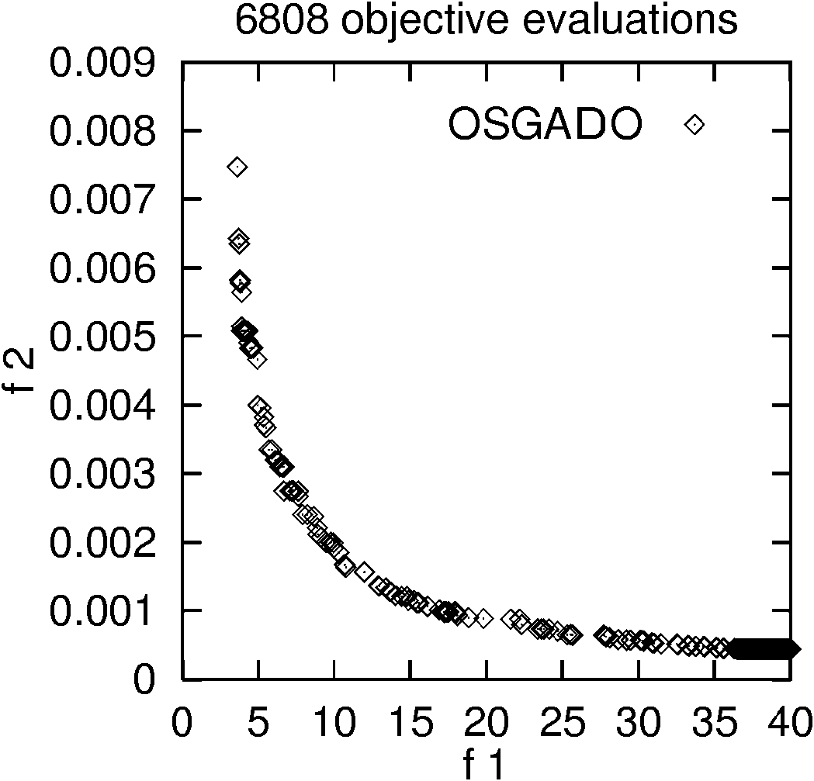
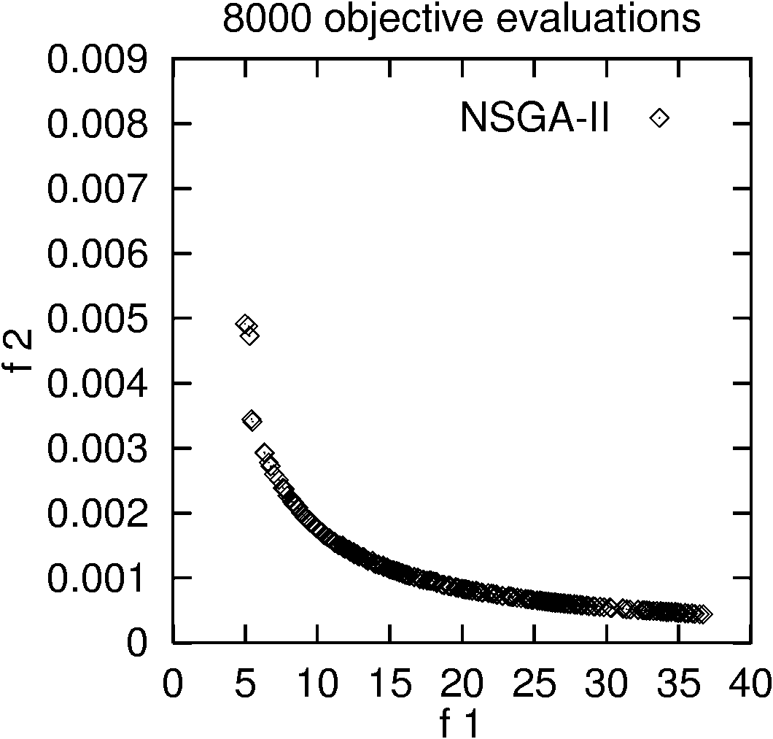
RESULTS (Welded Beam Design)
- For non-linear constraints OEGADO did better with a good distribution over the covered area
- OSGADO covered area that both OEGADO and NSGA II failed to explore.
- NSGA II did not achieve a good distribution

Slide 11
Ongoing and future work
Extending OEGADO to handle more than two objectives
Using Pareto-rank in addition to individual objectives in OSGADO
More realistic application domains
Adding Informed operators to OSGADO

