Slide 1

Machine Learning and Data Mining.
By:
Diptee Mehta.
Abhishek Agarwal.

Slide 2
What is Data Mining???
Extraction of hidden predictive information from large databases.
Using historical data to discover regularities and improve future decisions.
Similar to mining a mountain for a vein of valuable ore. Hence called DATA MINING.

Slide 3
Motivation
Massive data collection
Development of powerful multiprocessor computers.
Data mining algorithms.
DATA EXPLOSION PROBLEM!!!!!

Slide 4
Why Data Mining??
Potential applications
Retailing/Marketing
Find buying patterns
Market basket analysis
Banking
Credit card approval
Predicting customers that fail to repay their loans.

Slide 5
Potential Applications (contd.)
Insurance and Health Care
Claims analysis
Predicting factors that lead to a particular treatment
Internet Marketing
Association of items likely to be viewed or purchased together
Personalizing web pages

Slide 6
Commonly used techniques:
Artificial Neural Networks
Decision trees
Genetic algorithms
Nearest Neighbor method
Rule induction

Slide 7
An example in detail
Given
Set of medical records describing 9714 pregnant women.
The decision we wish to improve upon is our ability to identify high risk of requiring emergency C section delivery.

Slide 8
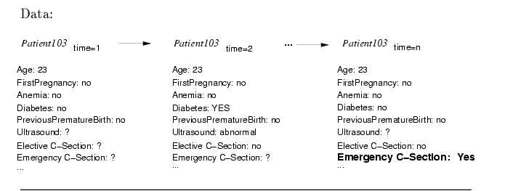
Given data

Slide 9
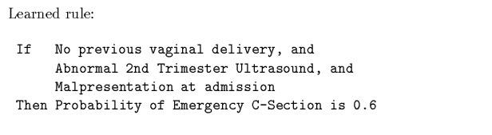
Learned rule

Slide 10
Current State of the Art
First Generation Data Mining Algorithms.
  E.g. Logistic regression, Decision Tree and rule learning, Neural networks, Bayesian learning methods.
Work best when:-
  large set of data in a single database.
  Data described by numeric or symbolic features
  Data does not contain text and image features interleaved with symbolic featues.

Slide 11
Req. Enhancements to Current Algorithms
Needs more diverse sources and types of data.
Needs mixed-initiative data mining.
Needs to learn from data that is a combination of various media.
  E.g. Combine ultrasound images ,notes made by physicians and recordings of phone calls.

Slide 12
Current Research Areas
Optimizing decisions rather than predictions.
Scaling to extremely large datasets.
Active Experimentation.
Learning over multiple databases and web.
Inventing new features to improve prediction accuracy.

Slide 13
Optimizing Decisions
Goal: Improve choice of actions in addition to predicting outcomes.
  E.g. : More helpful to learn pre-emptive action to reduce birth complication rather than predict which women suffer risk of one.
  Problem: Available data is often biased.
  E.g. Mothers giving birth at home suffer fewer complications; we cannot conclude sending a woman home will reduce the risk.

Slide 14
Scaling to extremely large datasets
Learning algorithms perform well on tens of thousands of examples.
Problem: Data from customer databases and Hubble telescope reach terabytes.

Slide 15
Active Experimentation
Need new methods to actively generate optimal experiments.
  E.g. In a manufacturing process it is easy to capture data under normal conditions.
  Performance under non-standard conditions??

Slide 16
Learning over multiple databases and web.
E.g. Equipment manufacturer
  Mines a database consisting of customer’s past purchases and servicing needs.
  corporate clients have their own database containing current and planned activities.
  Need to combine both information.
Requirement: Need to successfully extract information from hypertext

Slide 17
Inventing new features to improve prediction accuracy
Inventing more appropriate set of features to describe available data.
Given a large and long duration data set we should be able to identify the features most useful for learning.

Slide 18
Thank You!!

