Slide 1
Title: Using Machine Learning Techniques in Stylometry
By: Ramyaa, Congzhou He, and Dr. Khaled Rasheed
Presented by
Lorina Naci and Cy Routh

Slide 2
Introduction
What is Stylometry?
Why is Stylometry Controversial?
What is Controversial About Stylometry?
Where Does the Complexity Lie?
The Problem Formulation
Experimental Overview
Decision Trees
Neural Networks
Results
Comments

Slide 3
What is Stylometry?
The measure of style
Fundamental assumption: distinctive and quantifiable elements, which are not consciously controlled by the author, mark the style of an author.
Origins date back to the mid 19th century
Officially baptized in 1964 in attempts, by American statisticians Mosteller and Wallace, to determine the authorship of the Federalist Papers.
Two primary applications: attributional studies and chronological studies.
Practical applications of stylometry: fraud detection, email classification, clinical tools in disease detection, forensic tools in court trials, etc.

Slide 4
Why is Stylometry Controversial?
Stylometry’s Antagonism with Humanities
Controversial and Disputed Results Over the Course of its Developments
The Field Lacks Cohesion.

Slide 5
What is Controversial About Stylometry?
Categorize and compare the salient features of an authors style with those of another author.
There is no consensus as to what characteristic features to use.
Some of the indicators used are:
  word length, sentence length, tests of position, the distribution of once-occurring words, the frequencies of marker words, letter sequence, syllable length or syntactical measures, etc.
No comparison of results on a large scale.

Slide 6
What is Controversial About Stylometry?
There is no consensus as to what methodology to use.
  statistical methods or/and automated pattern recognition methods?
Statistical methods are: Bayesian analysis, cluster analysis such as the widely used Principal Components Analysis (PCA), Gram Analysis.
Automated pattern recognition methods are: Artificial Neural Networks (ANN), Genetic Programming (GP).

Slide 7
Where Does the Complexity Lie?
The challenges:
  human language has many non quantifiable features.
  the idiolect of each individual contains elements not shared by the community.
No computational system has yet accomplished the task without human aid.

Slide 8
The Problem Formulation
This study uses, an automatic text parser, decision trees and neural networks.
It recognizes the style of five authors instead of one or two, resulting in a more universal measure.
It controls for style features determined by genre or period (by using authors of the same era and same genre).
It uses unconventional indicators such as punctuation marks, as well as standard indicators such as function words.
It uses only 21 indicators showing that not many features are required for high-performance classification as opposed to common belief.

Slide 9
The Problem Formulation
78 samples from five popular Victorian authors
  Jane Austen:
    Pride and Prejudice Chapters 1-5
    Mansfield Park Chapters 1-5
    Emma Chapters 1-5
    Sense and Sensibility Chapters 1-5
  Charles Dickens
    David Copperfield Chapters 1-5
    Great Expectations Chapters 1-5
    Hard Times Chapters 1-6
    Tale of Two Cities Chapters 1-6
  William Thackeray
    Vanity Fair Chapters 1-6
    Men’s Wives Chapters 1-6
  Emily Bronte
    Wuthering Heights Chapters 1-12
  Charlotte Bronte
    Jane Eyre Chapters 1-12

Slide 10
The Problem Formulation
type-token ratio
mean word length
mean sentence length
standard deviation of sentence length
mean paragraph length
chapter length
number of commas per thousand tokens
number of semicolons per thousand tokens
number of quotation marks per thousand tokens
number of exclamation marks per thousand tokens
number of hyphens per thousand tokens
number of and’s per thousand tokens
number of but’s per thousand tokens
number of however’s per thousand tokens
number of if’s per thousand tokens
number of that’s per thousand tokens
number of more’s per thousand tokens
number of must’s per thousand tokens
number of might’s per thousand tokens
number of this’s per thousand tokens
number of very’s per thousand tokens

Slide 11
Experimental Overview
78 samples > 61 training + 17 testing
Decision Trees
  Quinlan’s See5 package
    Fuzzy thresholds
    Fuzzy thresholds + Winnowing
    Fuzzy thresholds + Boosting
ANNs
  Neuroshell
    4-layer Feed-Forward Backpropagation network

Slide 12
Decision Trees
Fuzzy Thresholds
  “The knife-edge behavior for decision trees is softened by the construction of an interval close to the threshold.”
  3.3% error on training / 23.5% error on testing
  No tree given

Slide 13
Decision Trees
Fuzzy Thresholds + Winnowing
  “Attributes found to be irrelevant or harmful to predictive performance are disregarded and only the remaining attributes are used to construct the decision trees.”
  6.6% error on training / 17.6% error on testing

Slide 14
Decision Trees
    Winnowing Tree
    semicolon <= 6.72646 (8.723425): charles (18/2)
    semicolon >= 8.97227 (8.723425):
    :...semicolon >= 16.2095 (14.64195): charlotte (11/1)
    semicolon <= 14.6293 (14.64195):
    :...but >= 4.71113 (4.69338): jane (15/1)
    but <= 4.67563 (4.69338):
    :...quotation mark <= 12.285 (14.7294): emily (10)
    quotation mark >= 17.1738 (14.7294): william (7)

Slide 15
Decision Trees
Fuzzy Thresholds + Boosting
  “The booster samples the input distribution to keep the accuracy of the learner’s current hypothesis near to that of random guessing. As a result, the learning process focuses on the currently hard data.”
  Boosting created 9 trees
  0% error on training / 17.6% error on testing

Slide 16
Decision Trees
Best Boosting Tree
    semicolon <= 8.47458 (8.723425):
:...might >= 498339 (249170.4): william (2.5)
: might <= 1.86846 (249170.4):
: :...sen length standev <= 23.1772 (24.8575): charles (14.9)
: sen length standev >= 26.5378 (24.8575): william (2.2)
semicolon >= 8.97227 (8.723425):
:...semicolon >= 14.6546 (14.64195):
:...sen length standev <= 10.2292 (12.68945): jane (1.9)
: sen length standev >= 15.1497 (12.68945): charlotte (10.4)
semicolon <= 14.6293 (14.64195):
:...but <= 4.67563 (4.69338):
:...mean sentence length <= 23.2097 (24.9242): emily (8.2)
: mean sentence length >= 26.6387 (24.9242): william (6.4)
but >= 4.71113 (4.69338):
:...this <= 2.46609 (3.4445): jane (12.6)
this >= 4.42291 (3.4445): william (1.9)

Slide 17
Neural Networks
Investigated several architectures
  Kohonen Self Organizing Maps, probability networks, networks based on statistical methods
Best result: feed-fwd back-prop
  21 input > 15 hidden > 11 hidden > 10 output
  two output nodes per author
  mean error 11.8% on testing
Surprises and bonuses
  both nodes for an author had similar values
  all texts assigned to a single author (not built in)

Slide 18
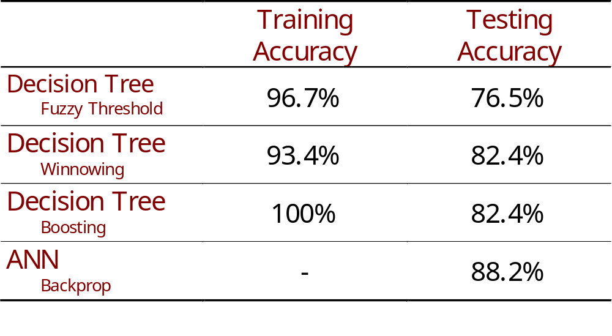
Results

Slide 19
Comments
Decision Trees
  thresholding not well explained, yet thresholding values given in trees
  winnowing used to find the most relevant attributes, but process not described
    finding relevant attributes is an underlying goal of the paper
  boosting methodology is unclear
    how are multiple classifiers constructed?
    how are multiple classifier results combined?

Slide 20
Comments
ANNs
  Good discussion of backpropagation network
    Motivation for dual outputs not quite clear
  Results for other architectures?
    Self Organizing Maps, probability networks,…?
    Are feed forward architectures robust?

Slide 21
Comments
Overall
  Good demonstration of applicability of ML to stylometry
  Good demonstration of utility of punctuation as an attribute
  Who is the intended audience?
    Too much or too little detail?

