Slide 1

A Neural Network Decision Module in RoboCup Simulation League
Nikolaos Kalyviotis and Huosheng Hu
By Kaan Tariman & Achim Rettinger

Slide 2
Outline
Introduction
Adaptive Strategic Planning
Hand Coded Approach
Neural Network Approach
Experiment Results
Critique and Future Work

Slide 3
Introduction
RoboCup started in 1996
Promotes a wide spectrum of research in Artificial Intelligence and Robotics
Divided into four leagues:
  Small Size Robots
  Middle Size Robots
  Sony Legged Robots
  Simulation

Slide 4
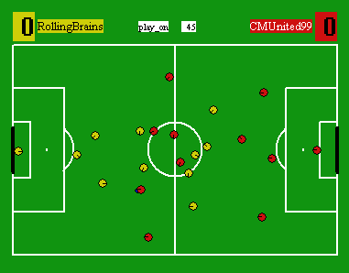
Simulation League
Purely synthetic autonomous agents
Real time goal-directed behaviors of Multi Agent Systems
Three challenges:
1) Learning
2) Teamwork
3) Opponent Modeling

Slide 5
Adaptive Strategic Planning Framework (ASPF)
ASPF is planning method extended from the common strategic planning in AI
ASPF maps plans to situations if the situation is important
Situations are important when they occur repeatedly. It is good to have ready plans for those situations.
If the important situation occurs, agent executes a Global Strategic Plan (GSP) , otherwise it thinks for an action.

Slide 6
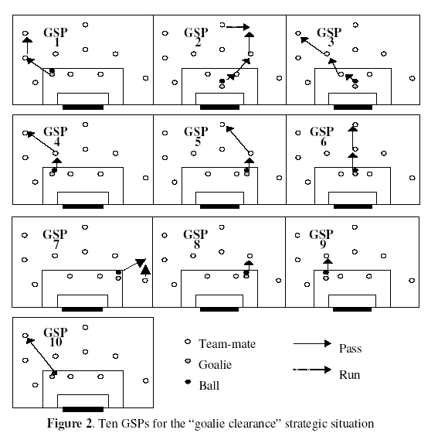
Important Situation: Goalie Clearance

Slide 7
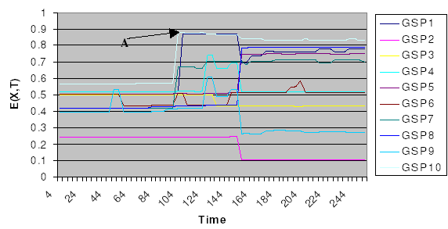
Hand Coded Approach
Finding the best GSP for the current situation can be viewed as a classification problem.
What action? What time?
Evaluation function E(x,t) outputs a value [0..1] given GSP-X at time t.

Slide 8

Evaluation Function
Risk Factor: RG(x,t) how risky to execute GSP-X at time t
Congestion: CON(x,t) how much congested of opponents at time T is the last player who recevies the ball
Usefullness: USE(x,t)
Cost: COST(x,t)
The best value of the evaluation function for given GSP-X is applied during the game when goalie receives the ball

Slide 9
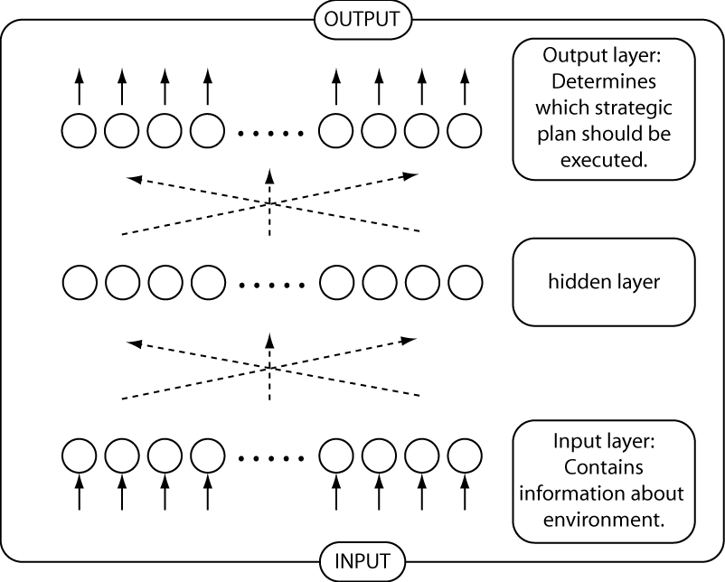
Neural Network Approach

Slide 10
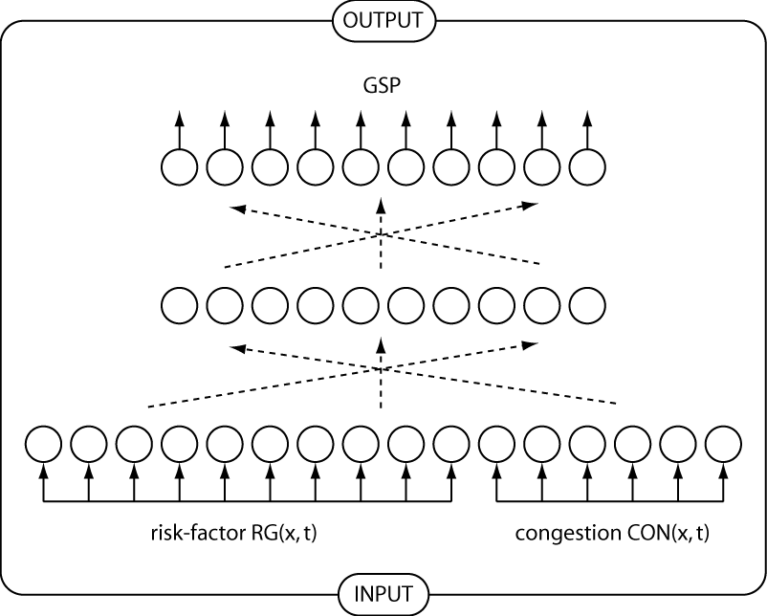
The Design of Inputs

Slide 11
Design Parameters
Training
96 sets of (Sbest, GSP Xbest) dataset
We assume that the situations were chosen and evaluated by a human
Evaluation
100 sets of (Sbest, GSP Xbest) dataset
We assume that the situations were chosen and evaluated by a human

Slide 12
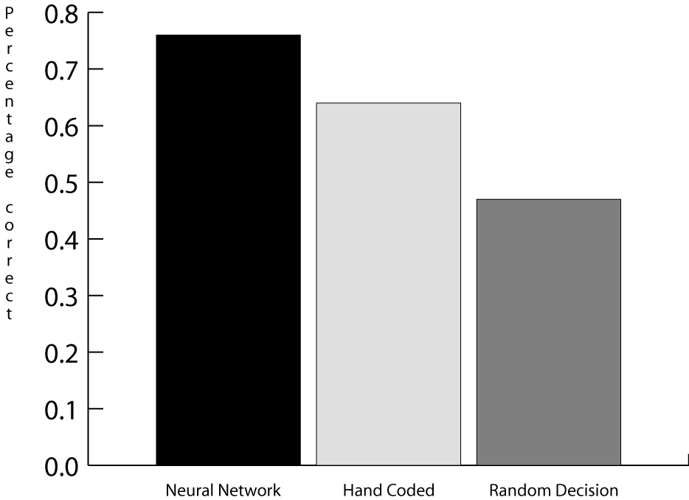
Results

Slide 13
Conclusion
Future Directions:
Use same method for other strategic situations
Critique:
More future directions:
  automatic picking and evaluation of situations
  automatic prediction of Sbest
How avoid overfitting?

Slide 14

Thank you!

