Slide 1

Data Mining & Machine Learning
Methods for Micro-Array Analysis
Presented by
Gayathri Gatamaneni
&
Preeda Rajasekaran

Slide 2
Data Mining
Pre-Processing
And
Representation
Knowledge discovery
Feedback
Intermediate
representation
Observational Data
Background Knowledge

Slide 3
Overview
Micro-Array analysis employs machine learning algorithms and techniques to mine useful data
Algorithms
  Decision Trees - C5.0 implementation
  Artificial Neural Networks – Back-propagation algorithm
Two complementary techniques
  Cross-validation
  Multi-model approaches

Slide 4
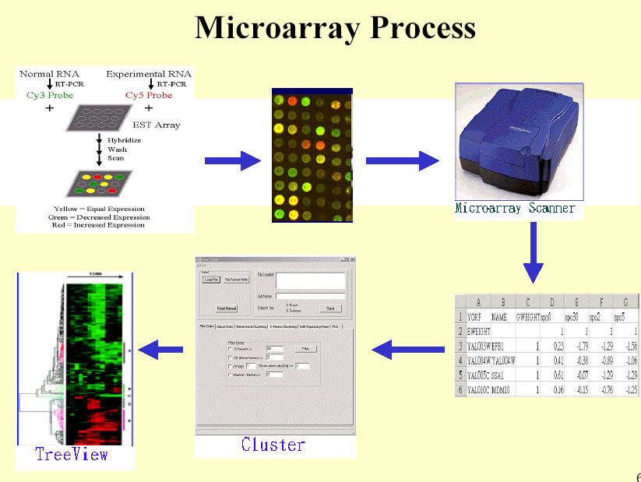
What is Micro-Array Analysis?

Slide 5
Sample Micro-Array Data
P1 P2
100_g_at, 7.8908060889829, 8.41474485950908,……………….,
1001_at, 6.11774987278628, 5.51130860710453,……………….,
1054_at, 5.16268171815626, 5.3180123481225,…………………,
Cancer Normal

Slide 6
Analysis of Micro-Array Data
Challenges posed
  Typical characteristic of micro array data is the large number of variables relative to the number of observations.
  Hidden knowledge in these data has to be discovered
    Eg.Gene expression data from 72 leukemia patients (samples) with 7,070 genes (variables)
  The study of the variability of gene expression patterns
Problems
  How to analyze micro-array data with the following requirements met simultaneously ?
    Efficiency
    Accuracy
    Automation

Slide 7
Analysis Gene Expression
Gene expression analysis can help understand the functions and relations of genes
Paradigm of gene expression analysis
  Gene Expression Grouping
    Clustering methods and validation techniques
  Reasoning
    Classification-based methods with gene properties
    Frequently used methods: DecisionTree, SVM, Neural Network, etc.

Slide 8
Machine Learning for Micro-Array Analysis
Two main methods are
  Cluster analysis:
    Identification of new subgroups or classes of some biological entity (e.g. ,tumors)
      K-Means ,K-Mediods,etc.
  Discriminant analysis:
    Classification of entities into known classes (e.g., diseases, therapies).
We require:-
  Efficient clustering methods and validation techniques

Slide 9
Machine Learning for Micro-Array Analysis [contd..]
Cross validation
  To test the robustness of the classifier
Algorithm choice depends on
  Attributes
  Ratio of the training data
  [ TP,TN;if TP is small- over-fitting occurs]
Combined approaches
  Limited amount of training data, the individual classifier may not represent the true hypotheses.
  Combined classifier may produce a good approximation to the true hypotheses.

Slide 10
Next…
Multi-Model Approaches -Boosting
Neural nets
Decision trees

Slide 11
Multi-Model Approaches
Problem with the regular models
Instability of Prediction Method
  Sensitivity of the final model to small changes in the training set.
Unstable machine learning methods
  Decision trees
Stable methods
  k-nearest neighbor
  Neural models
Now, let us see an approach to address the instability problem….

Slide 12
Multi-Model Approaches
Common methods for constructing multi-model systems
Boosting, Bagging, and Stacking
What they do?
Creates and Combines multiple classifiers
How are they different from each other?
Differ in how the classifiers are trained and in how their outputs are combined.
How they improve accuracy?
They improve accuracy by focusing the learning process on examples in the data that are harder to model than others.

Slide 13
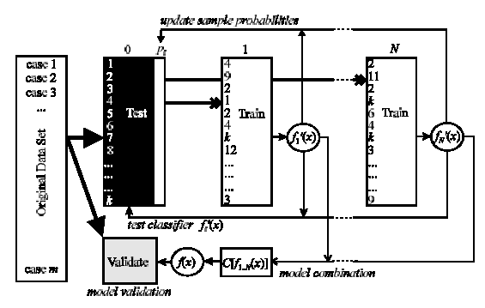
Boosting

Slide 14
Boosting Algorithm
Step 1: Form the Learning set and validation set (with uniform and without replacement sampling).
Step 2: N different training set replicas are sampled adaptively (with non-uniform sampling probabilities and with replacement)
Step 3: Build each classifier, f'_{i} (x), based on the training set.
Step 4: Establish each classifier’s performance by testing it against the learning set.
Step 5: Calculate a weight for each classifier based on its performance
Step 6: Combine model by means of a weighted voting scheme, where each individual prediction model carries a different weight.

Slide 15
Experiment & Results
Experiment:
  Analyzed Micro-array data using C5.0 Decision algorithm with boosting option
  Data set - 72 samples with 7,070 genes (variables)
Results:
  C5.0 Decision tree algorithm with 20-fold Boosting - 92.98%
  C5.0 Decision tree algorithm with 10-fold Boosting - 91.87%
  6-fold Cross-Validation procedure with non-boosting - 84.09%

Slide 16
Non-parametric models
Models that rely heavily on the empirical analysis of large data sets rather than on prior domain knowledge
Non-parametric Approaches:
Decision trees, Neural networks, Genetic algorithms, and Nearest neighbor methods.
Fundamental assumption:
Consistently observed relationships or patterns in large data sets will recur in future observations.
Advantages:
  Does not require a thorough understanding of the underlying system or problem
  Can be used to build arbitrarily complex models, that are highly non-linear and not restricted by human comprehension.

Slide 17
Decision Tree
Strengths:
  Clearly indicates which attributes are most important for prediction or classification.
Weaknesses:
  Limited ability to handle estimation or regression tasks where the goal is to predict the value of a continuous variable
  Error-prone when the number of training examples per class is small

Slide 18
Neural Networks
Strengths
  Ability to handle a range of problem tasks including classification (discrete outputs) and estimation or regression tasks (continuous outputs)
  Provision of an indication (through sensitivity analysis) of which attributes are most important for prediction or classification
Weaknesses
  The risk of premature convergence to an inferior solution (this is normally addressed by performing a sensible cross-validation procedure)

Slide 19
Experiment & Results
Experiment:
  Back propagation algorithm to analyze micro array data
  Total of 72 samples with 7,070 genes (variables)
Results:
  Learning accuracy thresholds of 80% - 93.94%
  Learning accuracy thresholds of 85% - 94.63%
  Learning accuracy thresholds of 90% - 89.70%
Decreased performance with the learning threshold of 90% is due to the well-known over fitting effect.

Slide 20
Bibilography
‘Data Mining and Machine Learning methods for Micro-Array Analysis‘ by Werner Dubitzky, Martin Granzow, Daniel Berrar ,German Cancer Research Center, Intelligent Bioinformatics Systems Group, Heidelberg, Germany
‘An empirical comparison of supervised machine learning techniques in bioinformatics’ by Aik Choon Tan and David Gilbert, Bioinformatics Research Centre, Department of Computing Science, University of Glasgow, UK.

Slide 21
Questions …

Slide 22
Thank You.

