Slide 1
Paper Presentation
Discovering Comprehensible Classification Rules with a Genetic Algorithm
By: Fidelis, Lopes, Freitas
Presented by:
Chris Halaschek
Matt Perry

Slide 2
Outline
Introduction
Overview
GA
Data Set
Results
Conclusions / Future Work
References

Slide 3
Introduction
Problem:
  Medical domain: Learn rules to predict occurrences of medical diseases
GA based system based for data mining task of classification
Goal: find accurate and comprehensible rules

Slide 4
Overview
Data Mining
  Extraction of non-trivial, previously unknown information from data in databases
Classification
  Assigning instances to a pre-defined class
In this paper, mining classification rules
GA
  Global search
  Comprehensible

Slide 5
GA – Individual Representation
Chromosome Level
  Divided into n genes
Gene Level
  Corresponds to a condition involving one attribute
n: Total number of attributes in problem
Fixed length but allows variable length rules

Slide 6

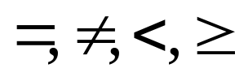
GA – Individual Representation
W_{i} – real-valued →[0..1] representing whether this attribute is present in the rule (threshold)
O_{i} – indicates relational operator used
V_{i} – value in the attribute domain

Slide 7
GA – Genetic Operators
Generational GA (elitist strategy)
Tournament Selection: size = 3
Two-point Crossover
Three Mutation Operators
  Weight Mutation
    Plus or minus random number
  Relational-Operator Muation
    Replace with a random valid operator
  Value Mutation
    Random replacement (nominal attribute)
    Plus or minus random amount (continuous attribute)

Slide 8
GA – Fitness Function
Based on TP, FP, TN, FN
Combines sensitivity and specificity
  Se = TP / (TP + FN)
  Sp = TN / (TN + FP)
Fitness:
  fitness = Se * Sp
Maximization problem

Slide 9
GA
System solves a two-class classification problem
Multiple runs for multiple classes

Slide 10
Data Set
From UCI machine learning repository
Dermatology Data Set
  Differential diagnosis of the disease erythematosquamous
  Six different diagnosis (classes)
  366 instances
  34 attributes

Slide 11
Data Set
Breast Cancer Data Set
  Re-occurrence of breast cancer after surgey
  Two different diagnosis (classes)
  286 instances
  9 attributes

Slide 12
Results
GA consisted of 50 individuals over 50 generations
2/3 training, 1/3 testing
Cannot cope with missing attributes, so those instances removed
For each class, GA run three times

Slide 13
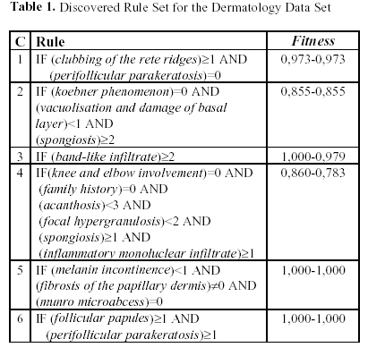
Dermatology Results
- 95 % accurate

Slide 14
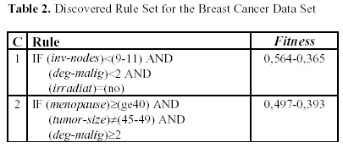
Breast Cancer Results
- 67 % accurate

Slide 15
Conclusions / Future Work
Accuracy levels comparable to other methods
More experiments with different data sets
Parameter optimization

Slide 16
References
Paper Link:
  http://citeseer.nj.nec.com/311786.html

