Slide 1
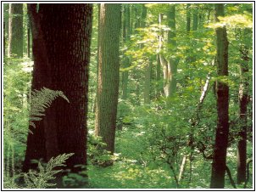
Process Modeling With Neural Networks Using Small Experimental Datasets
Cheng Hu
Xunyu Pan

Slide 2
Problems
Optimizing wood pulp processing that features:
  Complicated and highly nonlinear
  Costly to get experimental data
Only small experimental data sets are available.
  D-optimal experiment design
  Less than 15 patterns

Slide 3
Approaches
Neural networks
  Standard Feed-Forward net
    Single network
    Stacked network
  Radial basis function net
Statistic method
  Multiple regression

Slide 4


Modeling
Two hypothetical processes with known target functions
  (1)
  (2)
Real process - fabrication of wood pulp
  7 inputs and 1 output

Slide 5
Data Sets
The two hypothetical processes
  Training
    12 data generated by D-optimal design for both
    12 (?) random generated data points for equation (1)
    43 data generated by Draper-Lin design for equation (2)
  Testing
    50 randomly generated data points
Real process
  Training: 13 data by D-optimal design
  Testing: # of additional experiments

Slide 6
Standard Feed-Forward Neural Networks (FFNN)
Three-Layer feed-forward neural network
  7 inputs: 0~1
  1 output
  Generate prediction error by comparing output to real value
Weights range: -10~10
Transfer function

Slide 7
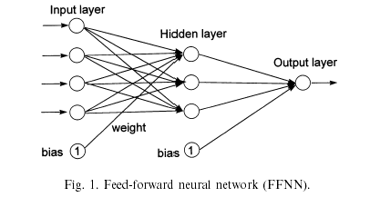
Three-Layer Feed-Forward Neural Network

Slide 8
Stacked Feed-Forward Neural Network
Identical training data set
Different levels of neural network
  Different set of initial weights
  Subset of the training data set. “Jack-knife bootstrapping”
Identical FFNN architecture
Combine outputs

Slide 9
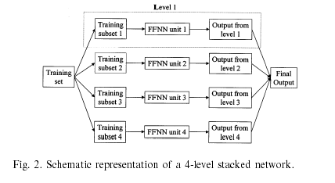
4-Level Stacked Network

Slide 10
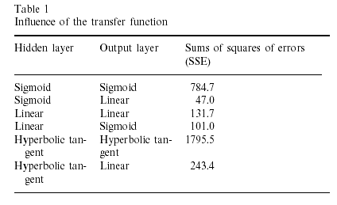
Transfer Functions of The Standard Neural Network

Slide 11
Architecture of The Stacked FFNN
The method used to combine the parallel models
The number of data removed from the training set to form the individual learning data subsets

Slide 12
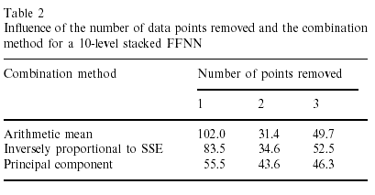
Architecture of The Stacked FFNN

Slide 13
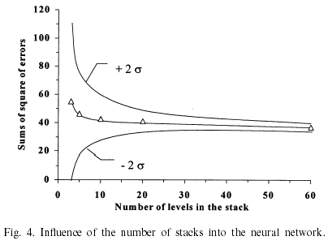
Architecture of The Stacked FFNN
The number of levels in the stack: 10

Slide 14



RBF Networks
Activation functions in the hidden layer
  Gaussian
  Thin plate spline
  Multi-quadratic
  t-location center, q-Euclidean distance, p-spread of the function

Slide 15
RBF Neural Networks
Selection of centers of the hidden layer
  Mapping methods
    Regular mapping
    Kohonen mapping
  Number of centers
    12
    6

Slide 16
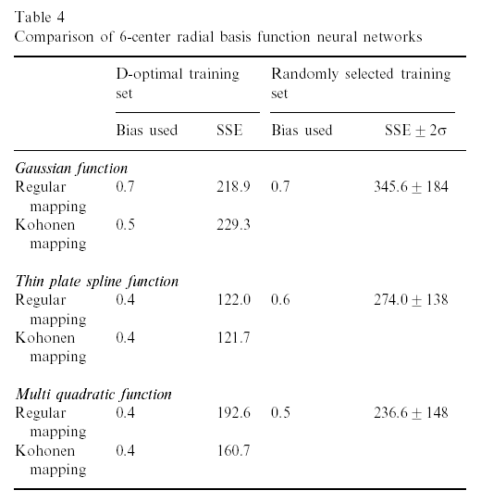

RBF Neural Networks

Slide 17
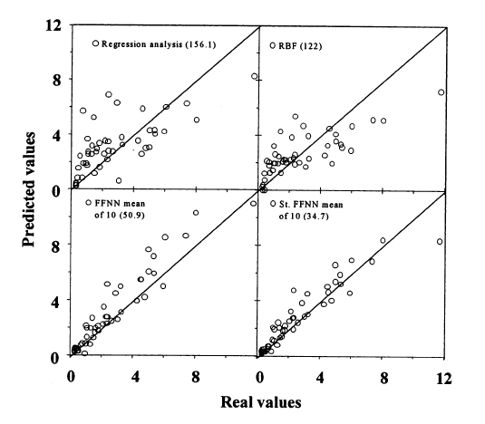
Results of Different Approaches for Equation (1)

Slide 18
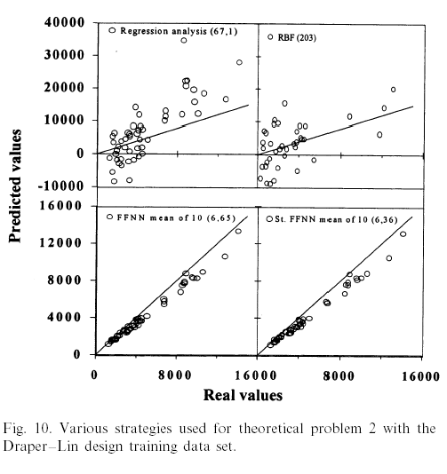
Results of Different Approaches for Equation (2)

Slide 19
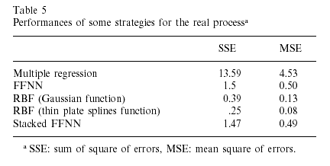
Results of Real Process

Slide 20
Conclusion
The experimental data sets are either difficult or too expensive to obtain (Small experimental datasets)
High level confidence is required
Stacked Neural Network

Slide 21
Reference
Robert Lanouette, Jules Thibault, Jacques L. Valade
Process modeling with neural networks using small experimental datasets
Computers and Chemical Engineering 23 (1999) 1167–1176

Slide 22
Thank you!

