Slide 1
Predicting HIV drug resistance with neural networks
Paper presentation
Lin Lin
Jian Wang

Slide 2
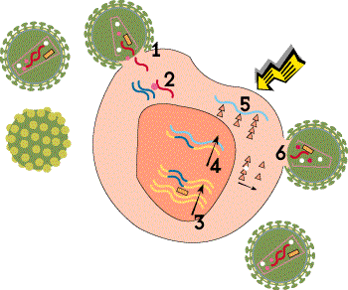
Life Cycle of HIV
1. Binding
2. Reverse Transcription
3. Integration
4. Transcription
5. Translation
6. Viral Assembly

Slide 3
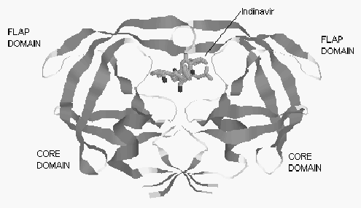
Targeting protease
A major AIDS therapy component.
FDA-approved drugs
  Indinavir
  Saquinavir
  …
Problems
  HIV resistance to those drugs

Slide 4
Predict HIV drug resistance
Structure-based data mining
Sequence-based data mining

Slide 5
Structure-based Data Mining
1. Produce the mutants’ structures
2. Produce a list of contact sites
3. Preprocess the contact information
4. Construct and train a self-organizing map to categorize mutant resistance
5. Test the network and analyze its performance

Slide 6
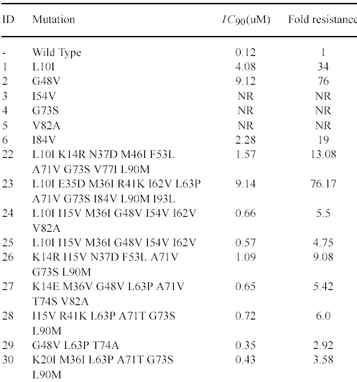
Data Sets
38 total patterns
31 for training(17 known, 14 unknown)
7 for validation (known).
Classification of mutants
  Fold resistance > 10 – high
  Fold resistance > 5 && < 10 – low
  Fold resistance < 5 – none

Slide 7
The Training Process
Done on all available patterns(38, known or unknown resistance).
Clustering, or categorization of the mutants based exclusively on structural similarity.
2-stage clustering

Slide 8
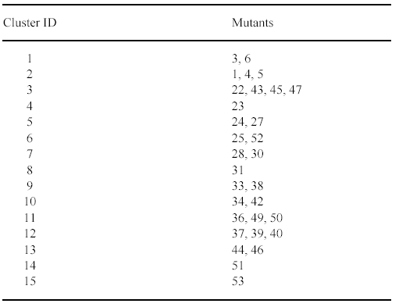
Two-stage clustering

Slide 9
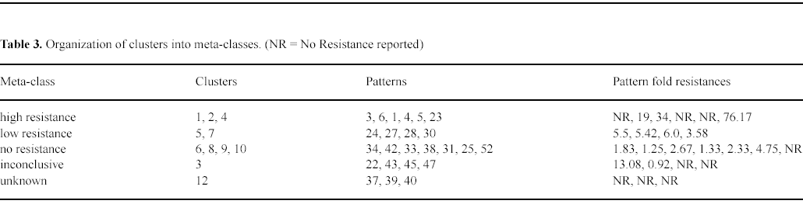
Two-stage clustering

Slide 10
Summary of the structure based data mining and results
Unsupervised learning
Obtain and label the clusters.
Predict the output for known patterns not used during the training
Results: Accuracy rate: >60%

Slide 11
Sequence-based Data Mining
Used the amino acid sequence of the HIV protease mutants to predict their resistance to Saquinavir.
Protease mutants used:
  32 mutants with reported drug resistance values.
  811 reported mutants obtained from the Los Alamos National Laboratory HIV Sequence Database.
  The wild type HIV protease sequence.

Slide 12
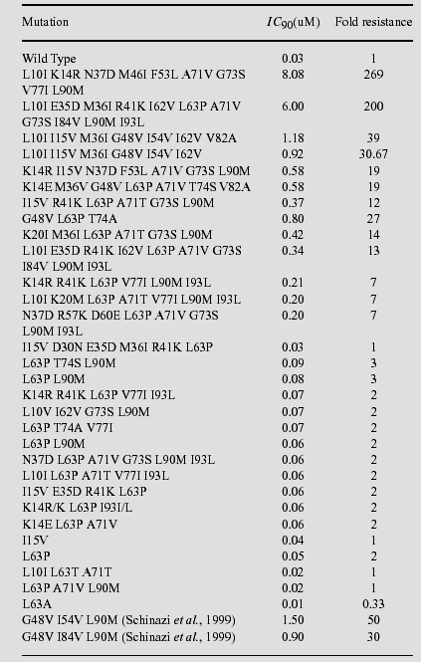

Slide 13
The Goal of this Approach
Not to predict the exact resistance of a particular mutant, but rather to be able to classify a mutant as having high, medium, or low resistance to the drug.

Slide 14
The Method
Preprocess the sequence information (input reduction, normalization)
Construct and train a set of SOFM networks while systematically varying the network parameters, excluding one known pattern each time
Assess network performance using leave-one-out cross validation.

Slide 15
Training the Networks
97 inputs out of 99 were used (2 residues were unchanged in all mutants and the wild type).
36 network architectures were considered.
Each network was trained 32 times (one for each leave-one-out pattern).
Use initial learning rates of 0.9 to 0.5.
Use initial neighborhoods corresponding to the dimensionality of their output matrix.

Slide 16
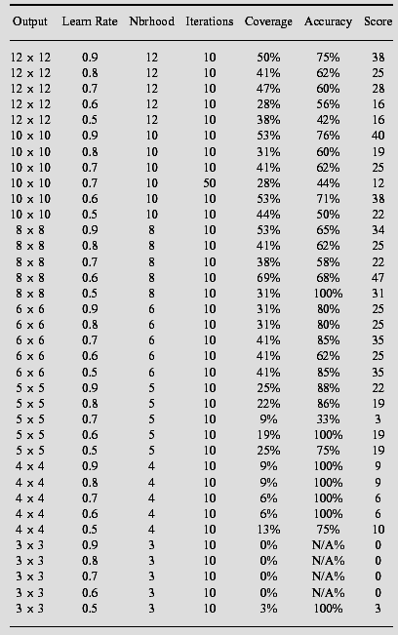

Slide 17
Validate the Networks
The pattern with known resistance that was not used during the training was run through the network.
For each network, the 32 test patterns are identified as correctly classified, FP, FN, or not classified.

Slide 18
Network Performance
The coverage of the network:
  # of test patterns classified / total # of test patterns
The accuracy of the network:
  # of patterns correctly classified / total # of test patterns classified
The network’s score:
  Score = Coverage*Accuracy*100

Slide 19
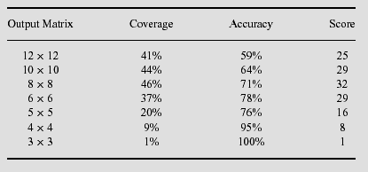
Average Performance of networks

Slide 20
Majority Voting Scheme
The results of presenting a pattern to a number of networks is tallied, and the majority classification is taken as correct.
Only the outputs of the networks that successfully classify the pattern are used.
In the case of a tie, the lowest drug resistance classification was to be selected.

Slide 21
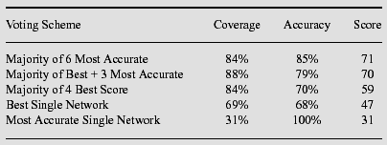
Voting Scheme Vs. Single network

Slide 22
Reference
The HIV Life Cycle: Definitions 2000. http://www.aidsmeds.com/lessons/LifeCycle1.htm
Draghici, Sorin. and Potter, R. Brian. 2003. Predicting HIV drug resistance with neural networks. Bioinformatics.19(1): 98-107.

