Slide 1
Building Domain-Specific Search Engines with Machine Learning Techniques
Andrew McCallum Kamal Nigam Jason Rennie Kristie Seymore
by
Chunmei Liu
Zhenyu Zhong

Slide 2
Introduction
Domain-specific search engines offer increased accuracy and extra features.
How to maintain the domain specific search engine
  Using machine learning techniques
    Reinforcement learning
    Text classification
    Information extraction
Demonstrating system
  A search engine for computer science research papers

Slide 3
Ra Project
Index the documents
  We need intelligent spider not only explore the Web indiscriminately, but in directed fashion to find domain-relevant document efficiently.
    Spidering task is a reinforcement learning framework.
Provide a hierarchical organization of materials
  Automatically adding documents into a topic hierarchy can be framed as a text classifier task
Information extraction
  automatically find specific textual substrings in a document(Hidden Markov Models)

Slide 4
3 stages of construction of search engine
Collecting new information
  A spider efficiently explores the web collecting all postscript paper using reinforcement learning.
Collating and extracting from that information
  Find the title, author, institution and other header information
  Therefore reference and paper matches are made
Presenting it in a publicly-available web interface

Slide 5
Reinforcement Learning
Refers to a framework for learning optimal decision making from rewards or punishment.
  The learner is never told the correct action for a particular state
  Only know how good or bad the selected action was
  Goal: learn a policy, a mapping from states to actions
Spidering as reinforcement learning
  On-topic documents are rewards
  Actions are following a particular hyperlink
  State is the locations of the on-topic documents remaining to be consumed.

Slide 6
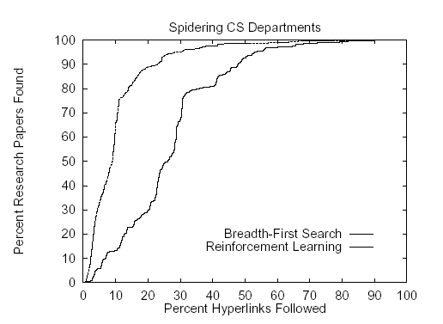
Experimental Results
The performance of reinforcement learning spidering versus traditional breadth-first search averaged over 4 test/train splits with data from 4 universities.
# of documents: 53012
#of hyperlinks: 592216
A nearly factor of three increase in spidering efficiency

Slide 7
Classification into a Topic Hierarchy
A topic hierarchy can be a useful, integral part of a
search engine, but
  it is difficult and very time-consuming to create a hierarchy, so
  automate this process with learned text classifiers.

Slide 8
Seeding Naïve Bayes using keywords
Three methods:
Keyword-Matching method, but
  finding enough keywords to obtain high accuracy is difficult
Naïve Bayes approach, but
  it requires large amounts of labeled training data to work well
Combining these two approaches
  using keyword-matching as a method of inexpensively obtaining imperfectly-labeled documents
  using these documents as training data for a Naïve Bayes classifier.

Slide 9
Shrinkage and Naïve Bayes
Naïve Bayes suffers from sparseness in the training data, so overcome it by combining it with Shrinkage
Shrinkage –a method improving the estimates by taking advantage of the hierarchy
  Get a set of parameter estimates along the path from a leaf to the root
  Decide the mixture weights that they maximize the likelihood of some previously unseen “held-out” data by using Expectation Maximization approach

Slide 10
Experimental Results
Classifying computer science research papers into 51-leaf hierarchy
Test set: 250 research papers from the 33,000 papers in the Cora archive
4631 documents with matches were found
Keyword-matching method: 66% accuracy
Traditional naïve Bayes: 62%
Shrinkage: 70%

Slide 11
Experimental Results(cont.)
Extra training data is completely unlabeled data
Randomly choose 464 out of the 4631 keyword
labeled documents.
  Traditional naïve Bayes: 29% accuracy
  Shrinkage: 47%
  Then got 56% accuracy by incorporating the remaining 4167 documents as unlabeled data

Slide 12
Information Extraction based on HMM
Information Extraction methods can increase the accuracy and efficiency of a directed search
HMM is one of them.
  Composition: states, transitions, and output symbols
  Goal: recover the state sequence that has the highest probability of having produced observation sequence
  Way to form a model:
    Each state is associated with a field class that we want to extract, such as title, author, institution, etc.
    Each state emits words from a class-specific unigram distribution
    Estimate transitions between states directly from a labeled training set

Slide 13
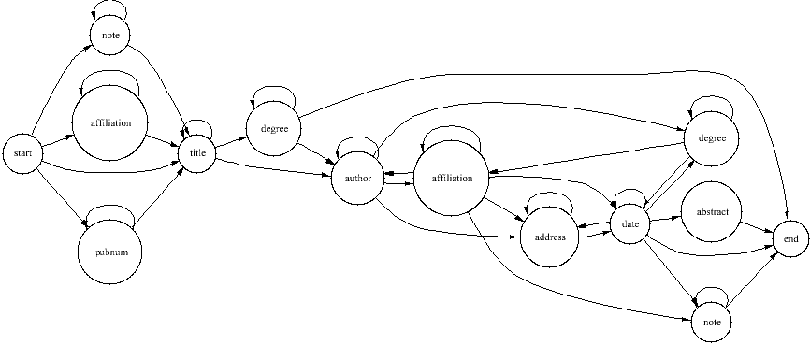
Information Extraction based on HMM(cont.)
...
author
title
institution
note
2 million words of BibTeX data from the Web

Slide 14
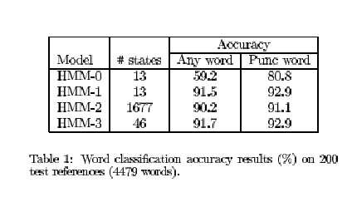
Experimental Results
HMM-0: one state per class; equal probability for each outgoing
transitions for each state.
HMM-1: one state per class; got transition probability from the labeled
training data.
HMM-2: After neighbor merging, reduce the maximally specific HMM
from 6997 states to 1677 states.
HMM-3: After V-merging, reduce the maximally specific HMM from
1677 states to 46 states.

Slide 15
Thank you!

