Slide 1
by Michael Shilman, Hanna Pasula, Stuart Russell, and Richard Newton
Department of Computer Science
University of California at Berkeley
CSCI 8950 Paper Presentation
By Shruti Pai, Jiang Xuan
Statistical Visual Language Models
for Ink Parsing

Slide 2
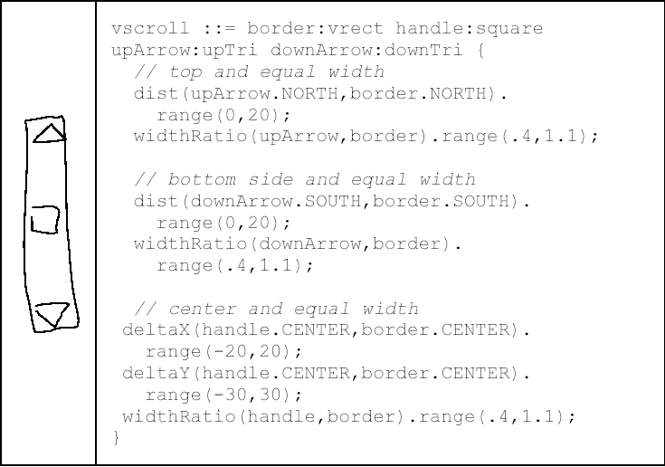
Introduction
Ink Parsing and Visual Language ?
  Objective: Automatic recognition of hand-sketched digital ink

Slide 3
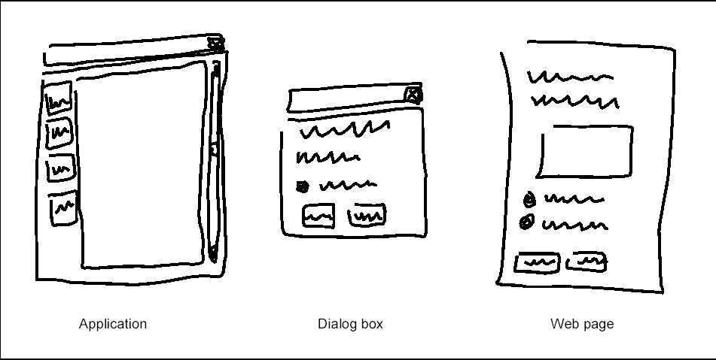
Previous Works and Difficulties
Prototype Systems
  Visual language syntax
    Flow-charts, Mathematics, Music notations, etc.
Problem: Low accuracy
  Reason: ambiguity

Slide 4
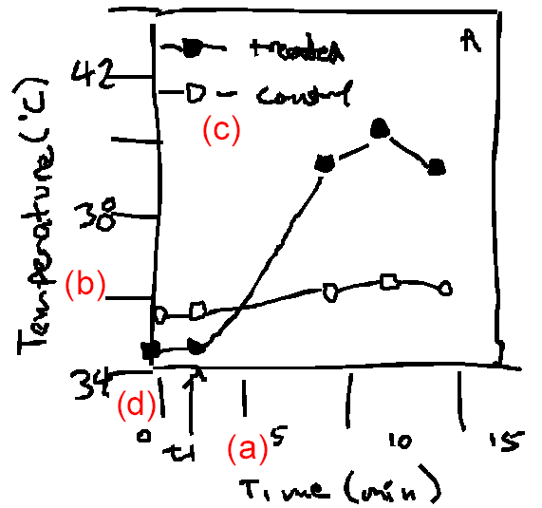
Ambiguity
Lexical ambiguities
  Terminal symbols
      arrow
Structural ambiguities
  Non-terminal symbols
    Attachment (a)
    Gap (b)
    Role (c)
    Segmentation (d)
Visual language ambiguities
  Label
      square/circle
  Attribute
      arrow-head

Slide 5
Our Work
Objective: Robust and Useful System, greater accuracy
  Dealing with ambiguity
Approach
  Use Context ← Visual Languages
  Disambiguation techniques
    Attribute grammars (for string languages)
    Statistical models (for continuous domains)
      Bayesian Statistic models
      Hidden Markov Models
      N-grams
      …
Our method

Slide 6
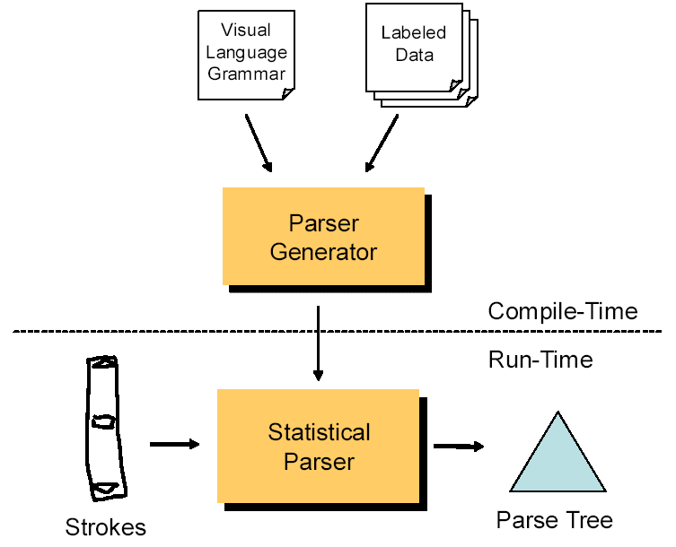
Overview
Overview of the system

Slide 7
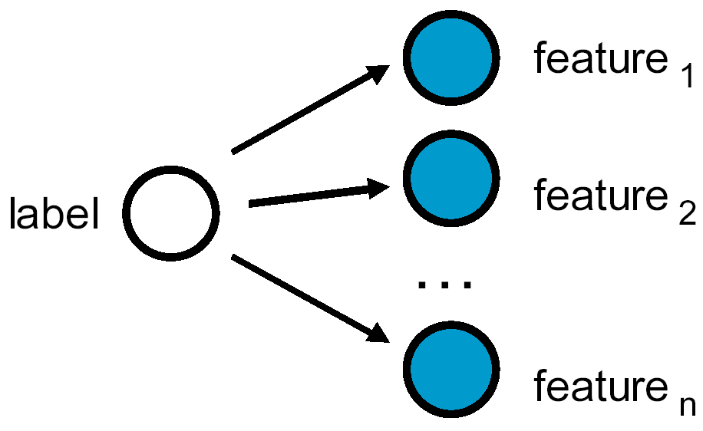
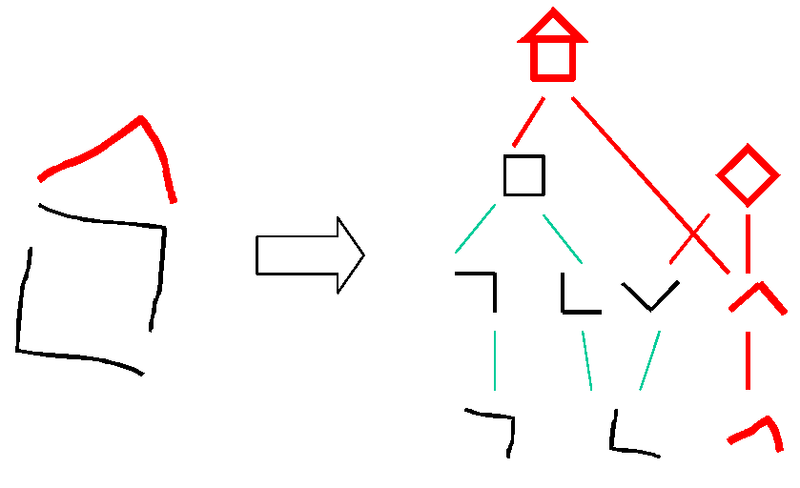
Overview cont.
Labels: “Square”, “Circle”, …
Features: Scalar values viz. Aspect ratio, # of corners, …
Naïve Bayesian Classifier
Parsing

Slide 8
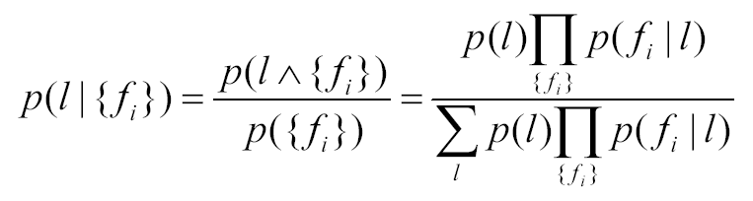
Bayesian Statistical Model
From the grammar: structure of the model
    Assumption: features are related to one another only thru the label; not directly dependent on one another.
From the training set: p( label ), p( feature_{i} | label )
From application of Bayes rule: p( label | { feature_{i} } )
l class label
f_{i} i’th feature

Slide 9
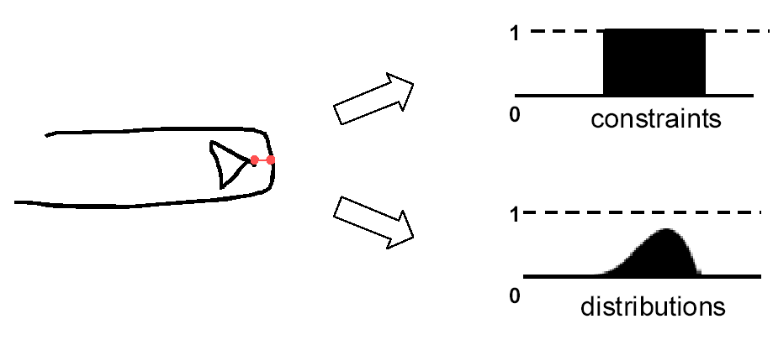
Bayesian Statistical Model cont.
Basic Labels to Composite Labels
  Spatial Relations (distances, …)
    Converted from thresholded ranges to statistical distributions

Slide 10
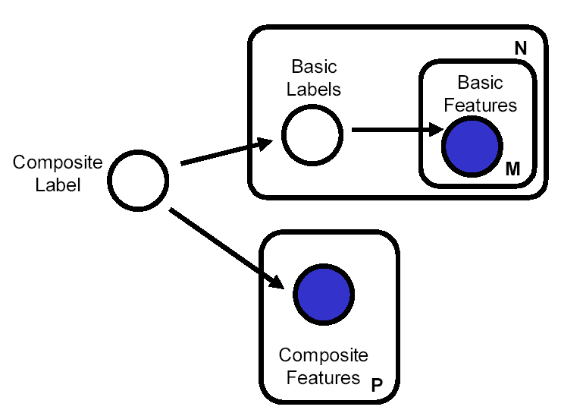
Bayesian Statistical Model cont.
Basic Labels to Composite Labels
  Spatial Relations (distances, …)
  Graphical Model for Composite representation
    Extended to the whole language
Basic labels: square, circle
Basic features: corresponding features
Composite features: spatial relations
Composite labels: vscroll

Slide 11
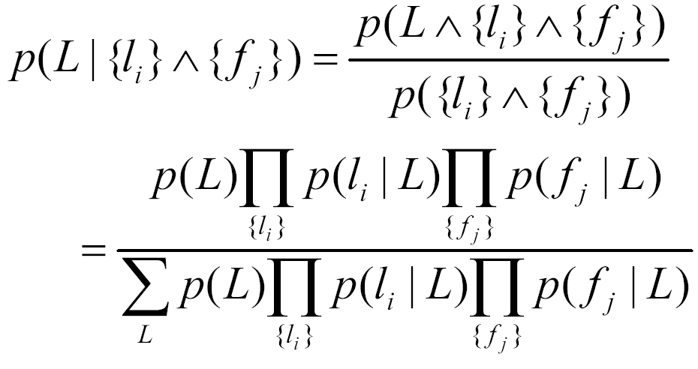
Bayesian Statistical Model cont.
Basic Labels to Composite Labels
  Spatial Relations
  Graphical Model for Composite representation
  Analogous derivation to naïve Bayesian classifier
L composite label
l_{i} i’th basic label
f_{j} j’th composite feature

Slide 12
Parsing Algorithm
Simple incremental approach
  Only parses relevant to the new symbol added to the parse tree
  Choose the highest-confidence invocation of rules
  Pruning parameter: prune low-confidence nodes

Slide 13
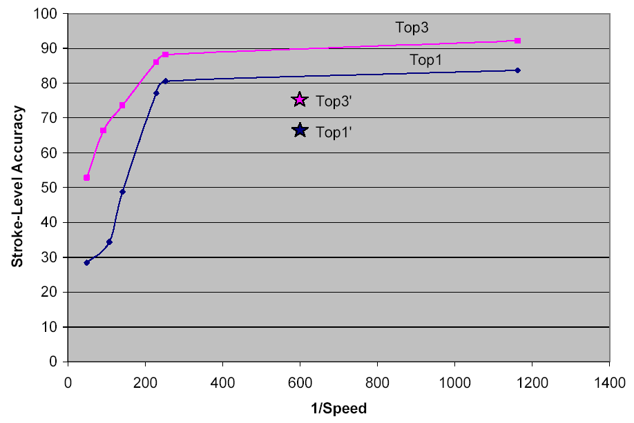
Training and Results
Train the model
  p( label ) & p( each feature | label )
Total instance set: 600 user files
  training set: 80%
  test set: 20%

Slide 14
Future Work and Comments
Try other Statistical Models
Encode stroke sequence to disambiguate further
Incorporate better parsing algorithms
Comments:
  Combines existing methods and use a novel approach
  Need background knowledge to understand

Slide 15
Thank You!

