Slide 1
Recommending Web Documents Based on User Preferences
Durga Yeluri.
Sujith Thomas.
CSCI 8950 / Machine Learning
Course Presentation.

Slide 2
What?
Inquirus-2.
Meta-search Engine.
NEC Research Institute.
Individual Recommendations.
Search based on keyword + topical relevance.

Slide 3
When? Who?
1997
Eric. J. Glover.
Steve Lawrence.
Michael. D. Gordon.
William. P. Birmingham.
C. Lee. Giles.

Slide 4
Why?
Different search needs.
Better, faster results.
Relevant results.
Customized user preferences.
No standards for the WebPages.

Slide 5
How?
Treat users as individuals.
No local database.
Different sources used.
Query optimization.
Ordering policy.

Slide 6
Search Engine
“A program that searches documents for specified keywords and returns a list of the documents where the keywords were found.”

Slide 7
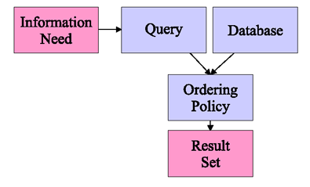
Standard Search Engine

Slide 8
Metasearch Engines
“A search engine that displays results from multiple search engines.”

Slide 9
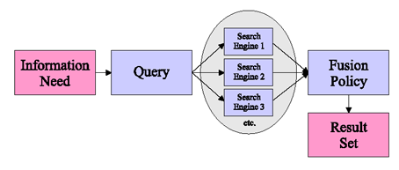
Standard Metasearch Engine

Slide 10
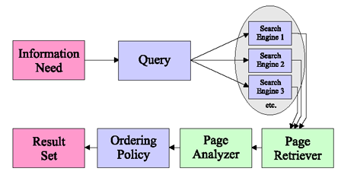
Inquirus.

Slide 11
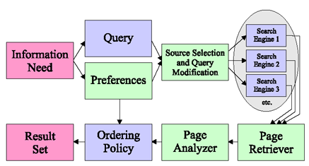
Inquirus2

Slide 12
Source Selection
Intelligent source selection.
Information category – Appropriate sources.
Many sources
    Increased coverage.
    Low score value's.
Solution: Choose a category
    Miss results from more general but not searched pages.
Scoring Function
    Captures specific Information need.
    Filter out bad results.

Slide 13
Query Modification
Automatic query modification.
    To enhance precision.
E.g:
    Current Events
    Research papers.
Any unmodified query – eventually find results of the modified one
    Limited number of retrievable results.
Overly General Query – Remove valuable results.

Slide 14
Personalized Result Scoring
Typical metasearch engines use values returned by the search engines they use.
    Actual pages – No longer relevant.
    High score because of keyword spamming.
    Paid advertising.
Inquirus downloads every webpage and applies customized scoring function.
Uses custom ordering policy.
Every user – Personal utility functions to define additional categories.

Slide 15
Dynamic Interface
Display results immediately.
Value of best documents increases as more documents are processed.
Java Applet + CGI Script Combo.
Allows background searching & evaluation.

Slide 16
Results
Individual Homepages
    Search for homepage of ‘X’.
    SNAP, Google, Yahoo, Inktomi and Hotbot.
Research Papers
    Search abstract links (.ps), Conference paper.
    No function of the desired additive linear form that captures both simultaneous preferences.
    Solution: Use 2 different preferences and run 2 different searches.
    Use MAX function over 2 different additive linear functions.

Slide 17
Research papers with reference X.
    A paper that reference someone or (some topic).
    Requires a strategy (sources and query modification).
    Keywords occur as a part of “references” section.
    Problems: Abstract links with (.ps).
    Solution: Look for terms like “pp”, “no”, “vol” (occurs in the references section.

Slide 18
Related Work
Non-topical relevance judgments.
“Utility” as measure of information retrieval systems.
Use of “agents” to dynamically reorder web pages.
Considering varied multiple attributes (including non topical) or features when making recommendations.
Intelligent source selection

Slide 19
Future Work
Collaborative notion of information need categories – by allowing user feedback.
Users can comment on value of various results.
The data points will be used to refine the utility functions and possibly choose alternate sources or query modifications.
The revised utility functions will be available for future users.

Slide 20
Summary and Conclusion
We described Inquirus2.
    Personalized web searching.
    No local database needed.
    General purpose metasearch engine.
    New search engines can be added.
    Allows large variety of information need category.
    Increased usefulness over standard search engine or meta search engine.
    Techniques Used
      Need based source selection.
      Dynamic query modification.
      Utility based ordering policy.

Slide 21
Thank You!
Question or Comments?

