Slide 1
Ant Colony System: A Cooperative Learning Approach to the Traveling Salesman Problem
Marco Dorigo
Luca Maria Gambardella
Université Libre de Bruxelles

Slide 2
Abstract
The progenitor of ACS: Ant System
Ant Colony System (ACS)
Agents (Ants) cooperate using indirect communication (pheromone) to find solutions to the TSP.
ACS performs better on TSP than other nature inspired algorithms such as Simulated Annealing and Genetic Algorithms.

Slide 3
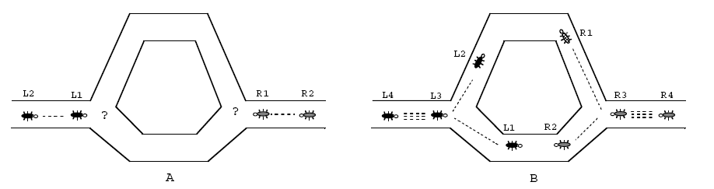
Natural Metaphor
Real ants exploit pheromone info to find the shortest path from food source to nest.

Slide 4
Prior Research
Ant System:
  graph representation: cities V={a,…,z}, edges A={(r,s) : r,s є V}
  cost measure: distance δ(r,s)
  desirability measure: pheromone τ(r,s)
  state transition rule: ants attracted to cities which are connected by short edges with high pheromone.
  global pheromone updating rule: fraction of the pheromone evaporates on all edges, then each ant deposits pheromone on edges in its tour proportional to the length of the tour.

Slide 5
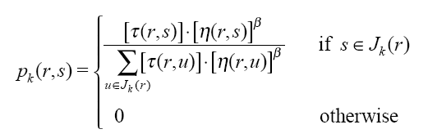
Specifics
State Transition Rule:
  random-proportional rule:
  η = 1/δ is the inverse distance of δ(r,s)
  β parameter determines relative importance of pheromone vs. distance (β>0)
  J_{k}(r) is the set of cities that remain to be visited by ant k positioned on city r.

Slide 6
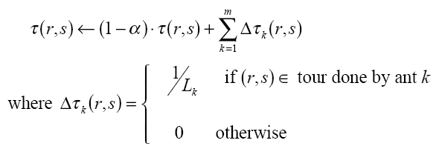
Specifics Cont.
Global updating rule:
  Once all ants have built their tours, pheromone is updated on all edges according to:
  0<α<1 is a pheromone decay parameter
  L_{k} is the length of the tour performed by ant k
  m is the number of ants

Slide 7
Ant Colony System
Differences:
  The state transition rule provides a direct way to balance exploration of new edges and exploitation of a priori and accumulated knowledge about the problem.
  The global updating rule is applied only to edges which belong to the best ant tour.
  While ants construct a solution a local pheromone updating rule is applied.

Slide 8
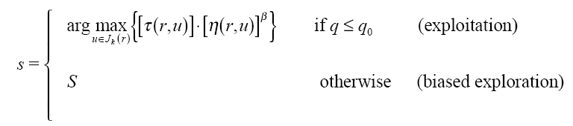
ACS State Transition Rule
pseudo-random-proportional rule
  an ant positioned on node r chooses the city s to move to by applying the rule given by
  q is a random number uniformly distributed in [0..1]
  q₀ is a parameter (0≤q₀ ≤1), for their experiments q₀ = 0.9
  S random variable selected according to random proportional rule used in Ant System.
  for their experiments β = 2

Slide 9
ACS Local Updating Rule
While building the tour, ants change pheromone levels of the edges they cross according to:
  0<p<1, for their experiments p=0.1
  Δτ(r,s) = τ₀ , where τ₀ is the initial pheromone level
    τ₀ = (n * L_{nn}) -1, where L_{nn} is the tour length produced by the nearest heuristic, and n is the number of cities
The effect of this is to make the desirability of edges change dynamically: every time an ant uses an edge it loses some of its pheromone and becomes slightly less desirable.

Slide 10
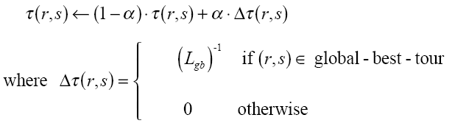
ACS Global Updating Rule
Performed after all ants have completed their tours.
  0<α<1 is the pheromone decay parameter, for their experiments α = 0.1
  L_{gb} is the length of the globally best tour

Slide 11
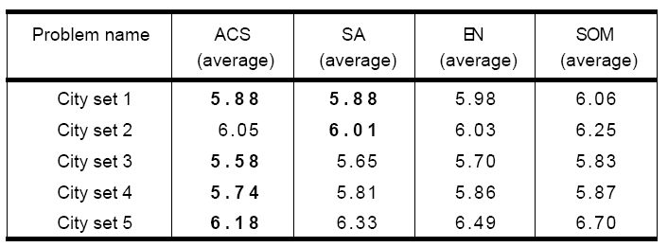
Performance
Comparison to other heuristics:
  Simulated Annealing, Elastic Net, Self Organizing Map
  Random instances of the symmetric TSP; Comparisons on average tour length in 50-city problems.

Slide 12
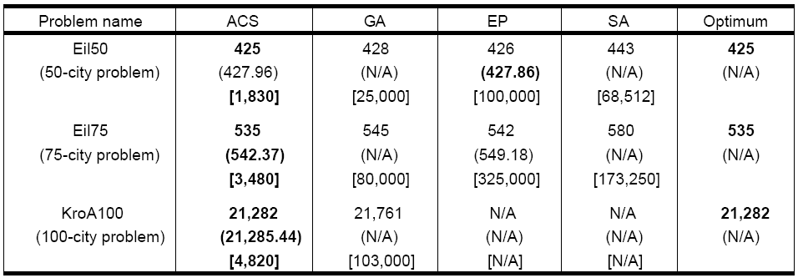
Performance
Comparison to other heuristics:
  Genetic Algorithm, Evolutionary Programming, Simulated Annealing
  Geometric instances of the symmetric TSP.

Slide 13
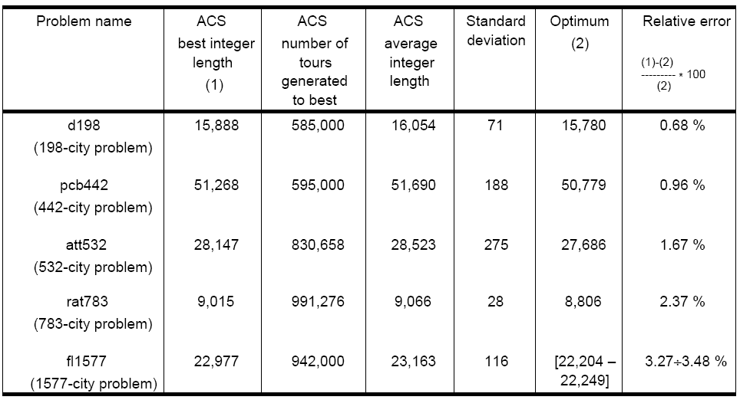
Performance
ACS on bigger problems
  Incorporated the use of a candidate list.

Slide 14
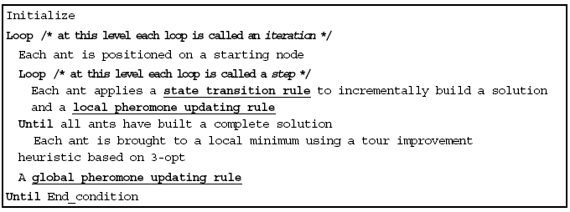
ACS and Local Search
3-opt tour improvement heuristic
  Insert or remove 3 edges on the path

Slide 15
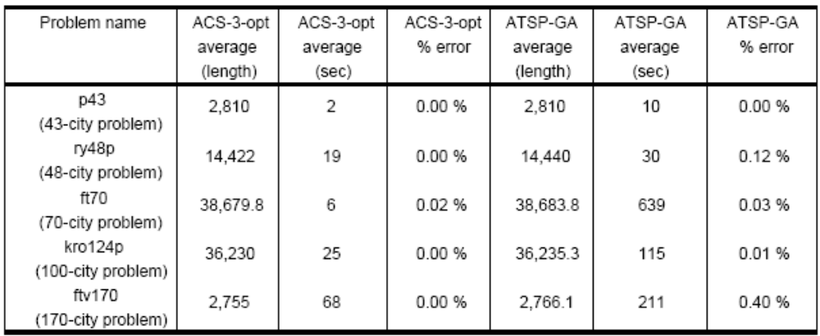
Performance

Slide 16
Possible Improvements
Alter the number of ants that contribute to the global updating rule.
Replace the current parallel local updating of pheromone to a sequential one.
Use a more effective local optimizer than the 3-opt method.

Slide 17
References
Ant Colony System: A Cooperative Learning Approach to the Traveling Salesman Problem
  http://www.idsia.ch/~luca/acs-ec97.pdf

