Slide 1
Co-Evolving Soccer Softbot Team Coordination With Genetic Programming
Presented By:
Alex Drazdowski

Slide 2
Overview
- Genetic Programming can generate functions and algorithms through natural selection.
- This paper uses GP’s on behavior-based team coordination in the RoboCup Soccer Server.
- The goal of this paper was that in the end, genetic programming would produce teams of soccer softbots which had learned to cooperate to play a good game of simulator soccer.

Slide 3
RoboCup
The RoboCup Soccer Simulator is a research and educational tool for multi-agent systems and artificial intelligence. It enables for two teams of 11 simulated autonomous robotic players to play soccer .

Slide 4
Introduction
Neural Networks, decision trees, etc.
  Effective for learning low-level soccer-player functions such as ball interception but not effective for high-level player coordination.
Genetic Programming
  Uses evolutionary techniques to learn symbolic functions/algorithms

Slide 5
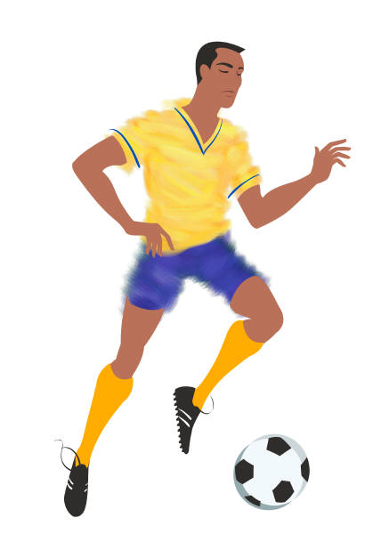

Introduction Cont…
Goal was NOT to evolve individual soccer players themselves.
It was to see if it could evolve the individual team itself…
The evolved teams would spread out amongst the field and coordinate movements with other teammates.

Slide 6
Genetic Programming
Uses LISP-like “program-trees”.
Trees serve as both genetic material of an individual and code for the result algorithm itself.
Each node in the tree is a function
If-v
Opp-closer
Block-goal
If-v
Mate-closer
Weight-+
ball

Slide 7
Genetic Programming Cont…
User provides a pre-set list of functions.
The user also provides an evaluation function.
Large population of trees and uses the evaluation function to determine fitness of the population.
Fitness's were based on competition with peers, etc.

Slide 8
Results
Players first wandered around not doing anything.
Then “Kiddie-Soccer” occurred.
Then teams then began to start spreading out players.

Slide 9

My Thoughts…
I was impressed with the fact they were able to evolve the teams.
Interesting but a little to long.
Some of the facts were a little over my head.

