Slide 1
Evolutionary Detection of Rules for Text Categorization.
Application to Spam Filtering.
By
Catalin Stoean, Ruxandra Gorunescu, Mike Preuss,
and Dan Dumitrescu
Presented by: Arlo Lyle
Evolutionary Computation
November 14, 2005

Slide 2
Introduction
The Problem of Spam
Text Categorization
EA Approach

Slide 3
Keyword Extraction
Keywords
Preprocessing
Representation of Emails
Representation of Categorization
Weight Modification
Keyword Selection

Slide 4
Genetic Chromodynamics
General Approach
  Local Selection
  Mating Region
  Variable Sized Population
  Merging

Slide 5
Implementation
Representation
Fitness
Selection
Variation
Termination
f(c) = f₁(c) + 1/f₂(c)
(a₁, …, a_{n}, a_{n+1}, … , a_{2n}): 1

Slide 6
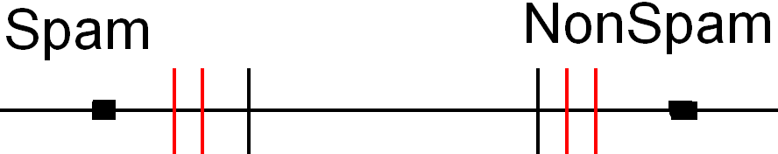
Rules
Definition of Rules
Always at Least Two Rules
Possibly Multiple Rules

Slide 7
Results
97.6% of Nonspam Correctly Classified
95.2% of Spam Correctly Classified
3.6% of Email Not Classified
0% of Nonspam Incorrectly Classified

Slide 8
My Opinion
Representation
Fitness
Rules
Results

