Slide 1
A Genetic Algorithm for the Generation of Jazz Melodies
George Papadopoulos and Geraint Wiggins
Department of Artificial Intelligence
University of Edinburgh, Scotland

Slide 2
Why GA?
GA is a good choice for a search engine in a musical application
  An efficient search method for problems with very large search spaces
  Able to provide multiple solutions, which is needed in creative domains

Slide 3
Introduction
Significant characteristics of the GA they use
  An algorithmic fitness function for objective evaluation of the GA results
  Problem-dependent genetic operators
  Symbolic representation of the structures and the data

Slide 4
Related Work
Three categories of GA’s for generating music algorithmically
  Use of a prescribed, knowledge-based fitness function
  Use of a human user as a fitness function
  Use of a neural network as a fitness function

Slide 5
Implementation
Design Motivation
  Using objective fitness functions, not the interactive approaches
  Interested in simulating human behavior, not in the quality of the results
  Expectations: although the final output may not be impressive enough, it will at least help understanding what needs to be improved in their and other systems

Slide 6
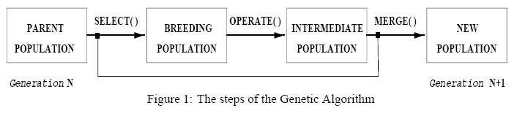
Implementation
The Genetic Algorithm
  Selection method: tournament selection
  Merge operator: simply copies the intermediate population to the new population
  Operate operator: mutation methods, to be explained

Slide 7
Implementation
Genetic Operators
  Three classes of musically meaningful mutations implemented
    Local mutations
    Copy and operate mutations
    Restricted copy and operate mutations
  One-point and two-point crossover also implemented
  The operators were selected with probabilities ranging from 10%-20%

Slide 8
Implementation
Fitness Function
  Evaluates eight distinct characteristics of a chromosome and calculate overall fitness
    Large intervals
    Pattern matching
    Suspensions
    Note at downbeat
    Note at half-bar
    Long notes
    Contour
    Speed

Slide 9
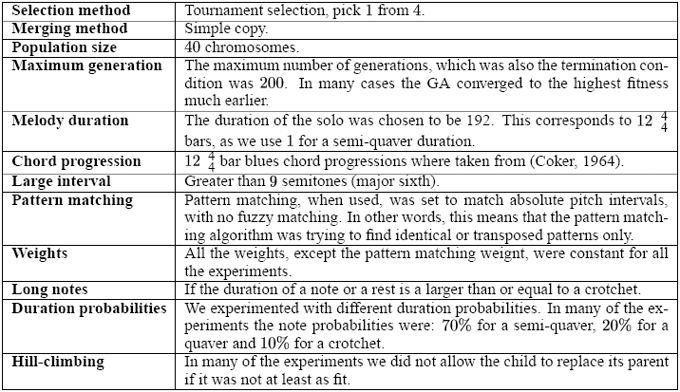
Implementation
Input, Parameters and Preferences

Slide 10
Results and Evaluation
Using local mutations
  Performed well in terms of reaching objective fitness
  Did not develop musically acceptable theme
Using copy and operate mutations
  Copying similar fragments of the melody to different positions created a feeling of development, but later mutation destroyed it
  The randomness of the GA’s choices is a problem

Slide 11
Results and Evaluation
Using restricted copy and operate mutations
  Much better musical feeling because these mutations put the copied motives in sensible metric positions, which makes it easier to perceive the relation between related motives

Slide 12
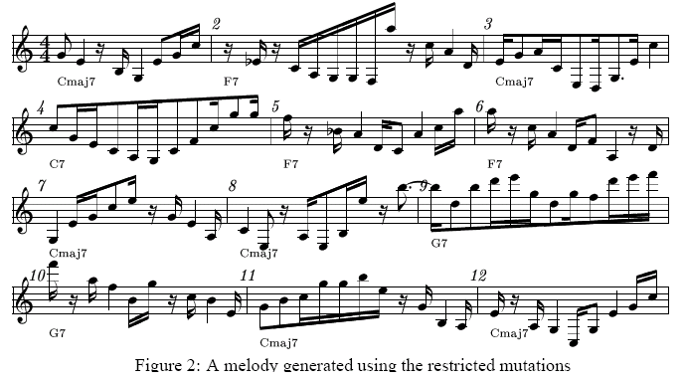
Results and Evaluation

Slide 13
Extensions
GA parameters
Statistical analysis in fitness function
Musical structure (e.g. beginning and ending)
Motive-based representation (instead of simple notes as the basic units)
Structured GA
Musical tension (tension curve of the melody)
The more musical knowledge encoded in the system, the better results

Slide 14
Conclusion
Results were encouraging since only small amount of knowledge was encoded in the system
Useful tool for them as a research tool, rather than an interactive GA

Slide 15
About the paper
Couldn’t understand in detail because of lack of knowledge in music
With some extensions in the system, it will be able to simulate the human improvisation

