Slide 1
GP-Gammon: Using Genetic Programming to Evolve Backgammon Players
Glenn Matthews
November 28, 2005
Y. Azaria and M. Sipper, GP-Gammon: Using genetic programming to evolve backgammon players, in Proceedings of 8th European Conference on Genetic Programming (EuroGP2005), M. Keijzer, A. Tettamanzi, P. Collet, J. van Hemert, and M. Tomassini, Eds. 2005, vol. 3447 of Lecture Notes in Computer Science, pp. 132-141, Springer-Verlag, Heidelberg.

Slide 2
Home Board
Bar
Points
Checkers
Home Board
Notes:
Relatives of backgammon are at least 5000 years old
15 pieces per player
24 board spaces

Slide 3
4
3
Notes:
Use pen here!

Slide 4
Concepts
A strategy is just a board-evaluation function
Given all possible next moves, picks the one that results in the best board state
An individual has two such functions
  Contact strategy (dealing with opponent)
  Race strategy (getting off the board ASAP)

Slide 5
Strategies
Strategies are LISP expressions
Strongly Typed GP (STGP) - distinguish between floats and booleans
Both strategy types use same operators (branch nodes)
  X = Y+Z, X = Y-Z, X = YZ, X = (P ? Y : Z)
  P = (X>Y), P = (X<Y)
  P = (Q and R), P = (Q or R), P = (not Q)

Slide 6
Race Strategy
Race strategy has simple terminal set (leaf nodes) compared to contact strategy.
Terminal set for race strategies
  A constant in the range (0..5), initialized randomly
  Number of pieces player has on a given point (initially chosen at random)

Slide 7
Contact Strategy
Terminal set for contact strategies
  Constant in range (0..5), chosen randomly
  Presence or absence of 1, 2, or 3+ of player’s checkers on a given point
  Presence or absence of 1 or 2+ of enemy’s checkers on a given point
  How far player’s or enemy’s pieces must all move to leave the board
  How likely player’s blots are to be hit by the opponent
  How thoroughly blocked the player’s or enemy’s home board is

Slide 8
Fitness
No absolute fitness measure!
Individuals play one another to determine relative fitness
Single elimination tournament
Each pair in the tournament plays a match consisting of 50 games
Fitness based on number of matches won before being eliminated
Notes:
Single elimination tournament cuts down on number of matches that must be played, allowing faster evaluation

Slide 9
Reproduction
Tournament selection of parent(s)
4 methods of generating new individuals
  Copy to next generation unchanged
  Exchange of random subtrees between two individuals (crossover)
  Replace a random subtree with a new one (mutation)
  Replace all constants in a random subtree with new values (mutation)
Notes:
Explain tournament selection concept

Slide 10
Parameters
Population size: 128 individuals
Duration: 500 generations
Every 5 generations, best individual was selected to play 1000 games vs. PubEval for benchmarking
Repeated experiment 20 times

Slide 11
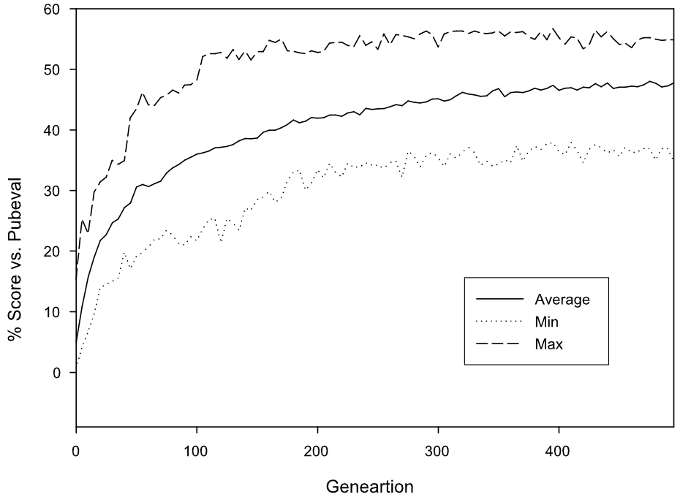

Slide 12
Comparison to Others
Player | % Wins vs. PubEval
GP-Gammon 1 | 56.8
GP-Gammon 2 | 56.6
GP-Gammon 3 | 56.4
GP-Gammon 4 | 55.7
GP-Gammon 5 | 54.6
GMARLB-Gammon | 51.2
ACT-R-Gammon | 45.94
HC-Gammon | 40.00
Notes:
GP-gammon results are best so far
Best 5 of the 20 runs are shown

Slide 13
Observations
Successful individuals have very complex strategies
No rigorous understanding of what makes an individual successful
It is apparent that general, board-wide sensors are more commonly used than location-specific ones
  This makes sense!

Slide 14
Future Work
Optimizing performance (# of games played and/or time per game)
Contact / race strategy combination vs. single strategy vs. 3+ strategies
Distributed GP for more evaluations / greater diversity

Slide 15
My Evaluation
Clear description of GP implementation
Solid comparisons to other methods, both EC and otherwise
Overall excellent paper
No example strategy given
Inclusion of pre-built heuristic functions is “cheating”

Slide 16
References
Y. Azaria and M. Sipper, GP-Gammon: Using genetic programming to evolve backgammon players, in Proceedings of 8th European Conference on Genetic Programming (EuroGP2005), M. Keijzer, A. Tettamanzi, P. Collet, J. van Hemert, and M. Tomassini, Eds. 2005, vol. 3447 of Lecture Notes in Computer Science, pp. 132-141, Springer-Verlag, Heidelberg.
A.E. Eiben and J.E. Smith, Introduction to Evolutionary Computing. 2003, Springer-Verlag, New York.
http://en.wikipedia.org/wiki/Backgammon
http://bkgm.com/

