Slide 1

Interactive Evolutionary
Computation:
Fusion of the Capabilities of
EC Optimization and Human Evaluation

Slide 2

This paper covers:
Survey of research on Interactive Evolutionary Algorithms
  Definition and features
  Overview of IEC research
    Application research
    Non-application research
Very broad paper
Covers A LOT of other papers (~250)

Slide 3
What is IEC?
The IEC is a computation method that is based on subjective human evaluation.
Basically it’s an EC technique where the fitness function is replaced by a human user.

Slide 4
2 definitions of IEC
Narrow
  “the technology that EC optimizes the target systems based on subjective human evaluation as fitness values for system outputs.”
Broad
  “the technology that EC optimizes the target systems having an interactive human-machine interface”

Slide 5
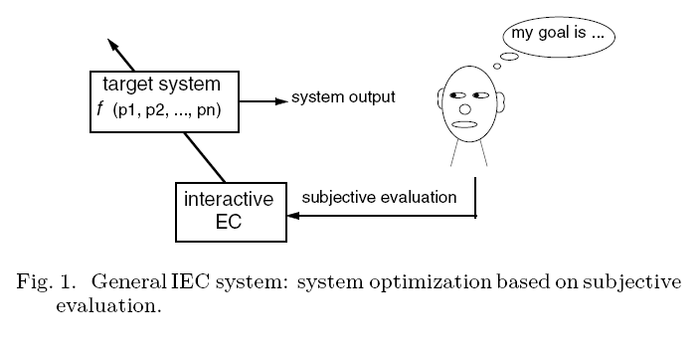
General IEC system:
Basically,
Human = Evaluation Function

Slide 6

Evaluation in IEC
Generally in n-levels of rating
Lowest level is 2, where values are “select” or “not-select”
  Also known as simulated breeding or user selection

Slide 7
Features of IEC:
Human and EC cooperatively optimize target systems
Map between psychological space and feature parameter space
Global optimum of IEC is very rough
Try to map to a “neighborhood” in the psychological space
  Cannot ignore the fluctuation of human preference

Slide 8
Problems with IEC
Human fatigue problem
    Inherent in all human-machine interaction systems
Improvements needed:
  Accelerated EC convergence
  Smaller population size
    Limited by display size or human ability
  Fewer generation numbers
    Usually 10 or 20 max

Slide 9
Applications:
Graphic Art and CG animation
3D CG lighting
Music
Editorial design
Industrial design
Facial image generation
Speech processing and synthesis
Hearing aid fitting
Virtual reality
Media database retrieval
Data mining
Image processing
Control and robotics
Food industry
Geophysics
Education
Entertainment
Social systems
And more...

Slide 10
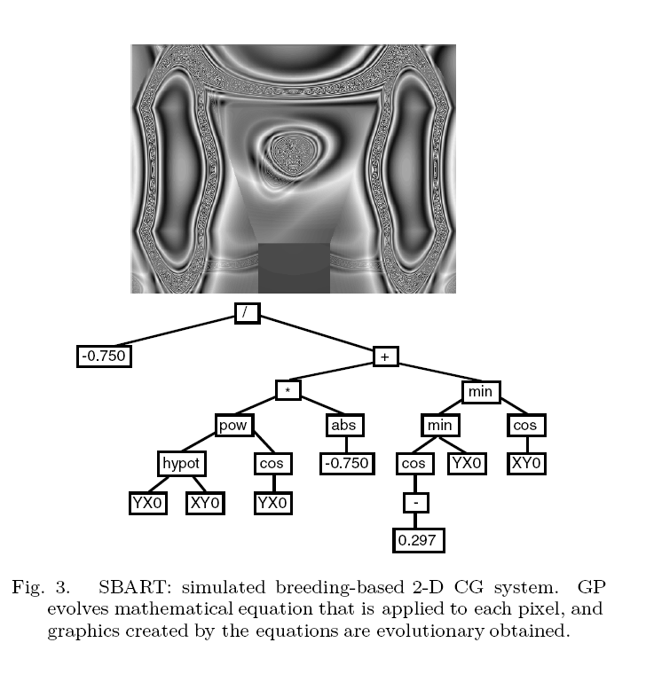
Computer Graphics
Carl Sims
  Used GP
  Evolved Equations that generated images
  Developed fine art
SBART
  Calculate pixels based on equations using (x,y) coordinates.
  also movies using a t parameter for time

Slide 11
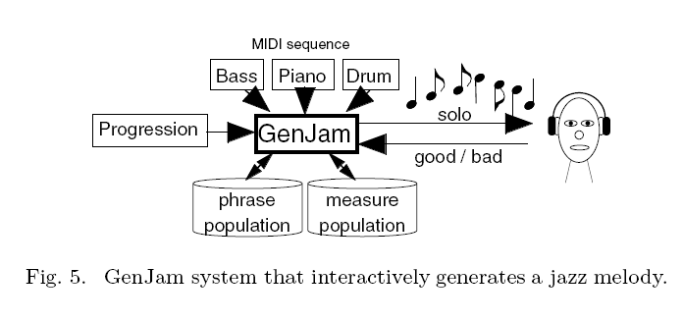
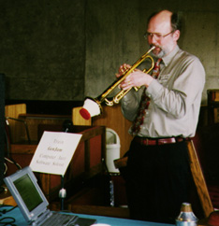
Music
GenJam (Genetic Jammer)
  Takes musical chords and rhythms as inputs and outputs jazz solos
  Released a commercial CD
  Can work with a real musician for live performances and interactive feedback
  Evaluate measure by measure to reduce fatigue

Slide 12
Industrial Design
Layout of interior furniture
  IGA optimizing position of furniture for functional optimization, Fung Shui, or purpose of room.
  Used both objective evaluation using information from experts and subjective evaluation by users

Slide 13


Food Industry
IES applied to coffee blending.
Before application, IES was tested on 3 toy tasks
  Cherry brandy color matching
  Generate square with dimensions and color matching target
  Generate polygon with same color, sides, and demensions
Finally applied to coffee blending with help from 3 professional coffee tasters
  Determine mixture ratio of 5 coffee beans to match target coffee

Slide 14
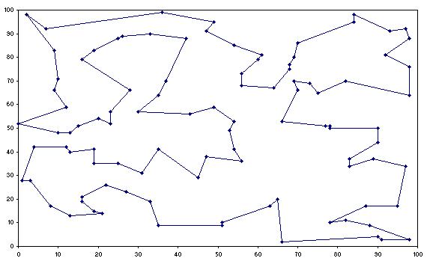
Broad Definition
TSP
Allow user to interactively divide larger TSP into smaller problems
  Interactively combine smaller solutions

Slide 15
Other Research:
Reducing Human Fatigue
  Discrete Fitness Value Input Method
    Reducing psychological fatigue by reducing rating levels to lower orders
    (say 6 or 7)
    Humans can be “daring” in their evaluation
    May hurt convergence
  Prediction of fitness values
    Use Euclidean distance
    grouping
    Predict human reasoning

Slide 16
Other research
Active Intervention (example)
  Mapping individuals from an n-D search space to 2-D search space
  User can estimate rough global optimum position in 2-D space.
    Use position for new elite individual
  Human’s have incredible capacity to grasp distribution of individuals on macro level
  Low risk, high return
    Convergence dramatically improved in best case
    Only a few bad individuals for worst case

Slide 17
My opinion
Paper Covered A LOT of information
Tons of sources cited
To broad???
Great place to start

