Slide 1
Island Model Cooperation with Speciation for Multimodal Optimization
Paper By: Mourad Bessaou, Alain Petrowski, Patrick Siarry
Presented By: Osama Al-Haj Hassan.

Slide 2
Paper Goal
Goal of paper:
  New Algorithm to Identify and obtain multiple optima of a multimodal function.

Slide 3
Points to remember
1- If a function has many local optima points, and we are interested in finding many of them, then regular GA’s does not work.
2- To find as many local optima points as we can, we must preserve diversity.

Slide 4
Points to remember (Cont.)
3- Island Model: Dividing the big population into subpopulation, and applying a GA to every population.
4- Island Model can be mixed with migration between subpopulation

Slide 5
Points to remember from Ch9 (Cont.)
5- Speciation
divide big population to species according to genotypic similarities.

Slide 6
How it works
General Idea
1- Algorithm relies on two phases:
  Exploration
  Multipopulation genetic algorithm coupled with speciation detects potential niches by classifying similar individuals in same population.
  Exploitation
  By allocating separate portion of search space to each population.

Slide 7
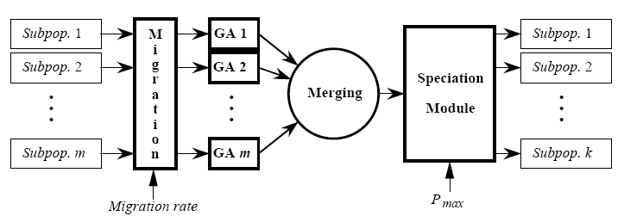
Algorithm

Slide 8
Algorithm (Cont.)
1 - Island Model:
  Used to divide population into subpopulations.
2 - Migration
  can happen between subpopulation, this enable the algorithm through crossover to discover individuals belonging to regions not already explored.

Slide 9
Algorithm (Cont.)
- Migration occurs according to migration rate (No of individuals to be replaced).
- Individuals selected to migration are selected randomly.

Slide 10
Algorithm (Cont.)
3- Speciation
  Gathering Individuals according to their genetic likeness.
  Importance: to avoid accumulation of several subpopulations around the same peak.
  Collect individuals in a common pool.
  Tree speciation is applied on the pool.
  Number of output species depend on pool diversity.

Slide 11
Algorithm (Cont.)
Practically a maximal number P_{max is} specified, It must be chosen so that diversity is sufficient. P_{max} must be higher than desirable number of peaks. K< P_{max}
At end of speciation, only keep subpopulations for which the best individual is better than the average one.

Slide 12
Tree Speciation Advantages
  1- It is an efficient algorithm, O(n log n)
  2- It does not require a lot of individuals , 2 for each peak achieves good classification.
  3- Does not need problem dependent information like “niche radius”

Slide 13
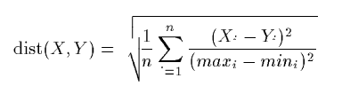
Algorithm (Cont.)
Speciation uses a distance to evaluate the similarity between individuals.
Let X,Y be individuals of dimension n, each of n parameters has max, min value. (Search space is bounded). Distance between X, Y can be given as equation to the right.

Slide 14
Algorithm (Cont.)
4- Apply GA:
- the same GA on different subpopulation.
- GA characteristics are discussed in the
following slide.

Slide 15

GA Characteristics
Linear Ranking Selection.
Elitism.
Real Coding.
Extended Intermediate Recombination. If P1, P2 are two parents, children C1, C2 are generated using formulas to the right.

Slide 16
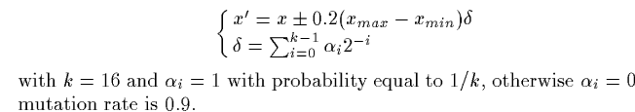
GA Characteristics (Cont.)
BGA mutation is used.

Slide 17
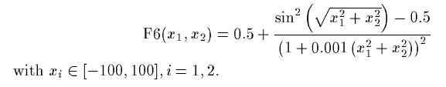
Experiments
Experiments is done on optimizing Schaffer’s function

Slide 18
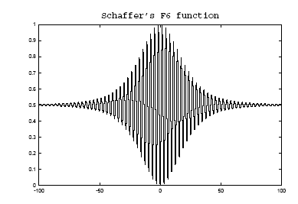
Experiments (Cont.)
Schaffer’s Function has many local optima values, the optimal is f(0,0) = 0, but it is hard to find it because the best local optima after this point only differs 10⁻³ from the global optima.

Slide 19
Success Criteria
Number of fitness evaluation with accuracy 10⁻³
Maximal number of generations = 100
30 runs are done because of stochastic nature of GA’s.

Slide 20
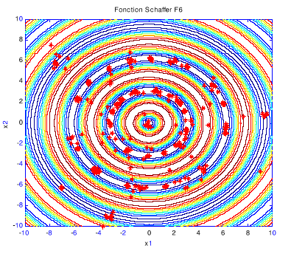
Results
Based on :
Number of individuals of each subpopulation
N = 10.
Maximal number of subpopulations P_{max}= 40
Search space is reduced from [-100,-100]² to
[-10,-10]²

Slide 21
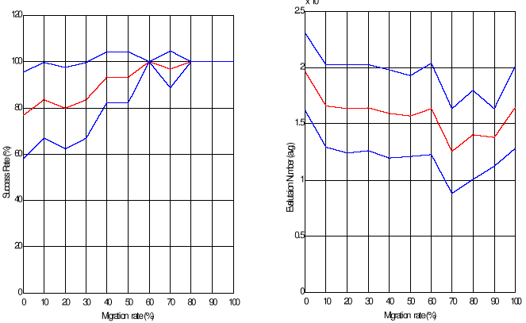
Results (Cont.)
Results showed that the bigger the migration rate is, the best results are. 3 lines in the figures (lowest, average, highest).

Slide 22
Results (Cont.)
Comparison:
 | N | Average Evaluation Number | Success Rate %
Island With Speciation | 400 | 16100 | 27
Island without speciation | 400 | 24800 | 4

Slide 23
Conclusion
Using Speciation with Island Model is better as shown with experimenting Schaffer’s function .
Future work:
- Tuning parameters of method.
- Testing on other functions.

Slide 24
My Opinion
The paper introduced a good new idea, but I think that more experiments must be done on other functions than Schaffer's function, this will make the results more trusted.

