Slide 1
Evolving neural networks through augmenting topologies

Slide 2
Neuroevolution (NE)
Uses GAs to evolve NNs
NE is faster and more efficient than some reinforcement learning methods because it searches for network behaviors instead of a value function

Slide 3
NN Topology
Hidden layer(s) of neurons
# of hidden neurons
Connectivity

Slide 4
Evolution of NNs
Search space: connection weights
Crossover and mutation of weights
Goal: to optimize connections weights such that NN behaves a certain way

Slide 5
TWEANNs
Topology and Weight Evolving Artificial Neural Networks
Evolve the topology of the NN along with the connection weights

Slide 6
Problems with TWEANNs
Direct vs. Indirect Encoding
Nonmating
Non-fixed gene length

Slide 7
NEAT
NeuroEvolution of Augmenting Topologies
Evolves the structures of the networks incrementally
Designed to take advantage of non-fixed structure in order to minimize the dimensionality of the search space

Slide 8
NEAT vs TWEANNs
NEAT
Direct encoding
Gene tracking – artificial synapsis
Mating within species
Minimal initial topologies
Protection of innovation through speciation
TWEANNs
Direct/indirect encoding
Non-matching chromosomes
Nonmating
Random initial topologies

Slide 9
NEAT – Minimal Structures
All individuals in the population start with minimal structures
No initial hidden nodes
User-defined connectivity

Slide 10
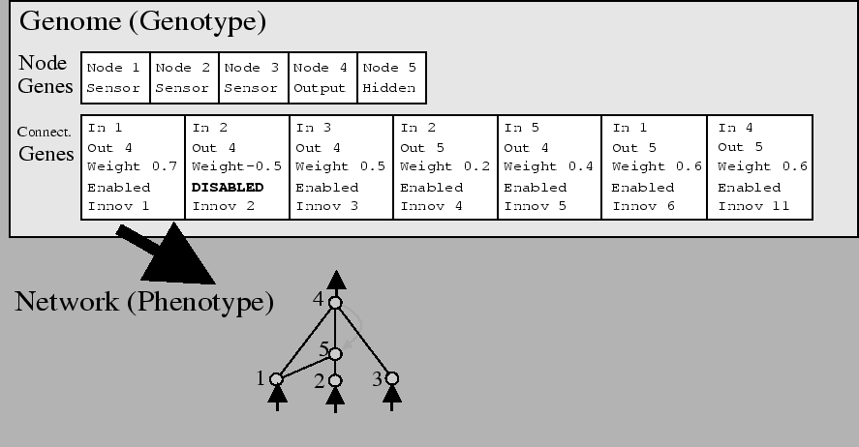
NEAT - Encoding

Slide 11
NEAT – Gene tracking
Historical tracking of newly introduced genes
Fixes gene-matching problem of TWEANNs
Allows meaningful crossover

Slide 12
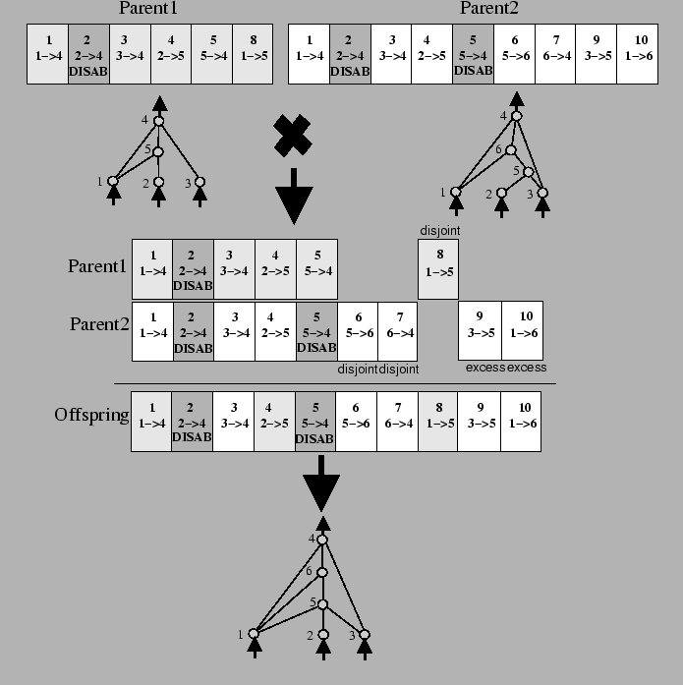
NEAT – Gene Tracking

Slide 13
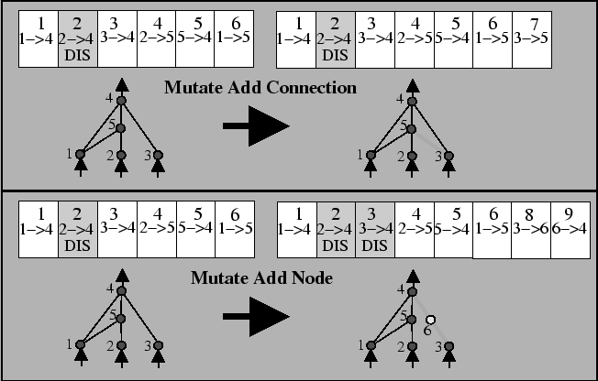
NEAT - Topology Mutation

Slide 14
NEAT - Speciation and Innovation
Speciation of the population preserves innovations
With explicit fitness sharing, innovations are ‘protected’ by their inclusion in a species
Speciation uses a distance measure of disjoint and excess genes, as well as weight distances

Slide 15
NEAT - Performance
NEAT outperforms other TWEANNs and other evolutionary algorithms in several benchmark tasks including…
XOR
Pole-balancing problems

Slide 16
Conclusion
NEAT can be a powerful method due to:
Historical markings of genes
Protection of innovation through speciation
Incremental growth from minimal structure
Increasingly complex solutions

