Slide 1
The Evolution of Secondary Organization in Immune System Gene Libraries
Ron Hightower
Stephanie Forrest
Alan S. Perelson

Slide 2
Abstract
A binary model of the immune system is used to study the effects of evolution on the genetic encoding for antibody molecules.
Experiments show the evolution of an immune system, simulated by a genetic algorithm, encourage a specific genetic organization that is not explicitly defined by the fitness function.

Slide 3
Immune System
The immune system defense depends on its ability to recognize foreign cells or molecules called antigens.
Antibody molecules are responsible for antigen recognition.
A human immune system can make 10^11 antibody molecules.
Antibody molecules are generated from a collection of gene libraries.

Slide 4
Artificial Immune System
They used bit-strings to represent molecules and gene libraries.
Each individual in the simulated population contain four equal-size gene libraries.
Within each library there are eight elements, represented as bit-strings of length sixteen.

Slide 5
Gene Selection
One segment from each library is chosen at random.
The four elements are concatenated into a bit-string that is 64 bits in length. This bit-string is one antibody molecule.

Slide 6
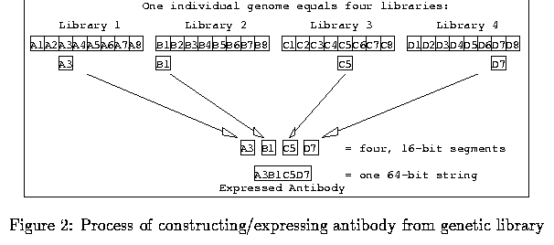
Antibody Molecule

Slide 7
Genetic Algorithm
The population is the set of bit-string representations.
At each generation the population is evaluated based on some measure of fitness.
A new population is formed based on the evaluated population, where the individuals with a higher fitness have more offspring than the less fit individuals.
This cycle continues through time and the average fitness of the population increases.

Slide 8
Fitness
The experiment used 2 types of fitness:
  True Fitness
  Sampled Fitness
True fitness is defined as an individual’s fitness based on all possible conditions.
Sampled fitness is defined as an individual’s fitness based on only a sample of possible conditions.

Slide 9
Fitness
In the experiment, the fitness was computed based on the individual’s ability to recognize antigen strings.
The individual selects the best antibody that recognizes the expressed antigen and receives a match score.
The antigen match score averaged over the set of antigens it encounters becomes the individual’s sampled fitness.

Slide 10
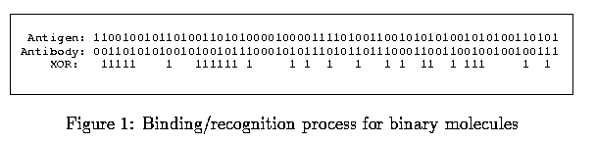
Match Fitness

Slide 11
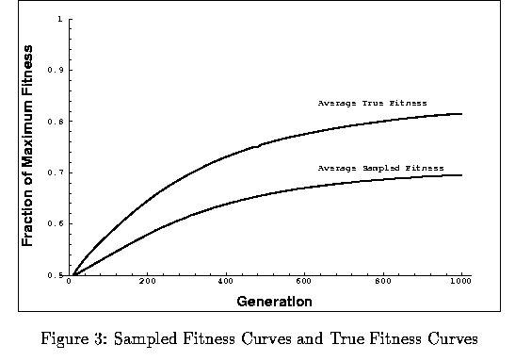
Experiment
The experiment used a population size of 500 and ran for 1000 generations.

Slide 12
Experiment results
For this experiment, sampled fitness is computed by expressing only eight antibodies of the 4096 in the potential repertoire.
This sampling was motivated by the fact that at most 10^7 of the 10^11 possible antibodies are present in the body.
The curves were averaged over thirty experiments.
The experiment showed that even with sparse and incomplete information, the immune system libraries could evolve and make continued improvement in overall fitness.

Slide 13
Conclusion
This artificial immune system allows us to study concepts like genetic organization with a manageable amount of complexity.
The GA experiments also show that genetic algorithms can optimize complex genetic information.
The GA was able to organize the complex structure of the antibody libraries acting only on the basis of sampled fitness.

Slide 14
My Opinion
Undefined crossover and mutation
Explained everything well
Outdated, so possibly newer material on the subject matter

Slide 15
References
http://citeseer.ist.psu.edu/27805.html
  Ron Hightower-Univ. Of New Mexico
  Stephanie Forrest-Univ. Of New Mexico
  Alan S. Perelson-Los Alamos Nat. Lab

